Slide 1
Incentive Reconciliation to AWS
Expedia – FCTS

Slide 2
Introduction
Writing CFT scripts for allocating and linking various AWS resources.
Linked those resources within.
Deployed them on MAUI framework.

Slide 3
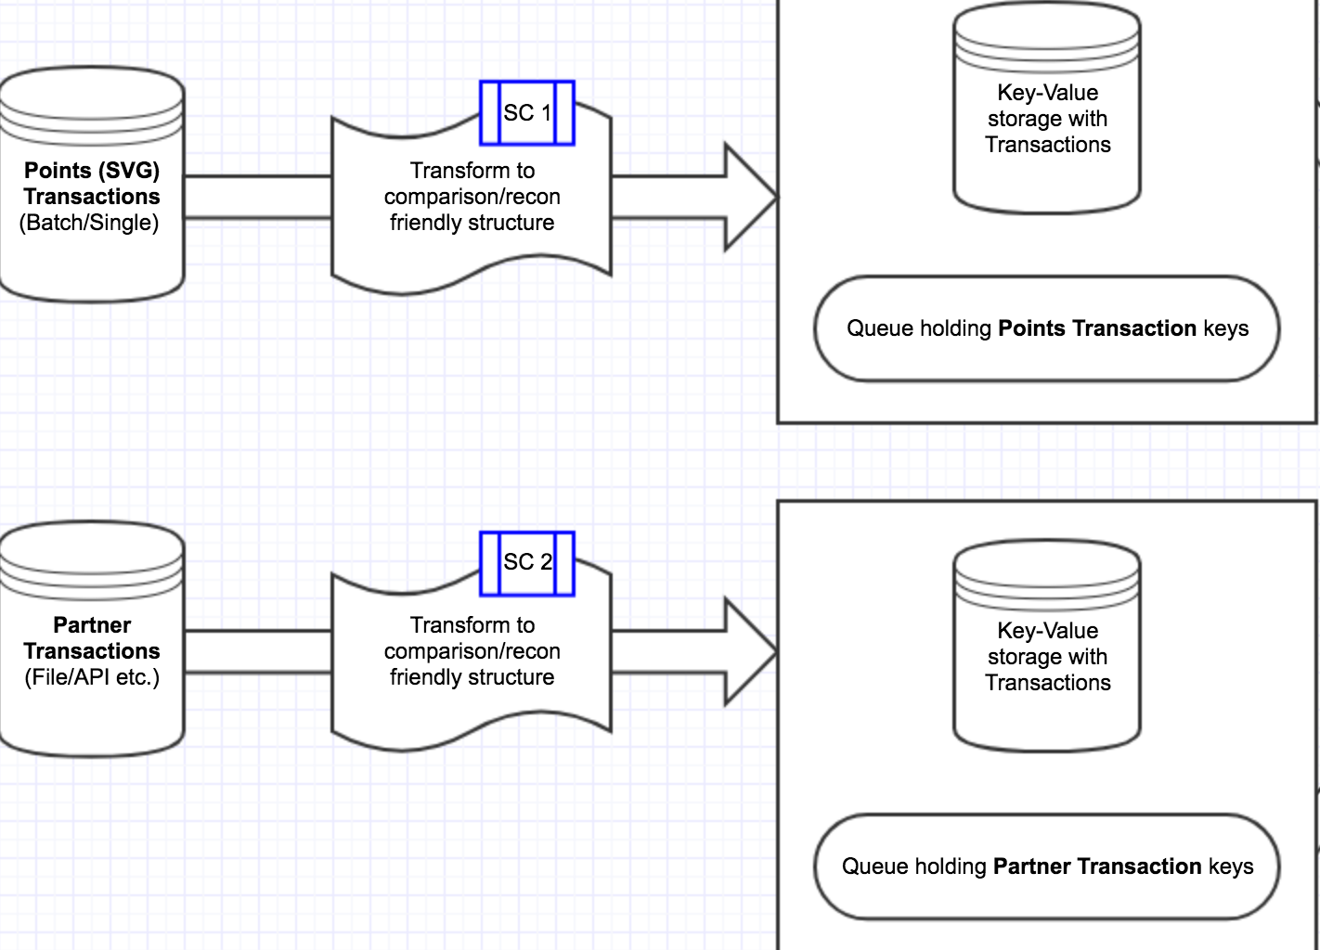

Components

Slide 4
Component #1
API Gateway
Lambda
DynamoDb
SQS
Brief summary: Any call to API Gateway triggers a lambda which executes code storing data in Dynamo and SQS.

Slide 5
Component #2
S3
Lambda
DynamoDb
SQS
Brief summary: An object creation in S3 will trigger a lambda which executes code storing data in Dynamo and SQS.

Slide 6
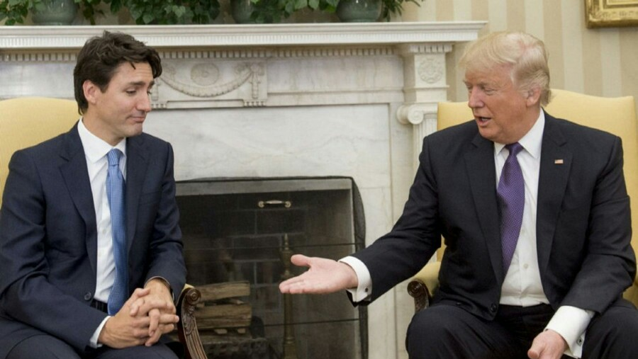
Component #3
AWS Lamdba (Triggered via scheduled cron)

Slide 7
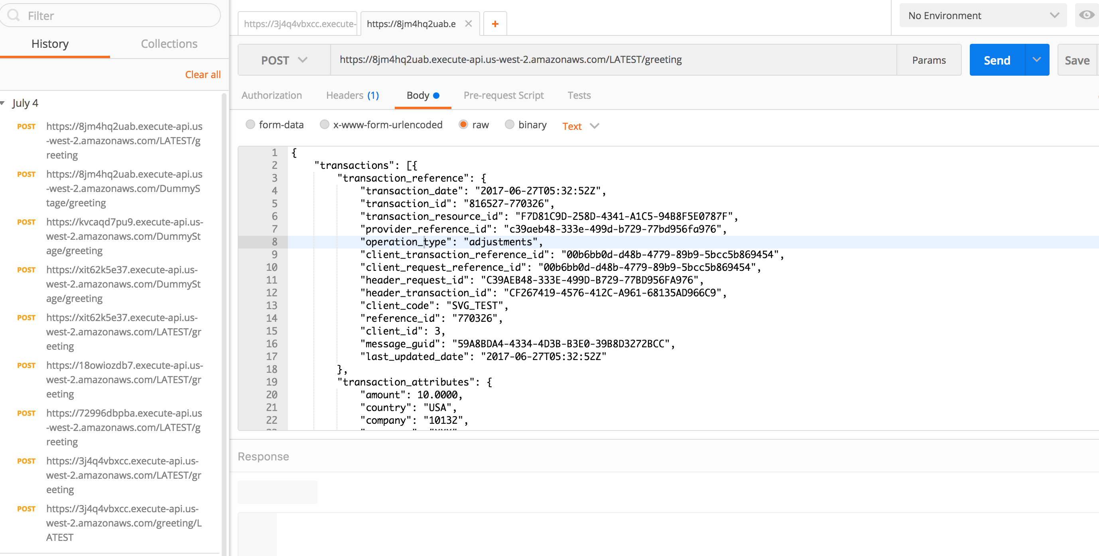
Some Snapshots
Triggering API

Slide 8
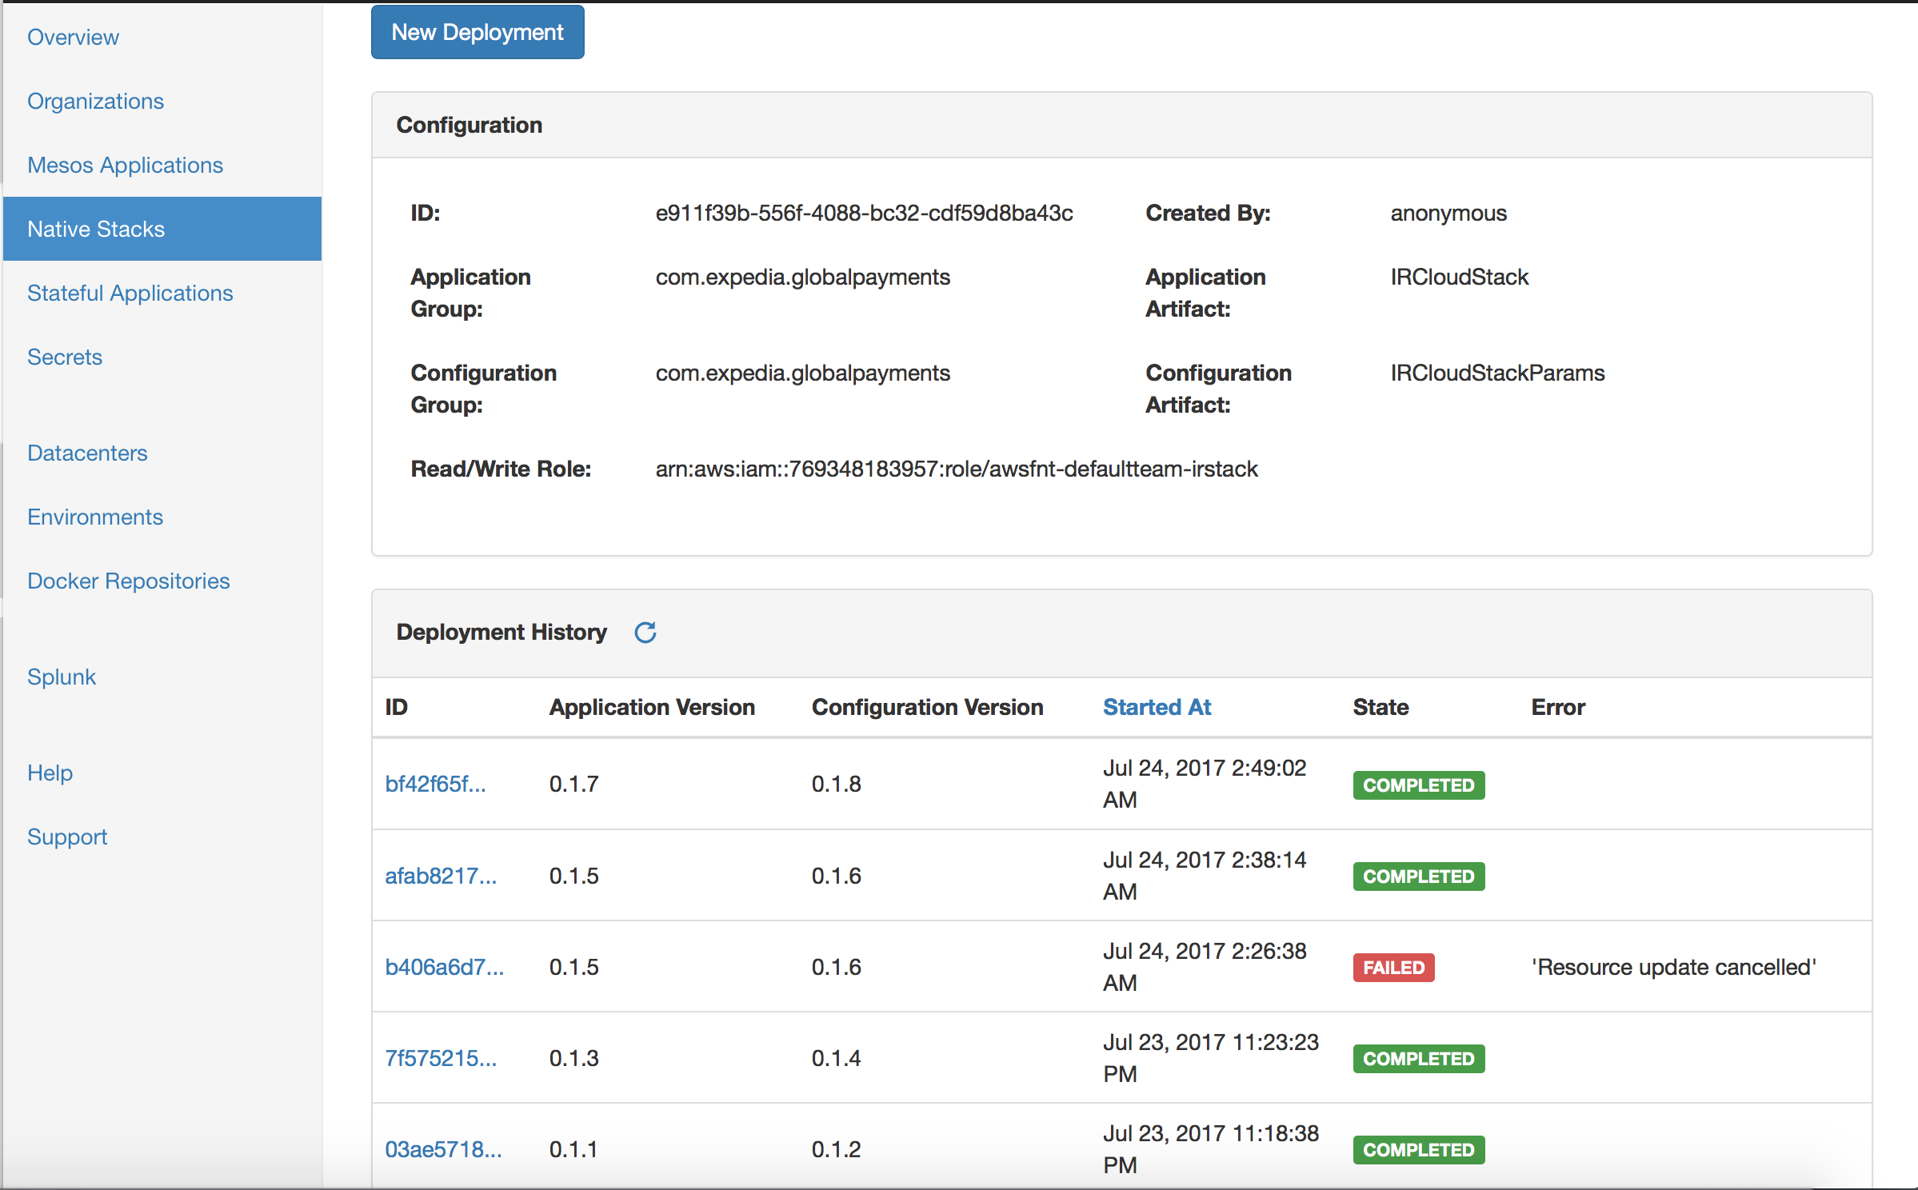
On MAUI Framework

Slide 9
Deployment on MAUI framework
Artifact preparation
Step 1: Obtain permissions to publish to maven
Step 2: Prepare CFT
Sphinx needs two artifacts:
Application artifact: This artifact consists of the mandatory cloudformation template (namely application.template) and, optionally, any other asset that user might want to refer to in his/her cloudformation template.
Examples of such assets are lambda code and sql scripts.
Configuration artifact: This artifact consists of the parameter file (namely parameter.json) required by the cloudformation template.

Slide 10
Upload artifacts
Upload both the artifacts prepared to the maven repo of your desired account.
Cloud Native app creation
Go to sphinx in your desired account and create your app corresponding to the stack, providing information such as artifact and group id published in previous step.
Deployment
From the app page created above, simply deploy the cloud native application giving versions for both, the application as well as configuration artifact. These versions should have already been published to the corresponding AWS account.

Slide 11

Thank You

