Slide 1
ATIF KHAN NIAZI
NFC- Institute of Engineering and Technology Multan,Pakistan

Slide 2

Social Media
&
Cyber Crime

Slide 3
WHAT IS SOCIAL MEDIA?
Social media are online communications in which individuals
shift flexibly between the role of audience and author.
To do this, they use social software that enables anyone without
knowledge of html coding, to create, comment on, and share
content and to form communities around shared interests.

Slide 4
WHAT IS SOCIAL MEDIA?
■
Social networking sites (Facebook, LinkedIn, Twitter)
■
Photos/Video/Music (flickr, YouTube, last.fm)

Slide 5

WHAT IS FACEBOOK?

Slide 6

WHAT IS TWITTER?

Slide 7
FACEBOOK

Slide 8
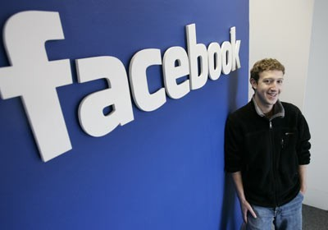
OVERVIEW
“the facebook.com” – 2004, Mark Zuckerberg
Winklevosses’ lawsuit
2006 – everyone over the age of 13
800 million active users

Slide 9
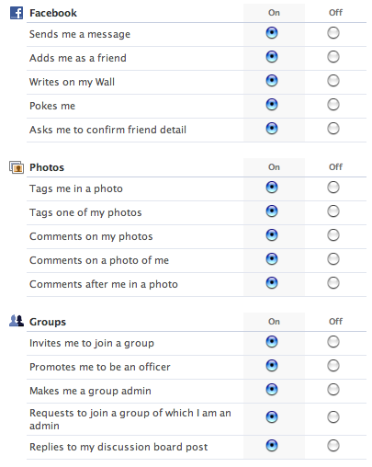
OVERVIEW
■
#1 visited website worldwide
Free account Access to networks
Control own privacy settings
Communication – pictures, videos, blog feeds, groups
■
■
■
■

Slide 10
OTHER FACEBOOK FEATURES
Facebook Chat
“Like” button
Ticker
Events
Facebook Mobile

Slide 11
BENEFITS
Enhancing communication
Reconnect with old friends/family
Networking
Promoting events
Easier to send media
Education and news

Slide 12
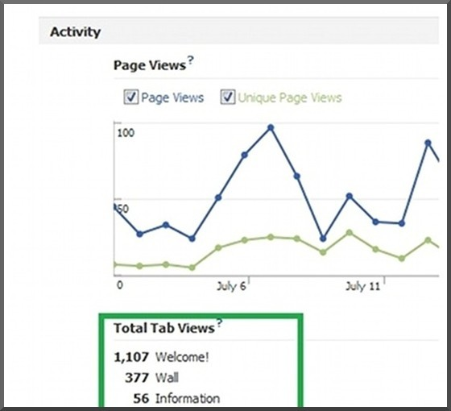
BENEFITS, CONT.
■ Marketing for businesses
Brand image/reputation Viral effect
❑
❑
❑
Pagemodo – user friendly “Welcome” page tab

Slide 13
RISKS
■
Spam on newsfeeds
■
Children under 13 use it despite the Children’s Online Privacy Protection Act
■
The rise of other social networks
❑
Twitter, Google+
■
Harms Communication Skills
■
Reports of a “Facebook Depression”
Students score lower in school when using Facebook while studying
Decreases need for face-to- face communication
Affects college acceptance and job hiring
❑
❑
Provides a skewed view of what is really going on
❑
■
It has been banned in many countries and workplaces
❑
50% of British employers in May 2011 banned it from workplace
❑

Slide 14
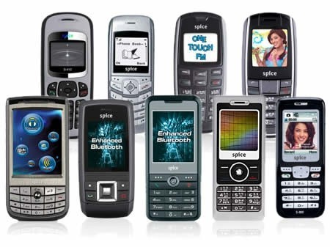
Mobile Phone:

Slide 15
Report:
■
Some research reveals that there are 4.8 billion mobile users but only 4.2 billion people with a toothbrush.

Slide 16
Use of Mobile Phone By Students:
Students’ Facebook addictions weren’t bad enough when they were limited to the computer, now they have portable social media devices in their pockets. Across the board, students with smartphones use social media apps, including Facebook & Twitter.
■

Slide 17
It surveyed 100 students to get an insight on their mobile phone habits and usage.
■
Do you have a smartphone?
■
Yes – 82% | / | No – 18%
Yes – 84% | / | No – 16%
Yes – 37% | / | No – 63%
■
Do you regularly use the internet on your phone?
■
■
Have you ever used your phone to search for a job?
■

Slide 18


Slide 19
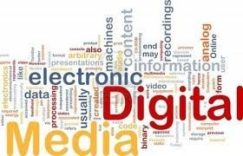

Slide 20
Role of Electronic Media…?
■
Voice of Public
Country Image
Cultural Representation

Slide 21
Negative Role of Electronic Media:
Personal Interest.
People Likes.
No Rules and Regulation of Media.

Slide 22


Slide 23
SOCIAL MEDIA:
The best thing is you can trust the facts on social media like Facebook, twitter any many other popular social network.

Slide 24
Why Social Media…?
No Personal Interest.
Best Source of Sharing News.
Keep In Touch With Each Other.
■
Social Media Is Very Easy For Real Updating.

Slide 25
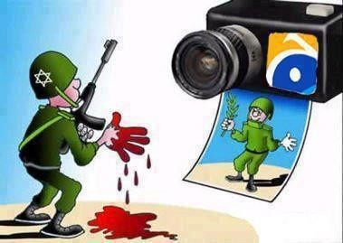
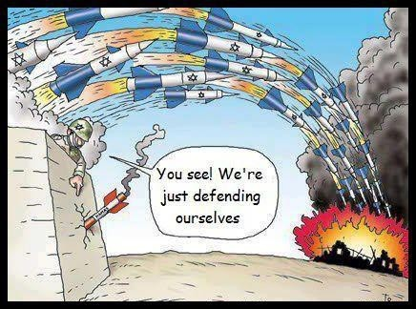
Electronic Media Is Exposed By Social Media:

Slide 26
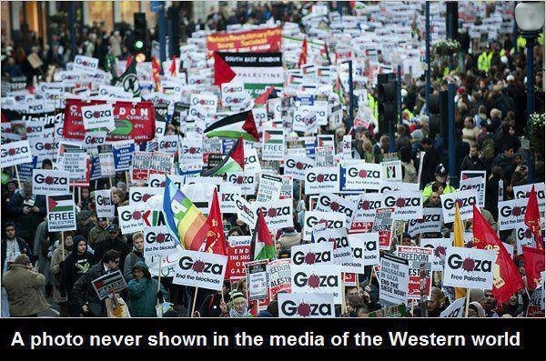

Slide 27
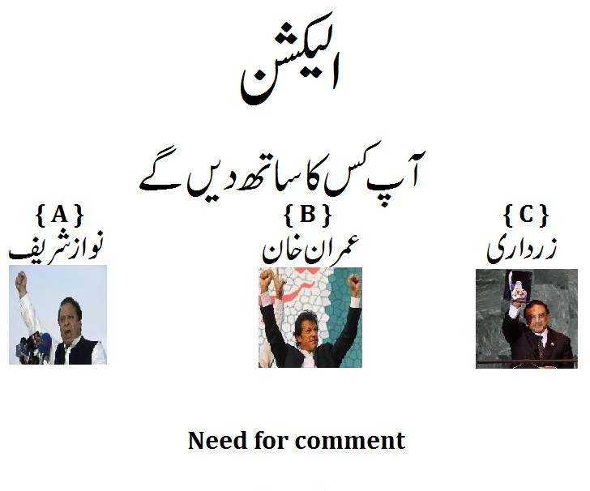
Check The Status of Any Politician:

Slide 28

The Power of Social Media:

Slide 29
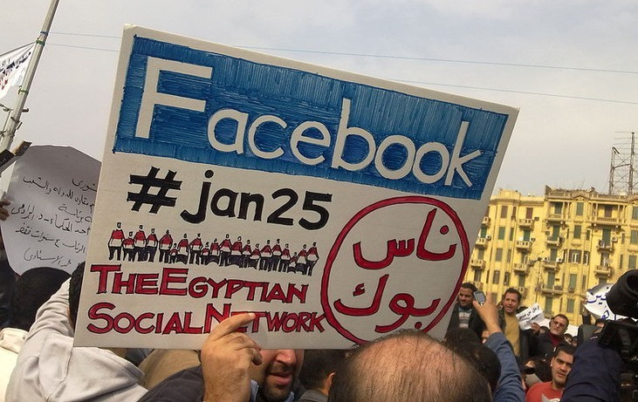
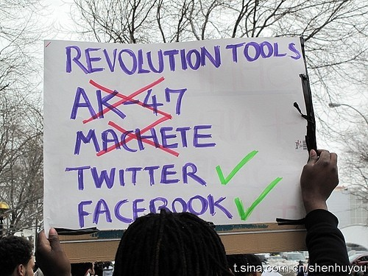
Facebook, YouTube and Twitter that, for the First Time, Gave Voice to The People of Egypt.

Slide 30
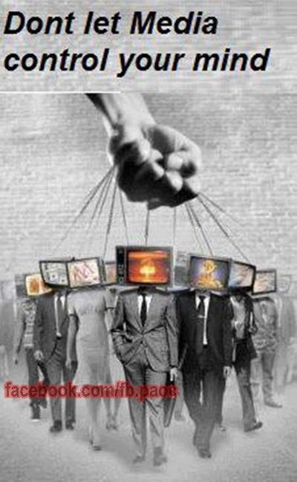

Slide 31
Cyber Crime &
Cyber Laws

Slide 32
Cyber Crime
Activity in which computers or networks are a tool, a target, or a place of criminal activity.
Cyber crime also stated as any use of a computer as an instrument to further illegal ends, such as
Committing fraud Stealing identities Violating privacy
❑
❑
❑

Slide 33
It is also include traditional crimes in which computers or networks are used to enable the illicit activity.
As the computer has become central to commerce, entertainment, and government.
Cyber crime has grown in importance.

Slide 34
■ Examples:
E-mail account of a Federal Minister was hacked. Credit cards frauds reach to an alarming level.
Financial institutions are the favorite targets of Cyber criminals --- worst effecting the technological and progress in the area of e – Commerce.
❑
❑
❑

Slide 35
Cyber Laws
■
The legal issues related to use of communications technology, particularly "cyberspace", i.e. the Internet.
It is an intersection of many legal fields, like:
■
❑
Intellectual property, Privacy
❑
■
Cyber laws is an attempt to apply laws designed for the physical world to human activity on the Internet

Slide 36
Cyber Laws in Pakistan
■
■
■
There are different law are promulgated in Pakistan. These laws not only deal with crime of Internet
These deal with all dimensions related to computer & networks.
Two of them are most known. They are:
■
■
❑
Electronic Transaction Ordinance 2002 Electronic / Cyber Crime Bill 2007
❑

Slide 37
Electronic Transaction Ordinance 2002
■ Overview
❑
The Electronic Transactions Ordinance (ETO), 2002, was the first IT-relevant legislation created by national lawmakers.
A first step and a solid foundation for legal sanctity and protection for Pakistani e-Commerce locally and globally.
Laid the foundation for comprehensive Legal Infrastructure.
It is heavily taken from foreign law related to cyber crime.
❑
❑
❑

Slide 38
Electronic/Cyber Crime Bill 2007

Slide 39
Overview
■
“Prevention of Electronic Crimes Ordinance, 2007″ is in force now
It was promulgated by the President of Pakistan on the 31st December, 2007
The bill deals with the electronic crimes included:
■
■
❑
❑
❑
❑
❑
❑
Cyber terrorism Data damage Electronic fraud
Unauthorized access to code Cyber stalking
Cyber Spaming

Slide 40
It offers penalties ranging from six months imprisonment to capital punishment for 17 types of cyber crimes
It will apply to every person who commits an offence, irrespective of his nationality or citizenship.
It gives exclusive powers to the Federal Investigation Agency (FIA) to investigate and charge cases against such crimes.

Slide 41
Punishments
Under this law there are defined punishment for the offence.
Every respective offence under this law has its distinctive punishment which can be imprisonment or fine.

