Slide 1
WELCOME

Slide 2
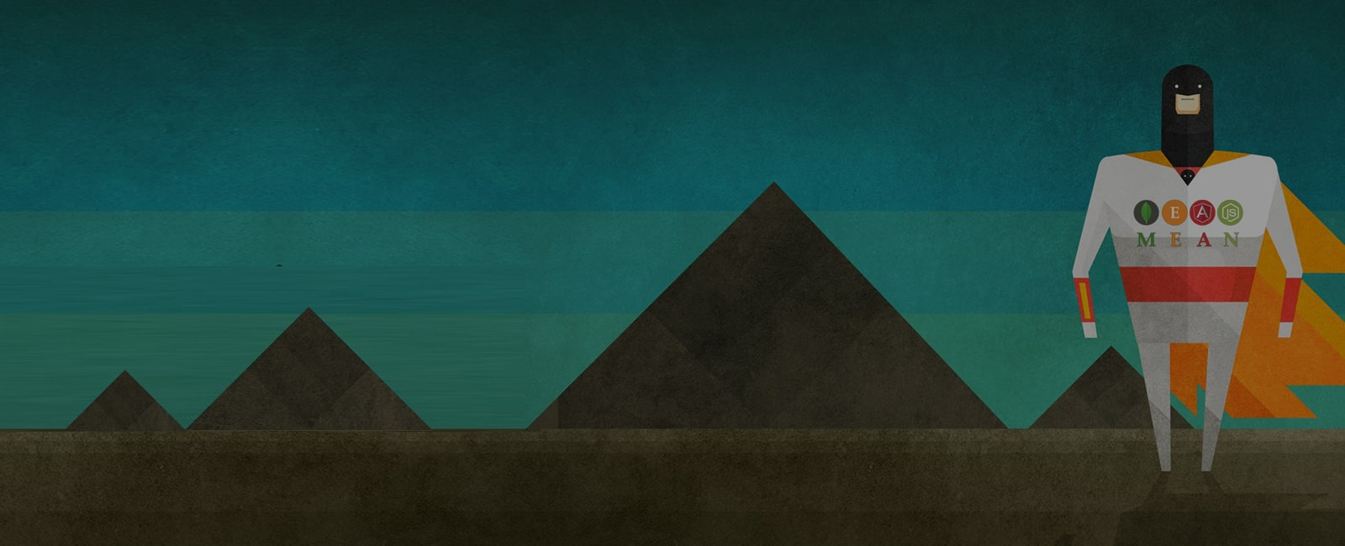
Presentation On MEAN Stack Chat Application

Slide 3
Team Members
Deepak Sharma
Gargi Soni
Guide Names
Mr. Sanjay Rathore
Mr. Ankush Sharma

Slide 4
Introduction
This project is a web based chat application built on modern technology stack that is the MEAN Stack.
Users can make an create groups or join different groups to chat with other users.
MEAN Stack provides developers the ease to build a single page application rapidly and efficiently. It provides high productivity and high performance of the web application.
This project was made during our training at GRRAS solutions Pvt. Ltd., under the guidance Mr. Sanjay Rathore sir and Mr. Ankush Sharma sir.

Slide 5
Technology Used
For Front End
HTML5
CSS3
BOOTSTRAP4
JAVASCRIPT
ANGULAR
TYPESCRIPT
For Back End
JAVASCRIPT
EXPRESS.JS
NODE.JS
For SHARING
GIT
GITHUB
For Database
MONGO DB ATLAS

Slide 6
Modules
Login/Register: User Logs in an already existing account or register’s a new account.
Profile: User can set up his/her profile.
Join room: User can join a chat room.
Create room: User can create a chat room.

Slide 7
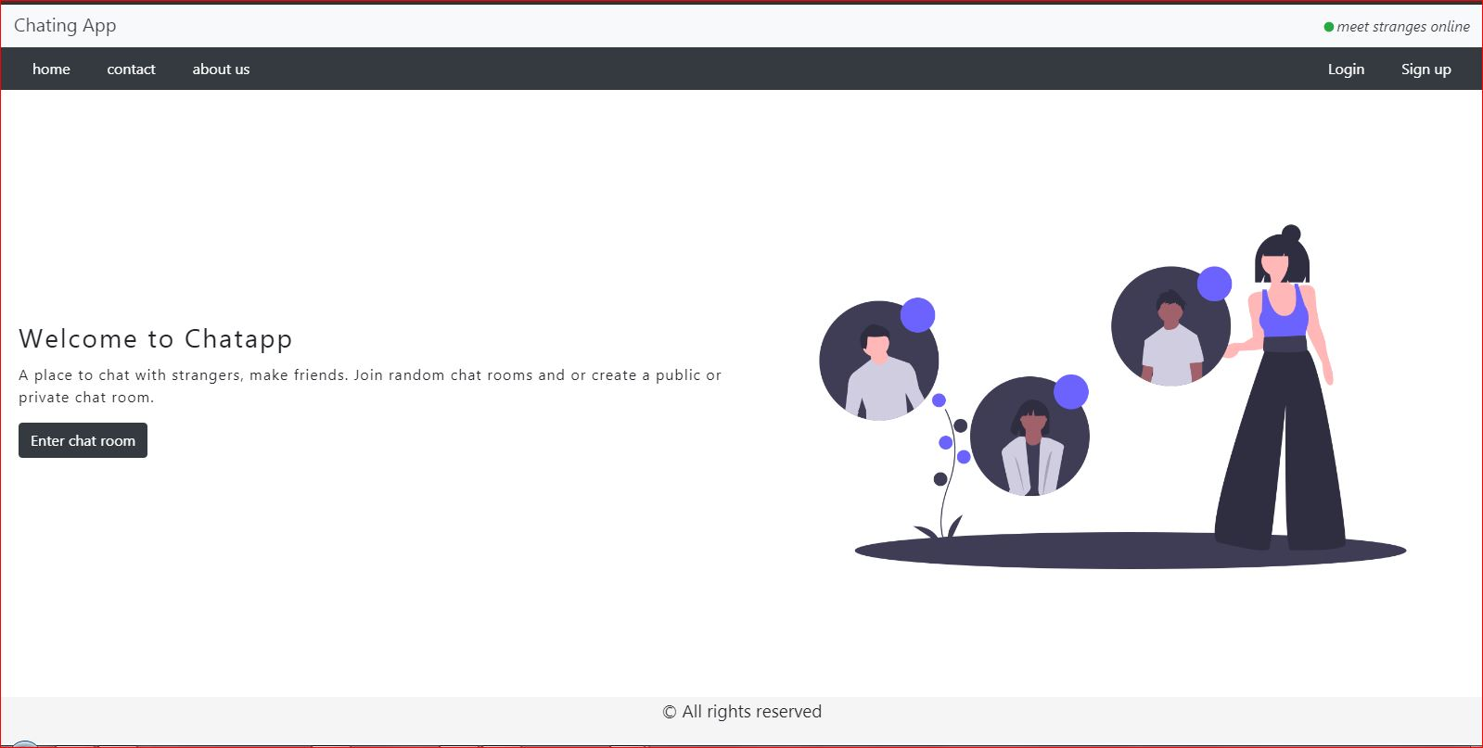
Using the site: Step-1
We see this home page on opening the website.
The menu contains: Home, Contact, About us, Login and Sign-up

Slide 8
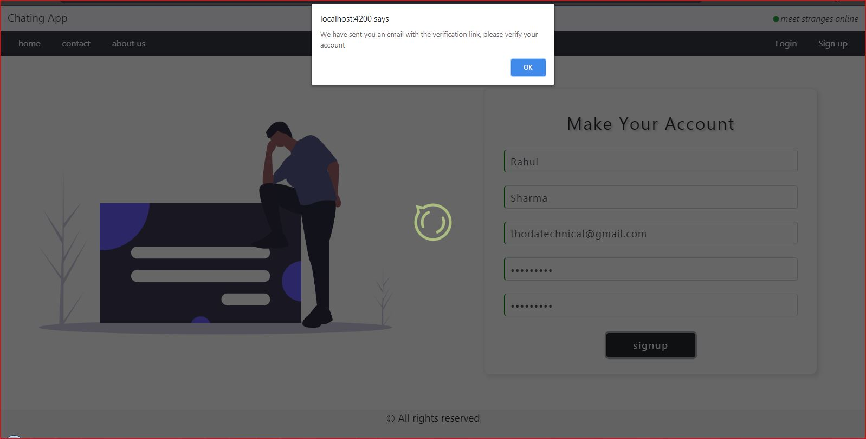
Step-2: Sign up
Click on sign up : fill the details and click on sign-up button. A link will be sent to you email to verify your email. Click on that link to activate your account.

Slide 9
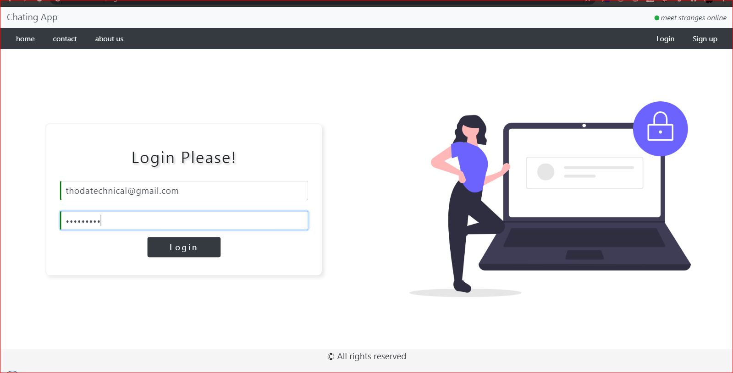
Step-3: Login
You can login to your account after verifying your account

Slide 10
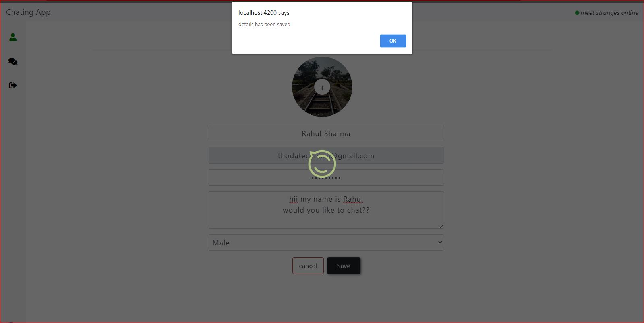
Step-4: Setting up your profile
You can fill up your profile details in here and add a profile picture and save it .

Slide 11
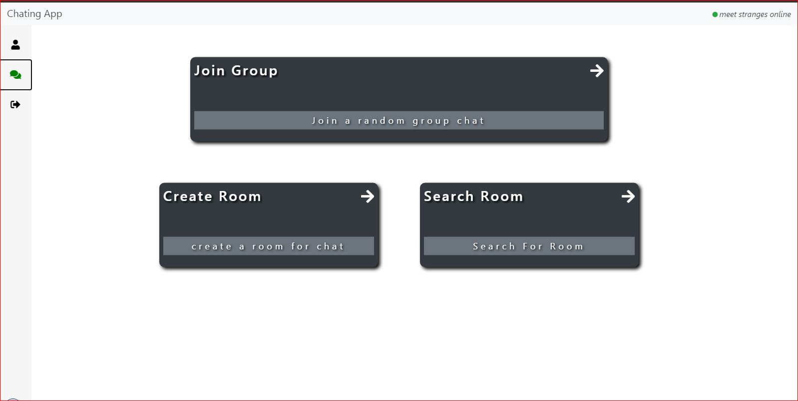
Step-5: Join a room
Join a random room or create a room or join specific room .

Slide 12
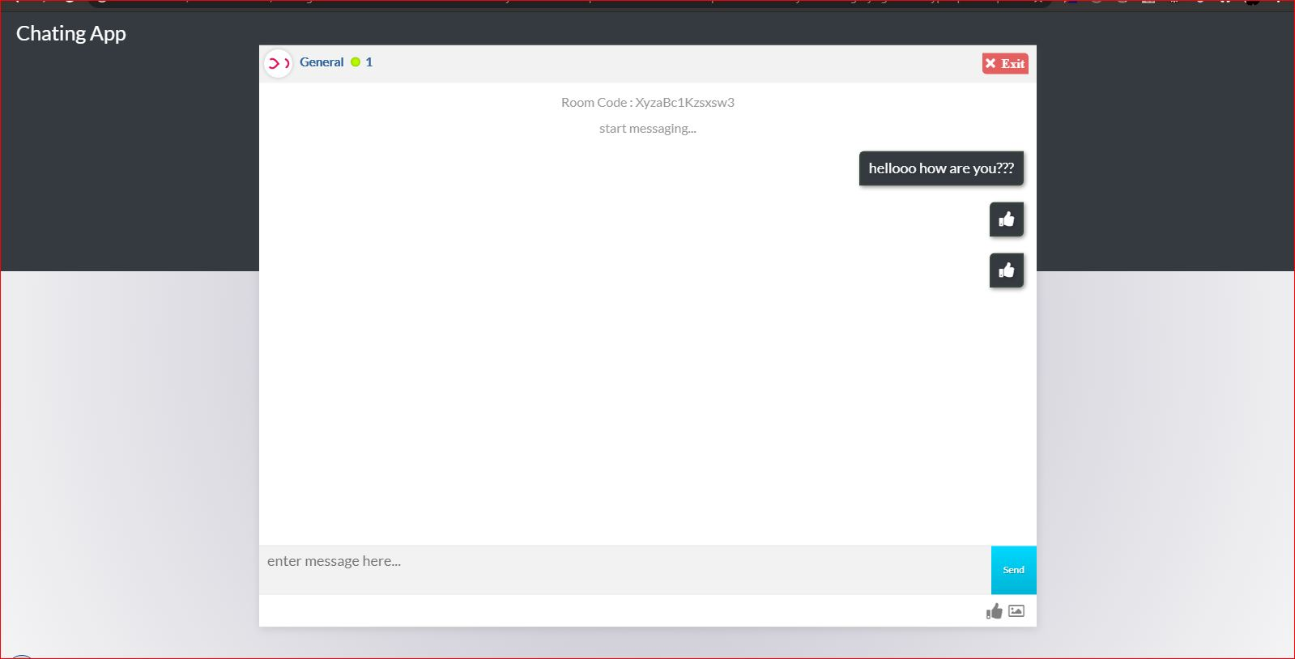
Step-6: Chat
After entering the chat room you can chat with other users

Slide 13
Thank You

