Slide 1
Hang Up!
Team: Isme Kya Hai
Deepak
Kshitij
Shivam
Vikas

Slide 2
Introduction
Imagine planning a hang up with people, just by some clicks from your mobile app.
No more worries about deciding location nearer to all pals .
No need to keep reminding or no fear to forget.
Yes, The “Hang Up” app will do it all for you.

Slide 3
Walk Through
Decide a meet.
Invite people and get their locations.
Select venue either as per your preferred location or Optimised Location calculated by app as per location of all members.
Share the hang up details with friends and enjoy!!!
Notes:
The sales data of the CPG company comes from various sources on a weekly basis. This data is difficult to analyse as it is in different formats and is not filtered. For this reason the company requires a system that would provide them with data that can be analysed easily.

Slide 4
Venue Suggester
Start from the centroid of n-points.
Iteratively, find a better solution on the basis of sum of distances.
Algorithm moves the point closer to Geometric median and iteration ends after precision reaches a threshold.
Pickup some famous locations near to the resulted answer and suggest them to host.
A future extension might be prioritizing location with more attractions at a certain extra cost in distance.

Slide 5
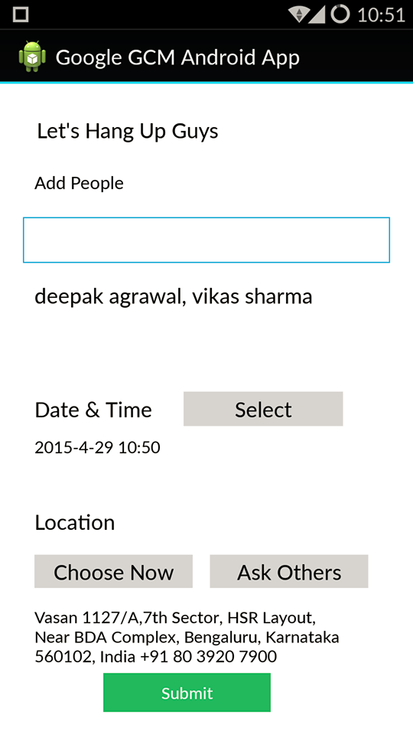
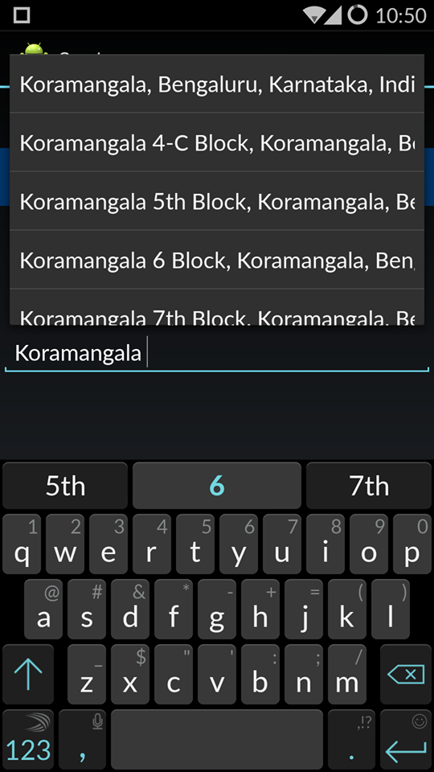
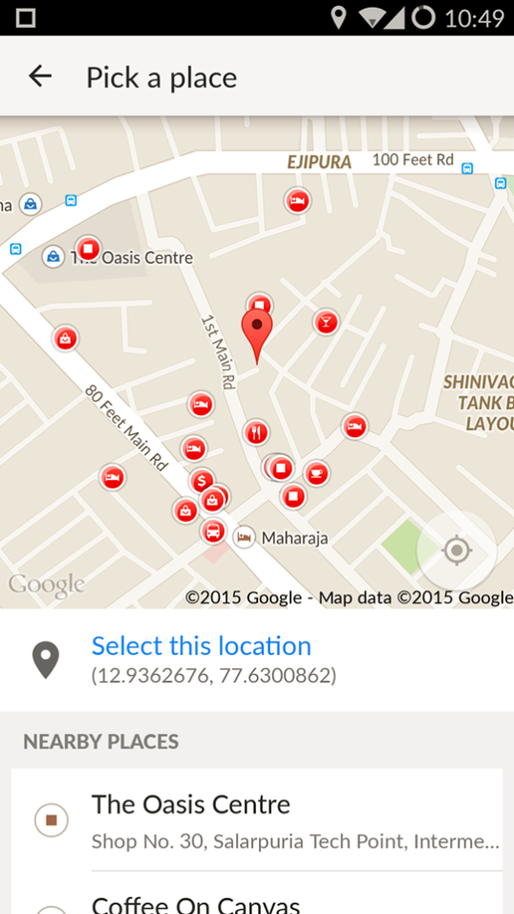
Screenshots

Slide 6
Future Scope
Can be integrated easily into a messenger app.
Might introduce dashboard showing past and upcoming meetups.
Determining interest of user through his past chosen locations and prioritizing the type of landmarks.

