Slide 1
IBM DATA SCIENCE PROFESSIONAL CERTIFICATE · APPLIED CAPSTONE
SpaceX Falcon 9
First-Stage Landing Prediction
A data science capstone project: collecting, wrangling, exploring, and modeling Falcon 9 launch data to predict whether the first stage will land successfully.
Author: Deepak Kachhap Oraon
GitHub: https://github.com/deepak1145460-design/Data-science-capstone
Date: August 20, 2026

Slide 2
EXECUTIVE SUMMARY
What this project set out to do — and what we found
🛰
📊
🤖
🏆
Methods
Analysis
Modeling
Key Result
Collected launch data via the SpaceX REST API and by scraping Wikipedia's Falcon 9 launch-records table, then wrangled both into a single analysis-ready dataset with an engineered landing-success label.
Explored the data with visual EDA (Matplotlib/Seaborn) and SQL, then built an interactive Folium map and a Plotly Dash app to analyze launch sites, payloads, and outcomes.
Trained and tuned four classifiers (Logistic Regression, SVM, Decision Tree, KNN) with GridSearchCV to predict first-stage landing success from flight parameters.
Landing success rate rose from near 0% in 2010–2013 to over 80% by 2019–2020. The tuned Logistic Regression / SVM models reached 83.3% test accuracy, the best of the four candidates.
SpaceX Falcon 9 Landing Prediction — Data Science Capstone
2

Slide 3
INTRODUCTION
Background and problem statement
Why this matters
Project Questions
SpaceX advertises Falcon 9 launches at $62M, far below competitors' $165M+, largely because SpaceX reuses the first stage instead of discarding it.
If we can predict whether a launch's first stage will land successfully — before it flies — we can estimate the true cost of a launch, which is valuable for a company that wants to compete with SpaceX for a contract.
Problem statement: using historical launch data (site, payload, orbit, booster version, flight number), predict the binary outcome — did the first stage land successfully or not?
Which variables most affect landing outcome?
How has success rate changed over time?
Which orbit types and launch sites are riskiest?
Which classification model best predicts a landing?
SpaceX Falcon 9 Landing Prediction — Data Science Capstone
3

Slide 4
DATA COLLECTION — SPACEX API
Notebook 01: pulling Falcon 9 launch data from api.spacexdata.com
1
2
3
4
→
→
→
GET requests
Resolve IDs
Flatten & assemble
Filter & clean
Call 4 REST endpoints — launches, rockets, payloads, launchpads, cores — to pull raw JSON.
Each launch record only stores IDs; helper functions look up booster, launchpad, payload and core names.
Merge the resolved fields into one flat DataFrame — one row per launch.
Keep Falcon 9 only (drop Falcon 1), renumber flights, fill missing payload mass with the column mean.
Result
GitHub URL for this notebook
https://github.com/deepak1145460-design/Data-science-capstone/blob/main/01_data_collection_api_.ipynb
90 Falcon 9 launch records
17 raw fields → flattened, human-readable
Saved as the base dataset for wrangling & modeling
📎 Optional: paste a screenshot of the fetched-data output
from the notebook (record count / shape) here.
SpaceX Falcon 9 Landing Prediction — Data Science Capstone
4

Slide 5
DATA COLLECTION — WEB SCRAPING
Notebook 02: scraping Wikipedia's Falcon 9 & Falcon Heavy launch table
1
2
3
4
→
→
→
Fetch HTML
Locate tables
Parse rows
Build & export
Request the Wikipedia page "List of Falcon 9 and Falcon Heavy launches" with requests.
Use BeautifulSoup to find the launch-record <table> elements on the page.
Programmatically read table headers, then iterate every <tr>/<td> to extract each launch's fields.
Assemble the parsed rows into a DataFrame — an independent, cross-check dataset.
Purpose
GitHub URL for this notebook
https://github.com/deepak1145460-design/Data-science-capstone/blob/main/02_data_collection_webscraping_.ipynb
Provides an independent dataset to cross-check
the API-sourced records for consistency
before the two are combined during wrangling
📎 Optional: paste a screenshot of the scraped table
head / row count from the notebook here.
SpaceX Falcon 9 Landing Prediction — Data Science Capstone
5

Slide 6
DATA WRANGLING
Notebook 03: cleaning the data and engineering the landing-success label
Audit missing values
Review distributions
1
Reviewed nulls column by column — concentrated in LandingPad, expected for expendable or failed landings.
2
Checked launch-site and orbit-type frequency counts to understand class balance.
Encode outcomes
Engineer Class label
3
Landing outcome strings (e.g. 'True ASDS', 'False Ocean', 'None None') mapped to a bad/good outcome set.
4
Class = 1 only when landing_success is True; every other outcome (failure, no attempt) = 0.
GitHub URL for this notebook
Overall landing success rate in the wrangled dataset: 66.67% (90 launches, 18 fields incl. Class)
GitHub: https://github.com/deepak1145460-design/Data-science-capstone/blob/main/03_data_wrangling_.ipynb
SpaceX Falcon 9 Landing Prediction — Data Science Capstone
6

Slide 7
EDA WITH DATA VISUALIZATION
Notebook 04: charts used and what each one shows
Scatter — Flight Number vs Launch Site
Scatter — Payload Mass vs Launch Site
Whether landing success improves as flight number (experience) increases, per site.
Whether heavier payloads at a given site are linked to lower success.
Bar — Success Rate by Orbit
Scatter — Flight Number vs Orbit
Ranks orbit types by landing success rate to flag the riskiest orbits.
How success by orbit type has evolved as SpaceX gained more flights.
Scatter — Payload Mass vs Orbit
Line — Yearly Success-Rate Trend
Whether payload mass interacts with orbit type to affect landing odds.
The overall trajectory of landing success from 2010 to 2020.
GitHub: https://github.com/deepak1145460-design/Data-science-capstone/blob/main/04_eda_visualization_.ipynb
SpaceX Falcon 9 Landing Prediction — Data Science Capstone
7

Slide 8
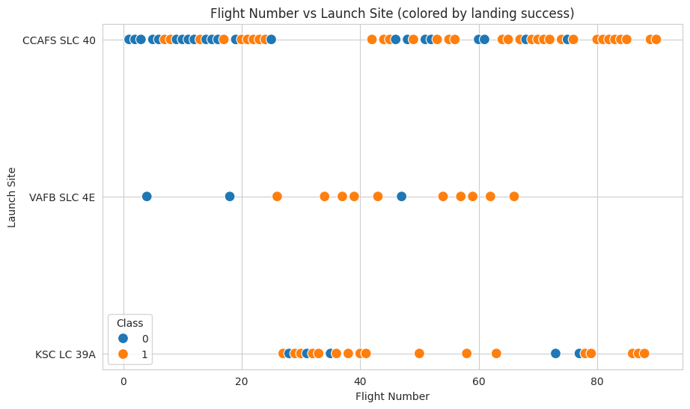
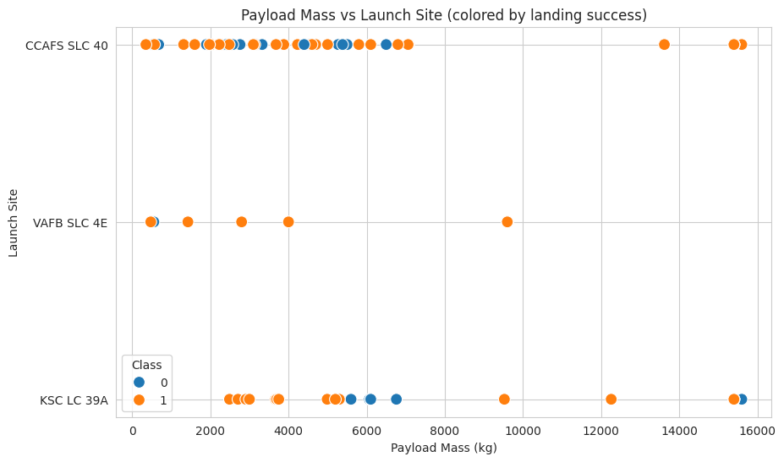
EDA VISUALIZATION — RESULTS (1/3)
Flight number & payload mass vs. launch site
Later flights (higher FlightNumber) skew orange (success) at every site — SpaceX's recovery process visibly matured with experience.
Heavier payloads succeed less consistently, especially at VAFB SLC-4E — payload mass is a meaningful risk factor.
SpaceX Falcon 9 Landing Prediction — Data Science Capstone
8

Slide 9
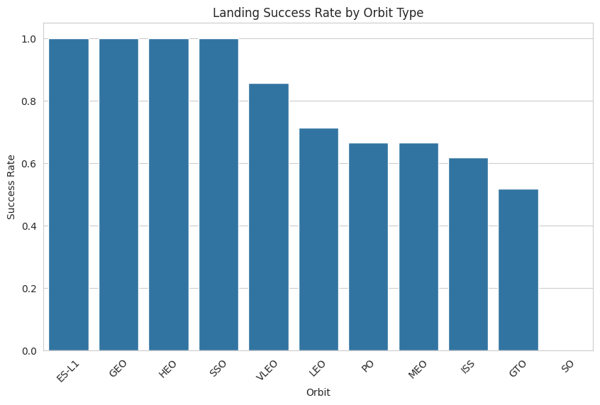
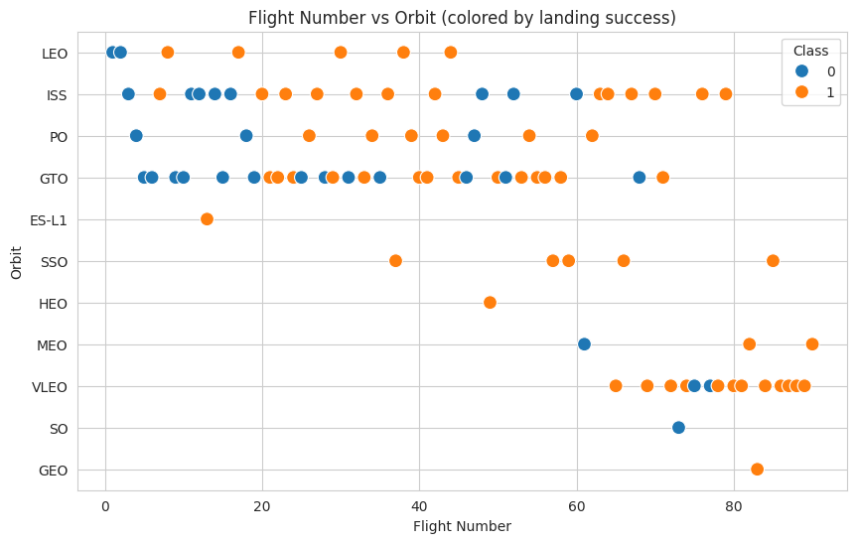
EDA VISUALIZATION — RESULTS (2/3)
Success rate by orbit & flight number vs. orbit
ES-L1, GEO, HEO and SSO orbits show a 100% landing success rate in this dataset; GTO and SO are the riskiest.
Success in higher-energy orbits (GTO, ISS) also improves at higher flight numbers, tracking overall program maturity.
SpaceX Falcon 9 Landing Prediction — Data Science Capstone
9

Slide 10
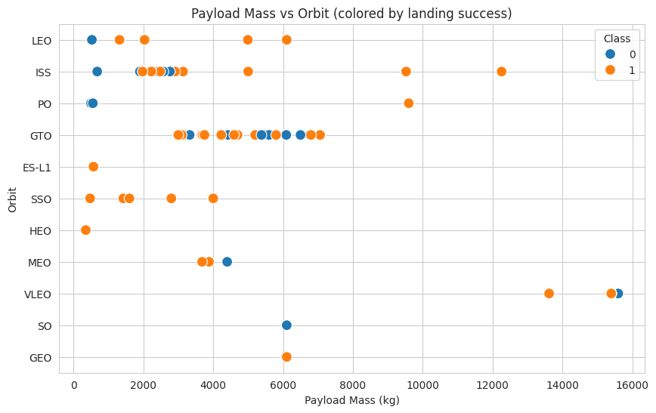
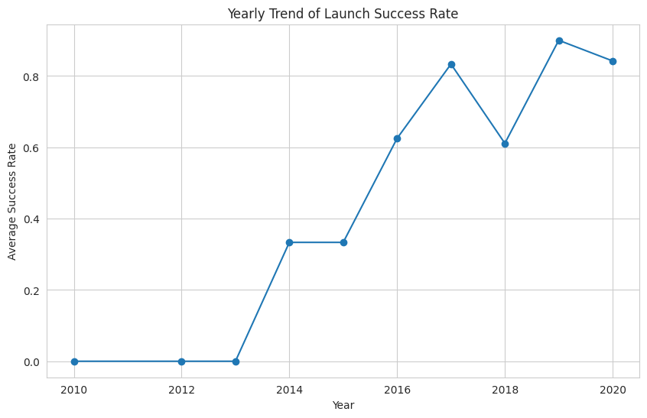
EDA VISUALIZATION — RESULTS (3/3)
Payload mass vs. orbit & the yearly success-rate trend
Payload/orbit combinations cluster — very heavy payloads mostly target LEO/ISS, where recovery is comparatively easier.
Success rate was ~0% through 2013, climbed sharply from 2014, and has stayed above 60–90% since 2016.
SpaceX Falcon 9 Landing Prediction — Data Science Capstone
10

Slide 11
EDA WITH SQL
Notebook 05: 10 queries run against a local SQLite table (SPACEXTBL)
1. Distinct launch sites
2. Sites beginning with 'CCA'
3. Total NASA (CRS) payload mass
4. Average payload mass by booster version
5. Date of first successful ground-pad landing
6. Boosters: drone-ship success, 4000–6000 kg payload
7. Total successes vs. failures
8. Booster versions carrying max payload
9. Launch-site / outcome ranking by year
10. Failure-outcome ranking, 2010-06-04 to 2017-03-20
GitHub URL for this notebook
https://github.com/deepak1145460-design/Data-science-capstone/blob/main/05_eda_sql_.ipynb
SpaceX Falcon 9 Landing Prediction — Data Science Capstone
11

Slide 12
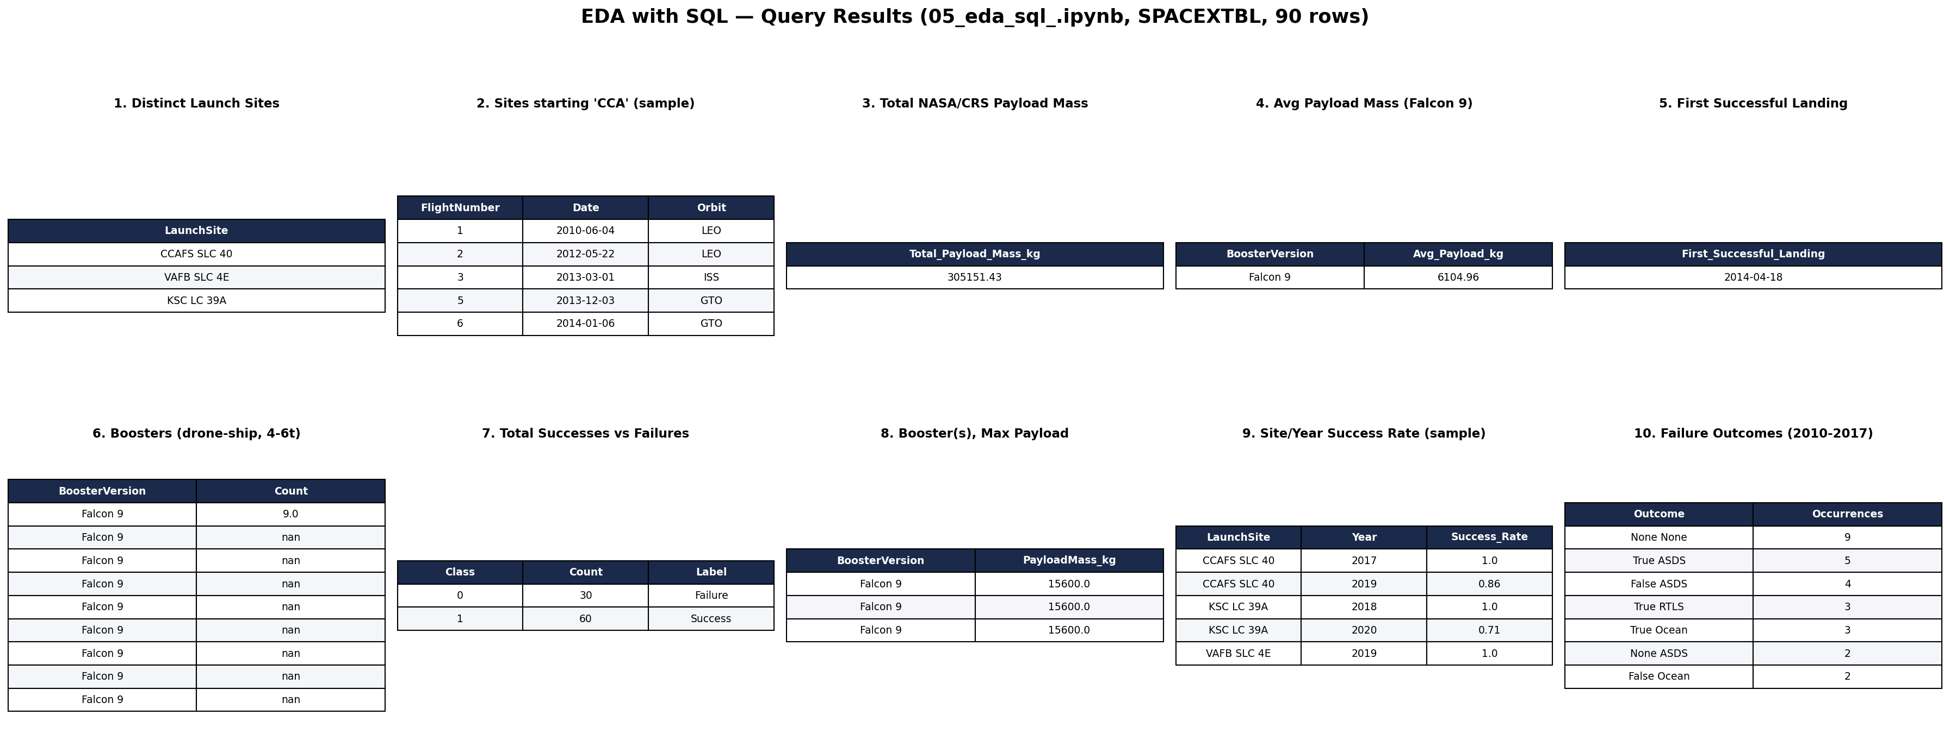
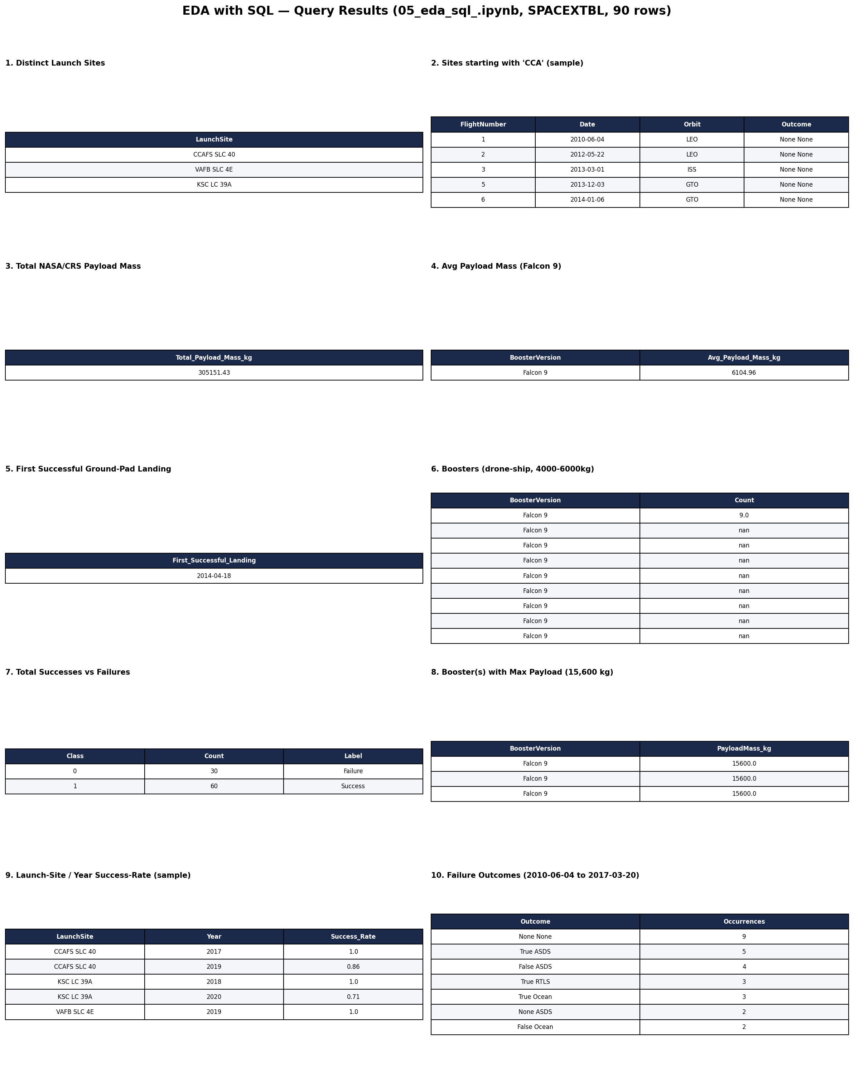
EDA WITH SQL — RESULTS
Query outputs: launch sites, payloads, success rates, rankings, time analysis
SpaceX Falcon 9 Landing Prediction — Data Science Capstone
12

Slide 13
INTERACTIVE VISUAL ANALYTICS
Notebook 06 (Folium) & 07_spacex_dash_app.py (Plotly Dash)
🗺 Folium Map
📈 Plotly Dash App
Marks every launch site on an interactive map
Colors each launch record green (success) / red (failure)
Adds a mouse-position readout for distance measurement
Proximity analysis to coastline, railway, highway & nearest city
Dropdown to pick a launch site (or "All Sites")
Pie chart: success-count share by site
Range slider to filter by payload mass
Scatter: payload mass vs. success, colored by booster version
GitHub URL
GitHub URL
GitHub: https://github.com/deepak1145460-design/Data-science-capstone/blob/main/06_folium_launch_site_analysis_.ipynb
GitHub: https://github.com/deepak1145460-design/Data-science-capstone/blob/main/07_spacex_dash_app_.py
SpaceX Falcon 9 Landing Prediction — Data Science Capstone
13

Slide 14
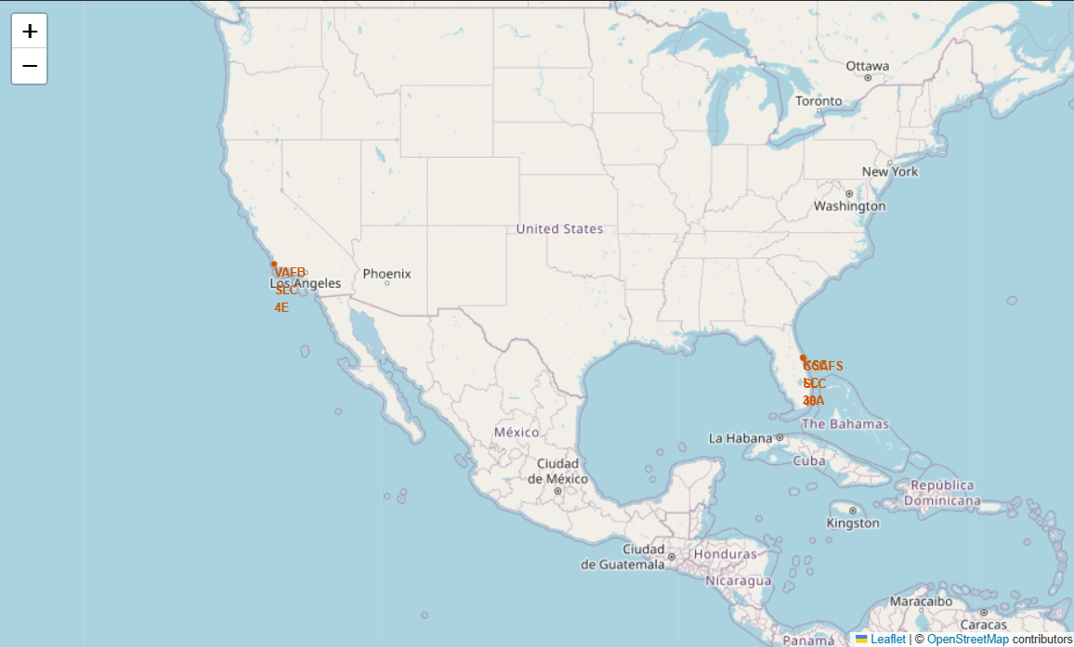
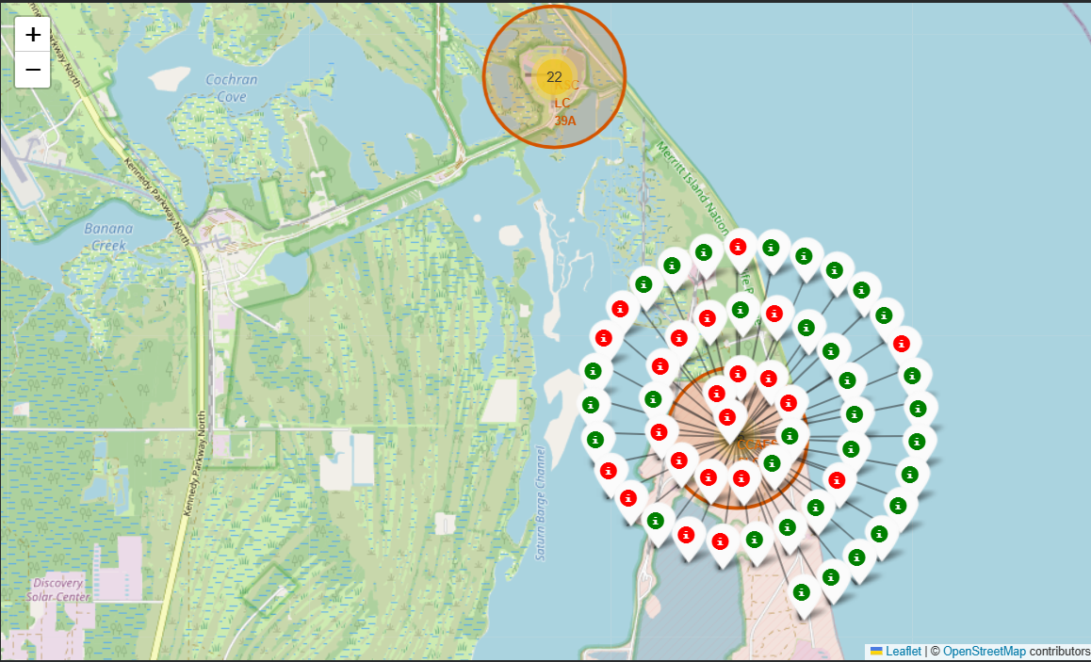
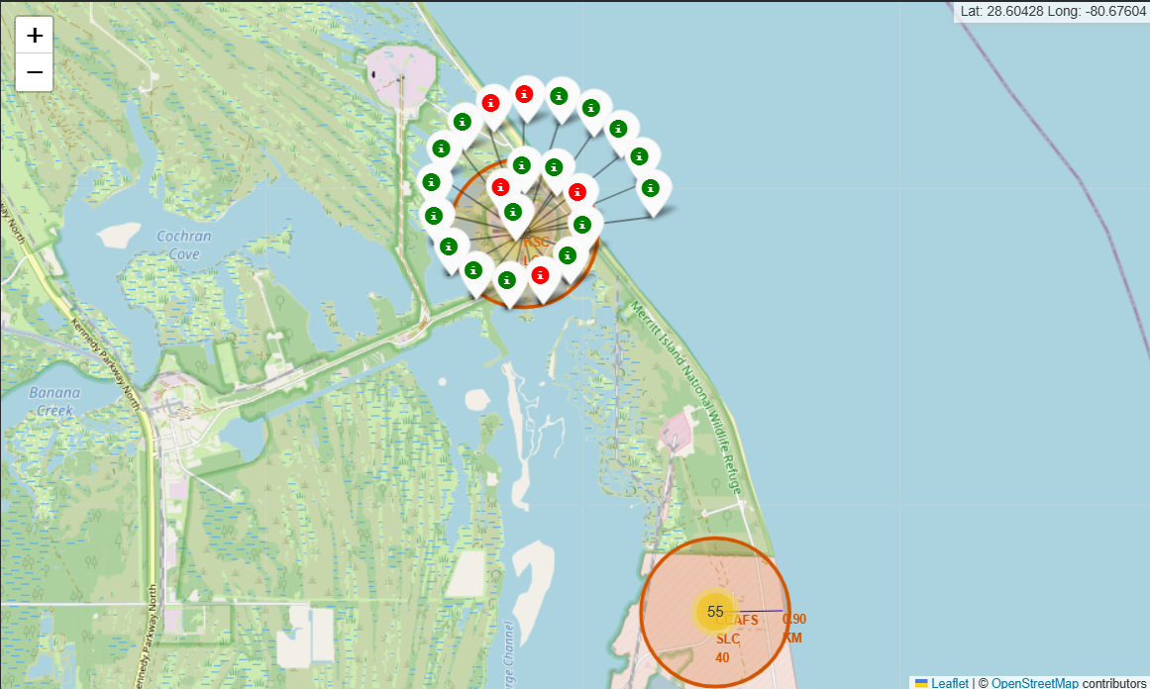
FOLIUM MAP — RESULTS
Launch site markers, launch outcomes, and proximity analysis
SpaceX Falcon 9 Landing Prediction — Data Science Capstone
14

Slide 15
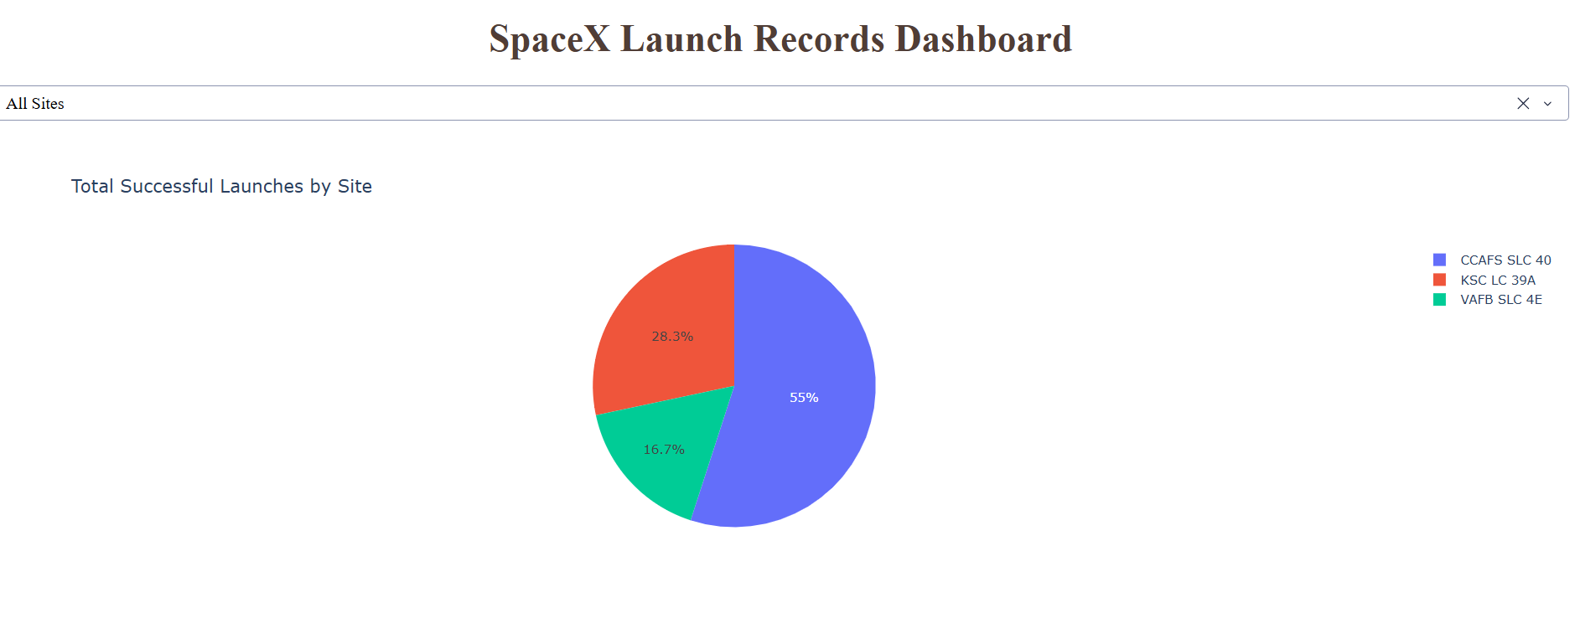
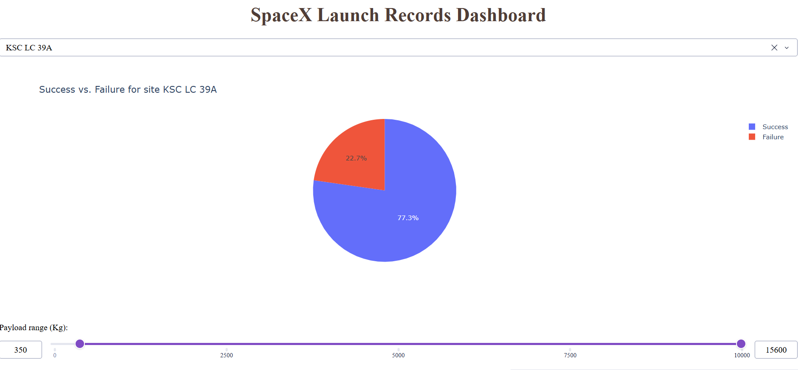
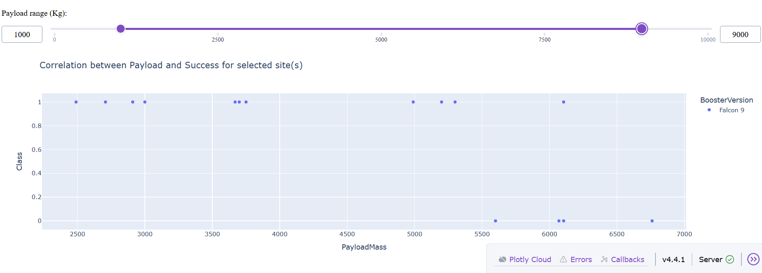
PLOTLY DASH APP — RESULTS
Success pie chart and payload-vs-outcome scatter plot
SpaceX Falcon 9 Landing Prediction — Data Science Capstone
15

Slide 16
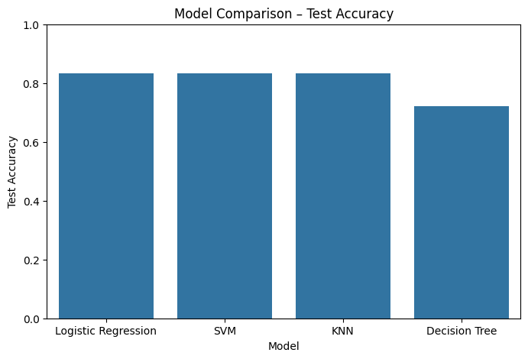
PREDICTIVE ANALYSIS — METHODOLOGY
Notebook 08: four classifiers, tuned with GridSearchCV
Approach
Standardized features, split 80/20 train (72) / test (18)
GridSearchCV (10-fold CV) tuned Logistic Regression, SVM, Decision Tree, and KNN
Selected the best hyperparameters per model on CV accuracy
Compared all four on held-out test accuracy
Logistic Regression, SVM & KNN tied
at 83.3% test accuracy;
Decision Tree trailed at 72.2%
SpaceX Falcon 9 Landing Prediction — Data Science Capstone
16

Slide 17
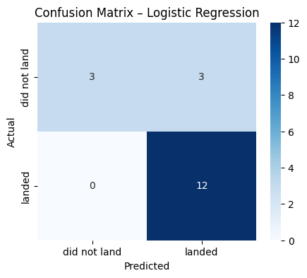
PREDICTIVE ANALYSIS — BEST MODEL
Confusion matrix and evaluation metrics
Best Model: Logistic Regression
Accuracy
83.3%
F1 Score
0.889
Jaccard Score
0.80
Model correctly identified all 12 actual landings and 3 of 6 non-landings — it over-predicts success, so it should be paired with a cost-aware threshold in production.
SpaceX Falcon 9 Landing Prediction — Data Science Capstone
17

Slide 18
CONCLUSION
Key Insights
1
Landing success climbed from ~0% (2010-13) to 80-90% (2019-20) as SpaceX matured its recovery process.
2
Flight number, payload mass, launch site, and orbit type all measurably influence landing outcome.
3
ES-L1, GEO, HEO and SSO orbits show the highest success; GTO and SO are the riskiest.
4
Logistic Regression, SVM and KNN each reached 83.3% test accuracy — Decision Tree underperformed at 72.2%.
5
The tuned model gives a reasonable first estimate of launch cost for competitive bidding, with room to improve recall on failed landings.
SpaceX Falcon 9 Landing Prediction — Data Science Capstone
18

