Slide 1


SMART INDIA HACKATHON 2026
Problem Statement ID – 26092
Problem Statement Title- AI-Driven Scheme matching for Marginalized Entrepreneurs
Theme- Smart Automation
PS Category- Software
Team ID-
Team Name- Nirman

Slide 2
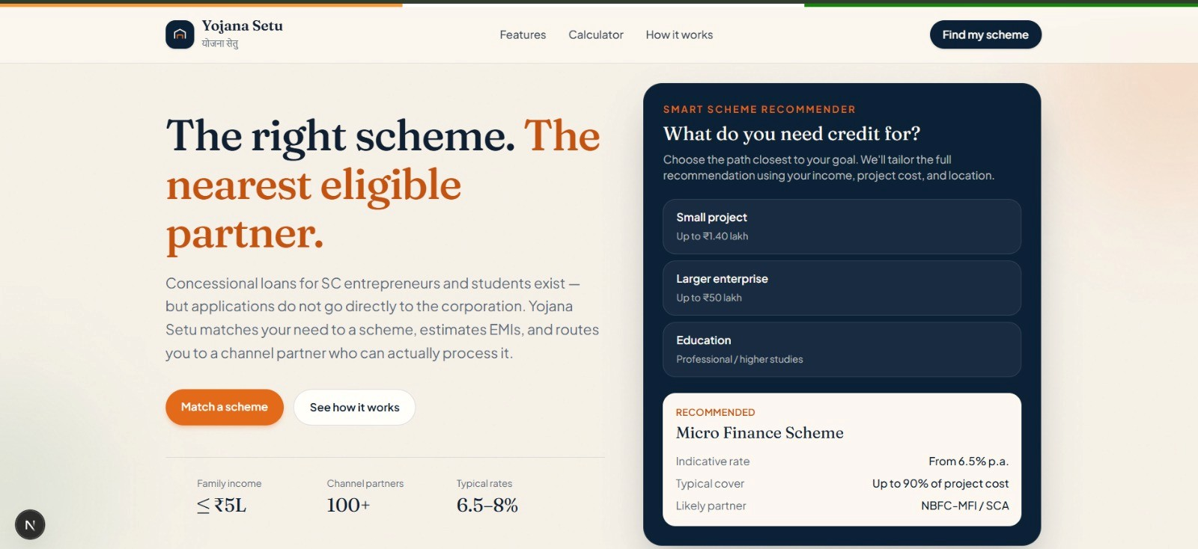
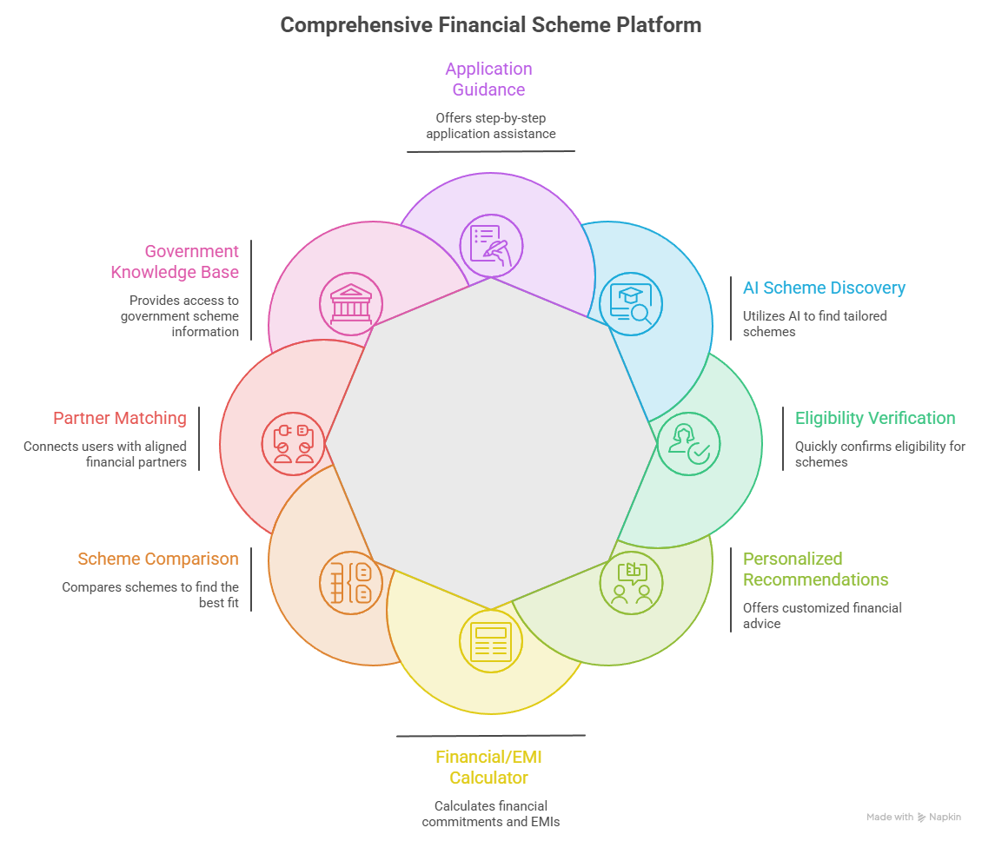
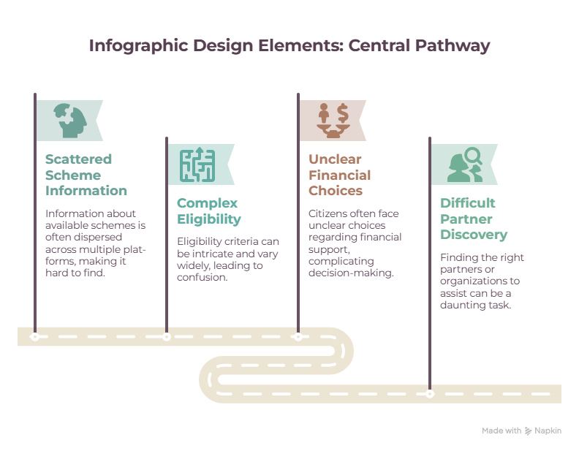
YOJANA - SETU
Nirmaan
THE FRAGMENTED JOURNEY
01 — Scattered Information Government schemes are spread across multiple sources.
02 — Complex Eligibility Different criteria make it difficult to know what you qualify for.
03 — Unclear Financial Choices Loan, EMI and repayment options can be difficult to understand.
04 — Partner Discovery Finding the right channel partner can be challenging.
ONE PLATFORM. EVERY STEP.
AI-powered scheme discovery, eligibility verification, personalized recommendations, financial guidance, and partner matching — all in one platform, helping citizens find the right government financial support and take the next step with confidence.
That's where Yojana-Setu comes in. It is a unified web platform that simplifies the journey to government financial support by bringing scheme discovery, eligibility verification, personalized recommendations, financial guidance, and partner matching into one seamless experience.

Slide 3
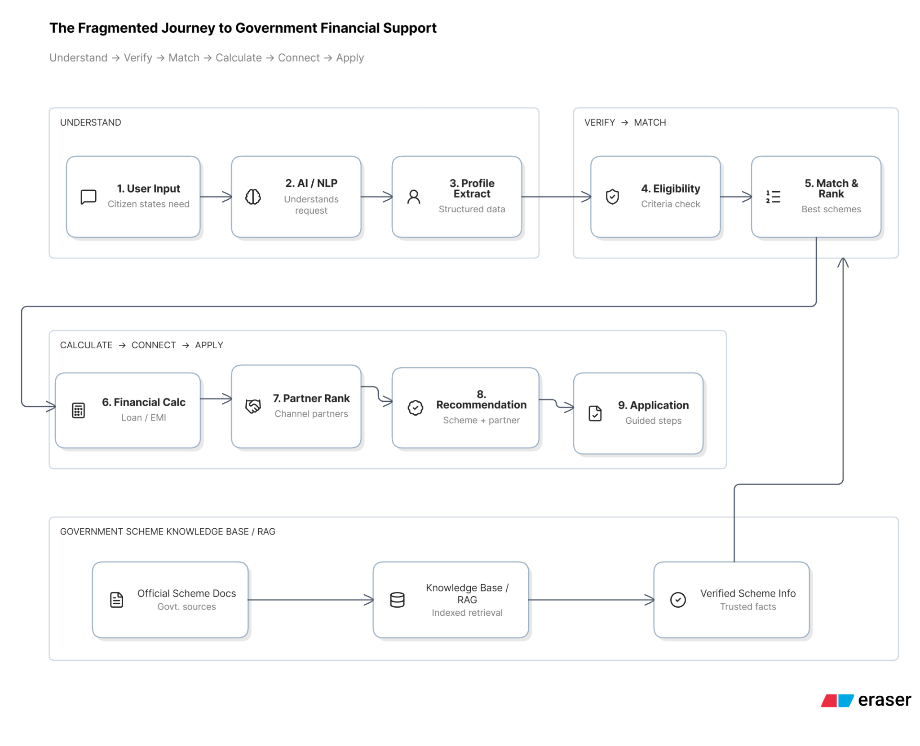









TECHNICAL APPROACH
Nirmaan
Tech Stack
Frontend:-
Backend:-

Slide 4
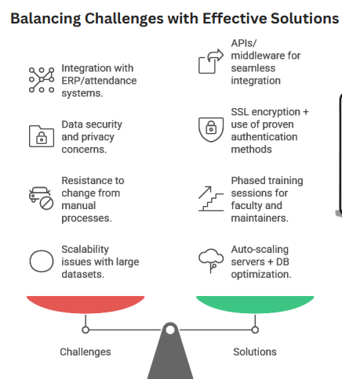
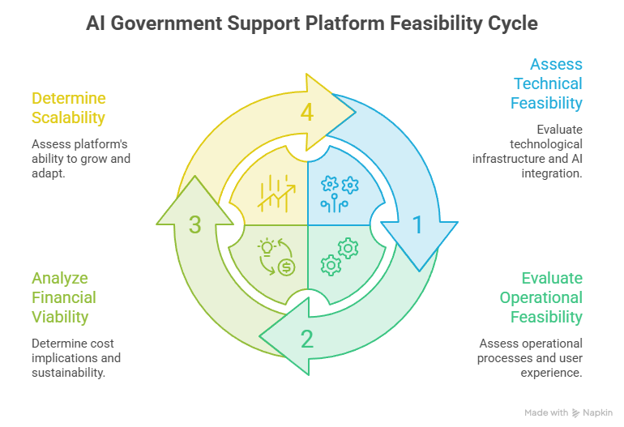
FEASIBILITY AND VIABILITY
Nirmaan

Slide 5
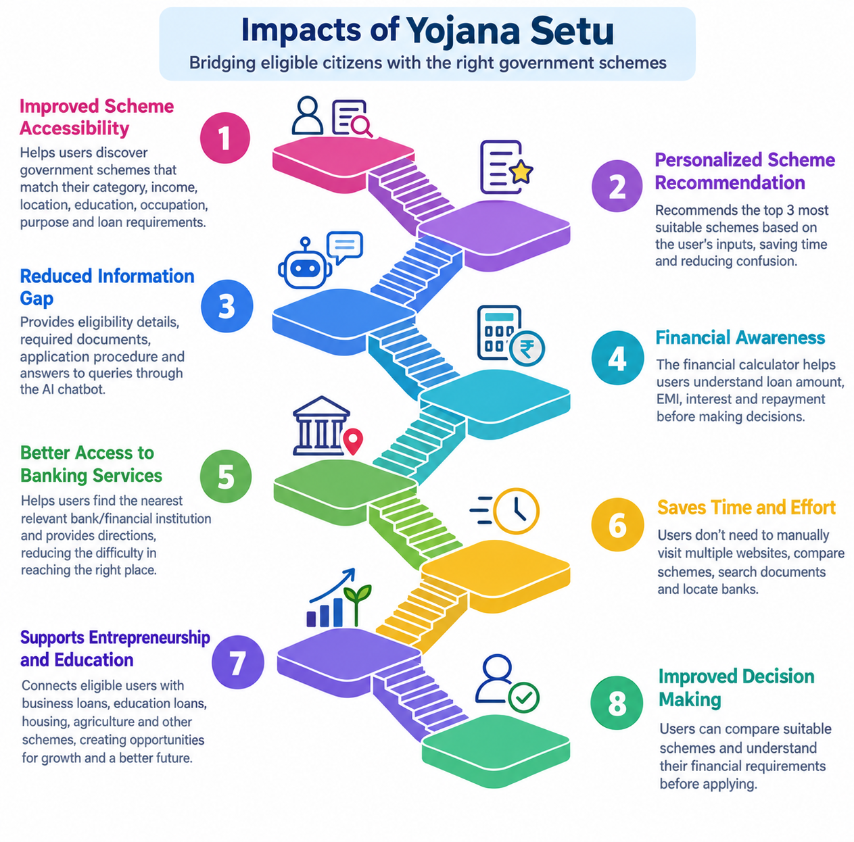
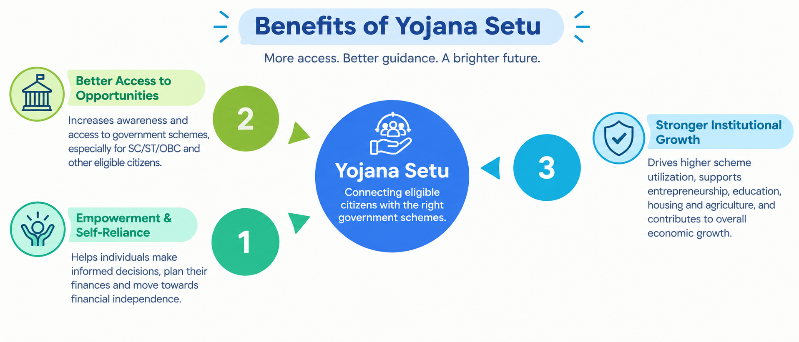
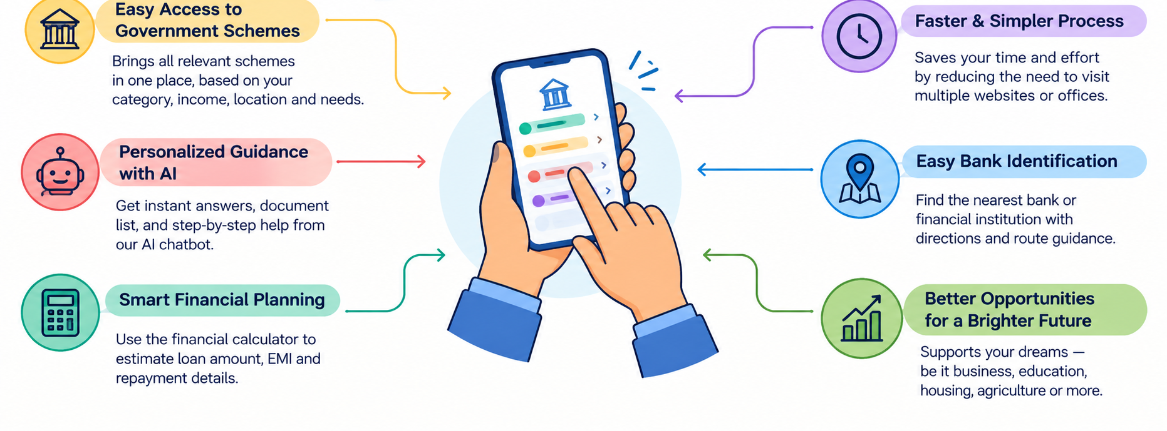
IMPACT AND BENEFITS
Nirmaan
Impacts of Yojana-Setu
Benefits of Yojana-Setu
Why Yojana-Setu

Slide 6
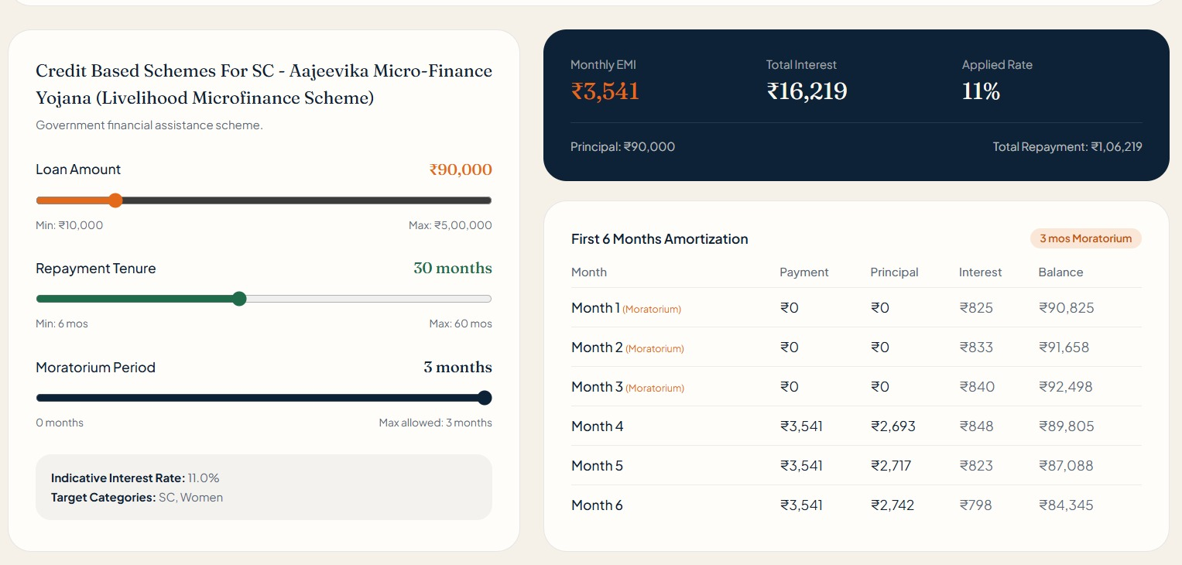
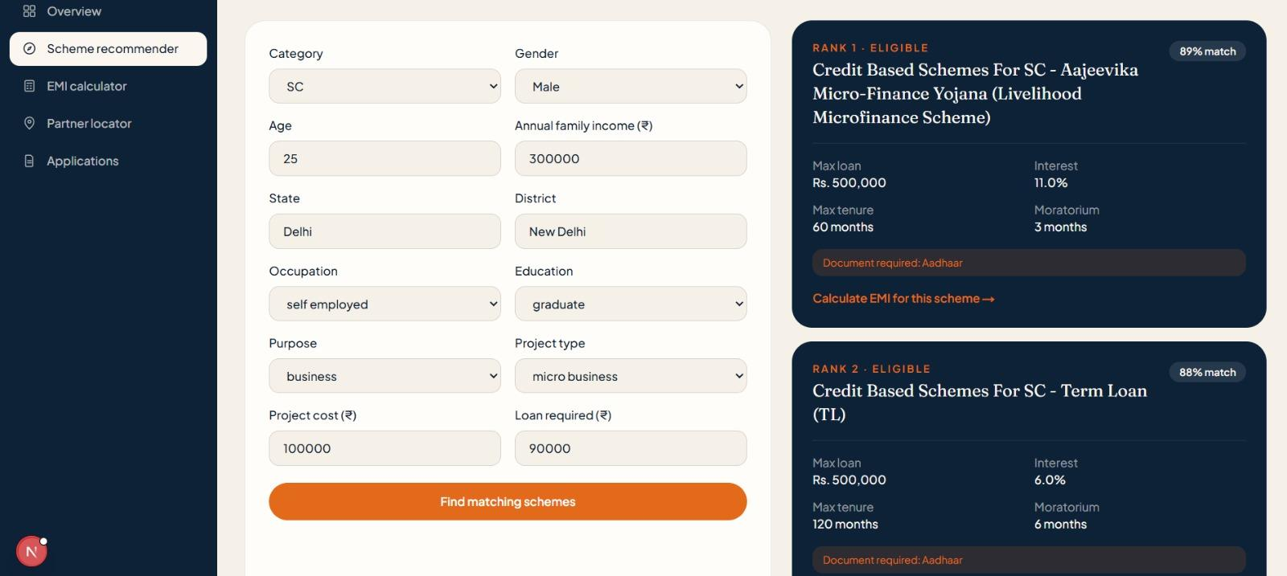
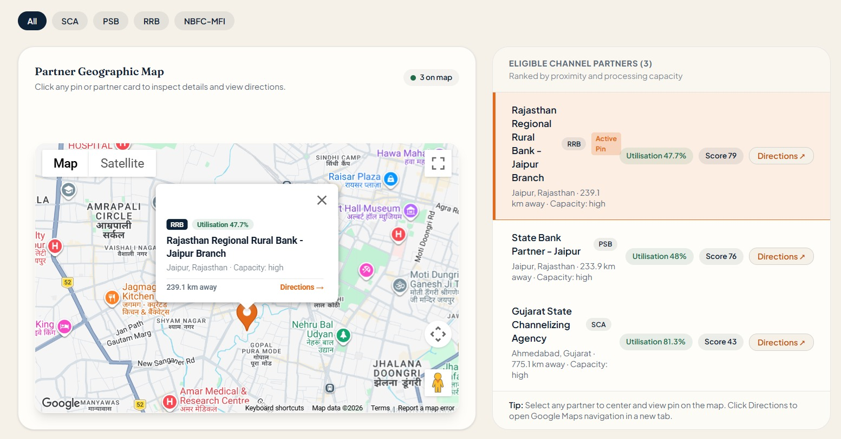
RESEARCH AND REFERENCES
Nirmaan
– Government Schemes and benefits : myScheme – Government of India
Project Links
Github Repo:- https://github.com/deepak1268/yojana-setu
Youtube Video:- https://youtu.be/eMVt-i6nTjE
Live Demo:- https://yojana-setu-chi.vercel.app/
– SC-specific financial assistance : NSFDC – National Scheduled Castes Finance and Development Corporation
– Lack of Awareness of Government Schemes among SC Beneficiaries: Welfare schemes for Scheduled Castes
– SC/ST entrepreneurship financing : Stand-Up India – Government of India
– Used to study government support for self employment , skill development : PM Vishwakarma – Government of India
– JanSamarth – National Portal for Credit-Linked Government Schemes:
financialservices.gov.in/jansamarth

