Slide 1
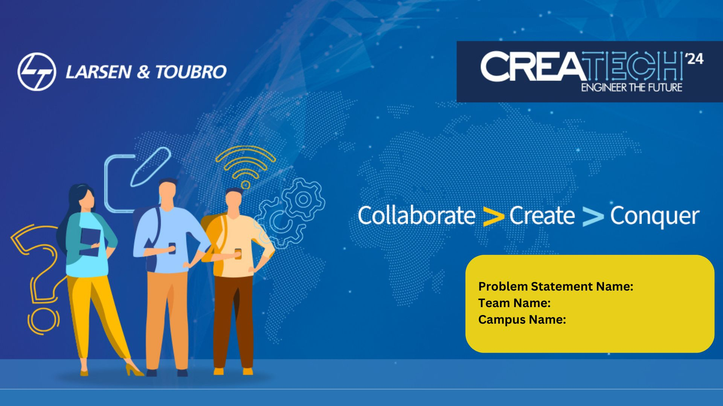
Develop an AI based model for monitoring construction equipment/assets utilization, productivity, and maintenance at construction sites.
Akatsuki
SRM Institute of Science and Technology

Slide 2
Introduction:
1. Our system aims to revolutionize construction site management.
2. Leveraging automation and data analysis, it addresses critical issues within the construction industry.
3. The system comprises three key subsystems: Equipment & Asset Utilization Monitoring, Productivity
Analysis, and Infrastructure & Equipment Maintenance.
4. Its primary objectives include optimizing resource usage, increasing productivity, and ensuring timely
maintenance practices.
5. By implementing token-based checkout systems and data-driven productivity assessments, the system
emphasizes accountability and operational efficiency.
6. Advanced algorithms such as ARIMA are utilized for effective inventory management.
7. Maintenance focus includes vibration monitoring and service data analysis for defect identification and
lifecycle estimation.
8. Real-time performance tracking capabilities empower proactive decision-making and interventions.
9. This system signifies a significant step forward in construction management, offering a holistic solution
to industry challenges.
10. The integration of automation, data analytics, and maintenance strategies drives efficiency, cost savings,
and project success in construction operations.

Slide 3
Abstract:
Abstract: The proposed system revolutionizes construction site management through automation and
data analysis.
2. It comprises three key subsystems: Equipment & Asset Utilization Monitoring, Productivity Analysis, and
Infrastructure & Equipment Maintenance.
3. The system optimizes resource utilization, increases productivity, and ensures timely maintenance practices.
4. Token-based checkout systems and data-driven productivity assessments promote accountability and
operational efficiency.
5. Advanced algorithms like ARIMA are utilized for effective inventory management.
6. Maintenance focus includes vibration monitoring and service data analysis for defect identification and
lifecycle estimation.
7. Real-time performance tracking enables proactive decision-making and interventions.
8. The system represents a significant advancement in construction management, offering a holistic solution
to industry challenges.
9. Integration of automation, data analytics, and maintenance strategies drives efficiency and project success.
10. Overall, the system streamlines operations, minimizes errors, and enhances resource management in
construction projects.

Slide 4
Working:
Subsystem 1: Equipment & Asset Utilization Monitoring
1.Implements a token-based checkout system for assets and equipment.
2.Tracks usage, authentication, and availability of assets through digitalized processes.
3.Utilizes algorithms like ARIMA for data analysis and generates monthly reports on inventory usage.
Subsystem 2: Productivity Analysis
1.Evaluates workforce productivity through time and force calculations.
2.Measures workforce efficiency based on output and input metrics.
3.Compares productivity data over time to identify trends and make necessary adjustments in workforce
and environment.
Subsystem 3: Infrastructure & Equipment Maintenance
1.Tokenizes and categorizes infrastructure elements for systematic maintenance.
2.Conducts timely maintenance based on categorization and detects defects through vibration monitoring.
3.Utilizes service data for estimating product lifetimes and managing stock vs requests effectively.

