Slide 1
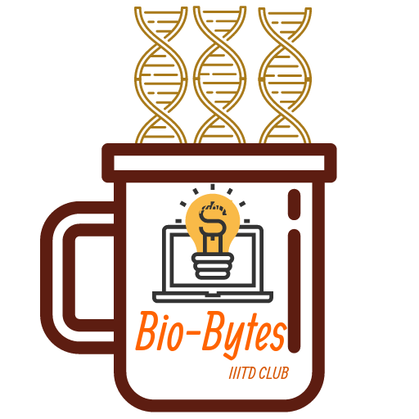
Bio-Bytes
Bio-Talk 1.0
DNA Sequence

Slide 2
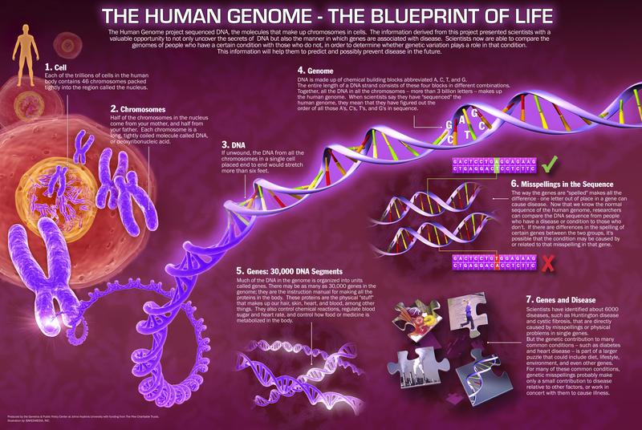

Slide 3
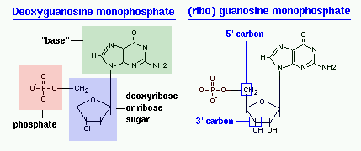
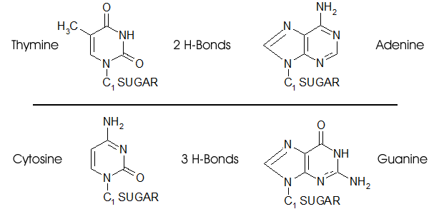
Structure of a nucleotide
DNA nitrogenous bases- Adenine, Guanine, Cytosine, Thymine

Slide 4
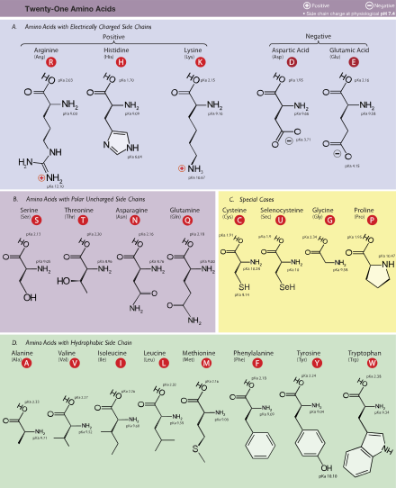
Amino Acids

Slide 5
