Slide 1
Content based book recommendation sytem

Slide 2
Presented by :
Chekurthi Deepak B200802CS
Yendluri Jahnav B200847CS
Meesala Suresh Gopi B200850CS

Slide 3
Table of contents
01
02
03
04
05
Introduction
Motivation
Literature
Survey
Proposed Design
Summary

Slide 4
01
Introduction

Slide 5
Introduction
In this presentation,we will be discussing about
the different methods and accuracy of some book recommendation systems
What is a Content-Based book recommendation system?
How does it work?
Building a content based recommendation model
Why Content-Based book recommendation system?

Slide 6

02
Motivation

Slide 7
Motivation
Addressing Information Overload
Personalized Recommendations
Enhanced Quality
Promotes Inclusivity
Encourages Exploration

Slide 8

03 Literature Survey

Slide 9
Literature Survey
Background
Related Works in this area

Slide 10
Background
Content-based filtering dates back to the 1960s, initially termed "Selective Dissemination of Information" (Hensley 1963), aiming to match newly arriving information.
Artificial Intelligence (AI), particularly Machine Learning (ML), has gained widespread use, notably in recommendation systems, revolutionizing information dissemination.
Boosting user engagement and sales in various online platforms, such as Netflix and YouTube, where a significant portion of content consumption is driven by recommendations.
Deep learning models, including neural networks, have played a transformative role in recommendation systems, showcasing significant improvements over traditional models.
The success of deep learning algorithms in recommendation systems necessitates a comprehensive review, enabling researchers and developers to understand their strengths, weaknesses, and application scenarios for future advancements.

Slide 11
Related Works in this area
Dharmendra Pathak, Sandeep Matharia And C. N. S. Murthy proposed an efficient and best unique hybrid recommendation algorithm, by providing the recommendation more satisfying the user’s desire.
The hybrid recommendation approach integrates collaborative, content, and context-based algorithms, combining user ratings, personal information, and behavioral data. Collaborative filtering relies on user ratings, while content-based factors in user preferences and context includes behavioral cues like mood and weather. Cosine similarity is utilized for measuring similarity. Subject priorities are determined from the user's history, adjusting based on book purchases to enhance recommendations. The study concluded that this hybrid approach outperformed other recommendation algorithms.

Slide 12
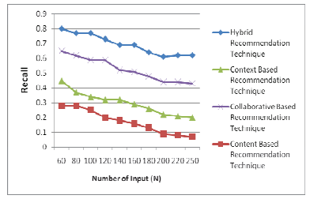
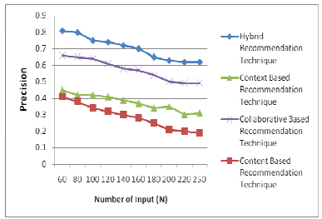
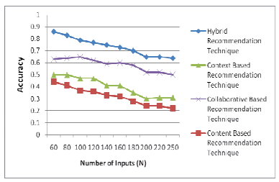

Slide 13
Yongen Liang and Shimingwan proposed a method which can mine products by understanding the user’s preferences.
The university library's personalized book recommendation system leverages collaborative filtering, utilizing both user-user and item-item filtering methods. Key to this approach is measuring similarity between books and readers using cosine similarity, aiding in predicting a user's probable rating for a particular book. However, a challenge arises with new users who lack a purchase or borrowing history, known as the "cold start" problem. To mitigate this, an "Expert and New Book Recommendation" module suggests top-rated or popular books, addressing the informational gap for newcomers.
This recommendation service operates exclusively for registered users within the university library, enhancing their experience by tailoring book suggestions to their preferences. The system emphasizes promoting engagement and satisfaction by ensuring the recommendations align with individual tastes and the library's collection dynamics.

Slide 14
Raymond J. Mooney et al. proposed a content-based book recommendation system
They focused on learning individualized profiles from book descriptions, characterizing each patron uniquely without matching their interests to others. Recommendations were based on the book's information itself rather than relying on the preferences of other users. The system, named LIBRA (Learning Intelligent Book Recommending Agent), utilized automated text categorization methods applied to semi-structured text extracted from the web. The evaluation of LIBRA involved diverse datasets predominantly in literature fiction, mystery, science, and science fiction genres. Various metrics were employed, such as classification accuracy, recall, precision, F-measure, and rank correlation, demonstrating the effectiveness of LIBRA in providing relevant and highly rated book recommendations, even with a limited number of training examples.

Slide 15
Hai Liu et al. content-based recommendation algorithm leveraging convolutional neural networks (CNN).
The CNN was utilized to predict latent factors from text information extracted from multimedia resources. The authors introduced the split Bregman iteration method to solve the model efficiently. The recommendation process involved using text information related to the input learning resource, which could be the content itself or a brief introduction.
This input was passed through a CNN to extract features of the learning resource. These features, combined with the user's preferences, were used to predict ratings. The objective was to minimize the mean squared error (MSE) of the predictions by proposing a latent factor model regularized by L1-norm, ensuring the accuracy of recommendations.

Slide 16
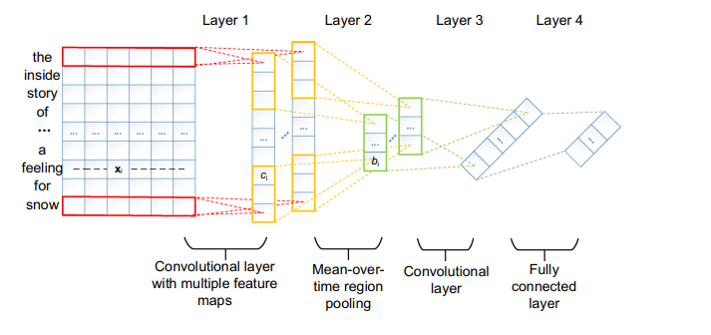
Construction of convolutional neural network. Layer 1 is a convolutional layer with multiple feature maps. Layer 2 is a mean-over-time pooling layer. Layer 3 is an over-time convolutional layer. Layer 4 is a full connected layer, and is then the output

Slide 17
Year | Author | Technique | Methods used
2000 | Robin van Meteren et.al | Content-based Recommendation System | It uses tf-idf scheme to find the weight of a document vector.This document vector is used to find the similarity with user’s request using cosine smilarity formula.
2015 | Kumari Priyanka et.al | Content-based with Opinion mining | sentiment analysis is used to classify the reviews or comments from the different users for different book into positive or negative.Then, naïve bayes algorithm will perform the text classification.
2017 | Youdong Yun | Collaborative filtering with Opinion Mining | Incorporates sentiment analysis and user opinions
2022 | T.Fujimoto | Content-based recommendation system considering emotions of user interests | based on the similarity of the vectors of contents and emotions,sentence-BERT model
Research on various other recommendation models

Slide 18
04 Proposed Design

Slide 19
Proposed Design
Our objective is to construct our model by filtering data based on book genres and summaries.
We intend to use different known algorithms and neural networks.
we will be finalizing the methodology by the 1st week of November.

Slide 20
05 Summary

Slide 21
Summary
The literature emphasizes content-based recommendation systems for books, analyzing attributes like descriptions and genres to offer personalized suggestions.
This approach is pivotal, providing tailored recommendations irrespective of user behavior. Deep learning, especially neural networks, is increasingly adopted, enhancing recommendation quality by capturing intricate book patterns.
Personalization is central, shaping rich user profiles to align with unique interests. Content-based methods diversify reading experiences by suggesting varied genres and authors, beyond user history. As technology advances, content-based recommendations promise enhanced accessibility and enjoyment for readers with diverse preferences, facilitated by AI and machine learning.

Slide 22
Thank You!

