Slide 1

Neural Networks/EE-258/FALL2018
PUBG Finish Placement Prediction
- Regression problem to predict the win percentage using a simple Neural Network
Baseline model
Presentation by Deepak Shivani
Under the guidance of Prof. Birsen Sirkeci

Slide 2
OBJECTIVE:
Getting the data.
Data visualization and data cleaning.
Determining performance metrics and target values.
Implementing a working end to end pipelined Neural Network Model.
To predict final placement on a scale from 1 (first place) to 0 (last place) from final in-game stats and initial player ratings .

Slide 3
DATASET VISUALISATION AND CLEANING:
We are given a dataset of 65000 games split into test and training data sets.
There are 29 features available based on different player stats. (Id, groupId, matchId, assists, boosts, damageDealt, DBNOs, headshotKills, heals, killPlace, killPoints‘, kills, killStreaks, longestKill, matchDuration, matchType, maxPlace, numGroups, rankPoints, revives, rideDistance, roadKills, swimDistance, teamKills, vehicleDestroys, walkDistance, weaponsAcquired, winPoints, winPlacePerc)
“winPlacePerc” is considered to be our target variable.
The features like Id, groupId, matchId and matchType are categorical and thus not play a crucial role in the initial baseline model, therefore are dropped from dataset.
All the NA values are removed from the dataset.

Slide 4
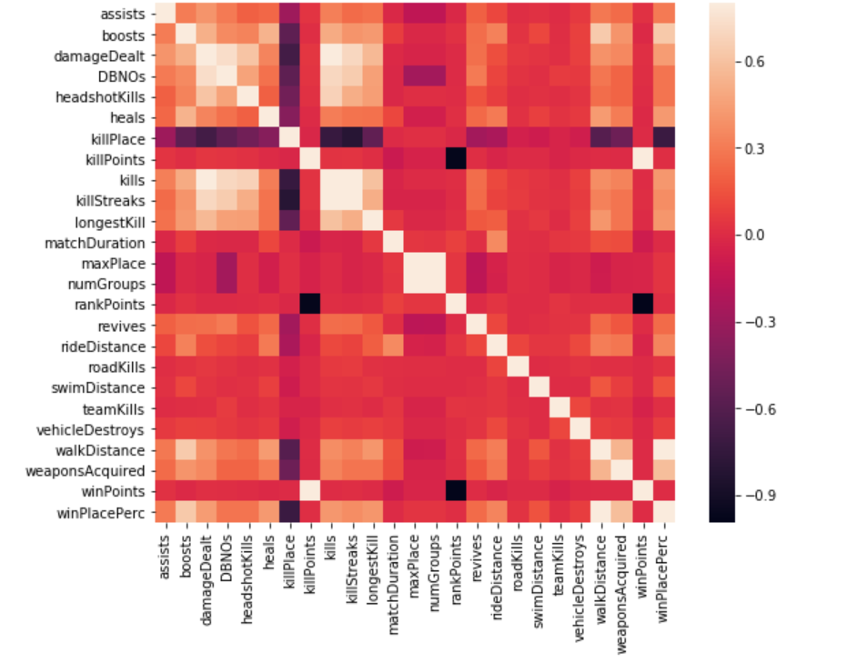
HEAT MAP:
Correlation is used to see the relation between the features.
Here, it is depicted with the help of a heat map.
If the value on the target is close to 0, it means that the feature may be irrelevant to the target.
As shown in the figure, if the color is black then the value tends to -1 else the value in case of white is +1.
The values near 0 are shown in red color.
It is seen from the figure that winPlacePerc is highly correlated to walkDistance whereas inversely correlated to killPlace.

Slide 5
BUILDING THE MODEL:
A basic feed forward neural network is implemented using keras python library.
Number of neurons in each layer:
Input layer = 80, Hidden layer1 = 160, Hidden layer2 = 320, Hidden layer3 = 160, Hidden layer4 = 80, Hidden layer5 =
40, Hidden layer6 = 20, Output layer = 1.
Activation functions used:
ReLU in input layer and hidden layers
Sigmoid in output layer
Performance Metric Used:
Mean Absolute Error (MAE) is the simplest measure of forecast accuracy, it is simply, as the name suggests, the mean
of the absolute errors. The absolute error is the absolute value of the difference between the forecasted value and
the actual value.
Optimizer used: Adam
Number of Epochs = 500

Slide 6
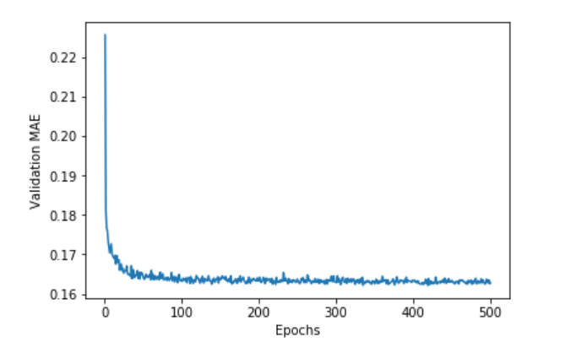
INITIAL PERFORMANCE:
The figure is plotted between the validation MAE and the total number of epochs.
At the start of training, the validation MAE is very high but reduces exponentially as the number of epochs increases.
The validation MAE saturates to the lowest MAE value once the number of epochs are about to end.

Slide 7
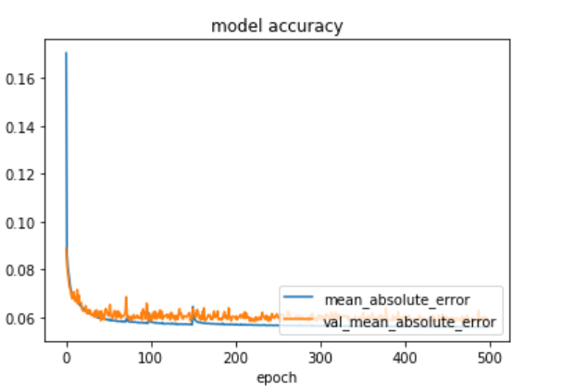
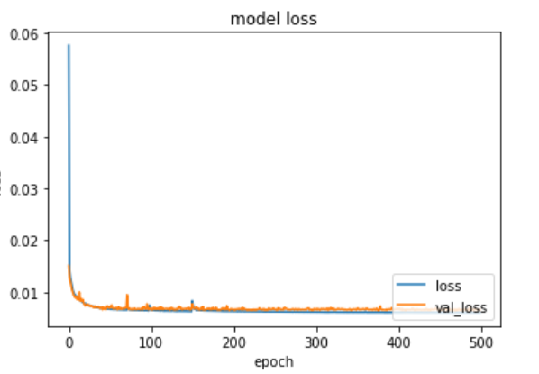
ACCURACY V/S LOSS:
The figure model accuracy is the comparison between the MAE of validation dataset and training dataset.
It gives us the rough idea about the accuracy of our model based on MAE.
In the figure model loss, the comparison between the training dataset loss and validation dataset loss is depicted.
Loss can be effective to evaluate the performance of a model.

Slide 8
CONCLUSION:
After training the model, it is evaluated on the given test dataset to predict the winPlacePer of each player.
The prediction made is stored in a .csv file and later uploaded on kaggle to get a rank on competition leader board.
The desired MAE for this project is less than 0.025.
The performance can be improved by the use of effective feature engineering i.e. using some techniques on the data set such as combining highly correlated features, effective feature selection etc.
The performance is also enhanced if the outliers are removed.
RESULT:
The Mean Absolute Error for this problem turned out to be 0.0658.

Slide 9
THANK YOU

