Slide 1
Thesis presentation
Design and implementation of scalable FFT processor for wireless applications
By
Deepak Revanna
Department of computer systems
Tampere university of technology

Slide 2
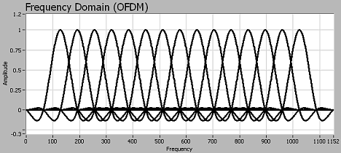
Introduction
FFT..?
Why FFT..?
Digital signal processing
  OFDM based wireless communication systems

Slide 3
Motivation
Wireless communication systems
Multimedia streaming applications
Scalability
Speed, low cost, low power, time to market

Slide 4
Wireless communication standards
 | DAB | DVB | 802.11a/g | 802.16e-OFDM | 3GPP-LTE EUTRA
FFT size | 2048, 1024, 512, 256 | 8192, 2048 | 64 | 256 | 128, 256, 512, 1024, 1536, 2048
FFT period(us) | 1000, 500, 250, 125 | 896, 224 | 3.2 | 8 | 66.7

Slide 5
Scope
16-bit, fixed point, radix-2 N-point FFT
Design
VHDL
Synthesis
Wireless applications

Slide 6
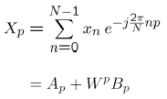
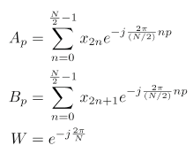
FFT
Basic DFT equation:
Where

Slide 7
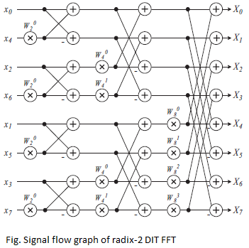
DIT FFT

Slide 8
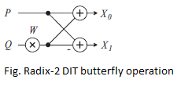
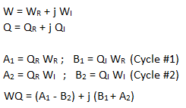
Butterfly
Pipelined complex multiplication

Slide 9
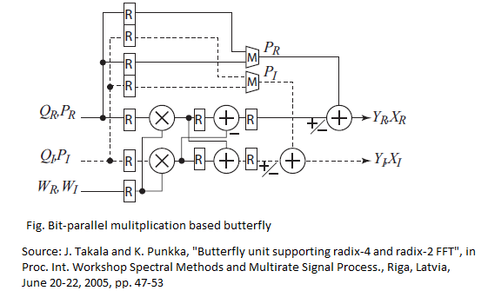
Butterfly internal architecture

Slide 10
FFT processor
Control unit
Address generation unit
Interconnect
Butterfly unit
RAM memory storage
ROM memory storage

Slide 11
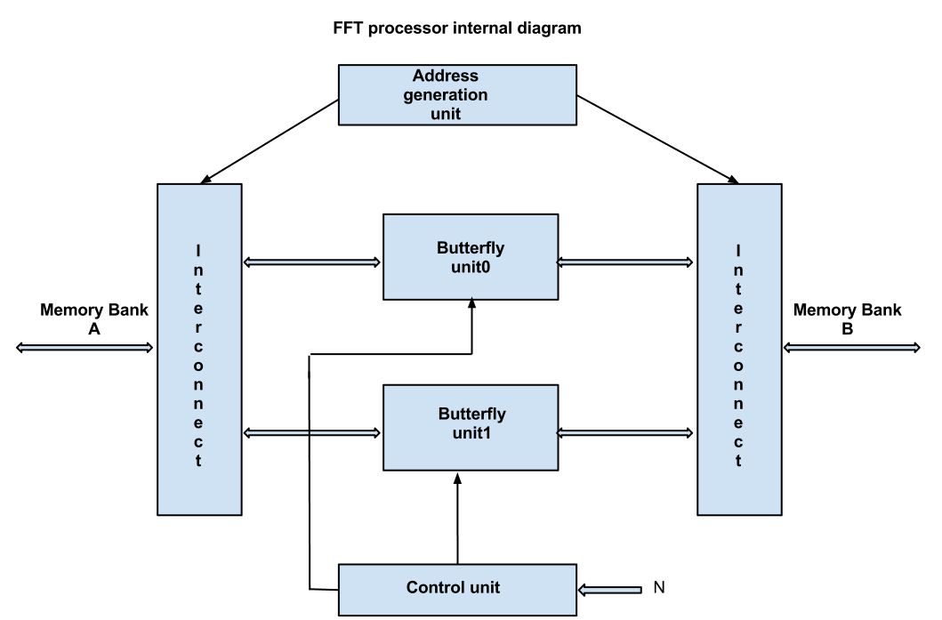
Block diagram

Slide 12
Implementation stages
Literature study
Design
VHDL implementation
Verification
Synthesis
Result analysis

Slide 13
Tools
Emacs
Modelsim simulator, Mentor Graphics Inc.
HDL designer, Mentor Graphics Inc.
Quartus II synthesis tool, Altera corp.
Altera Stratix II FPGA

Slide 14
Results
Parameter | Values
Combinational ALUTs | 723
Dedicated logic registers | 782
Total block memory bits | 6144
Maximum operating frequency | 128 MHz
Cycle time | 7.8 ns

Slide 15
Results
FFT size (N) | Clock cycles | FFT period(us) | Wireless standard
64 | 200 | 1.5 | 802.11a/g
128 | 448 | 3.5 | 3GPP-LTE EUTRA
256 | 1024 | 7.9 | 802.16e-OFDM, 3GPP-LTE EUTRA, DAB,
512 | 2304 | 17.9 | DAB, 3GPP-LTE EUTRA
1024 | 5120 | 39.9 | DAB, 3GPP-LTE EUTRA
2048 | 11264 | 88.9 | DAB, DVB

Slide 16
Things to do..!
Simulation
Synthesis
Result analysis
Documentation

Slide 17
Questions..?

Slide 18
Thank you..!

