Slide 1
Transformer

Slide 2
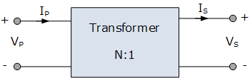
Introduction
The transformer is a static device (i.e. the one which does not contain any rotating or moving parts) which is used to transfer electrical energy from one ac circuit to another ac circuit, with increase or decrease in voltage/current but without any change in frequency.

Slide 3
Course outcome
C403.3: Evaluate efficiency and regulation of a given transformer by conducting load test

Slide 4
Continued….
Function of transformer:
The electrical energy is generated and transmitted at extremely high voltages. The voltage is to be then reduced to a lower value for its domestic and industrial use.
This is done by using a transformer. Thus it is possible to reduced the voltage level using a transformer called step down transformer.
On the other hand, the transformer used to increase the voltage level is called step up transformer.
When the transformer changes the voltage level, it changes the current level also.

Slide 5
Types of Transformer
There are two types of transformer depends on supply system:
Single phase transformer
Three phase transformer
However the principle of operation for both the types is same.

Slide 6
Principle of Operation
The construction of single phase transformer is as shown in fig.(1a). It consists of two highly inductive coils (windings) wound on an iron or steel core.
The winding connected to ac supply is called as primary winding whereas the other one is called as the secondary winding.
Operating principle of a transformer:
As soon as the primary winding is connected to the single phase ac supply, an ac current starts flowing through it.

Slide 7
Continued….
2. The ac primary current produces an alternating flux ø in the core.
3. Most of this changing flux gets linked with the secondary winding through the core.
4. The varying flux will induce voltage into the secondary winding according to the Faraday’s law of electromagnetic induction.
Thus due to primary current, there is an induced voltage in the secondary winding due to mutual induction.
Hence the induced emf in secondary is called as the mutually induced emf.

Slide 8
Continued….
Can the transformer operate on DC?
Answer is NO. Because with a DC primary current, the flux produced in the core will not alternate, it is of constant value.
As there is no change in flux linkage, the induced emf in secondary winding is zero.

Slide 9
Construction of Transformer
As shown in fig.(1) Basically a transformer consists of two inductive windings and a laminated steel core.
The coils are insulated from each other as well as from the steel core.
A transformer may also consist of a container for winding and core assembly (called as tank), suitable bushings to take our the terminals, oil conservator to provide oil in the transformer tank for cooling purposes etc.

Slide 10
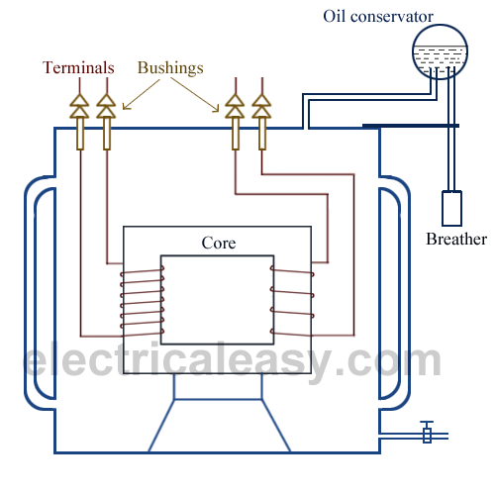
Continued….
Fig.(1): construction of transformer

Slide 11
Continued….
In all types of transformers, core is constructed by assembling (stacking) laminated sheets of steel, with minimum air-gap between them (to achieve continuous magnetic path).
The steel used is having high silicon content and sometimes heat treated, to provide high permeability and low hysteresis loss. Laminated sheets of steel are used to reduce eddy current loss.
The sheets are cut in the shape as E,I and L. To avoid high reluctance at joints, laminations are stacked by alternating the sides of joint. That is, if joints of first sheet assembly are at front face, the joints of following assemble are kept at back face.

Slide 12
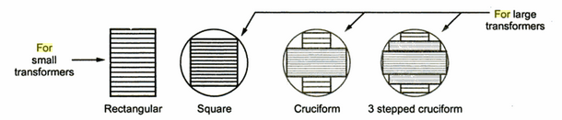
Continued….
Fig.(2): Different cross-sections for transformer limbs

Slide 13
Continued….
Transformer tank:
The whole assembly of large size transformer is placed in a sheet metal tank. Inside the tank the assembly of the transformer is immersed in oil which acts as an insulator as well as coolant.
The oil will take out the heat produced by the transformer windings and core and transfer it to the surface of the transformer tank.

Slide 14
Types of transformer
The transformers are of different types depending on the arrangement of the core and windings as follows:
Core type
Shell type
Berry type

Slide 15
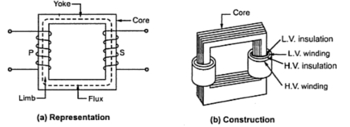
Continued….
Core type transformer:
The construction of core type transformer is as shown in fig.(1).
Fig.(1): core type transformer

Slide 16
Continued….
It has a single magnetic circuit. The core rectangular having two limbs. The winding encircles the core. The coils used are of cylindrical type.
The coils are wound in helical layers with different layers insulated from each other by paper or mica. Both the coils are placed on both the limbs.
The low voltage coil is placed inside near the core while high voltage coil surrounds the low voltage coil. Core is made up of large number of thin laminations.
As The windings are uniformly distributed over the two limbs, the natural cooling is more effective. The coils can be easily removed by removing the laminations of the top yoke, for maintenance.

Slide 17
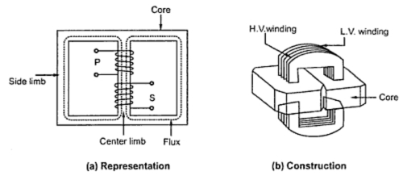
Continued….
2. Shell type transformer:
The construction of shell type transformer is as shown in fig.(1).
Fig.(2): shell type transformer

Slide 18
Continued….
It has a double magnetic circuit. The core has three limbs. Both the windings are placed on the central limb. The core encircles most part of the windings.
The coils used are generally multilayer disc type or sandwich coils. Each high voltage coil is in between two low voltage coils and low voltage coils are nearest to top and bottom of the yokes.
The core is laminated. Generally for very high voltage transformers, the shell type construction is preferred. As the windings are surrounded by the core, the natural cooling does not exist.
For removing any winding for maintenance, large number of laminations are required to be removed.

Slide 19
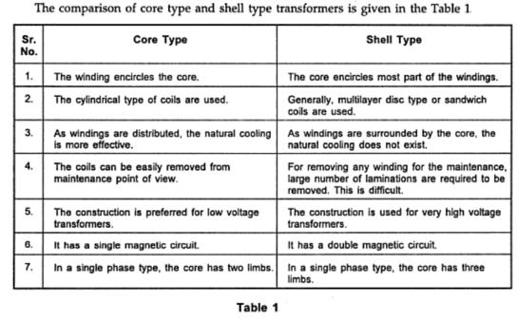
Continued….

Slide 20
EMF equation of a transformer
In a transformer, source of alternating current is applied to the primary winding.
Due to this, the current in the primary winding (called as magnetizing current) produces alternating flux in the core of transformer.
This alternating flux gets linked with the secondary winding, and because of the phenomenon of mutual induction an emf gets induced in the secondary winding.
Magnitude of this induced emf can be found by using the following EMF equation of the transformer.

Slide 21
Continued…
Let, N₁ = Number of turns in primary winding N₂ = Number of turns in secondary winding Φ_{m} = Maximum flux in the core (in Wb) = (B_{m} x A) f = frequency of the AC supply (in Hz)
As, shown in the fig., the flux rises sinusoidally to its maximum value Φ_{m} from 0. It reaches to the maximum value in one quarter of the cycle i.e in T/4 sec (where, T is time period of the sin wave of the supply = 1/f). Therefore, average rate of change of flux = ^{Φ}_{m} /_{(T/4)} = ^{Φ}_{m} /_{(1/4f)} Therefore, average rate of change of flux = 4f Φ_{m} ....... (Wb/s).

Slide 22
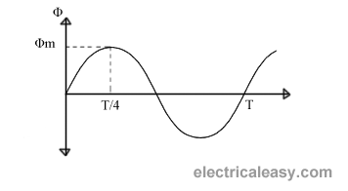
Continued…
Fig.(1)

Slide 23
Continued…
Now, Induced emf per turn = rate of change of flux per turn Therefore, average emf per turn = 4f Φ_{m} ..........(Volts).
Now, we know, Form factor = RMS value / average value Therefore, RMS value of emf per turn = Form factor X average emf per turn. As, the flux Φ varies sinusoidally, form factor of a sine wave is 1.11 Therefore, RMS value of emf per turn = 1.11 x 4f Φ_{m} = 4.44f Φ_{m}. RMS value of induced emf in whole primary winding (E₁) = RMS value of emf per turn X Number of turns in primary winding E₁ = 4.44f N₁ Φ_{m} ............................. eq (1)

Slide 24

Continued…
Similarly, RMS induced emf in secondary winding (E₂) can be given as E₂ = 4.44f N₂ Φ_{m}. ............................ (eq 2) rom the above equations 1 and 2,

Slide 25
Continued…
This is called the emf equation of transformer, which shows, emf / number of turns is same for both primary and secondary winding. For an ideal transformer on no load, E₁ = V₁ and E₂ = V₂ . where, V₁ = supply voltage of primary winding V₂ = terminal voltage of secondary winding
Factors affecting the induced emf are:
Flux Φ_{m}
Frequency of applied voltage
Number of turns N.

Slide 26
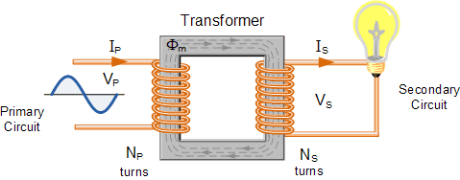
Voltage & Current ratios of a transformer
Fig.(1): Elementary single phase transformer

Slide 27
Continued…
Voltage ratios of the transformer with load:
As shown in fig.(1), let
N₁ = Number of turns in primary winding N₂ = Number of turns in secondary winding
E₁ = rms induced voltage in primary winding
E₂ = rms induced voltage in secondary winding
E₁ = 4.44f N₁ Φ_{m} volts
E₂ = 4.44f N₂ Φ_{m} volts
By taking the ratio of these expressions we get,
E₁ …(1)
N₁
=
E₂
N₂

Slide 28
Continued…
Voltage ratios of the transformer without load:
Assume the load on secondary winding is disconnected.
∴ I₂ = 0
∴ load terminal voltage v₂ is equal to secondary induced voltage E₂
i.e. V₂ = E₂ …….(2)
As the primary current on no load is very small,
V₁ = E₁ …….(3)
By substituting eq.(2) & (3) in eq.(1) we get,
V₁ N₁ ……(4)
=
V₂
N₂

Slide 29
Continued…
Voltage ratio:
The ratio of the primary and secondary terminal voltages (i.e. V₁ & V₂ ) is called as the voltage ratio.
Transformation ratio (k):
The transformation ratio for voltage is defined as the ratio of secondary voltage to the primary voltage of a transformer.
∴ K = V₂ = E₂ = N₂ ……(5)
V₁
E₁
N₁

Slide 30
Continued…
Turns ratio:
The turns ratio of a transformer is defined as the ratio of the number of primary turns to the number of secondary turns.
∴ turns ratio = N₁ …….(6)
Types of transformers based on the value of K:
Step up transformer:
If K > 1 or V₂ > V₁ is called step up transformer.
Step down transformer:
If K < 1 or V₂ < V₁ is called step down transformer.
N₂

Slide 31
Continued…
3. One-to-one transformer:
If K=1 or V₁ = V₂ is called as a one-to-one transformer. It is also known as the isolation transformer.
Current ratios:
The transformer transfer electrical power from one side to the other (primary to secondary) with a very high efficiency (η).
If we assume that the power loss taking place in the transformer is very low (η = 100%) then, we can write that
power input = power output
∴ V₁ I₁ cos ø₁ = V₂ I₂ cos ø₂ …….(7)
where I₁ and I₂ are the RMS values of the primary and secondary currents of the transformer respectively.

Slide 32
Continued…
cos ø₁ and cos ø₂ are the power factors of the primary and secondary sides of the transformer. Practically they are of same value.
∴ cos ø₁ = cos ø₂ …..(8)
∴ V₁ I₁ = V₂ I₂ …..(9)
∴ I₁ V₂ N₂ …..(10)
This expression shows that the primary & secondary currents are inversely proportional to the number of turns of the corresponding windings.
=
=
I₂
V₁
N₁

Slide 33
Rating of Transformer
Generally the rating of a machine should indicate the power supplied by it. But incase of transformer, the output power is not constant.
It keeps changing with the load. The output power factor is also a function of load.
Hence rating of a transformer is expressed in terms of voltage and current as follows:
Rating of transformer = Primary voltage x primary current
or = Secondary voltage x secondary current

Slide 34
Continued…
As the voltage and current may or may not be in phase, the units of transformer rating are Volt Ampere (VA) or kiloVolt-Ampere (kVA) or Mega Volt Ampere (MVA).
∴ Rating in VA or kVA or MVA = V₁ x I₁ = V₂ x I₂
Why is the transformer rated I VA or kVA?
There are two type of losses in a transformer; 1. Copper Losses 2. Iron Losses or Core Losses or Insulation Losses
Copper losses ( I²R)depends on Current which passing through transformer winding while Iron Losses or Core Losses or Insulation Losses depends on Voltage.

Slide 35
Continued…
Hence the total losses depends on the volt ampere (VA) and not on the power factor. Therefore rating of transformer is in VA or kVA and not in kW.
The complete rating of a transformer:
The complete rating of a transformer includes the ratio of primary and secondary voltages, kVA rating and supply frequencies as follows:
3300 V/ 240 V , 5 kVA , 50 Hz
where, 3300 V is primary voltage V₁
240 V is secondary voltage V₂
5 kVA is kVA rating and 50 Hz is the supply frequency.

Slide 36
Continued…
Specifications of transformer:
When transformer is to be purchased, we have to consider following specifications:
kVA rating 2. Number of phases
3. Primary voltage 4. Secondary voltage
5. Primary current 6. Secondary current
7. Frequency of operation
8. Types of cooling

Slide 37
Continued…
table 1 shows the typical specifications of a single phase transformer.
Sr. No. | Specification/rating | Value
1. | kVA rating | 5kVA
2. | Number of phases | 1
3. | Primary voltage V₁ | 230 V
4. | Secondary voltage v₂ | 100 V
5. | Primary current I₁ | 21 A
6. | Secondary current I₂ | 50 A
7. | Frequency of operation | 50 Hz
8. | Cooling | Open

Slide 38
Losses in a Transformer
An ideal transformer is loss free. But in the practical transformer there are following losses taking place.
Copper losses (P_{c})
Iron losses (P_{i}):
i. Hysteresis losses
ii. Eddy current losses

Slide 39

Continued…
Copper Loss (P_{c}):
The total power loss is taking place in the winding resistances of the transformer is known as the copper loss.
∴ Copper loss = Primary copper loss + Secondary copper loss
The copper loss is denoted by P_{c} .
where, R₁ and R₂ are resistances of primary and secondary winding respectively.

Slide 40
Continued…
The copper loss should be kept as low as possible to increase the efficiency of the transformer.
To reduced the copper loss, it is essential to reduce the resistances R₁ and R₂ of primary and secondary winding.
Copper losses are also called as variable losses as they are dependent on the square of load current.

Slide 41
Continued…
Iron loss (P_{i}):
Iron loss P_{i} is the power loss taking place in the iron core of the transformer.
P_{i} = Hysteresis Loss + Eddy current loss
Hysteresis losses:
Hysteresis loss is directly proportional to frequency f and voltage V. it is given by
P_{H} = K_{H} B_{m}^{1.67} fV …..[K_{H} constant]

Slide 42
Continued…
Eddy current losses:
Eddy current loss is proportional to square of frequency and square of thickness of laminations. It is given by,
P_{E} = K_{E} B_{m}² f².t² ……[t = thickness]
Due to time varying flux, there is some induced emf in the transformer core. This induced emf causes some currents to flow through the core body. These currents are known as the eddy currents.
The eddy current loss can be minimized by using laminated core for transformer.

Slide 43
An Ideal Transformer
An ideal transformer is a transformer having following characteristics:
The losses are zero.
The primary and secondary winding resistances are zero.
The external voltage applied to the primary, V₁ is same as the primary induced voltage E₁.
i.e. E₁ = V₁
Similarly, the voltage induced E₂ in secondary winding will be equal to the load voltage V₂.
i.e. E₂ = V₂
5.. The transformation ratio for an ideal transformer is given by,
K = E₂ = V₂
E₁ V₁

Slide 44
Continued…
Efficiency of an ideal transformer is 100%.
The voltage regulation is 0%. That means the secondary voltage will remain constant irrespective of the load current.

Slide 45
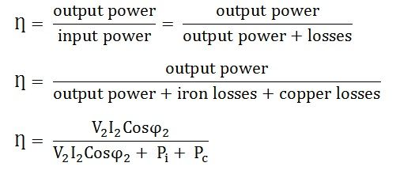
Efficiency & Regulation
Efficiency (η):
The efficiency of a transformer is defined as the ratio of output power to input power. It is denoted by η.
………………(1)

Slide 46
Continued…
Since the output power is always less than the input power due to losses in the transformer, the efficiency of the practical transformer is always between 0 and 1 i.e. 0% and 100% but it can never be 1 or 100%.
The output power at full load = V₂ I₂ cos ø₂
or = (kVA x cos ø₂ x 1000) watt
Then from eq.(1), full load efficiency is given by
η_{FL} = kVA x cos ø₂ x 1000
(kVA x cos ø₂ x 1000) + P_{i} + P_{c} …(2)

Slide 47
Continued…
In eq.(2), the value of kVA and copper loss will change with change in load.
The iron loss however remains constant. The copper loss will change in square proportion with the load. Hence for half load condition the efficiency is given by.
η_{HL} = 0.5 kVA x cos ø₂ x 1000
(0.5 kVA x cos ø₂ x 1000) + P_{i} +(0.5)² P_{c}

Slide 48
Continued…
Why the transformer efficiency is always higher than that of rotating machines?
The transformer is a static device with no moving parts. Hence losses due to friction and windage are completely absent.
The efficiency of the transformer can be atleast equal to 90%.
This why the transformer efficiency is always higher than the that of rotating machines.

Slide 49
Continued…
Condition for maximum efficiency:
It can be proved that the transformer efficiency is maximum when,
P_{i} = P_{c}
i.e. when copper loss equals the iron loss.
Load at maximum efficiency:
Let kVA_{(max)} be the kVA of the transformer at full load and kVA_{(load)} be kVA at a particular load.
Let P_{i} = constant iron loss and
P_{c} = copper loss at full load
kVA load for maximum efficiency is given by,
kVA load for maximum efficiency = kVA_{(max)} √P_{i}/P_{c}

Slide 50
Continued…
Voltage regulation:
Ideally, the secondary terminal voltage V₂ (or load voltage) of a transformer should remain constant independent of the load current.
But practically the load voltage decreases with increase in load current I_{L}.
No load Voltage:
The no load voltage is the secondary terminal voltage corresponding to zero load current. For a transformer
No load voltage = E₂ volts

Slide 51

Continued…
Full load voltage:
It is secondary terminal voltage (V₂) corresponding to the specified load current. The percent voltage regulation is given by mathematically as:
……(1)
Thus with increase in load current, the value of V2 decreases and the percent regulation increases. Ideal value of voltage regulation is 0%.

Slide 52
Continued…
Definition of voltage regulation:
The voltage regulation of a transformer is defined as the change in secondary terminal voltage(V2) from no load to full load with the primary source voltage (V1) and the temperature of the transformer maintained constant.
The regulation is positive for resistive and inductive loads and it can be negative for the capacitive load.

Slide 53
Load Test
Some of the tests carried out on a transformer are as follows:
Direct loading test of load test
Open circuit (O.C.) test
Short circuit (S.C.) test
Polarity test
Efficiency measurement:
% η = output power delivered to load x 100
input power to the primary

Slide 54
Continued…
Regulation measurement:
% Regulation = V_{2NL} – V_{2FL} x 100
V_{2NL}
Advantages of a two winding transformer:
It provides complete isolation between primary and secondary.
It has no moving parts.
Its construction is simple.
We can step up or step down the voltage.

Slide 55
Continued…
Disadvantages:
Large size.
Low efficiency.
Poor voltage regulation.
High power losses in the windings.
More copper is required to be used because it has two separate windings.
Variable output voltage can not be obtained.
Variable frequency operation is not possible.

Slide 56
Continued…
Applications of two winding transformer:
As the distribution transformer.
As isolation transformer.
As a step down transformer in the dc power supplies.
Welding applications.

Slide 57
Autotransformer
The normal transformer has separate primary and secondary windings.
But the autotransformer is a special transformer in which a part of winding is common for the primary and secondary windings.
The construction of autotransformer is as shown in fig. (1).
It consists of only one winding wound on a laminated magnetic core, with rotary movable contact. Thus form the autotransformer three terminals are brought out for connection.
The autotransformer can operate as a step down or a step up transformer.

Slide 58
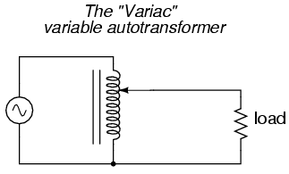
Continued…
Fig.(1): Autotransformer

Slide 59
Continued…
Autotransformer as step down transformer:
Fig.2(b) shows the connection of autotransformer as step down transformer.
It shows that two terminal A and B are connected to the single phase AC supply V₁. thus winding AB acts as the primary winding.
A part of complete winding i.e. CB acts as the secondary winding across which the load is connected.

Slide 60
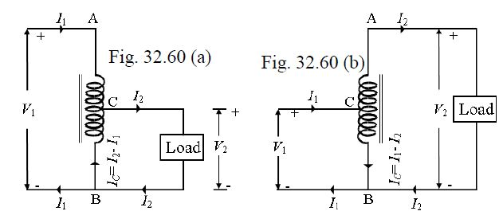
Continued…
Fig.2(a):Step down autotransformer fig.2(b):step down autotransformer

Slide 61
Continued…
The load voltage for this configuration is given by,
V₂ = N₂ x V₁
As the number of turns N₂ is less than N₁, this configuration operates as step down transformer.
N₁

Slide 62
Continued…
Autotransformer as step down transformer:
Fig.2(b) shows the connection of an autotransformer for operating as the step up transformer.
It shows the part CB of the complete winding acts as the primary winding. The full winding AB acts as a secondary winding and the load is connected between these terminals.
As the number of turns N₂ is higher than the number of turns N₁, the autotransformer acts as a step up transformer.

Slide 63
Continued…
Advantages of autotransformer:
As only one winding is used, the copper required for the transformer is very less.
The size and hence cost is reduced as compared to the conventional transformer.
The losses taking place in the winding are reduced hence the efficiency is higher than the conventional transformer.
Due to reduced resistance, the voltage regulation is better than the conventional transformer.

Slide 64
Continued…
Disadvantages of autotransformer:
There is no electrical isolation between the primary and secondary winding. This can be proved to be dangerous for high voltage applications.
If common part of the winding breaks, then transformer action is lost and full primary voltage appears across the secondary .
It possess a low impedance, hence if the secondary circuit is short circuited, then large current will flow on the secondary side.

Slide 65
Continued…
Applications of autotransformer:
It can be used as a variac, i.e. variable ac supply to vary the ac voltage applied to the load smoothly from 0 V to about 270 V.
In order to start the ac machines such as induction motors or synchronous motors.
To vary the supply voltage (as per requirement) of a furnace.
As a dimmerstat: when the variac autotransformer is used to control the intensity of lamps in the cinema halls etc., it is called as the dimmerstat.

Slide 66
Continued…
Comparison of two winding transformer and autotransformer:
Sr. no. | Parameter | Autotransformer | Conventional transformer
1. | Definition | A transformer, having only one winding a part of which acts as a primary and the other as a secondary. | It is a static machine which transfers electrical energy from one end to another without changing frequency.
2. | Number of Windings | Auto-transformer has only one winding wound on a laminated core | It has two separate winding, i.e., primary and secondary winding.
3. | Insulation | The primary and secondary winding are not electrically insulated. | The primary and secondary winding are electrically insulated from each other.

Slide 67
Continued…
Sr. no. | Parameter | Autotransformer | Conventional transformer
4. | Induction | Self Induction | Mutual Induction
5. | Size | Small | Large
6. | Power Transfer | Partly by transformation and partly by direct electrical connection. | Through transformation
7. | Voltage Regulation | Better | Good
8. | Winding Material | Less requires | More requires
9. | Circuit | The primary and secondary winding circuits are connected magnetically. | The primary and secondary winding circuits are connected both electrically and magnetically.
10. | Connection | Depends upon the tapping | Connect directly to the load.
11. | Starting current | Decreases | Decreases by 1/3 times.

Slide 68
Continued…
Sr. no. | Parameter | Autotransformer | Conventional transformer
12. | Excitation current | Small | Large
13. | Economical | More | Less
14. | Cost | Less costly | More costly
15. | Efficient | More | Less
16. | Leakage flux and resistance | Low | High
17. | Impedance | Less | High
18. | Cost | Cheap | Very costly
19. | Losses | Low | High
20. | Output voltage | Variable | Constant.
21. | Applications | Use as a starter in an induction motor, as a voltage regulator, in railways, in a laboratory. | Use in power system for step up and step down the voltage.

Slide 69
Three Phase Transformer
The electric power is generally generated in the form of three phase voltage. The distribution of the electric power also is three phase.
The voltage generation takes place at very high level typically at 13.2kV or 22 kV or even higher. The transmission of electricity takes place at voltage level such as 110kV, 132kV.
So it is necessary to use the step up transformer to raise the voltage levels from 13.2kV to 132 kV etc. The three phase transformer are used for the same.
Such high voltages can not be used by the domestic or industrial users. So the voltage should be stepped down. Three phase step down transformer are used as distribution transformer.

Slide 70
Continued…
Construction of three phase transformer:
The three phase transformer were constructed by combining three single phase transformer as shown in fig.(1).
The three single phase transformer are connected such that the three primary windings are connected in delta or star.
This type of construction is called as the bank of the transformer.

Slide 71
Continued…
Similarly, the secondary windings are connected in star or delta as shown in fig.(1).
But such construction proves to be costly and makes the transformer bulky. Therefore, specially made three phase transformer are being used now a days.

Slide 72
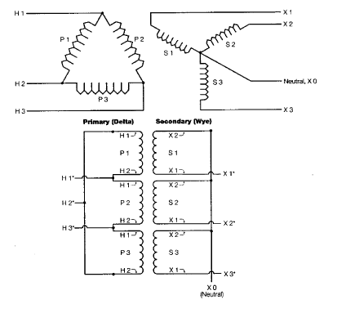
Fig.(1)construction of three phase transformer

Slide 73
Continued…
Advantages:
The advantages of using bank of single phase transformer are as follows:
Reliability is equally good as that of a 3 phase single unit transformer.
It is cheaper to carry spare stock of a sign phase transformer.
In the underground (mine) applications, the bank is preferred due to case of transport.
The bank also gives an advantages of derated open delta operation if one unit out of three become inoperative.

Slide 74
Continued…
Disadvantages:
The bank of transformers cost more.
It occupies more space.
The three phases are electrically connected but the three magnetic circuits are independent.

Slide 75
Continued…
Types of three phase transformer:
The three phase transformers are of two types:
Core type
Shell type

Slide 76
Continued…
Core type transformer:
Fig. (2) shows the construction of core type transformer.
The core of this transformer consists of three limbs. The primary and secondary windings of the three phases are wound on these limbs.

Slide 77
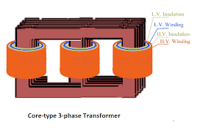
Continued…
Fig.(2): construction of core type three phase transformer

Slide 78
Continued…
2. Shell type transformer:
The construction of shell type transformer is as shown in fig.(3).
The construction of three phase shell type transformer is similar to that of a single phase shell type transformer.

Slide 79
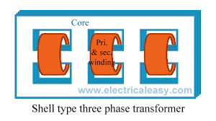
Continued…
Fig.(2): construction of shell type three phase transformer

Slide 80
Continued…
Three phase transformer connection:
There are several methods of connecting primaries and secondaries of three phase transformer. They are:
Star-star connection
Delta-delta connection
Star-delta connection
Delta-star connection
Vee-Vee or open delta
Tee-Tee or Scott

Slide 81
Continued…
These connections may be step-up or step-down.
Out of these transformer the delta-star type transformer is most commonly used for the distribution applications.

Slide 82
Continued…
Specifications/ratings of 3 phase transformer:
Sr. No. | Specifications/Ratings | Value
1. | kVA rating | 50kVA
2. | Number of phases | 3
3. | Connection | Delta/star
4. | Primary voltage | 415 V
5. | Secondary voltage | 230 V
6. | Primary current | 70 A
7. | secondary current | 126 A
8. | Cooling | Open
9. | Frequency | 50 Hz

