Slide 1
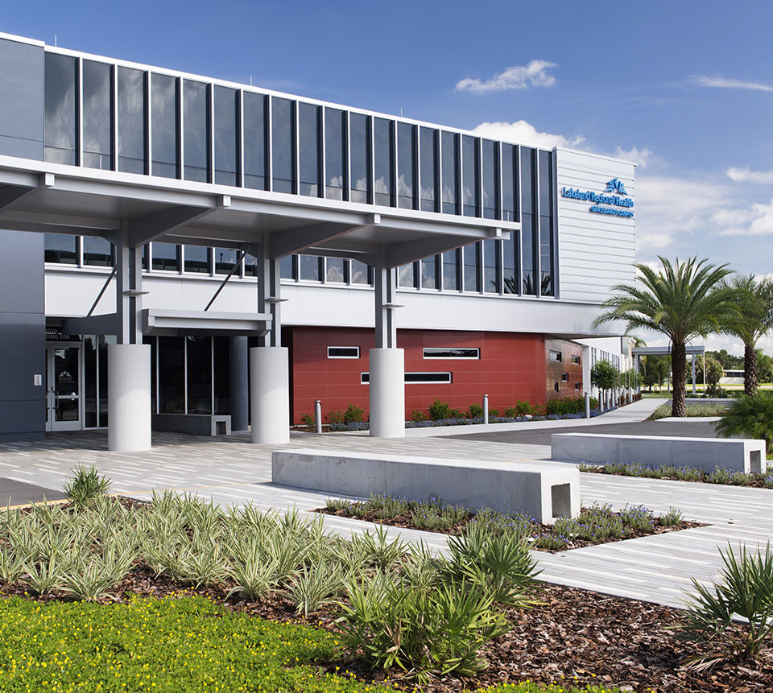

HOSPITAL MANAGEMENT SYSTEM
End term practicle
BY
Sachin Kumar, Nitesh Kumar Singh, Shreyash Tripathi,
& Mohammad Nadeem
Roll Numbers: 39, 42, 52 and 57
Department of Intelligent System
School of Computer Science and Engineering
Lovely Professional University, Jalandhar
April-2018

Slide 2

INTRODUCTION
A hospital management system is a vast system including many webpages like:
Hospital Homepage
Patient care and services
Finding Doctor
OPD schedule
Careers and jobs
Get appointment
Feedback & Query page

Slide 3

DESCRIPTION
HOSPITAL MANAGEMENT SYSTEM
With growing departments in hospitals, it is important for the technical department of the hospital to understand the needs and convenience of their patients. Hence, its site should contain portals to facilitate their patients with all necessary details.

Slide 4

FUTURE SCOPE
Our future work would be integrate this hospital management system with other hospitals.
we will add new features as and when we required.
improve effectiveness.
The system is simple to operate.
Any user can easily handle the data easily.
To make the data more secure , the software has provided the facility to the user to create their own individual password.
Reusability of this application is also possible.

Slide 5

Thank You

