Slide 1

AMTS Pass Registration System
Developed by :
Deepak Prajapati (3136)
Darshan Patel (3211)

Slide 2

Submitted To
Internal Guide: Mrs. Rujuta shah
AMTS Pass Registration
2

Slide 3
Project Profile
Defination
In This project we have Application for Ahmedabad Municipal Transport Services Pass registration System. In this System Create General pass, Senior Citizen pass, and Student pass. Users can also complain about any issue and other Services. Users can search the Routes of places.
Current System
As there is no this type of Desktop based application for Ahmedabad Municipal Transport Services Pass registration System.
There is no such application for create System Create General pass, Senior Citizen pass, and Student pass, and also renew that pass. A users can complain about the all services or the pass issue. They can find the routes about his places by place name or area code.

Slide 4
Project Profile(cont.)
Proposed System
New technology always leads to the formation and foundation of new more powerful and more featured system than other existing system.
This system is the very useful for the saving time of users.

Slide 5


System Requirement and Specification
Front End
JAVA language
Back End
MySQL
Hardware Specification
Operating System: Windows XP / 7 / 8 / 8.1 / 10
Processor : Intel Pentium Dual Core 3.1 GHz /
Intel Core i3-2310M Processor 2.10 GHz
RAM : 512 MB or more
Hard disk : 40 GB or more

Slide 6
System Design
Data Flow Diagram
ER Diagram
System flow Diagram

Slide 7
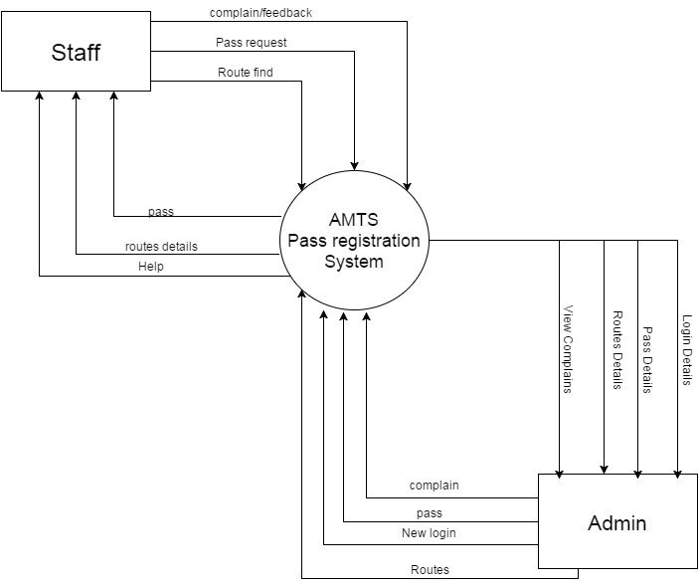
Data Flow Diagram
Context Level DFD:

Slide 8
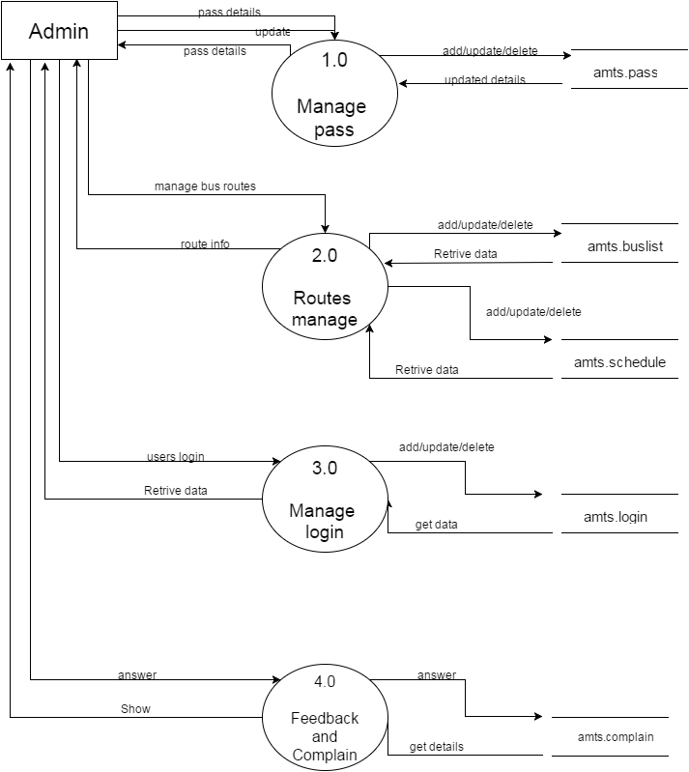
Data Flow Diagram (Cont.)
First Level DFD for Admin

Slide 9
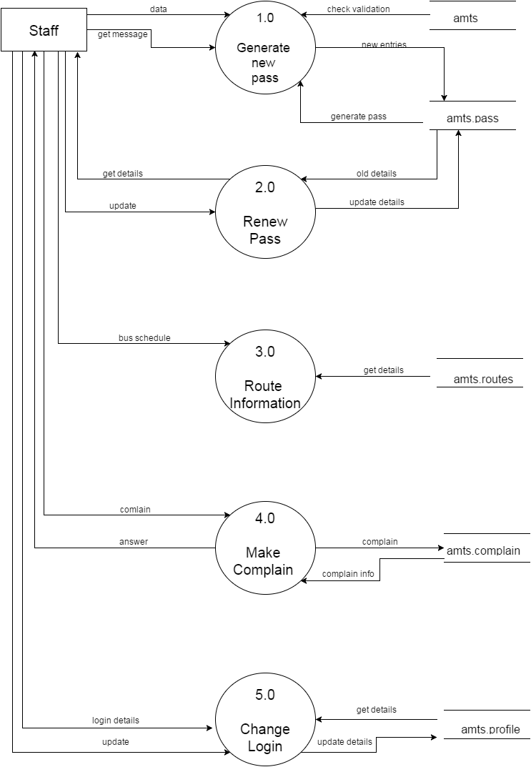
Data Flow Diagram (Cont.)
First Level DFD for Staff

Slide 10
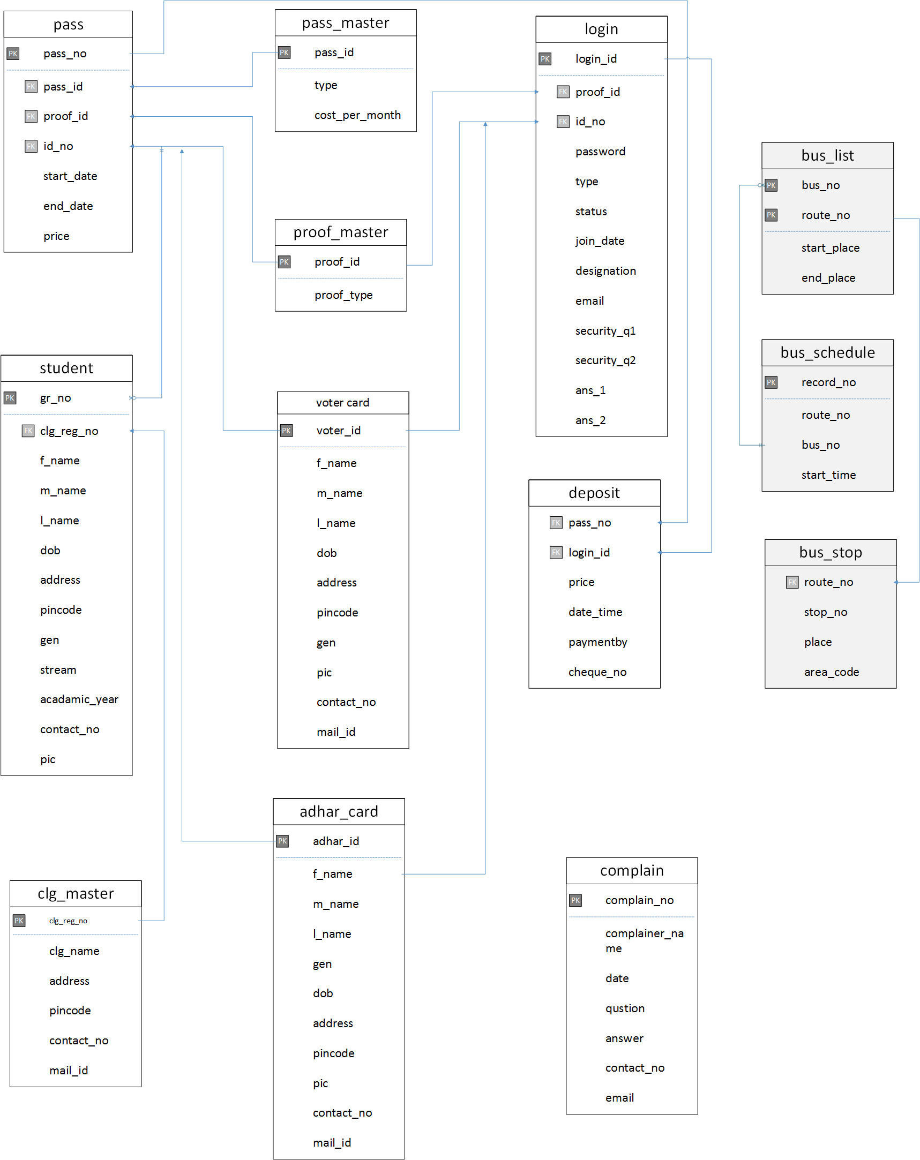
ER Diagram
AMTS Pass Registration

Slide 11
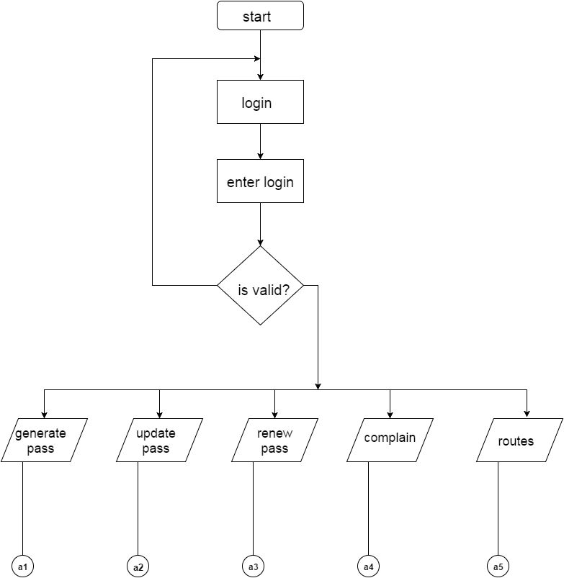
System Flow Diagram
AMTS Pass Registration

Slide 12
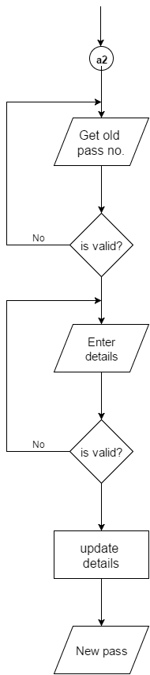
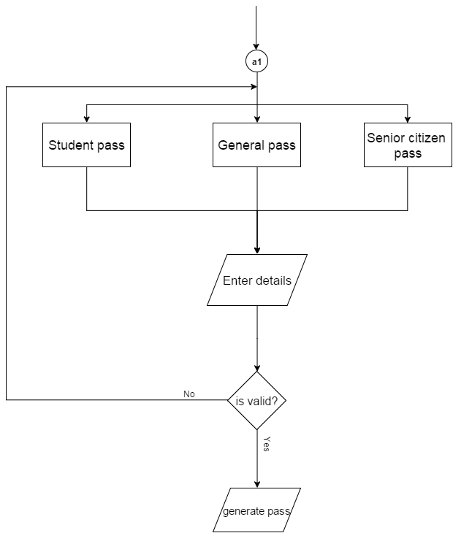
System Flow Diagram (Cont.)
AMTS Pass Registration

Slide 13
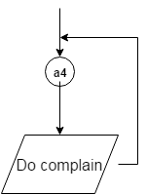
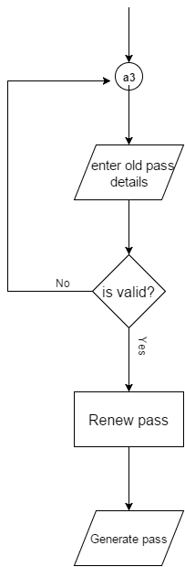
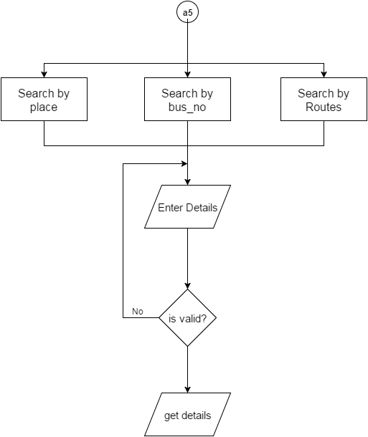
System Flow Diagram (Cont.)
AMTS Pass Registration

Slide 14
Data Dictionary
AMTS Pass Registration
14

Slide 15
Input and Output Design

Slide 16
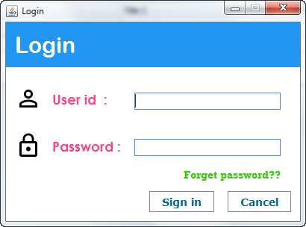
Login page

Slide 17
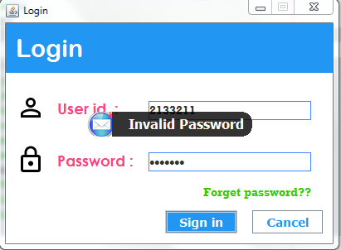
Validation for Login page

Slide 18
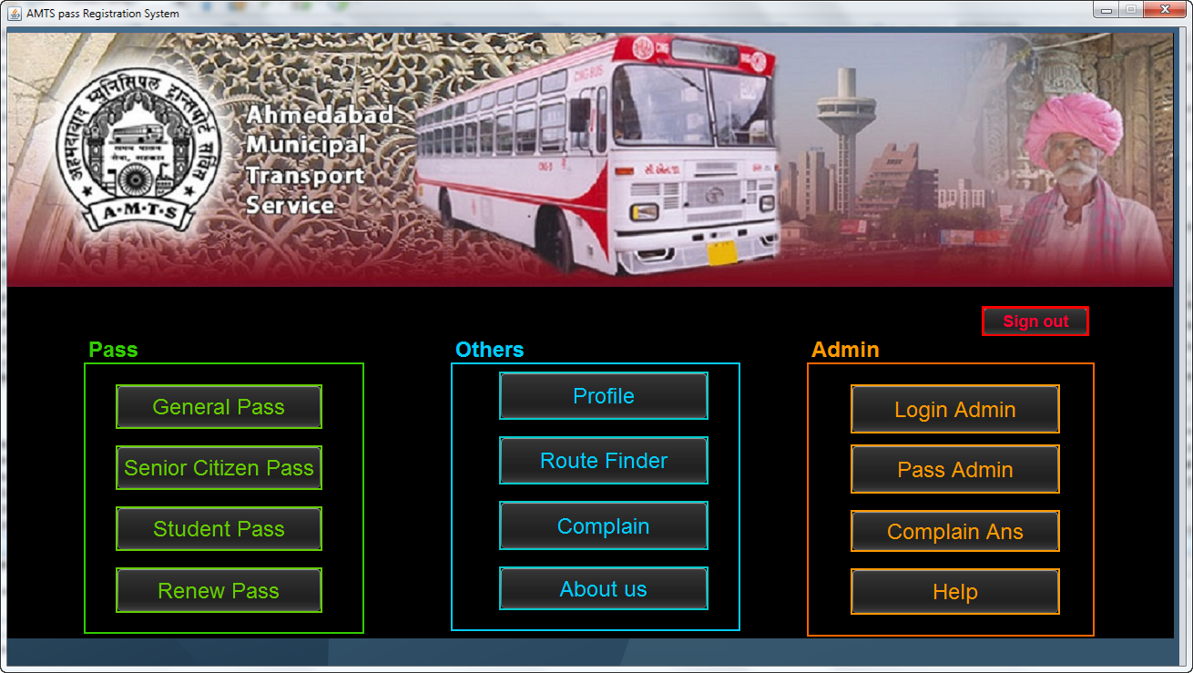
Home page

Slide 19
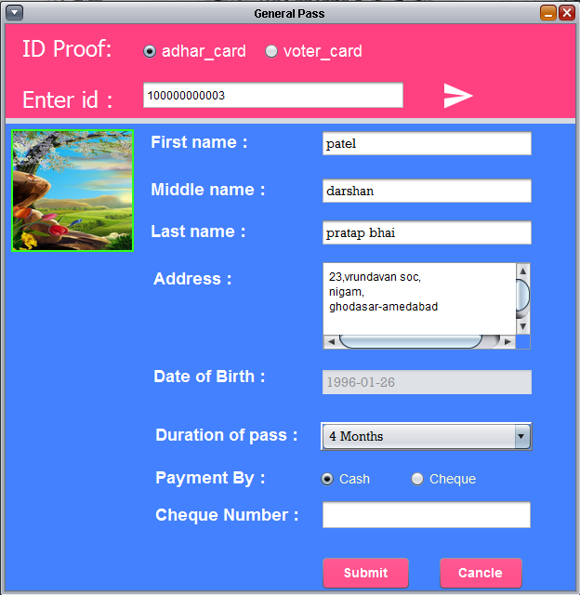
Create pass
Create pass for
General
Senior citizen
Student

Slide 20
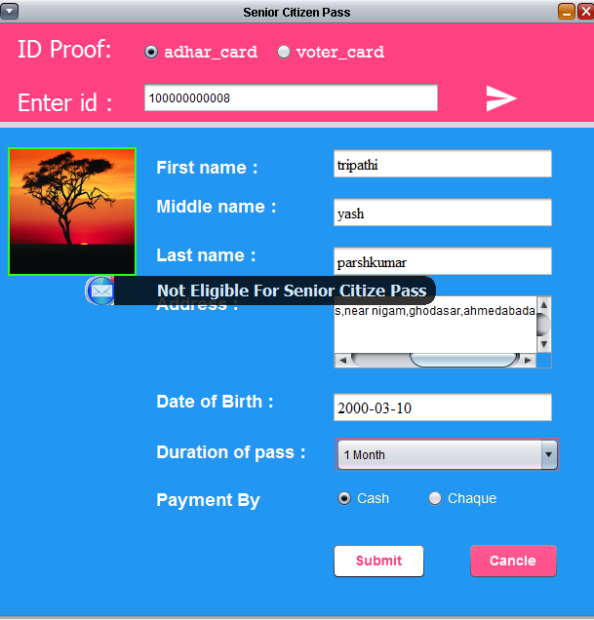
Senior citizen pass validation

Slide 21
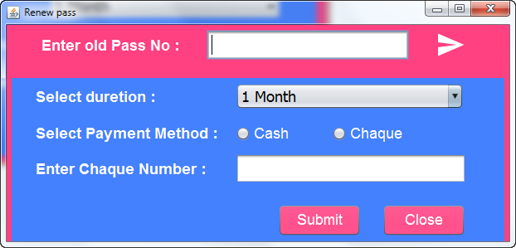
Renew pass

Slide 22
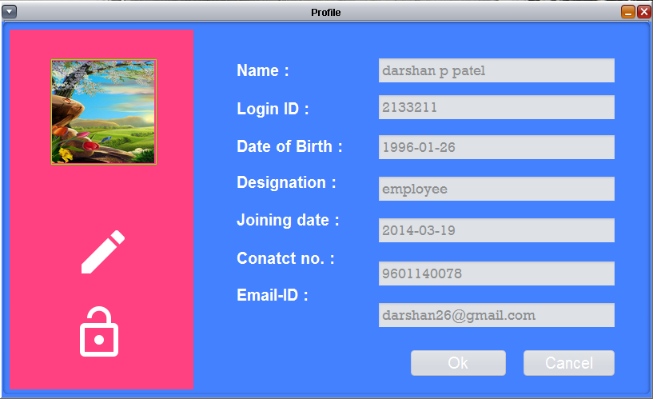
Profile

Slide 23
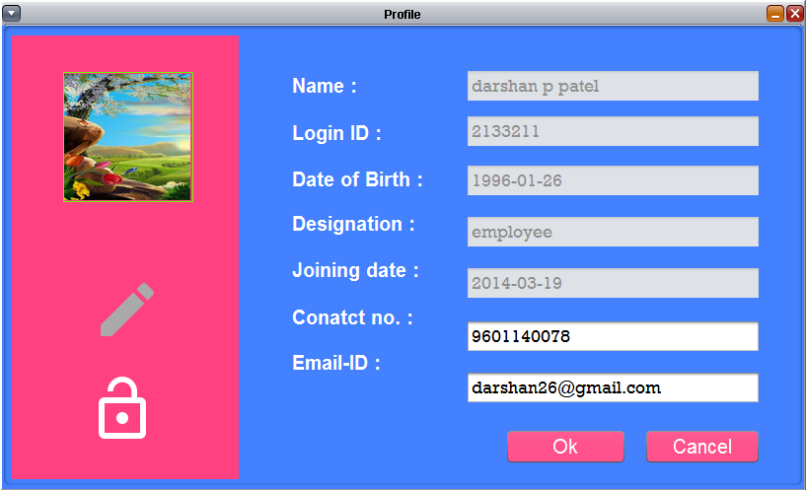
Edit profile

Slide 24
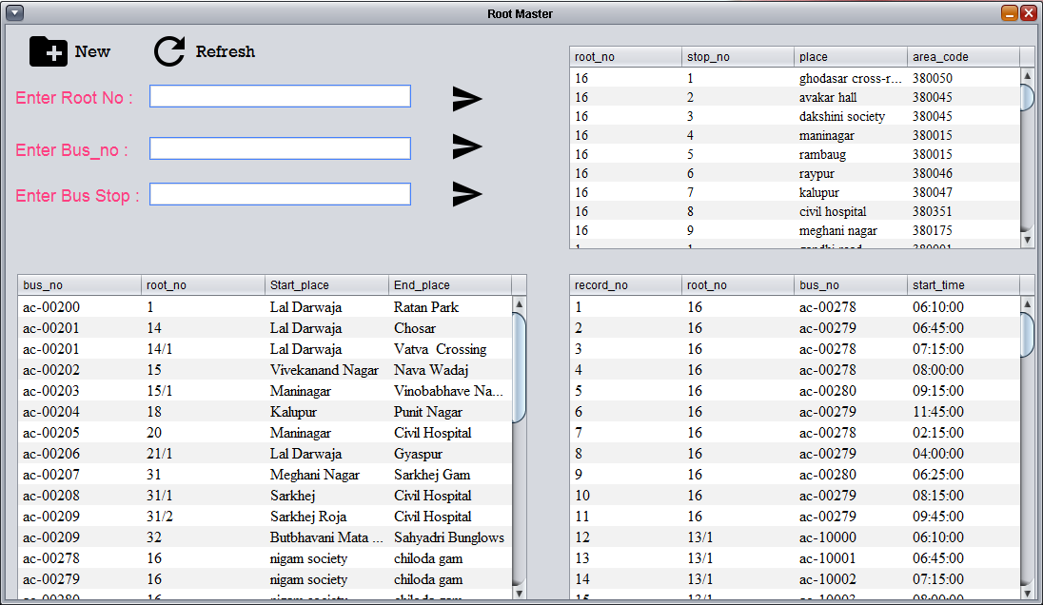
Route Find

Slide 25
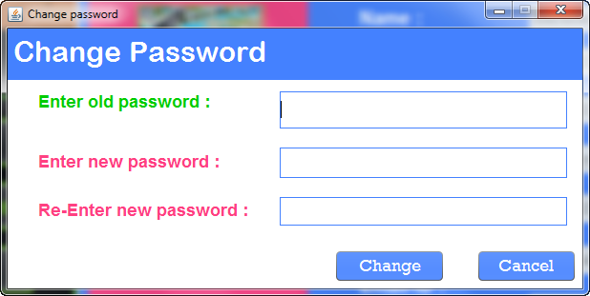
Change password

Slide 26
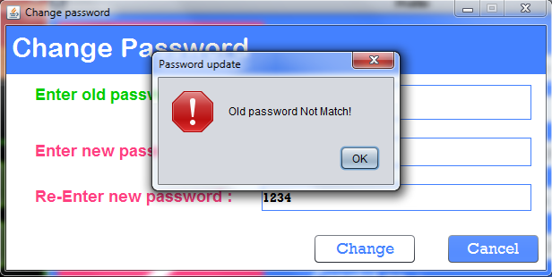
Check old password

Slide 27
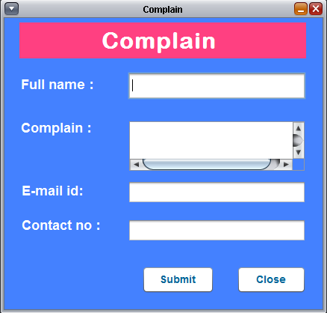
Complain

Slide 28
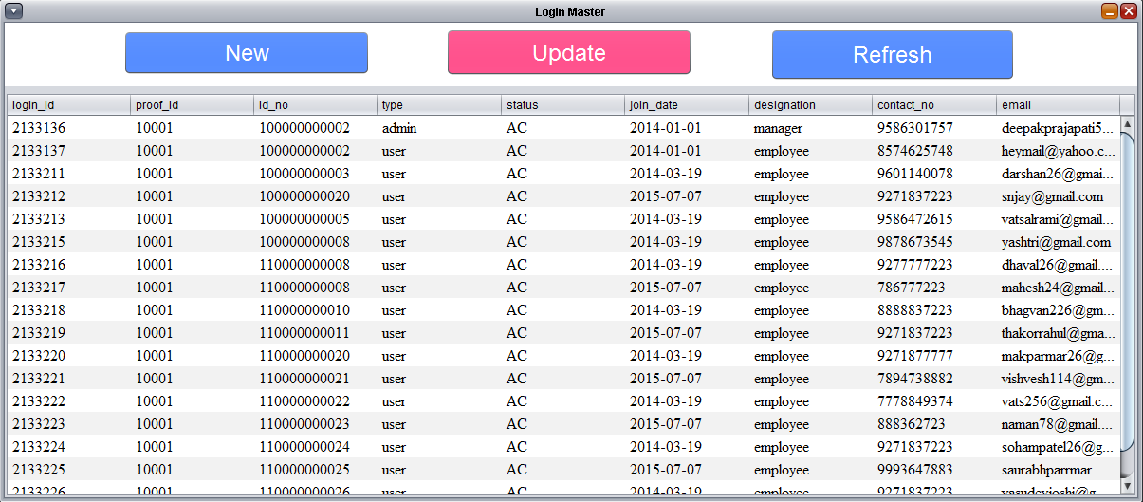
Login details (Admin)

Slide 29
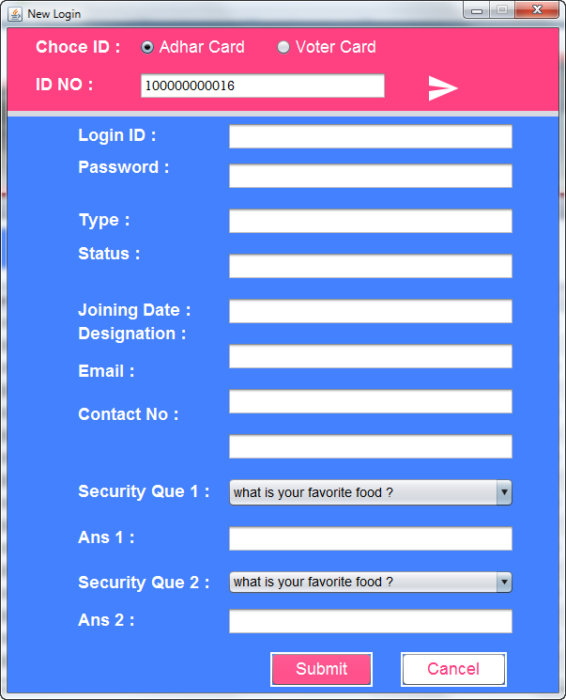
New login (Admin)

Slide 30
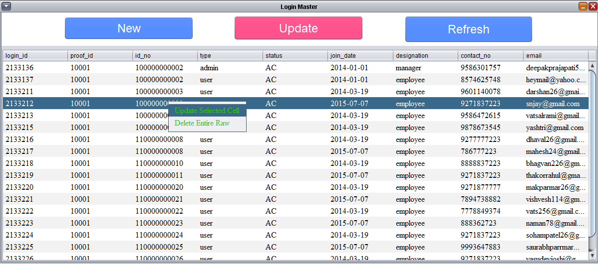
Update login details (Admin)

Slide 31
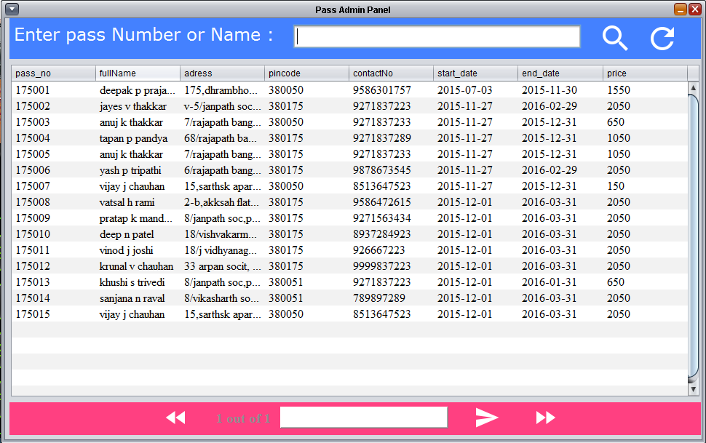
Created pass details

Slide 32
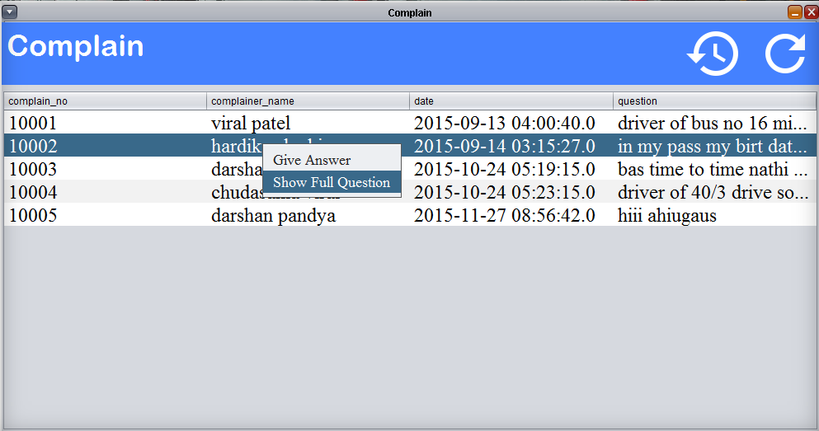
Answer of complain

Slide 33
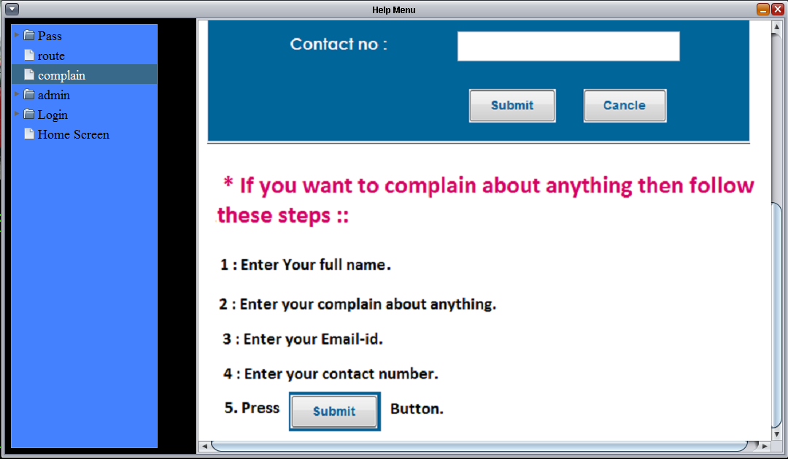
Help

Slide 34
Limitation & Future Enhancement
This system is an only in-house system.
That system is use only for employee or admin.
Application required access data of adhar-card , vote card, student registry.
As a scope is save the time of user for create pass for AMTS.

Slide 35
Conclusion
Reduce data redundancy and inconsistency.
Automation of the entire system improves the efficiency
Provides a friendly graphical user interface.
Gives appropriate access to authorized users and updating the information can be done easily.
System security, data security.
Adequate scope for future modification.

Slide 36
Thank You

