Slide 1
Chaotic Maps and Security Applications
Kajal Yadav
PhD Research — Cryptography in Quantum Computing

Slide 2
Part 1
Foundations of Chaotic Maps

Slide 3
What is a Chaotic Map?
▸ A chaotic map is a simple math formula that produces unpredictable results
▸ It is deterministic — same input always gives the same output
▸ But tiny changes in input lead to completely different outputs (chaos!)
▸ Think of it like weather: small changes today → big changes tomorrow
▸ Used in cryptography because the output looks random but is reproducible with a key
▸ Examples: Logistic Map, Tent Map, Hénon Map
2

Slide 4
Characteristics of Chaotic Maps
▸ Sensitivity to Initial Conditions (Butterfly Effect):
▸ — A 0.000001 change in starting value → completely different sequence
▸ Deterministic but Appears Random:
▸ — The formula is fixed, but output looks like noise to an observer
▸ Non-Linearity:
▸ — The relationship between input and output is not a straight line
▸ — This makes it impossible to 'reverse-engineer' the original input
▸ Bounded but Non-Repeating:
▸ — Values stay within a range but never follow the same pattern twice
3

Slide 5
Logistic Map — The Most Famous Chaotic Map
▸ Formula: x(n+1) = r × x(n) × (1 − x(n))
▸ x(n) = current value (between 0 and 1)
▸ r = growth rate (control parameter, between 0 and 4)
▸ When r is small (< 3): output settles to a fixed point — boring, predictable
▸ When r is medium (~3.5): output oscillates between 2 or 4 values
▸ When r is large (> 3.57): output becomes chaotic — completely unpredictable!
▸ This transition from order to chaos is what makes it useful for encryption
4

Slide 6
Behavior of the Logistic Map
▸ Stable Region (r < 3.0):
▸ — The sequence converges to a single value — no randomness
▸ Period Doubling (r ≈ 3.0 to 3.57):
▸ — Output oscillates: 2 values → 4 values → 8 values → ...
▸ — Like a heartbeat that gets more irregular
▸ Chaos Region (r > 3.57):
▸ — Output never repeats — appears completely random
▸ — This is the sweet spot for cryptographic applications
▸ Key Insight: by choosing r in the chaos region, we get a pseudo-random generator
5

Slide 7
Part 2
Visualizations & Analysis

Slide 8
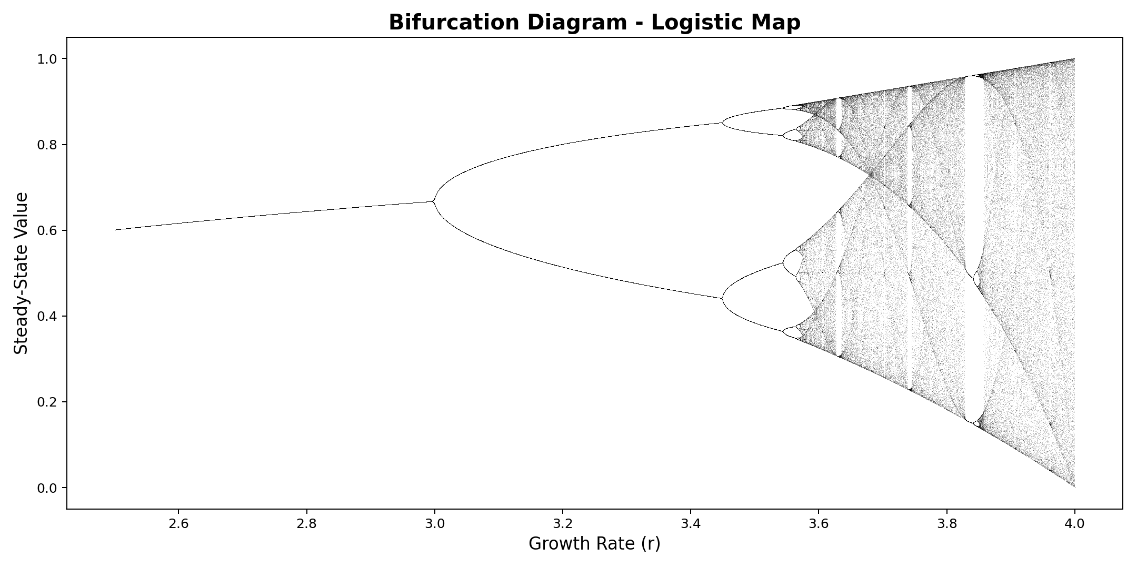
Bifurcation Diagram — Logistic Map
Shows the transition from order to chaos as growth rate r increases
7

Slide 9
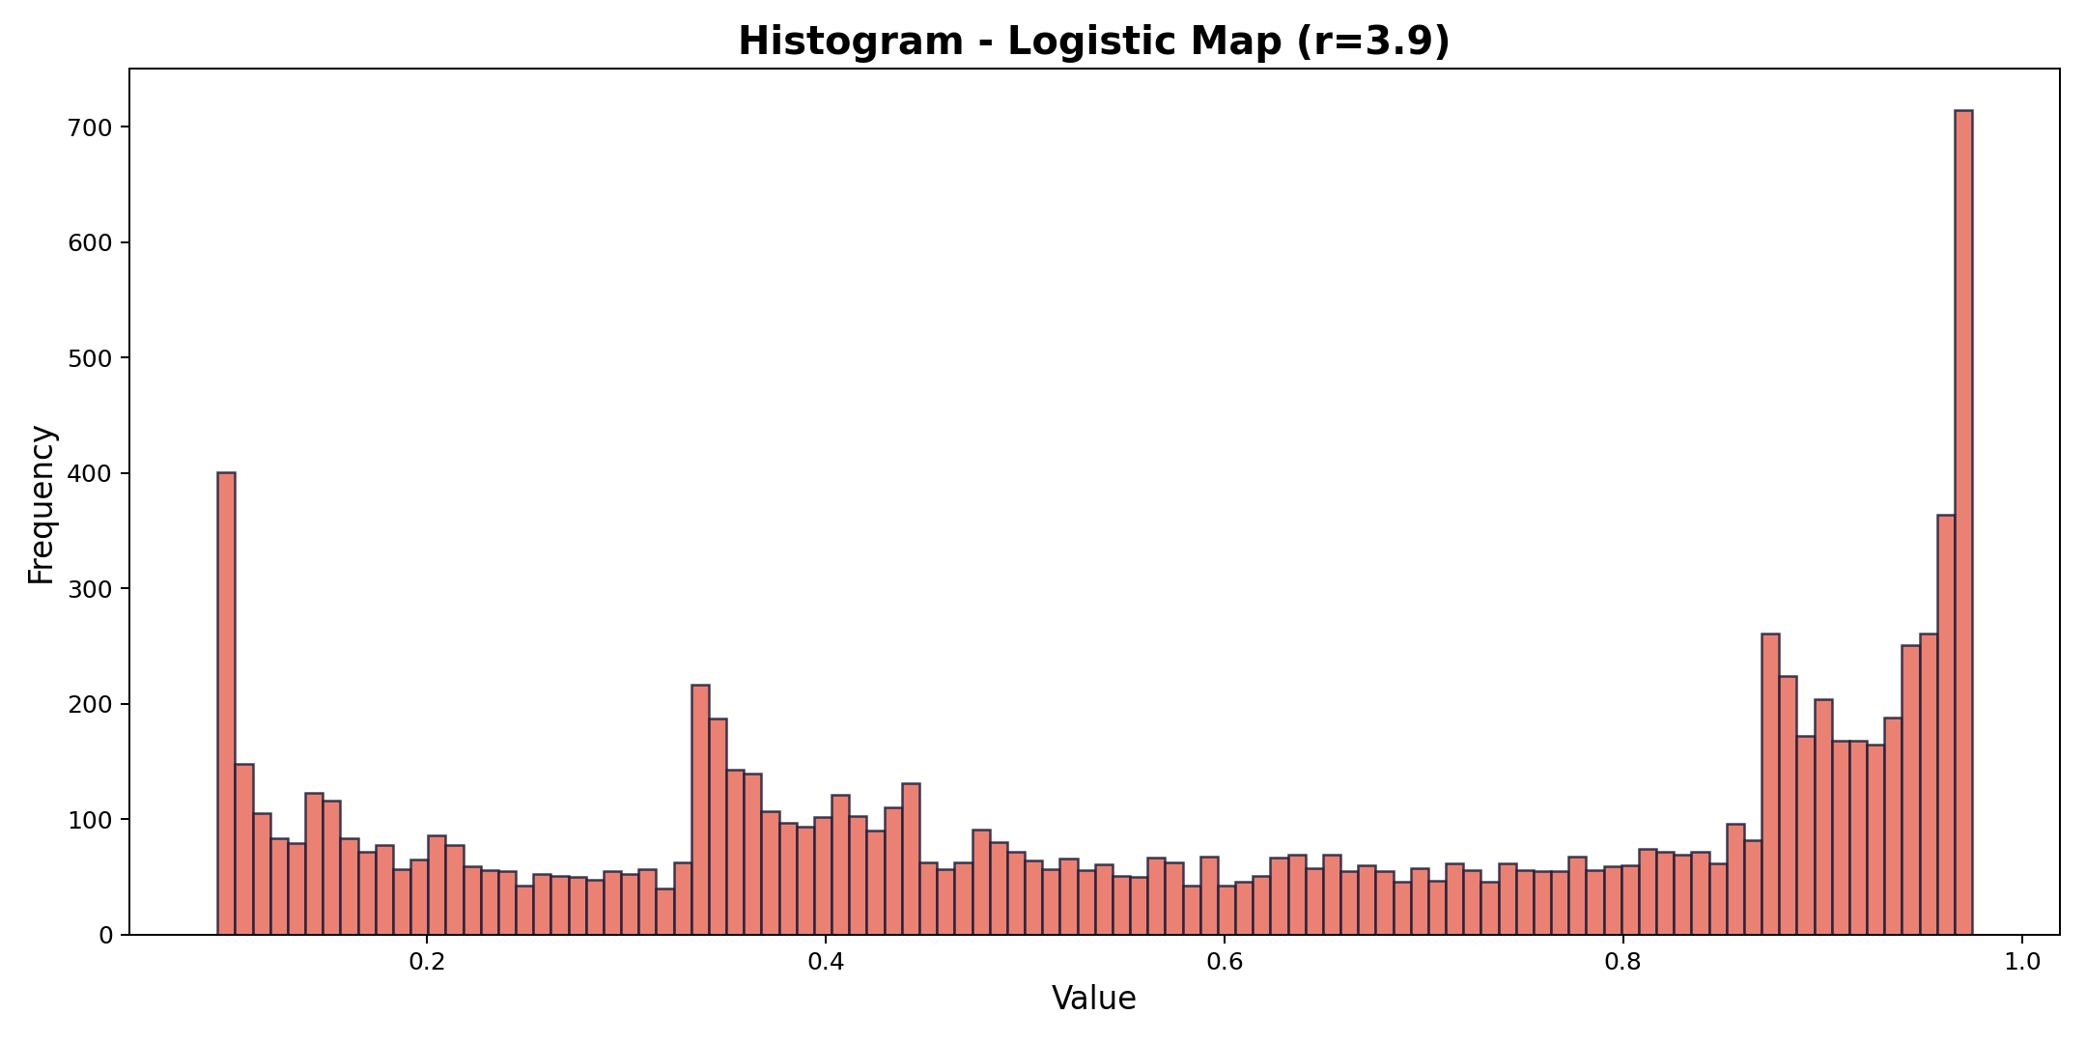
Histogram Analysis — Logistic Map (r=3.9)
Distribution of 10,000 iterations — near-uniform spread indicates good randomness
9

Slide 10
Tent Map — Simple but Powerful
▸ How it works: take a number between 0 and 1, then apply a simple rule:
▸ — If the number is below 0.5 → multiply it by μ (push it up)
▸ — If the number is 0.5 or above → multiply (1 − number) by μ (push it down)
▸ μ (mu) is the control knob — set it to 2 for maximum chaos
▸ Why 'Tent'? When you draw the formula on a graph, it looks like a tent ⛺
▸ Advantage: produces values that are more evenly spread than the Logistic Map
▸ Used together with Logistic Map to build stronger encryption systems
11

Slide 11
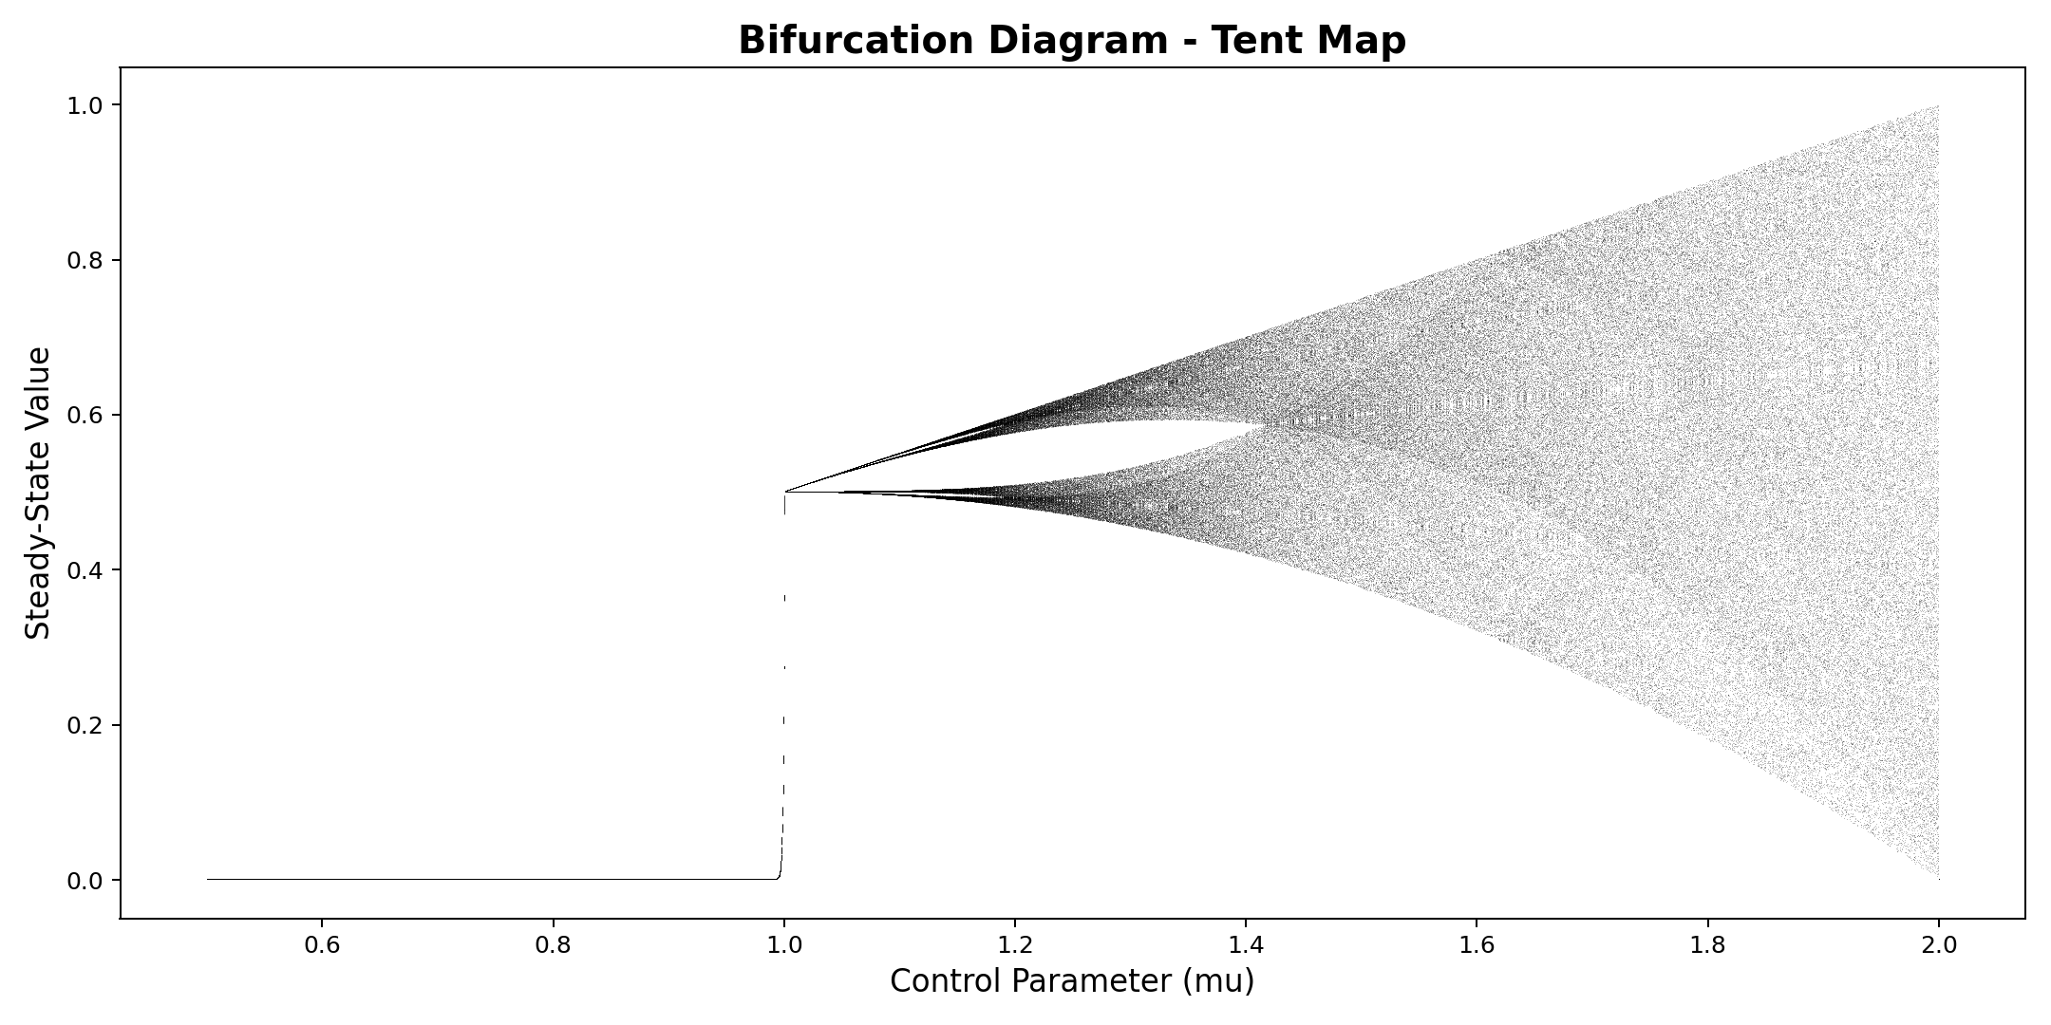
Bifurcation Diagram — Tent Map
Tent map exhibits a sharper transition to chaos compared to the logistic map
8

Slide 12
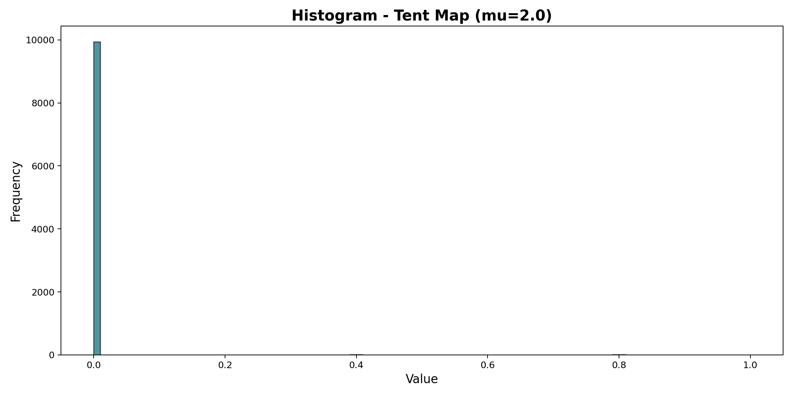
Histogram Analysis — Tent Map (μ=2.0)
Tent map produces a more uniform distribution than the logistic map
10

Slide 13
Code: Tent Map & Logistic Map
Python
import matplotlib.pyplot as plt
def logistic_map(growth_rate, current_value):
return growth_rate * current_value * (1 - current_value)
def tent_map(control_param, current_value):
if current_value < 0.5:
return control_param * current_value
else:
return control_param * (1 - current_value)
def generate_sequence(map_function, parameter, start_value, total_steps):
value = start_value
result = []
for step in range(total_steps):
value = map_function(parameter, value)
result.append(value)
return result
# Example
logistic_values = generate_sequence(logistic_map, 3.9, 0.5, 100)
tent_values = generate_sequence(tent_map, 2.0, 0.5, 100)
plt.plot(logistic_values, label="Logistic Map")
plt.plot(tent_values, label="Tent Map")
plt.legend()
plt.show()
12

Slide 14
Part 2
Security Evaluation

Slide 15
Intrinsic Mathematical Parameters
▸ These check if the chaos is strong enough to resist attacks:
▸ Lyapunov Exponent (λ):
▸ — Must be positive (λ > 0) — measures how fast nearby values diverge
▸ — Higher λ = faster divergence = harder to predict = more secure
▸ Key Space:
▸ — Must be ≥ 2¹²⁸ (128-bit equivalent) to resist brute-force attacks
▸ — Key = initial values (x₀, y₀) + control parameters (r, a, b)
▸ — Too few parameters or low precision → attacker can test all possibilities
▸ Bifurcation Range:
▸ — Must be wide and continuous — no 'periodic windows' (stability gaps)
▸ — If your key falls in a window, the 'random' sequence becomes a repeating loop!
14

Slide 16
Statistical Security Metrics — Overview
Parameter | What It Measures | Ideal Value
Information Entropy | Uncertainty / randomness of output | ≈ 8.0 (for 8-bit images)
Correlation Coefficient | How much a pixel relates to its neighbor | ≈ 0 (no relationship)
NPCR | % of pixels that change when 1 input pixel changes | > 99.6%
UACI | Average intensity of difference between outputs | ≈ 33.46%
Chi-Square (χ²) | Tests if distribution is truly uniform | χ² < Critical Value
PSNR (encrypted) | Signal distortion — higher = less distortion | Low value = good encryption
MSE (encrypted) | Average squared difference between plain & cipher | High value = good encryption
15

Slide 17
Entropy & Correlation — In Simple Words
▸ Information Entropy (How random is it?):
▸ — Think of a coin flip: heads/tails are equally likely → high entropy
▸ — A perfect encrypted image has entropy ≈ 8.0 (every pixel value 0–255 appears equally)
▸ — If entropy is low → some values repeat more → attacker can spot patterns
▸
▸ Correlation Coefficient (Are pixels related to their neighbors?):
▸ — In a normal photo, a pixel and its neighbor are almost the same color
▸ — After good encryption, neighboring pixels should have NO relationship (≈ 0)
▸ — If correlation is high → the image still has structure → encryption is weak
16

Slide 18
NPCR & UACI — Measuring the Avalanche Effect
▸ NPCR — Number of Pixels Change Rate:
▸ — Change just 1 pixel in the original image, then re-encrypt
▸ — How many pixels in the encrypted output are different? (should be > 99.6%)
▸ — If NPCR is low → changing input barely changes output → easy to reverse
▸
▸ UACI — Unified Average Changing Intensity:
▸ — Not just 'how many' pixels changed, but 'by how much' did they change?
▸ — Ideal value ≈ 33.46% — means changes are large and spread evenly
▸ — Together, high NPCR + high UACI = strong 'avalanche effect'
▸ — Like dominoes: one tiny push → everything changes dramatically
17

Slide 19
Chi-Square, PSNR & MSE — More Quality Checks
▸ Chi-Square (χ²) Test — Is it truly uniform?
▸ — Compares the encrypted output's distribution to a perfectly flat distribution
▸ — If χ² is small → distribution is uniform → good randomness ✓
▸
▸ PSNR — Peak Signal-to-Noise Ratio:
▸ — Measures how similar the encrypted image is to the original
▸ — For good encryption: PSNR should be LOW (they should look nothing alike)
▸
▸ MSE — Mean Squared Error:
▸ — Average squared difference between original and encrypted pixel values
▸ — For good encryption: MSE should be HIGH (big difference = strong scrambling)
18

Slide 20
Attack Resistance — How Secure Maps Defend Themselves
▸ A. Resistance to Statistical Attacks (Ergodicity):
▸ — Map must visit every possible value equally over time (no bias)
▸ — If biased (e.g., logistic map favors 0 and 1), attacker uses frequency analysis
▸ B. Resistance to Differential Attacks (Sensitivity):
▸ — Change 1 bit in original → encrypted version looks completely different
▸ — Measured by NPCR & UACI — low values mean attacker can compare files to find key
▸ C. Resistance to Finite Precision Effect:
▸ — Computers round numbers (64-bit float) → after 1000s of iterations, sequence can loop
▸ — Fix: use perturbation techniques or higher-dimensional maps to prevent degradation
19

Slide 21
Security Checklist — What Makes a Map 'Secure'
▸ ✓ Positive Lyapunov Exponent — high sensitivity to initial conditions
▸ ✓ Uniform Histogram — no statistical bias in the output
▸ ✓ Large Key Space — at least 128 bits (≥ 2¹²⁸ possible keys)
▸ ✓ No Periodic Windows — chaos must be continuous, no stability gaps
▸ ✓ High Entropy — close to the theoretical maximum (8.0 for 8-bit data)
▸ ✓ High NPCR & UACI — strong avalanche effect against differential attacks
▸ ✓ Resistant to Finite Precision — no degradation even after millions of iterations
21

Slide 22
Conclusion
▸ Chaotic maps are simple formulas that produce complex, unpredictable behavior
▸ The Logistic Map and Tent Map are powerful tools for generating pseudo-random sequences
▸ Key properties — sensitivity, non-linearity, and bounded chaos — make them ideal for encryption
▸ Security is validated through entropy, correlation, NPCR/UACI, and NIST tests
▸ A secure map must pass all intrinsic, statistical, and attack resistance checks
22

Slide 23
Thank You
Kajal Yadav
Questions & Discussion

