Slide 1
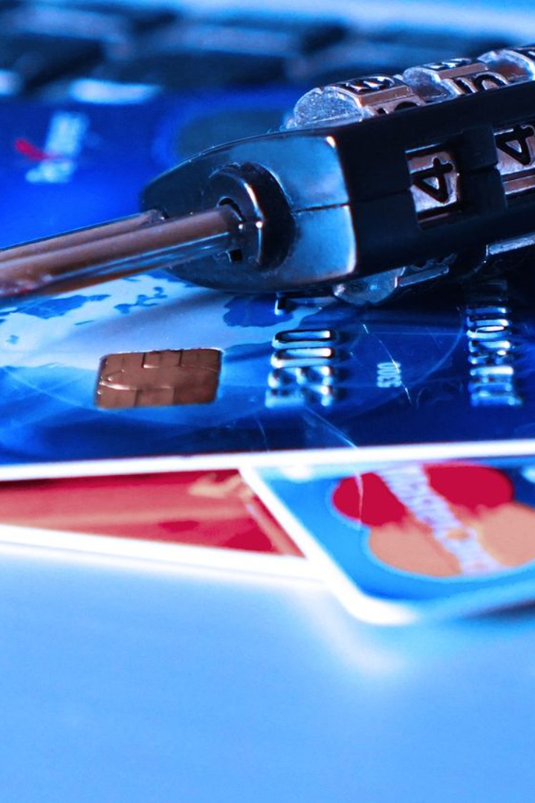
Credit Card Fraud Detection
From –Deepak Singh Panwar

Slide 2
Solution approach
1. Data understanding and exploring
2. Data cleaning
• Handling missing values
• Outliers treatment
3. Exploratory data analysis
• Univariate analysis
• Bivariate analysis
4. Prepare the data for modelling
• Check the skewness of the data and mitigate it for fair analysis
• Handling data imbalance as we see only 0.172% records are the fraud transactions
5. Split the data into train and test set
• Scale the data (normalization)
6. Model building
• Train the model with various algorithm such as Logistic regression, SVM, Decision Tree, Random forest, XGBoost etc.
• Tune the hyperparameters with Grid Search Cross Validation and find the optimal values of the hyperparameters
7. Model evaluation
• As we see that the data is heavily imbalanced, Accuracy may not be the correct measure for this particular case
• We have to look for a balance between Precision and Recall over Accuracy
• We also have to find out the good ROC score with high TPR and low FPR in order to get the lower number of misclassifications.

Slide 3
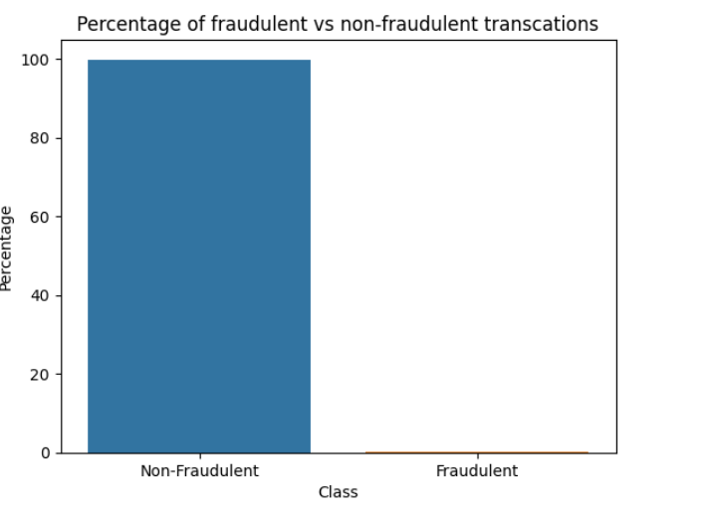
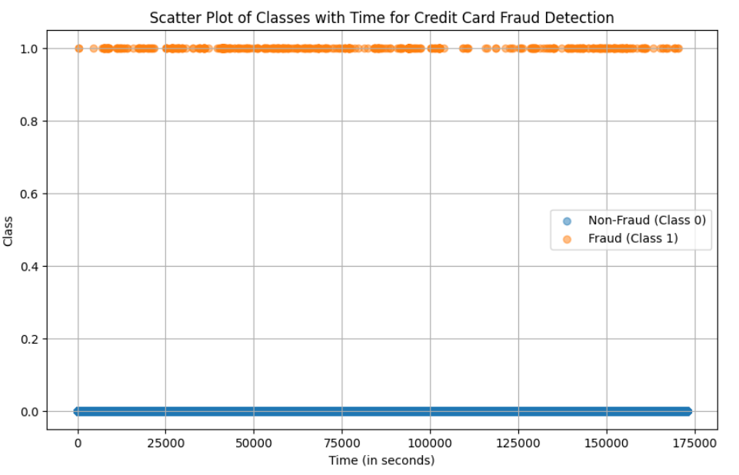
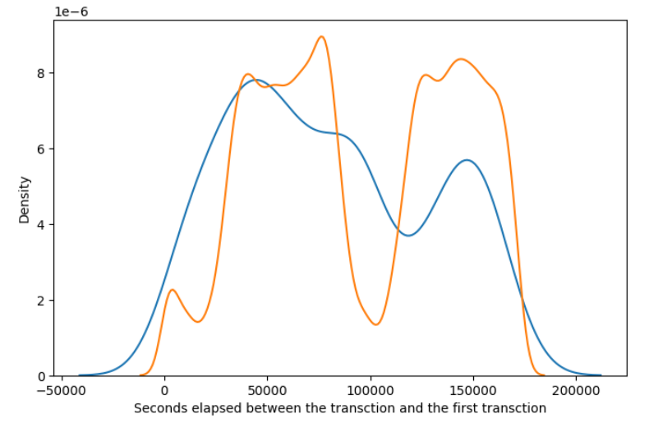
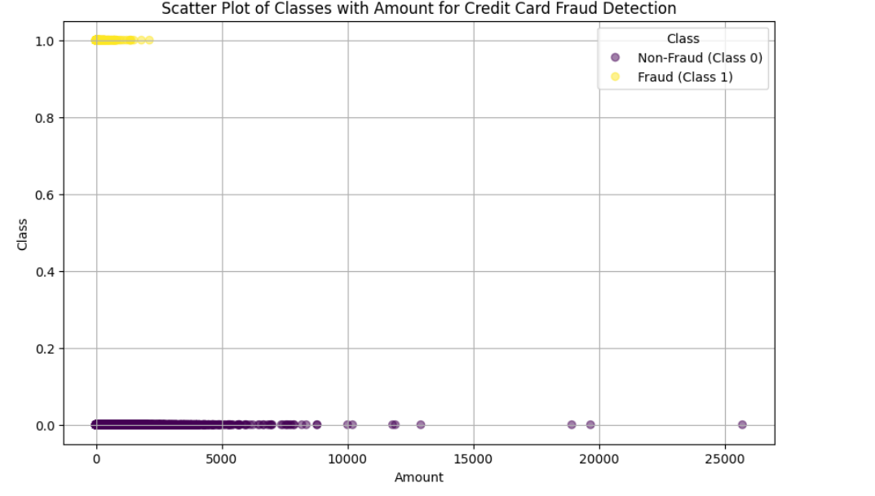
Exploratory data analysis
Analysis:
We do not see any specific pattern for the fraudulent and non-fraudulent transactions with respect to Time. Hence, we can drop the `Time` column.

Slide 4
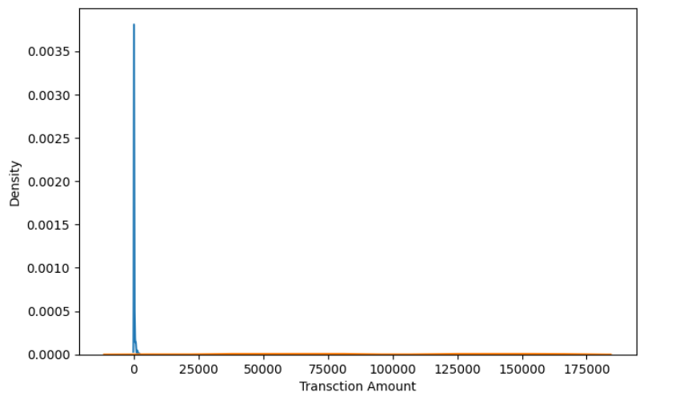
Observe the distribution of classes with amount
Analysis :
We can see that the fraudulent transactions are mostly densed in the lower range of amount, whereas the non-fraudulent transactions are spreaded throughout low to high range of amount.

Slide 5
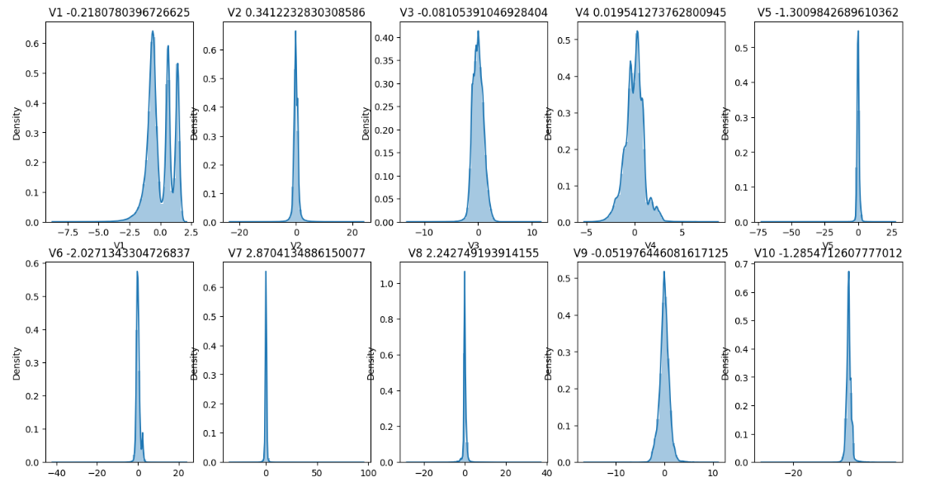
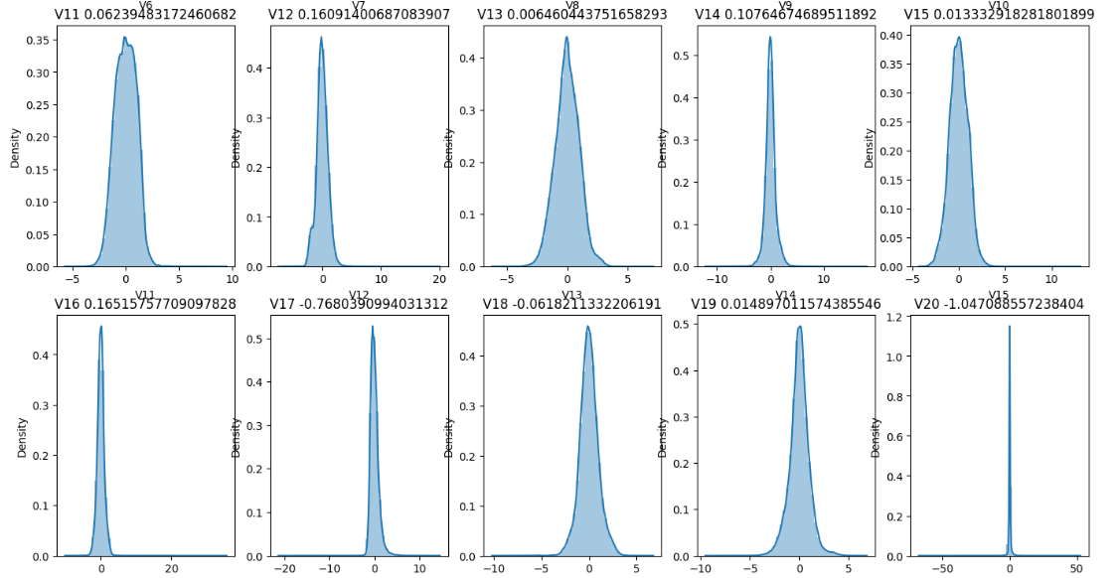
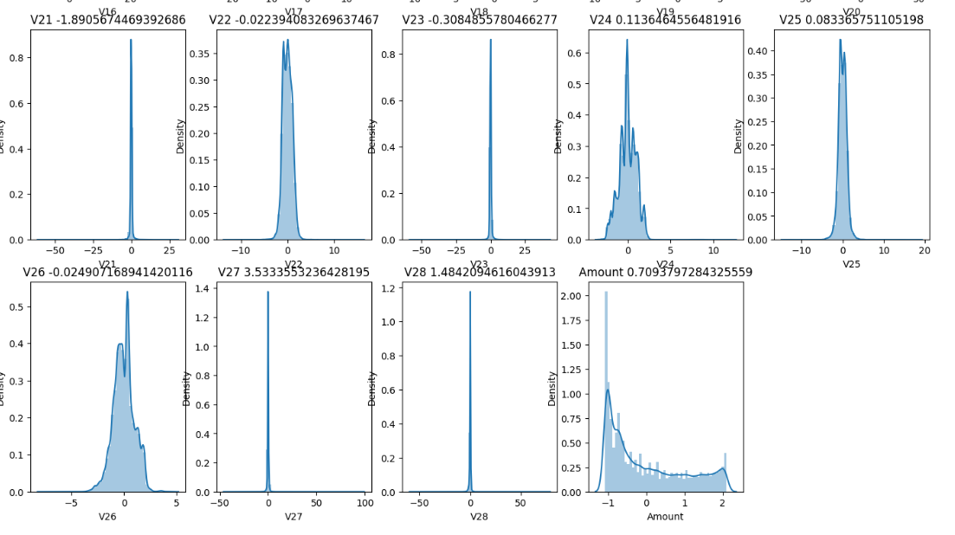
Mitigate skewness with Power Transformer
Analysis: we can see that all the variables are normally distributed after the transformation.

Slide 6
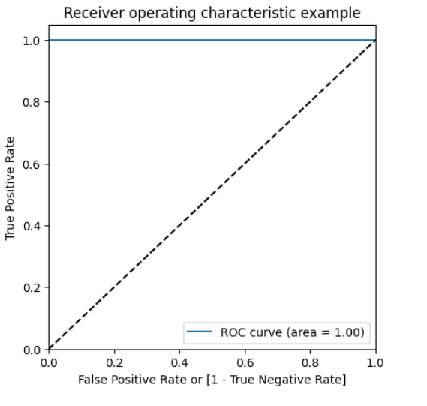
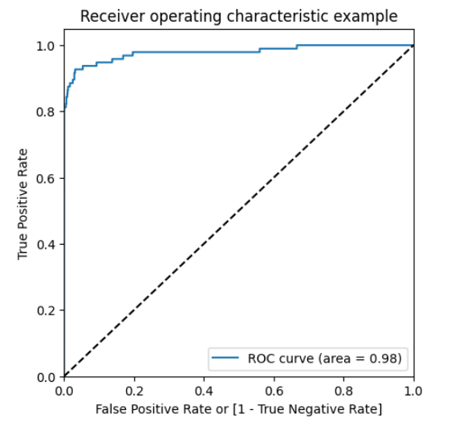
Choosing best model on the imbalanced data
On Train Data using XGBoost
On Test Data using XGBoost
We can see that among all the models we tried (Logistic, XGBoost, Decision Tree, and Random Forest), almost all of them have performed well. More specifically Logistic regression and XGBoost performed best in terms of ROC-AUC score.
But as we have to choose one of them, we can go for the best as `XGBoost`, which gives us ROC score of 1.0 on the train data and 0.98 on the test data.
Keep in mind that XGBoost requires more resource utilization than Logistic model. Hence building XGBoost model is more costlier than the Logistic model. But XGBoost having ROC score 0.98, which is 0.01 more than the Logistic model. The 0.01 increase of score may convert into huge amount of saving for the bank.

Slide 7
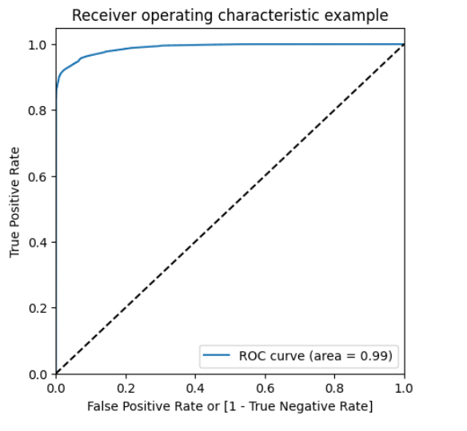
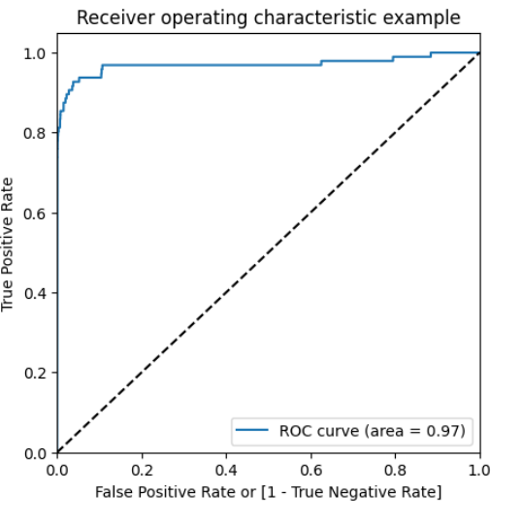
Choosing best model on the balanced data
On Train Data using Logistic Regression
On Test Data using Logistic Regression
He we balanced the data with various approach such as Undersampling, Oversampling, SMOTE and Adasyn. With every data balancing technique we built several models such as Logistic, XGBoost, Decision Tree, and Random Forest.
We can see that almost all the models performed more or less good. But we should be interested in the best model.
Though the Undersampling technique models performed well, we should keep mind that by doing the under sampling some information were lost. Hence, it is better not to consider the undersampling models.
Whereas the SMOTE and Adasyn models performed well. Among those models the simplest model Logistic regression has ROC score 0.99 in the train set and 0.97 on the test set. We can consider the Logistic model as the best model to choose because of the easy interpretation of the models and also the resourse requirements to build the model is lesser than the other heavy models such as Random forest or XGBoost.
Hence, we can conclude that the `Logistic regression model with SMOTE` is the best model for its simplicity and less resource requirement.

Slide 8
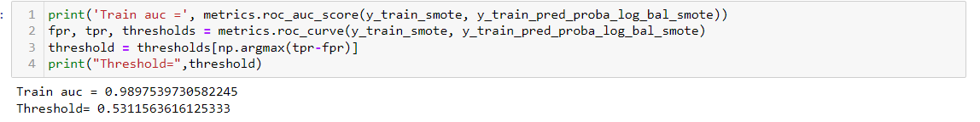
Print the FPR,TPR & select the best threshold from the roc curve for the best model
We can see that the threshold is 0.53, for which the TPR is the highest and FPR is the lowest and we got the best ROC score.

Slide 9
Cost benefit analysis
We have tried several models till now with both balanced and imbalanced data. We have noticed most of the models have performed more or less well in terms of ROC score, Precision and Recall.
But while picking the best model we should consider few things such as whether we have required infrastructure, resources or computational power to run the model or not. For the models such as Random forest, SVM, XGBoost we require heavy computational resources and eventually to build that infrastructure the cost of deploying the model increases. On the other hand the simpler model such as Logistic regression requires less computational resources, so the cost of building the model is less.
We also have to consider that for little change of the ROC score how much monetary loss of gain the bank incur. If the amount if huge then we have to consider building the complex model even though the cost of building the model is high.

Slide 10
Summary to the business
For banks with smaller average transaction value, we would want high precision because we only want to label relevant transactions as fraudulent. For every transaction that is flagged as fraudulent, we can add the human element to verify whether the transaction was done by calling the customer. However, when precision is low, such tasks are a burden because the human element has to be increased.
For banks having a larger transaction value, if the recall is low, i.e., it is unable to detect transactions that are labelled as non-fraudulent. So we have to consider the losses if the missed transaction was a high-value fraudulent one.
So here, to save the banks from high-value fraudulent transactions, we have to focus on a high recall in order to detect actual fraudulent transactions.
After performing several models, we have seen that in the balanced dataset with SMOTE technique the simplest Logistic regression model has good ROC score and also high Recall. Hence, we can go with the logistic model here. It is also easier to interpret and explain to the business.

