Slide 1

IPL Auction Strategy
Created BY : Deepak

Slide 2
Create Tables Queries
Ball Data Query
CREATE TABLE ball_data (id int, inning INT, over INT, ball INT, batsman VARCHAR(255), non_striker VARCHAR(255), bowler VARCHAR(255), batsman_runs INT, extra_runs INT, total_runs INT, is_wicket BOOLEAN, dismissal_kind VARCHAR(255), player_dismissed VARCHAR(255), fielder VARCHAR(255), extras_type VARCHAR(255), batting_team VARCHAR(255), bowling_team VARCHAR(255));
Import data from Csv file
copy ball_data from 'C:\Program Files\PostgreSQL\16\data\Data\IPL Dataset\IPL_Ball.csv' delimiter ','csv header;
Query to Retrieve Data
select * from ball_data;

Slide 3
Match Data Query
CREATE TABLE match_data (id integer, city varchar(255), date date, player_of_match varchar(255), venue varchar(255), neutral_venue int, team1 varchar(255), team2 varchar(255), toss_winner varchar(255), toss_decision varchar(255), winner varchar(255), result varchar(255), result_margin varchar(255), eliminator varchar(255), method varchar(255), umpire1 varchar(255), umpire2 varchar(255));
Import Data From Csv file
copy matches from 'C:\Program Files\PostgreSQL\16\data\Data\IPL Dataset\IPL_matches.csv' delimiter ','csv header;
Query to Retrieve Data
select * from match_data;

Slide 4
High Strike Rate (SR) with a minimum of 500 balls faced
Select batsman,round(sum(batsman_runs)*1.0/count(ball)*100,2) as strike_rate from ball_data where extras_type not in ('wides',)group by batsman having count(ball ) > 500 order by strike_rate des limit 10;
Batsman | Strike Rate
AD Russell | 182.33
SP Narine | 164.27
HH Pandya | 159.27
V Sehwag | 155.44
GJ Maxwell | 154.68
RR Pant | 151.97
AB de Villiers | 151.91
CH Gayle | 150.11
KA Pollard | 149.88
JC Buttler | 149.56

Slide 5
High Batting Average with experience of playing at least 2 IPL seasons
select batsman, round(sum(batsman_runs):: decimal /sum(case when is_wicket then 1 else 0 end),2) as average from ball_data as a full join match_data as b on a.id = b.id group by batsman having sum(case when is_wicket then 1 else 0 end) >= 1 and count(distinct extract(year from b.date)) > 2 order by average desc limit 10;
Batsman | Average
Iqbal Abdulla | 88
KL Rahul | 42.69
AB de Villiers | 42.54
DA Warner | 41.7
JP Duminy | 41.41
CH Gayle | 41.14
ML Hayden | 41
LMP Simmons | 39.96
KS Williamson | 39.49
OA Shah | 38.92

Slide 6
High Boundary Percentage with experience of playing at least 2 IPL seasons.
select batsman, round(sum(case when batsman_runs in (4,6) then batsman_runs else 0 end)::decimal/sum(batsman_runs)*100,2) as boundary_percentage from ball_data group by batsman having count(distinct id ) > 28 order by boundary_percentage desc limit 10;
Batsman | Boundary Percentage
SP Narine | 81.17
AD Russell | 78.71
CH Gayle | 76.07
ST Jayasuriya | 74.22
AC Gilchrist | 72.89
V Sehwag | 72.29
DR Smith | 70.52
CA Lynn | 69.53
Harbhajan Singh | 68.52
SR Watson | 68.25

Slide 7
Low Economy Rate with at least 500 balls bowled in IPL.
select bowler, round(sum(total_runs)::decimal / (count(ball) / 6.0), 2) as economy from ball_data group by bowler having count(ball) > 500 order by economy asc limit 10;
Bowler | Economy
Rashid Khan | 6.33
A Kumble | 6.65
M Muralitharan | 6.68
DW Steyn | 6.77
R Ashwin | 6.77
SP Narine | 6.82
DL Vettori | 6.83
Washington Sundar | 6.89
J Botha | 6.92
R Tewatia | 6.99

Slide 8
Low Bowling Strike Rate with at least 500 balls bowled in IPL
select bowler, round(count(is_wicket)::decimal/sum(case when is_wicket then 1 else 0 end),2) as strike_rate from ball_data group by bowler having count(is_wicket) > 500 order by strike_rate asc limit 10;
Bowler | Strike Rate
K Rabada | 12.73
DE Bollinger | 13.95
AJ Tye | 14.33
MA Starc | 15.69
SL Malinga | 15.82
Imran Tahir | 15.83
DJ Bravo | 16.26
A Nehra | 16.31
S Aravind | 16.42
KK Cooper | 16.67

Slide 9
All-Roundars with at least 500 balls faced and 300 balls bowled in IPL
Create Table batting_sr
create table batting_sr as select batsman, round(sum(batsman_runs)*1.0/count(ball)*100,2) as strike_rate from ball_data where extras_type not in ('wides')group by batsman having count(ball ) > 500order by strike_rate desc;
Create Table bowling_sr
create table bowling_sr as select bowler, round(count(is_wicket)::decimal/sum(case when is_wicket then 1 else 0 end),2) as strike_rate from ball_data group by bowler having count(is_wicket) > 300 order by strike_rate asc;
select a.batsman, a.strike_rate as batting_strike_rate, b.strike_rate as bowling_strike_rate from batting_sr as a inner join bowling_sr as b on a.batsman = b.bowler order by batting_strike_rate desc, bowling_strike_rate asc limit 10;
Batsman | Batting Strike Rate | Bowling Strike Rate
AD Russell | 182.33 | 17.7
SP Narine | 164.27 | 19.75
HH Pandya | 159.27 | 20.31
GJ Maxwell | 154.68 | 27.9
CH Gayle | 150.11 | 30.74
KA Pollard | 149.88 | 19.92
ST Jayasuriya | 144.36 | 18.81
YK Pathan | 142.97 | 25.74
KH Pandya | 142.45 | 26.18
JA Morkel | 141.98 | 18.82

Slide 10
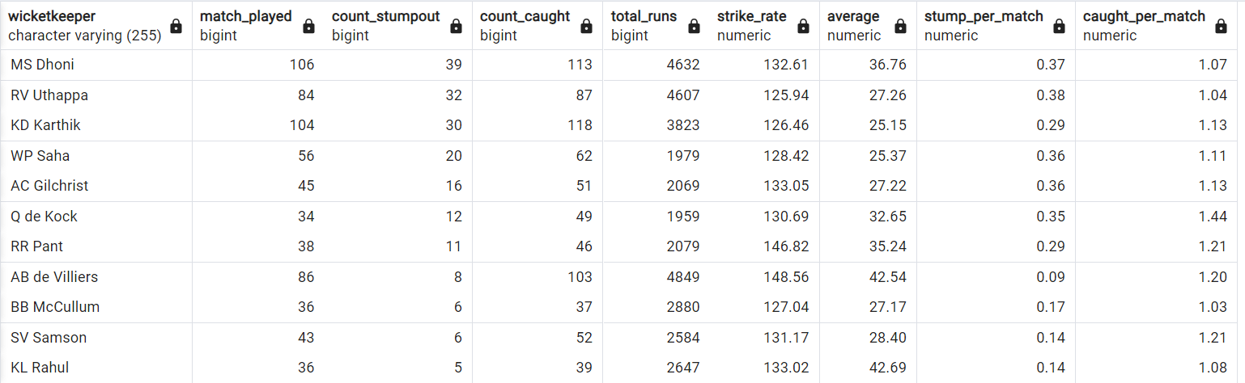
First find Criteria for Choosing the Two Best Wicketkeepers from given data
Select w.wicketkeeper,w.match_played,w.count_stumpout,w.count_caught,r.total_runs,r.strike_rate,r.average,round(cast(w.count_stumpout as numeric(10,2))/ w.match_played,2) as stump_per_match,round(cast(w.count_caught as numeric(10,2))/ w.match_played,2) as caught_per_match from wicketkeeper as w join wicketkeeper_runs as r on w.wicketkeeper = r.wicketkeeper where match_played > 15 and count_stumpout > 1 and strike_rate > 125order by count_stumpout desc;

Slide 11
Criteria for Choosing the Two Best Wicketkeeper
After analyzing IPL data criteria for best wicketkeeper
Batting Ability: Give Priority to those wicketkeepers who can score quickly and hit boundaries, contributing to the team's run total.
Batting strike rate > 130 and Batting Average > 35
Wicketkeeping skills: Strong wicketkeeping skills are important. Look for wicketkeepers with quick reflexes, clean catching ability, and accurate stumpings.
Stumps > 10 and caught > 30
Experience : Focus on those wicketkeepers who have played in the IPL or similar high-pressure T20 tournaments. Experience in handling pressure in crucial situations and also should have experience to play with lower order batsman
Also have experience to played minimum 2 IPL season.
Match played > 30 and Total runs > 1500
Leadership and Communication: Wicketkeepers who can lead the fielding unit and effectively communicate with bowlers and fielders are valuable and also should have great instinct to take DRS.
Consistency: Look for wicketkeepers with a consistent track record, both in batting and wicketkeeping, to ensure stable performance throughout the tournament

Slide 12
Get the count of cities that have hosted an IPL match
select count(distinct city) as count_of_cities
from match_data;
Count of cities
33

Slide 13
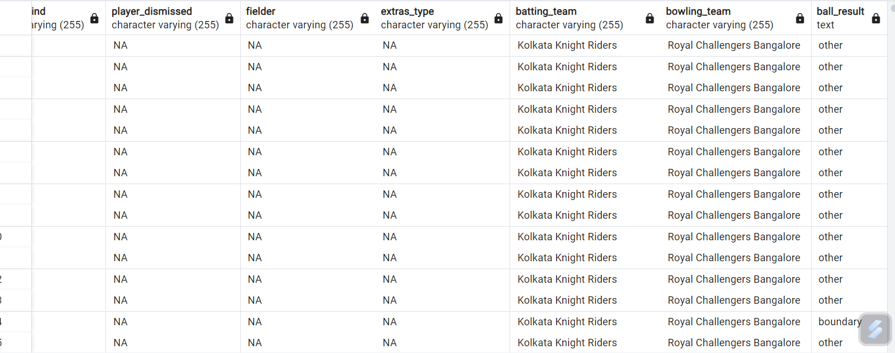
Create table deliveries_v02
create table deliveries_v02 as
select * , case
when total_runs >=4 then 'boundary’ when total_runs= 0 then 'dots’
else 'other’
end as ball_result
from ball_data;

Slide 14
Write a query to fetch the total number of boundaries and dot balls from the deliveries_v02 table
select ball_result as boundary_dot_ball ,
count(*) as total_boundary_dots
from deliveries_v02
where ball_result in ('boundary','dot’)
group by ball_result;
Boundary & Dot Ball | Total Boundary Dots
boundary | 31468
dot | 67841

Slide 15
Write a query to fetch the total number of boundaries scored by each team from the deliveries_v02 table
select distinct batting_team as team,
count(ball_result) as count_of_boundary_each_team
from deliveries_v02
where ball_result = 'boundary’
group by batting_team
order by count_of_boundary_each_team desc;
Teams | Count of boundary each team
Mumbai Indians | 4118
Royal Challengers Bangalore | 3800
Kings XI Punjab | 3780
Kolkata Knight Riders | 3739
Chennai Super Kings | 3496
Rajasthan Royals | 3041
Delhi Daredevils | 3022
Sunrisers Hyderabad | 2306
Deccan Chargers | 1387
Pune Warriors | 733
Delhi Capitals | 659
Gujarat Lions | 624
Rising Pune Supergiant | 290
Rising Pune Supergiants | 242
Kochi Tuskers Kerala | 231

Slide 16
Write a query to fetch the total number of dot balls bowled by each team
select distinct batting_team as team,
count(ball_result) as count_of_dotBall_each_team
from deliveries_v02
where ball_result = 'dot’
group by batting_team
order by count_of_dotBall_each_team desc;
Teams | Count dot balls
Mumbai Indians | 8756
Kolkata Knight Riders | 8017
Royal Challengers Bangalore | 7988
Kings XI Punjab | 7858
Chennai Super Kings | 7389
Rajasthan Royals | 6762
Delhi Daredevils | 6592
Sunrisers Hyderabad | 4944
Deccan Chargers | 3227
Pune Warriors | 2099
Delhi Capitals | 1324
Gujarat Lions | 1153
Rising Pune Supergiant | 616
Kochi Tuskers Kerala | 595
Rising Pune Supergiants | 521

Slide 17
Write a query to fetch the total number of dismissals by dismissal kinds where dismissal kind is not NA
select dismissal_kind as dismissal_type
count (dismissal_kind) as count
from ball_data
where dismissal_kind != 'NA’
group by dismissal_kind
order by dismissals desc;
Dismissal type | Count
caught | 5743
bowled | 1700
run out | 893
lbw | 571
stumped | 294
caught and bowled | 269
hit wicket | 12
retired hurt | 11
obstructing the field | 2

Slide 18
Write a query to get the top 5 bowlers who conceded maximum extra runs
select bowler,
sum(extra_runs) as extra_runs
from ball_data
group by bowler
order by extra_runs desc
limit 5;
Bowler | Extra Runs
SL Malinga | 293
P Kumar | 236
UT Yadav | 226
DJ Bravo | 210
B Kumar | 201

Slide 19
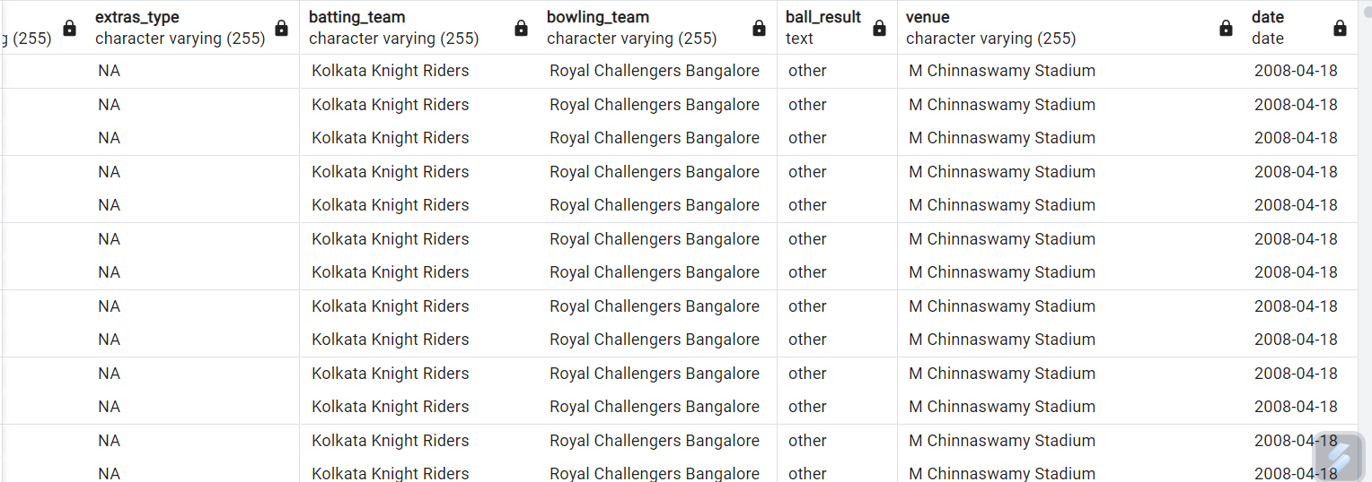
Write a query to create a table named deliveries_v03 with all the columns of deliveries_v02 table and two additional column (named venue and match_date) of venue and date from table matches
create table deliveries_v03 as select a.*, b.venue, b.Date
from deliveries_v02 as a
full join match_data as b
on a.id = b.id;

Slide 20
Write a query to fetch the total runs scored for each venue
Venue | Total runs
Eden Gardens | 23658
Wankhede Stadium | 23390
Feroz Shah Kotla | 22947
M Chinnaswamy Stadium | 20237
Rajiv Gandhi International Stadium, Uppal | 19484
MA Chidambaram Stadium, Chepauk | 17821
Sawai Mansingh Stadium | 14264
Punjab Cricket Association Stadium, Mohali | 10987
Dubai International Cricket Stadium | 10402
Sheikh Zayed Stadium | 8830
Punjab Cricket Association IS Bindra Stadium, Mohali | 7021
Maharashtra Cricket Association Stadium | 6780
Sharjah Cricket Stadium | 5924
M.Chinnaswamy Stadium | 5127
Dr DY Patil Sports Academy | 4810
Subrata Roy Sahara Stadium | 4755
Kingsmead | 4353
Brabourne Stadium | 3842
Dr. Y.S. Rajasekhara Reddy ACA-VDCA Cricket Stadium | 3746
Sardar Patel Stadium, Motera | 3746
SuperSport Park | 3653
Saurashtra Cricket Association Stadium | 3316
Himachal Pradesh Cricket Association Stadium | 2897
Holkar Cricket Stadium | 2872
New Wanderers Stadium | 2292
Barabati Stadium | 2278
JSCA International Stadium Complex | 2056
St George's Park | 2033
Newlands | 1764
Shaheed Veer Narayan Singh International Stadium | 1741
Nehru Stadium | 1363
Green Park | 1298
De Beers Diamond Oval | 897
Vidarbha Cricket Association Stadium, Jamtha | 882
Buffalo Park | 799
OUTsurance Oval | 529
select venue,
sum(total_runs) as total_runs
from deliveries_v03
group by venue
order by total_runs desc;

Slide 21
Write a query to fetch the year-wise total runs scored at Eden Gardens
select extract('year'from date) as season,
sum(total_runs) as total_runs
from deliveries_v03
where venue = 'Eden Gardens’
group by season
order by total_runs desc;
Season | Total runs
2018 | 2885
2019 | 2651
2015 | 2386
2013 | 2304
2017 | 2194
2010 | 2167
2016 | 2073
2012 | 2012
2011 | 1854
2008 | 1843
2014 | 1289

