Slide 1


Customer Shopping Behavior Analysis
Uncovering insights from transactional data to guide strategic business decisions.

Slide 2




Project Overview & Dataset Summary
Project Goal
Dataset Size
Analyze 3,900 purchases to understand spending patterns, segments, and preferences.
3,900 Rows, 18 Columns. Missing data (37 values).
Key Features
Demographics, Purchase Details, Subscription Status, and Shopping Behavior.

Slide 3




Exploratory Data Analysis (EDA) in Python
Cleaning & Imputation
Data Preparation
Handled missing Review Rating values using median per product category.
Load data, check structure df.info(), and summary statistics df.describe().
Integration
Feature Engineering
Loaded cleaned DataFrame into MySQL for structured SQL analysis.
Created age_group and purchase_frequency_days columns.

Slide 4
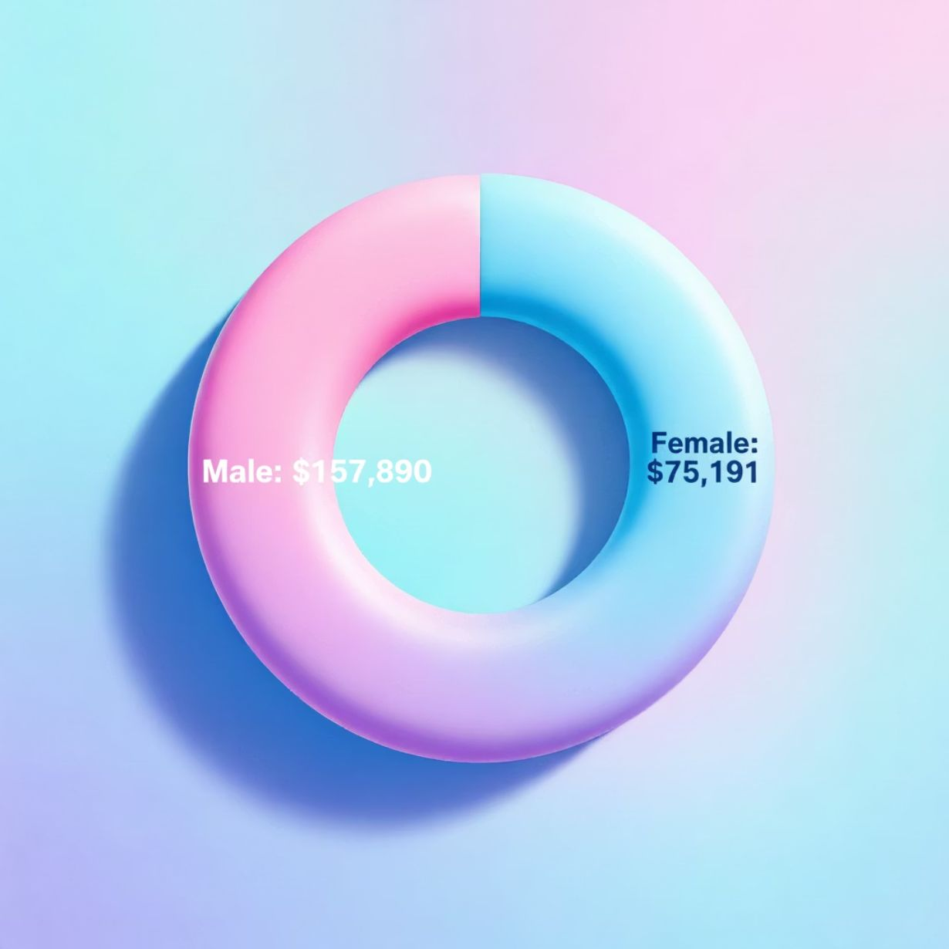
SQL Analysis: Revenue & Spending
Revenue by Gender
High-Spending Discount Users
Compared total revenue generated by male vs. female customers.
Identified customers who used discounts but still spent above the average purchase amount.
Average spent : $59.76
Number of customer who spend more than Average spend: 1963
Example: Customer 4 spent $90, Customer 9 spent $97.
Shipping Type Comparison
Express shipping users have a higher average purchase amount.
Express: ~ $60.48
Standard: ~ $58.46

Slide 5

SQL Analysis: Product Performance
Top 5 Products by Rating
Top 3 Products per Category
Gloves: 3.86
Clothing: Blouse, Pants, Shirt
Sandals: 3.84
Outerwear: Jacket, Coat
Boots: 3.82
Accessories: Jewelry, Sunglasses, Belt
Hat: 3.8
Clothing: Blouse, Pants, Shirts
Skirt: 3.78

Slide 6
SQL Analysis: Subscription & Loyalty
Subscribers vs. Non-Subscribers
Repeat Buyers & Subscriptions
Non-subscribers have a slightly higher average spend, but subscribers drive significant total revenue.
Customers with >5 purchases are more likely to be subscribers (958 Yes vs. 2518 No).
Customer Segmentation
Classified customers based on purchase history:
3116
701
83
Loyal
Returning
New
Highest segment count.
Mid-level engagement.
Smallest segment.

Slide 7
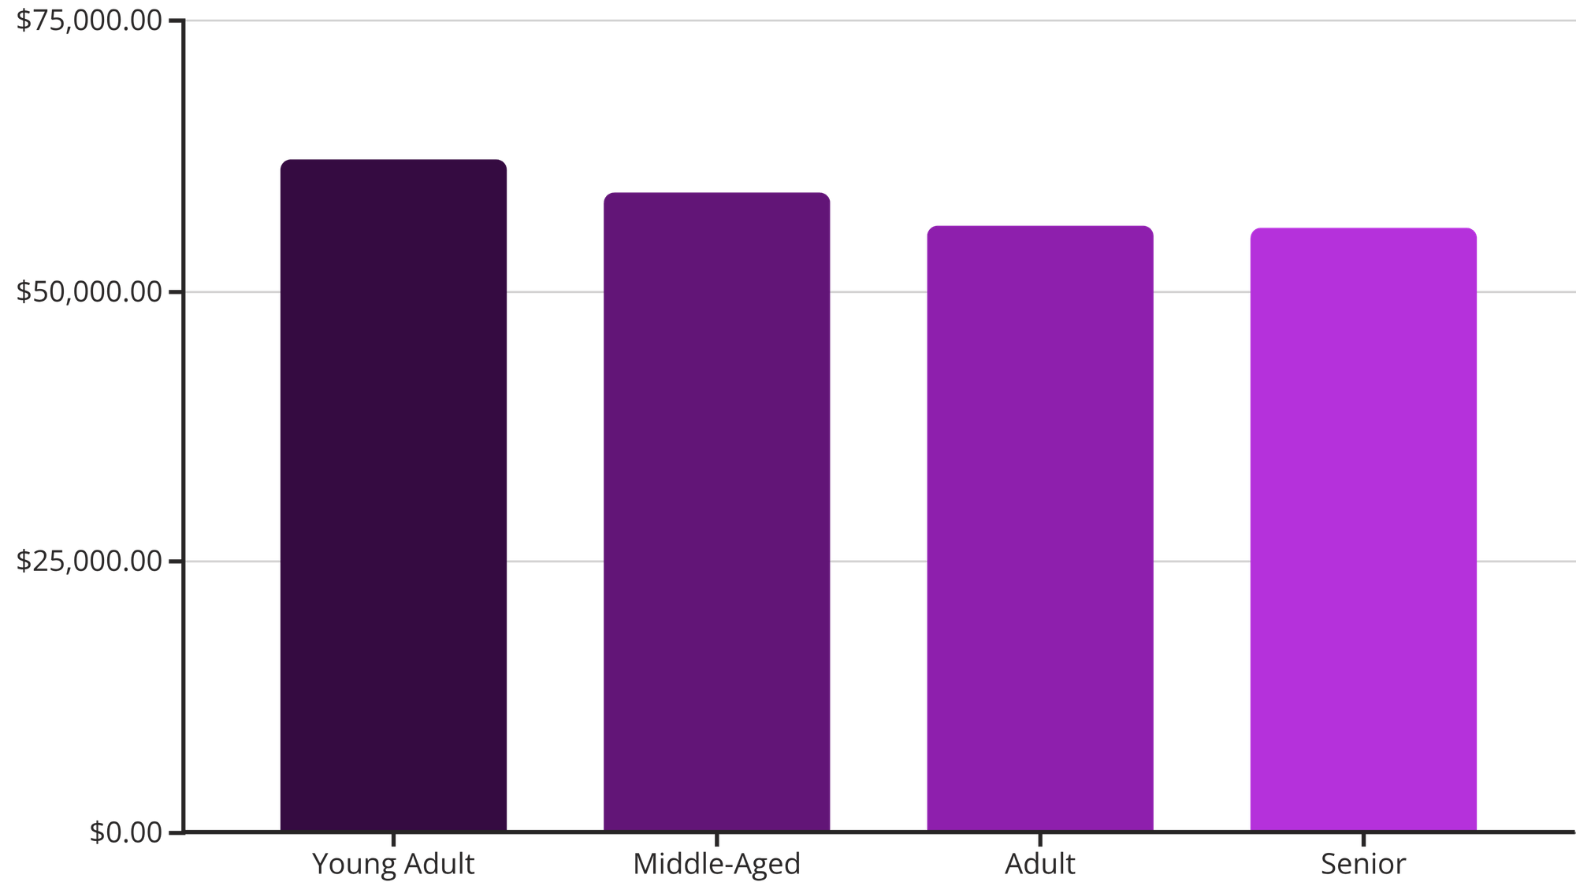
Revenue Contribution by Age Group
Understanding which age groups generate the most total revenue.
Young Adults and Middle-Aged customers are the highest revenue contributors.

Slide 8
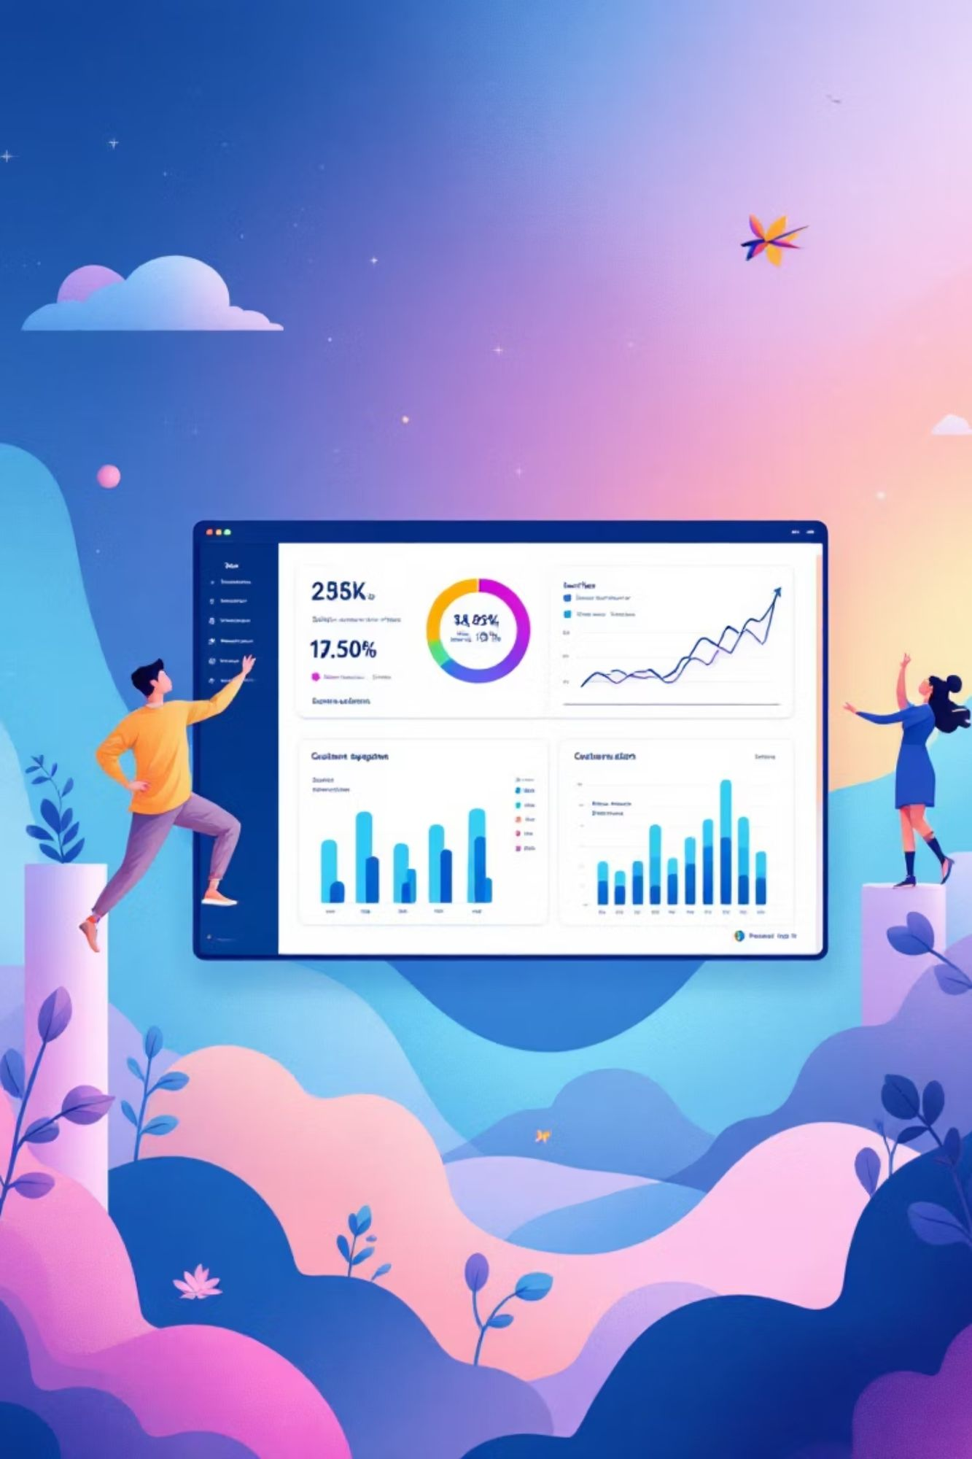

Visualizing Insights: Power BI Dashboard
Interactive dashboard built to present key findings visually and facilitate deeper exploration.
The dashboard integrates all Python and SQL analysis for real-time decision support.

Slide 9
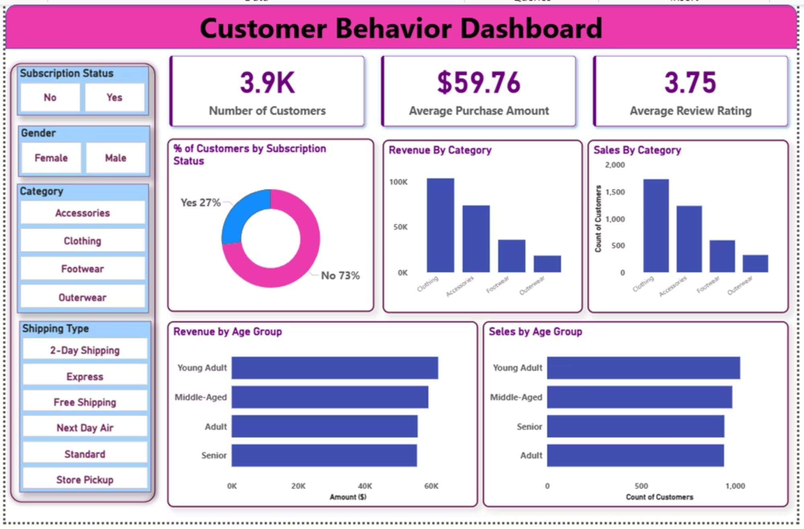
Customer Behavior Dashboard

Slide 10


Key Business Recommendations
Boost Subscriptions
Promote exclusive benefits to increase subscriber base and retention.
Customer Loyalty
Implement programs to reward repeat buyers and move them to the "Loyal" segment.
Review Discount Policy
Optimize discount strategy to balance sales volume with profit margins.

Slide 11

Targeted Marketing & Product Focus
Targeted Marketing
Product Positioning
Focus efforts on high-value segments:
Highlight top-rated and best-selling items in campaigns to leverage social proof.
High-revenue age groups (Young Adult, Middle-Aged).
Express-shipping users (higher average spend).
Top-Rated Items
Gloves, Sandals, Boots, Hat, Skirt.
Best-Selling Items
Jewelry, Sunglasses, Belt, Blouse, Pants, Shirts, Sandals,
Shoes, Sneakers, Jacket, Coat.

