Slide 1
Parallel Simulation of Large-Scale Heterogeneous Communication Systems
PI: Rajive Bagrodia
rajive@cs.ucla.edu
Senior Dev Engr: Dr. Mineo Takai
mineo@cs.ucla.edu
Computer Science Department
UCLA
Partial support from DARPA

Slide 2

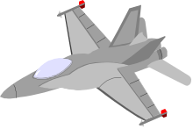

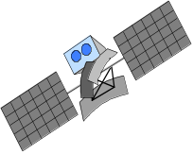


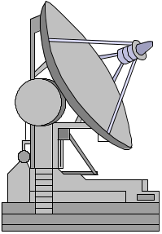


Generic Warfighter’s Information Network (WIN) Components
UAV Network
How does the network perform as it is scaled to 100,000+ heterogeneous devices?
OSPF, LANDMARK, or DAWN, routing?

Slide 3
Project Accomplishments
Design & development of GloMoSim framework with rich protocol stack
Demonstrated substantially superior sequential performance compared to existing alternatives (2-5x faster)
Demonstrated further improvement with parallel execution (up to 10x)
Demonstrated scalability of GloMoSim using very high-fidelity models with a complete protocol stack to networks with 50,000+ devices;
Demonstrated feasibility of real-time simulation of networks with 100s of nodes
Demonstrated hybrid simulations with integration of real applications running with virtual protocol stack.
Direct comparison of alternative unicast and multicast wireless protocols for GloMo scenarios

Slide 4
Technology Transfer
GloMoSim and PARSEC integrated into SEAM-LSS, a DARPA-funded M&S environment developed by SAIC
GloMoSim commercialized by Scalable Simulation Solutions
Commercial version of GloMoSim being used in M&S study for the JTRS program
Wide distribution (close to 3000 downloads) of public domain simulation software

Slide 5


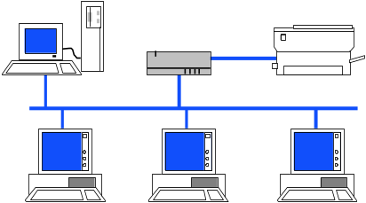


Scalable Simulation Technology
Efficient and high-fidelity simulations via parallel execution on diverse parallel architectures (PARSEC)
PARSEC (C-Based) Front-End
Portable Multi-threaded Communication Library
(xsend, xrec, etc...)
Linux, Windows NT,
Unix
MPI/AIX
MPI CH/ BSD Unix
Pthreads on Windows NT, Linux, Solaris, IRIX
Dell SMP, Sun Sparc 1000; SGI Origin 2000
Uniprocessor
Machine
IBM SP
PC Network
Modular and composable library of parallelized models with standard APIs for end-end models (GloMoSim)

Slide 6


GloMoSim Library
Data Plane
Modular, extensible library for network models
Model each layer using abstract or detailed model
Built-in statistics collection at each layer
Customizable GUI
Large and growing model library
worldwide installed base of users
Application Processing
Application
RTP Wrapper
TCP, UDP, RSVP
Transport
IP
IP
OSPF, AODV, …
Network
Packet Store/Forward
Link Layer
IEEE 802.11, 802.3, …
MAC Layer
EPLRS, WaveLAN, ...
Radio
Free space, TIREM
Propagation
model

Slide 7
Models currently available in GloMoSim
Glomosim
Standalone
Application: Replicated file system, ftp, telnet, cbr, web caching, NetMeeting, WebPhone, synthetic traffic generators
Transport : TCP(FreeBSD), NS TCP (Tahoe), UDP, DBS satellite models,
Multicasting: ODMRP, CAMP, AMRIS, AMRoute, AST, DVMRP
Routing: Distributed Bellman-Ford, Flooding, Fisheye, DSR, DSDV, WRP, LAR, NS-DSDV, DREAM, MMWN
MAC: CSMA, IEEE 802.11, MACA-W,
Radio: DS SS with and without capture
Propagation: analytical (free space, Rayleigh, Ricean), 2-ray ground reflection model, path loss trace files
Mobility: random waypoint, trace files

Slide 8
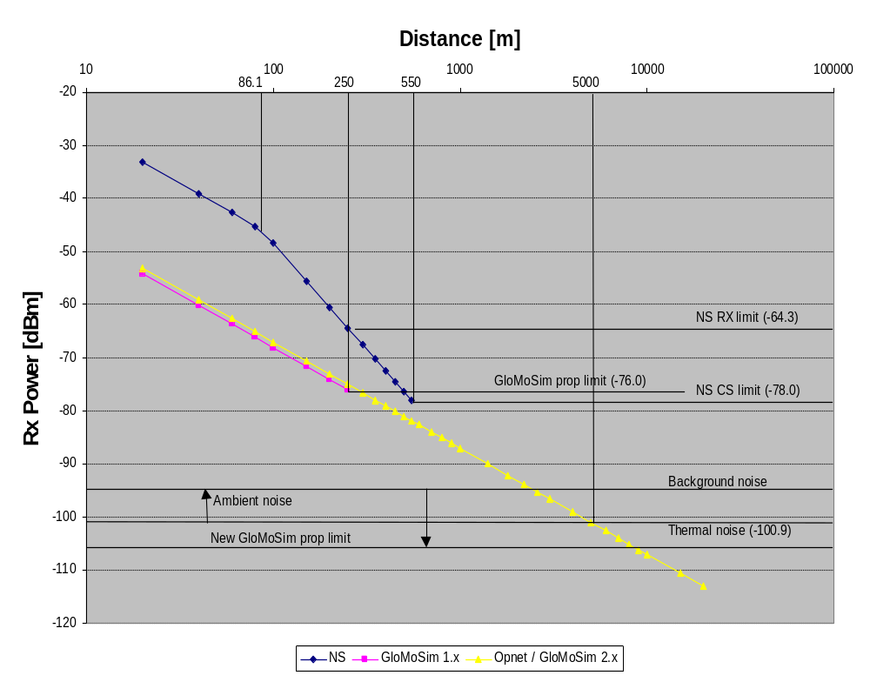
GloMoSim Path Loss Models
Critical for accurate wireless network simulations
Free space
Abstracted two-ray
ground reflection(NS-2)
Trace based
(path loss - distance)
Generic (n, σ)
  n: path loss exponent
  σ: std dev for log normal shadowing
SIRCIM (topography,
building type)
GloMoSim 2.x includes all the above.

Slide 9
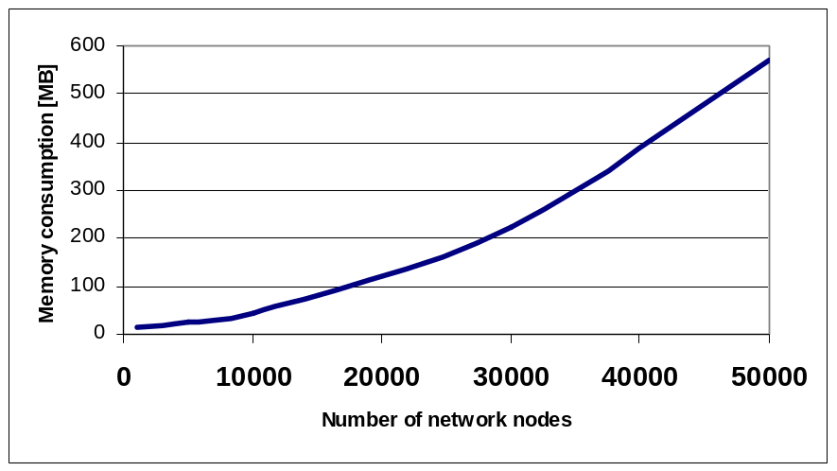
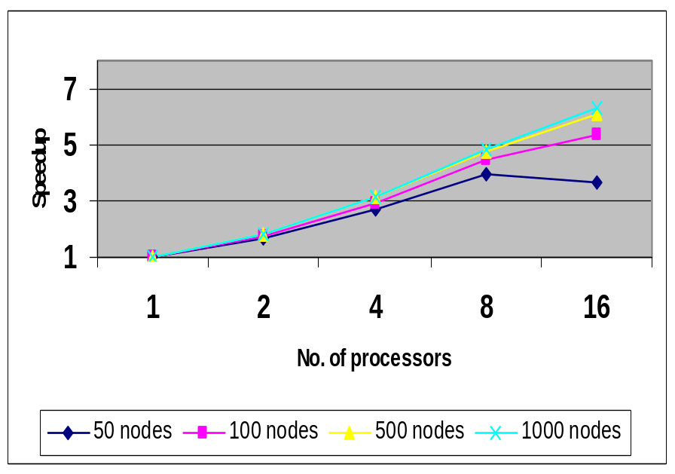
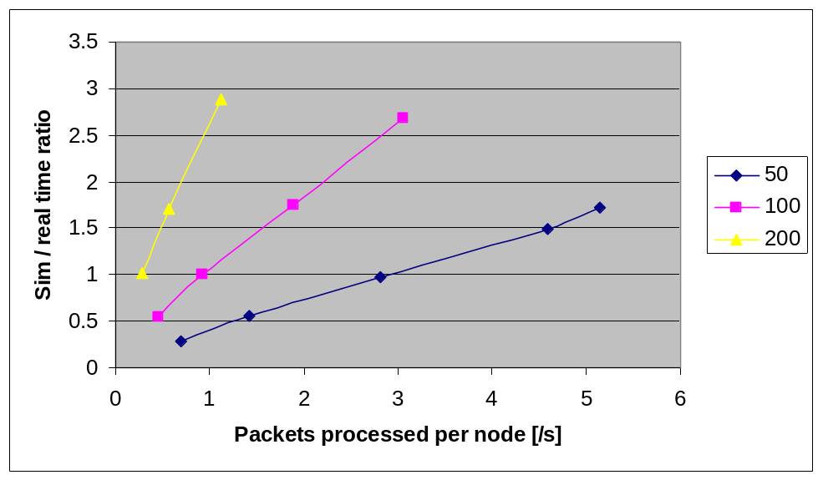
GloMoSim
Unique Features:
Scalability to very large (wireless) networks
Unique Features:
Scalability to very large (wireless) networks
Efficiency via transparent support for parallel execution
Potential for real-time simulation of networks
Unique Features:
Scalability to very large (wireless) networks
Efficiency via transparent support for parallel execution
Scalability
Parallel Execution
Real-Time

Slide 10
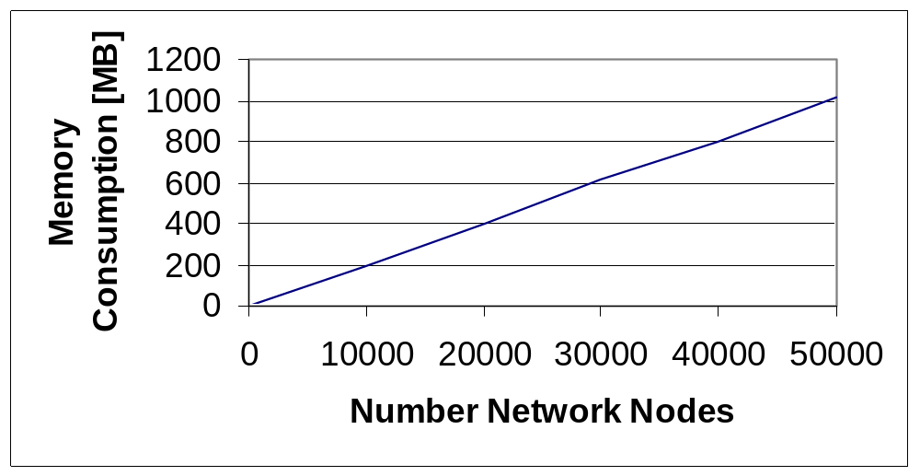
Simulation Scalability
Simulation of wireless networks with full protocol stack (density of 20,000m² per node, free space, 250m boundary radio model, IEEE 802.11 DCF, AODV, UDP, 10% nodes have CBR traffic with 4 packet per second)

Slide 11
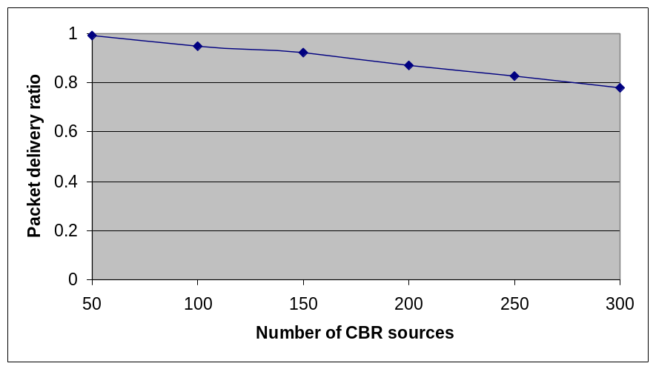
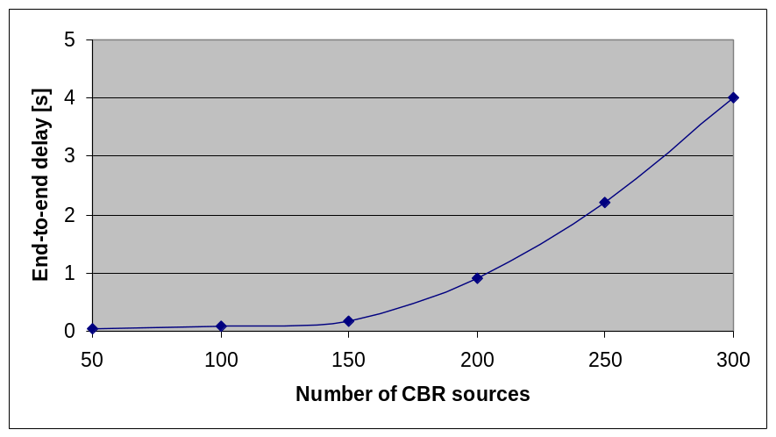
Network analysis using large-scale Simulations
1,000 network nodes on a flat terrain (density of 20,000m²/node)
376m boundary radio model (from the WaveLAN specification) with detailed SIR (signal to interference) calculation
IEEE 802.11 DCF with RTS / CTS option; LAR (Location Aided Routing Protocol) scheme 1 ad hoc wireless routing
100 to 300 CBR sources with 4 packets/s for randomly selected destinations (about 6 hops away)
What causes this increase?

Slide 12
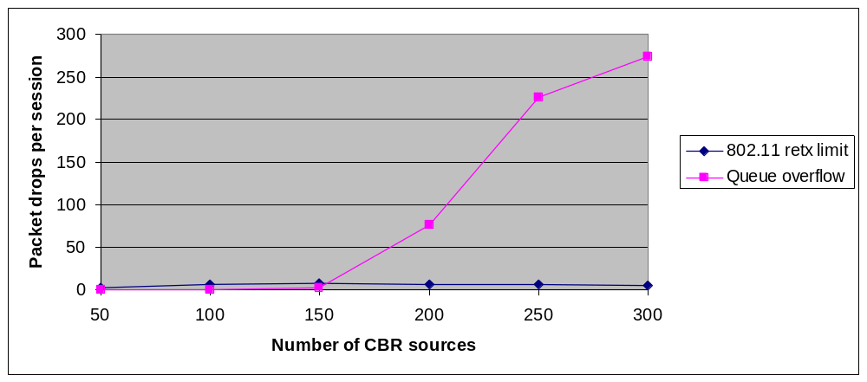
Large-scale Simulation Results (2)
The packet delivery ratio decreases gradually as the CBR traffic increases.
The end-to-end delay is more adversely affected by heavier traffic than the packet delivery ratio due to many retransmission, but the major loss of packets is derived from the network queue overflow (50 tail drop), not from IEEE 802.11 retransmission limits.

Slide 13
GloMoSim & QualNet
GloMoSim: library for mobile ad hoc networks developed as a research tool at UCLA
QualNet: Wired & wireless network modeling library commercialized by Scalable Simulation Solutions (SSS)
  GUI for experiment design, animation, protocol model design
  Larger model library: wired, wireless, QoS
  Built in statistics collection and analysis capabilities
  Application level performance prediction
  Technical support, maintenance & training
  For information on QualNet: info@scalable-solutions.com

Slide 14
Models available in QualNet 1.0
wireless
Application: ftp,telnet,cbr, Tcplib, NetMeeting, WebPhone, MODSAF, SEAM-LSS, synthetic traffic, self-similar traffic with long range dependency
Transport : TCP (FreeBSD), UDP, RTP, RSVP, MPLS, DiffServ
Multicasting: ODMRP, PIM
Routing: Distributed Bellman-Ford, OSPFv2, RIPv2, BGP, Flooding, Fisheye, DSR, DSDV, WRP, LAR, AODV
MAC: CSMA, IEEE 802.11, IEEE 802.3
Physical: point-point link, wired bus, IEEE 802.11 DSSS radio
Propagation: analytical(free space, Rayleigh, Ricean), TIREM, 2-ray ground reflection model, path loss trace files
Mobility : random waypoint, MODSAF, SEAM-LSS, trace files

Slide 15




SEAM-LSS Integration
Developing a complete analysis capability for military comm needs (in partnership with Telcordia/SAIC)
Mobility Scenarios
Scenarios
Simulation
QualNet Models
Realistic Propagation
Models
Communication Threads

Slide 16
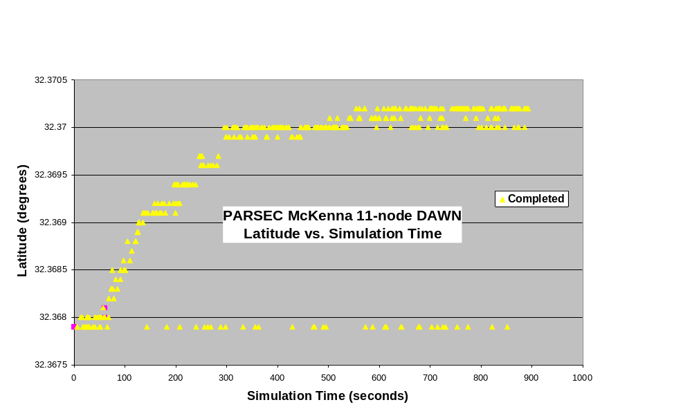
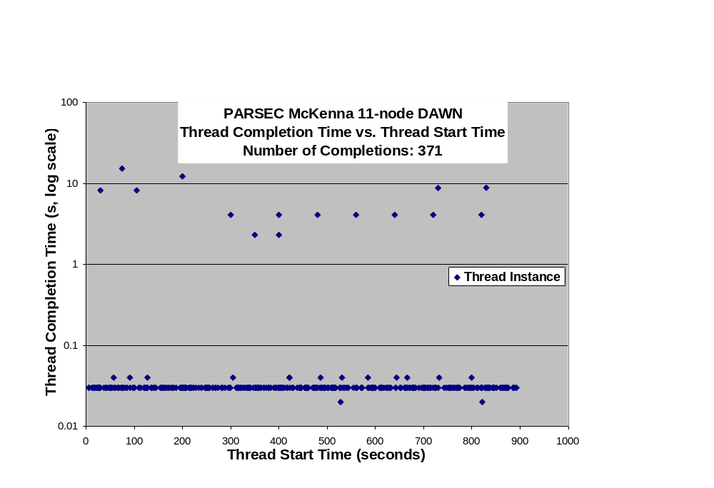
SEAMLSS Results

Slide 17
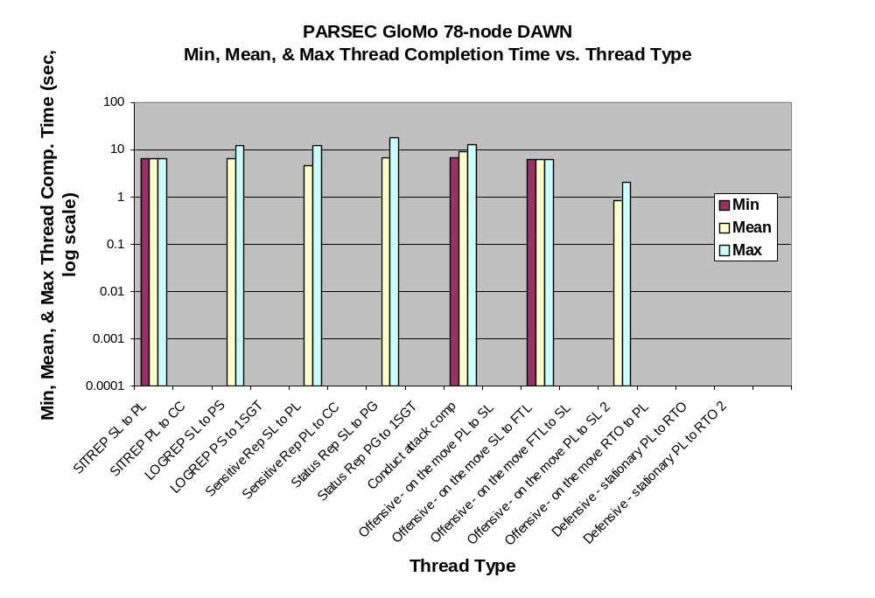
SEAMLSS Results

Slide 18
GloMoSim and ModSAF 5.0 Co-simulation
ModSAF (Modular Semi-Automated Forces) models munitions, group movement behavior
  ModSAF supports HLA through a DIS/HLA gateway
  GloMoSim, being written in PARSEC, supports HLA extensions
HLA Interactions between MODSAF & GloMoSim:
  ModSAF sends unit positions through HLA
  GloMoSim receives position updates, computes signal transmission based on new positions
HLA and sfdsimulator interfaces from GloMoSim have been integrated with MODSAF 5.1

Slide 19
Execution Constraints
ModSAF position updates are real-time, while GloMoSim/PARSEC is a DES
  an intermediate PARSEC federate was created between the gateway and GloMoSim
DIS-HLA
Gateway
RO
Intermediate
Federate (IF)
Time Regulated
MODSAF
Real time
GloMoSim
Time Constrained

Slide 20
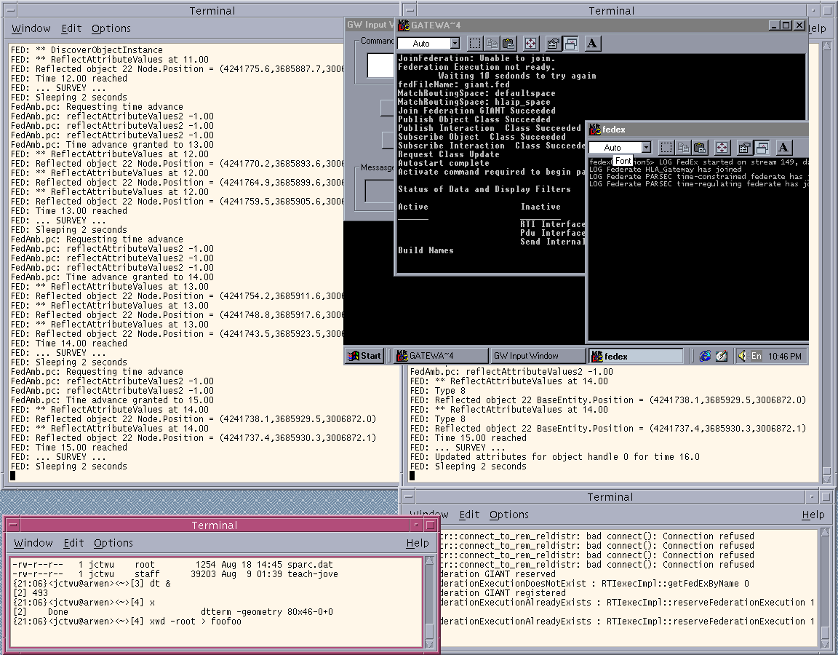
ModSAF, DIS/HLA, Intermediate Federate, GloMoSim
DIS-HLA
IF
MODSAF
GloMoSim
RTI

Slide 21
Co-Simulation
Interfaces to support interoperability of OPNET and GloMoSim models using HLA and modified RPR-FOM
OPNET
DAWN subnets in PARSEC/SEAMLSS
Gateway
Gateway

Slide 22
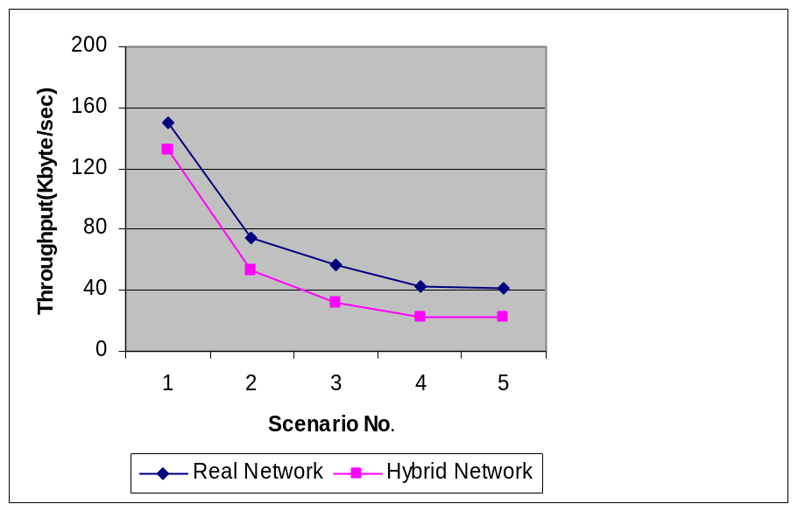
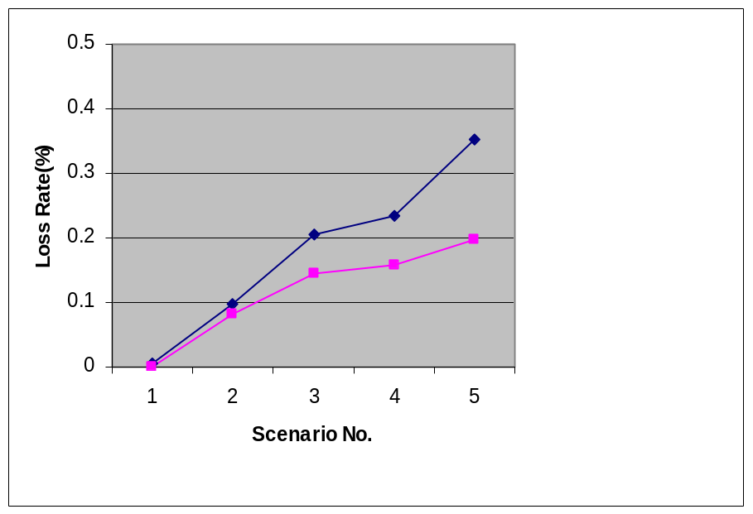
Validation Using Emulation
Heavy traffic using FTP transferring a 10MByte file in a wireless Wavelan network over 802.11 (with RTS/CTS) using a 2Mbit/s link
Same scenarios in both real network and hybrid network with a real FTP client and server
Distance between nodes is 1m
0
Ftp
1
Ftp
Ftp
3
Ftp
2
Scenario5

Slide 23
Technology Transfer
Users by Platform
19%
0%
2%
Redhat Linux
Other
36%
2%
1%
0%
Other Linux
PC Solaris
1%
Solaris
HPUX
2%
0%
Windows 95/98
Irix
Windows NT
Macintosh
SunOS
OSF
FreeBSD
21%
1%
12%
5%
Over 1775 PARSEC and/or GloMoSim downloads Mar 00-July 00
  Over 900 PARSEC/GloMoSim downloads Nov ‘99-- Feb 00
  http//pcl.cs.ucla.edu/projects/parsec
Second Parsec workshop held Nov 11 & 12, 1999
  http//pcl.cs.ucla.edu/projects/parsec/workshop99
  Over 50 attendees including commercial, military, universities
Integrated into SEAM LSS: http://www.seamlss.com
Commercialization via Scalable Simulation Solutions

Slide 24
Selected Users
Government/Military: MITRE, Lawrence Livermore National Labs*, FAA, Jet Propulsion Lab, NASA *, MIT Lincoln Laboratory, Space and Naval Warfare System Center (SPAWAR)*, …
Corporations: Cisco Systems, Fujitsu Laboratories, General Dynamics*, Philips Research, Lockheed Martin, Lucent Technologies*, Motorola*, NEC*, Nortel Networks, Nokia Research Center*, Oracle Telecomputing, Primeon Inc.*, SAIC*, SRI International*, …
Universities (US): Boston University*, Caltech*, Cornell, Dartmouth, UC Berkeley, UCLA*, University of Texas*, USC*, …
International Sites: AT&T (UK), CSIRO (Australia), NATO SACLANT Undersea Research Centre, Italy; Technion, Israel; University of Aizu, Japan; VTT Electronics, Finland; …

Slide 25
Selected Case Studies

Slide 26
Multicast Protocol Performance
ODMRP (UCLA)
  Creates a mesh of nodes (the forwarding group) to provide redundant multicast routes
  on-demand technique to establish route/membership
CAMP (UCSC)
  Creates a shared mesh
  requires underlying unicast protocols (e.g., WRP)
AMROUTE (Telcordia)
  Creates bidirectional shared multicast tree
  Uses virtual mesh links to establish the multicast tree
AMRIS (NUS, Singapore)
  Creates a shared tree and uses ranking to direct the flow of multicast data
Flooding

Slide 27
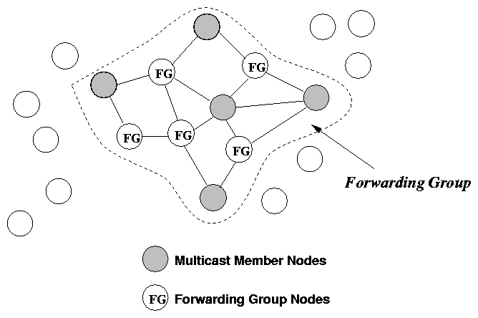
Forwarding Group Concept
A set of nodes in charge of forwarding multicast packets
Supports shortest paths between any member pairs
Mesh topology and flooding help overcome displacements and channel fading

Slide 28
Multicast Protocol Comparisons
Configuration:
  50 nodes placed randomly in 1000m x 1000m area
  Capture Radio; power of 250 m; Bandwidth: 2 Mbps
  MAC: IEEE 802.11 DCF
  Traffic: CBR with payload size 512 bytes
Metrics:
  Packet delivery ratio;
  control overhead
Independent variables:
  Mobility
  Network traffic load
  Multicast group size
  No. of senders
Paper presented at Infocomm 2000 (Lee et al): http://pcl.cs.ucla.edu/papers

Slide 29
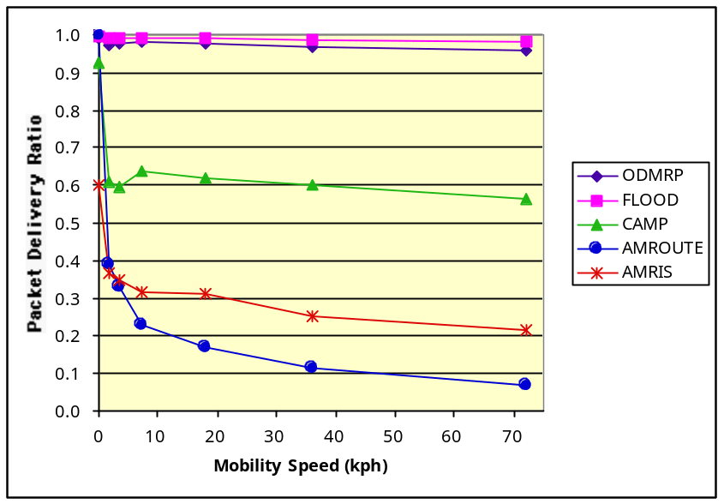
Multicast Performance with Mobility
Packet Delivery Ratio (PDR)
20 multicast members
5 sources transmit packets at the rate of 2 pkt/sec each
Mobility Speed: 0-72 km/hr
PDR: fraction of packets actually received by intended recipients.
Mesh-based (CAMP, ODMRP, flooding ) do better than tree based (AMRIS, AMROUTE)
Good delivery ratio in ODMRP due to multiple redundant routes
CAMP degrades due to poor pkt delivery to distant routers (these have fewer redundant paths); WRP loop detection can temporarily mark node subsets as unreachable, postponing rote updates for mesh maintenance.

Slide 30
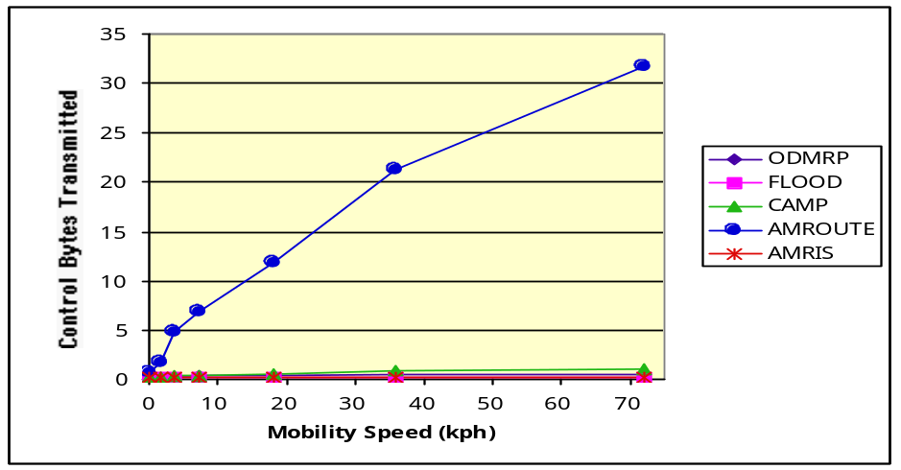
Multicast Performance with Mobility
Control Overhead
1.2
1.0
0.8
Control Bytes Transmitted
0.6
0.4
0.2
0.0
0
10
20
30
40
50
60
70
Mobility Speed (kph)
Control overhead: no. of control pkt bytes + header size in data packets
AMRIS is low due to very low delivery ratio; AMROUTE high due to loops
CAMP has higher overhead than ODMRP due to trigerred updates in WRP, particularly with high mobility.

Slide 31
TCP and MAC Interactions
Evaluate MAC interaction with TCP in presence of mobility.
0
1
2
8
81 nodes;
radio range : 30m;
bandwidth: 2Mbps
10 m
9
10
11
17
18
19
20
26
72
73
74
80
Mobility: 10 meters per second in a random direction with a probability of 0.5.
Routing:
  without mobility : static routing
  with mobility: Bellman-Ford with routing table updates every second.
3 horizontal (18-26; 36-44; 54-62) and 3 vertical (2-74; 4-76; 6-78) end-end FTP connections.
WMSCA ‘99 (Gerla, Bagrodia, Tang): http://pcl.cs.ucla.edu/papers

Slide 32
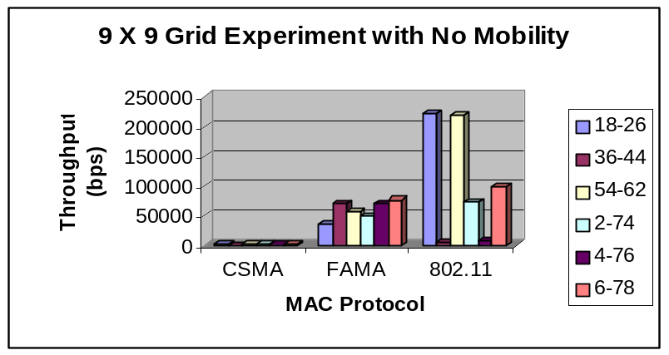
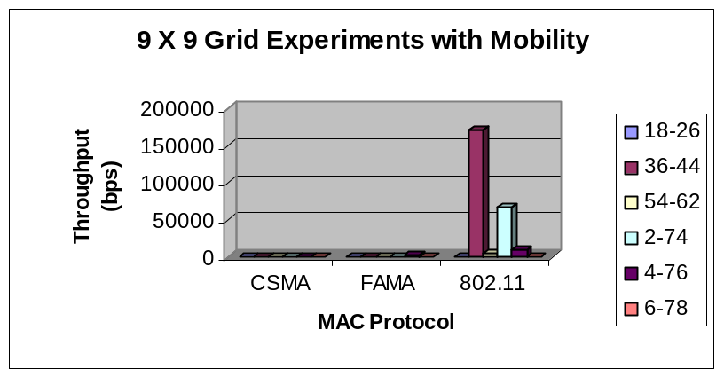
TCP/MAC Performance
Without mobility
  CSMA performs poorly due to interference by neighboring and intersecting streams.
  FAMA fair due to RTS/CTS and less aggressive yield time.
  802.11 exhibits capture.
With mobility
  CSMA and FAMA collapse due to lack of fast loss recovery facilities.
  802.11 still operational.
    Link level ACKs help recover from loss caused by transient nodes.
    Capture exists.
Conclusion
  Link-level ACKs important to combat packet loss in wireless ad-hoc environment.

Slide 33
Application Performance in AdHoc Networks
Study performance issues of (ad hoc) wireless networks using real applications
Importance of abstract vs. detailed network models
Efficient simulation of large scale models via parallel execution

Slide 34

The Replicated File System (RRFS):
Distributed Data Replication
RRFS shares data through peer replication
  Every unit gets its own copy of the data
  Every unit can make updates to its copy
Use periodic update propagation for data reconciliation
Use opportunistic update propagation between any replicas
Contrast with client server architecture
    Faster update dissemination
    Better adaptation to dynamic network topologies

Slide 35
Replicated File System
Application performance Metrics:
  Average Reconciliation time: Time from when a replica generates a reconciliation request to when the reconciliation completes.
  Stale read/write rate: No. of read/write access to data that has since been modified by another replica
Frequency of reconciliation?
Scalability of design with no. of replicas, nodes, traffic, deployment area, …?
When are detailed models of the protocol stack necessary for studying application performance?

Slide 36
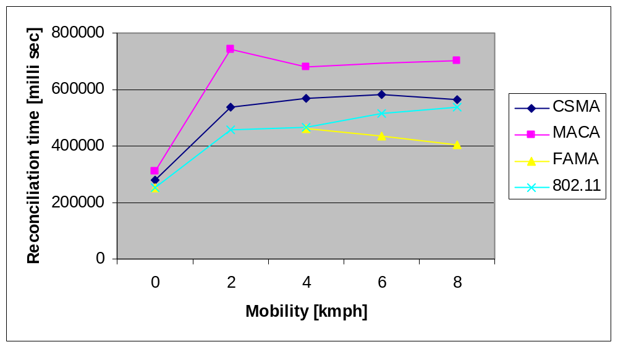
Replicated File System: Results
Reconcilitaion behavior as a function of MAC protocol & mobility speed
Abstract models may be used only in absence of mobility
Globecomm ’99: Ahuja et al: http://pcl.cs.ucla.edu/papers

Slide 37
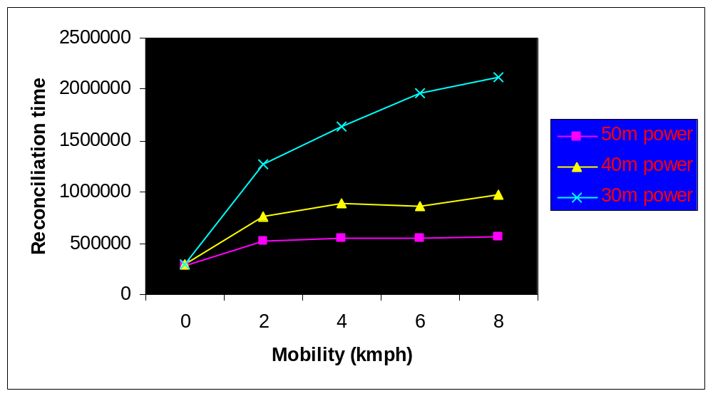
Replicated File System: Results
Impact of transmit power on recon time
Simulation of replication service with a detailed stack model: TCP, Bellman Ford, CSMA, radio
Topology: 20 mobile nodes; 6 Rumor nodes; ring topology.
Reconcilitation interval: 4 hours
Abstract models may have errors upto 400% in presence of mobility.

Slide 38
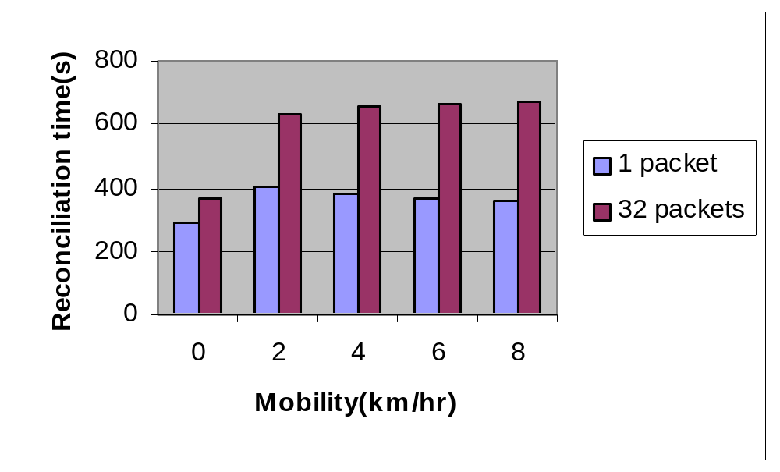
Replicated File System: Results
Impact of varyingTCP window size from 1 to 32 packets
Increasing window size causes more collissions between data packets and ACKs travelling in opposite directions
Again, difference with mobility is much more than no mobility

Slide 39
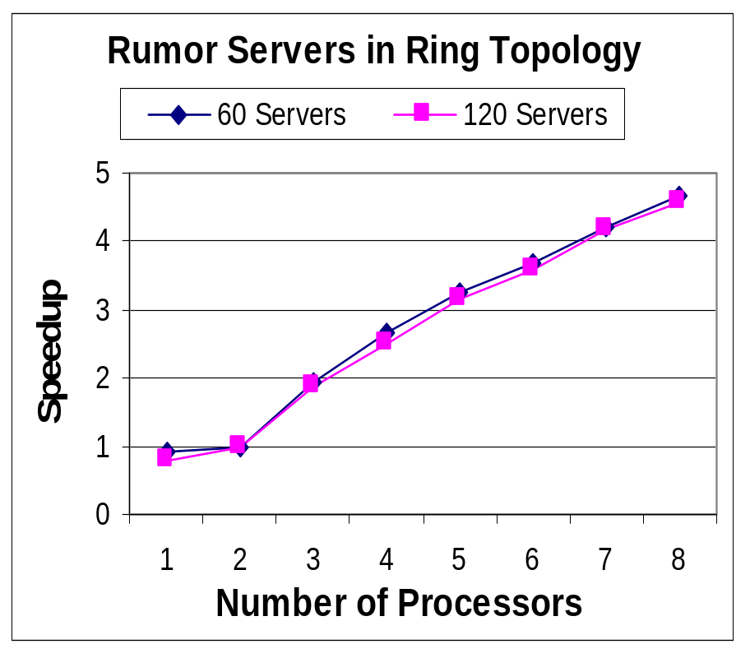
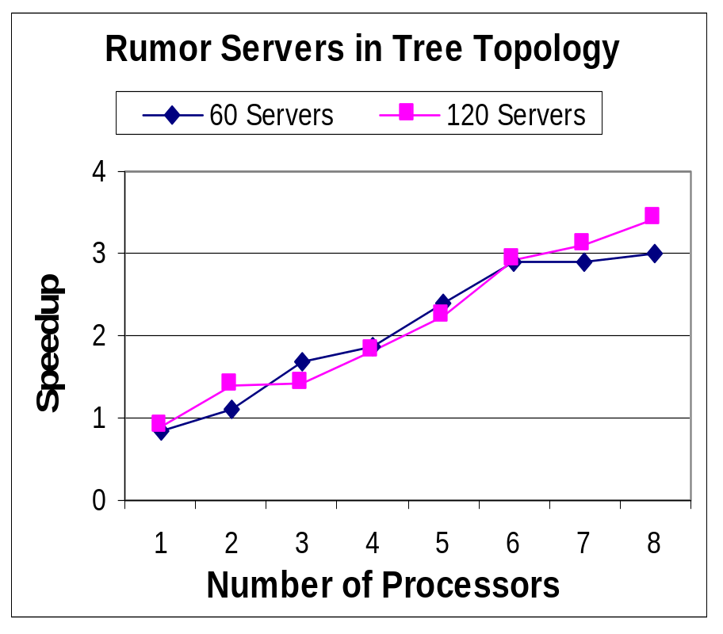
Scalability via Parallel Execution
2
3
0
1
0
1
2
3
4
n
5
6
7
8
9

Slide 40
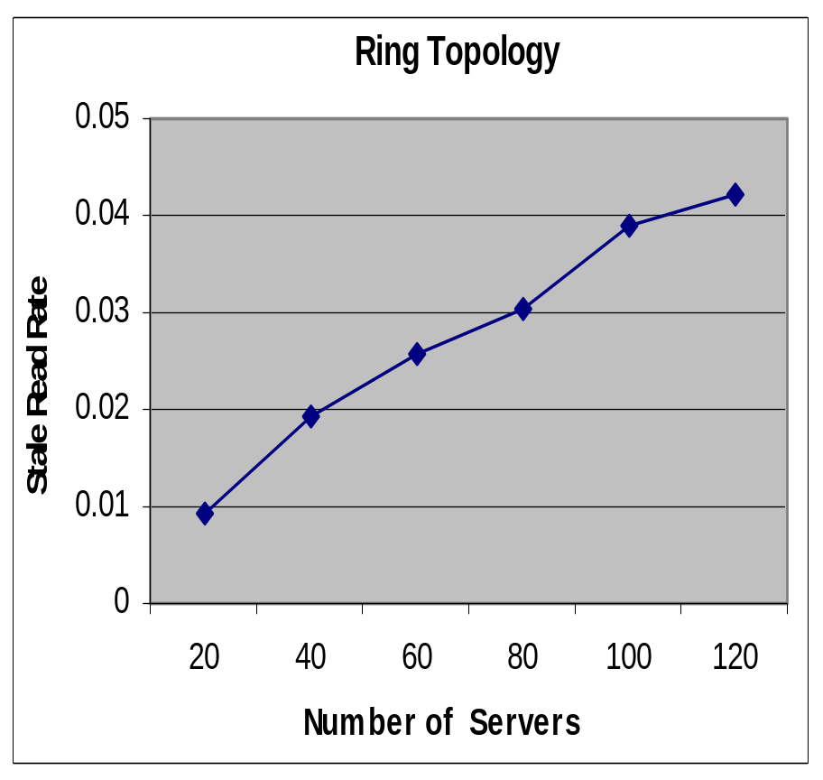
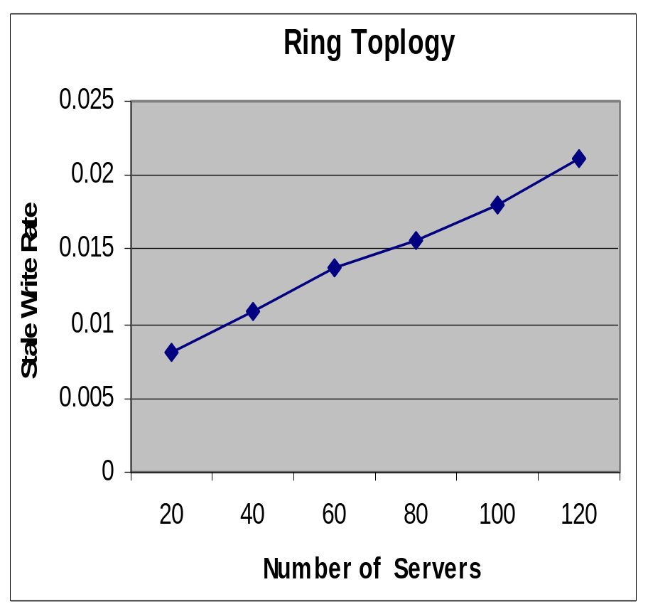
Scaling Replicas
Consider a set of servers in ring topology with reconciliation interval of four hours.

Slide 41
Conclusion
Accomplishments
Design & development of GloMoSim framework for detailed simulation of networks with tens of thousands of nodes.
Demonstrated hybrid simulations with integration of real applications running with virtual protocol stack.
Direct comparison of alternative unicast and multicast wireless protocols for GloMo scenarios
Design of scaleable unicast & multicast wireless protocols
Technology Transfer:
GloMoSim and PARSEC integrated into SEAM-LSS
GloMoSim commercialized by Scalable Simulation Solutions
Commercial version of GloMoSim being used in M&S study for JTRS program
Wide distribution (close to 3000 downloads) of public domain simulation software

