Slide 1
Smart Objects: The “Things” in IoT

Slide 2
Sensors are fundamental building blocks of IoT networks
Sensors are the foundational elements found in smart objects—the “things” in the Internet of Things
Smart objects are any physical objects that contain embedded technology to sense and/or interact with their environment in a meaningful way by being interconnected and enabling communication among themselves or an external agent.

Slide 3
Basic Principle of Sensor
Measuring
Parameter
Useful Signal
Conversion Device
Displacement, Temperature, Pressure etc….
Voltage, current, capacitance
Sensor is a device that when exposed to a physical phenomenon (temperature, displacement, force, etc.) produces a proportional output signal (electrical, mechanical, magnetic, etc.).

Slide 4
Sensors
Stimulus (s)
Signal (S)
Physical
Medium
Sensing
Element
Conditioning
Target
Handling
Temperature
Resistance
Voltage
Information
Transducers
Micro-sensors 10⁻⁶m

Slide 5
Transfer Function
where S = output signal; s = stimulus; and f(s) = functional relationship
For binary sensors: S = 1 if s > 0 and S = 0 if s < 0.
The ideal functional form for an analogue measuring device is a simple proportional relationship, such as:
where C = output value at a stimulus value of zero
and m = constant of proportionality (sensitivity)

Slide 6
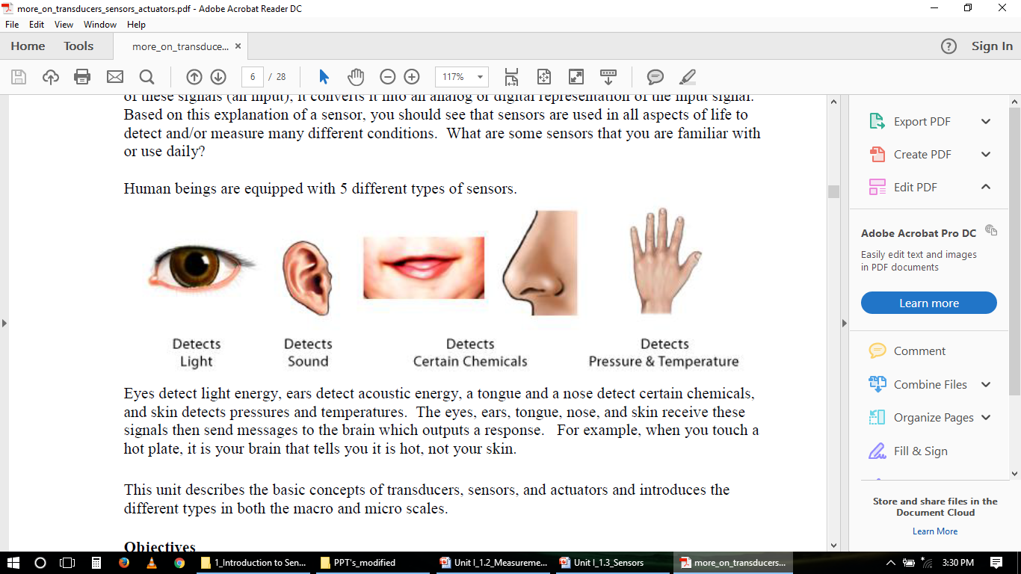
Human beings are equipped with 5 different types of sensors.

Slide 7
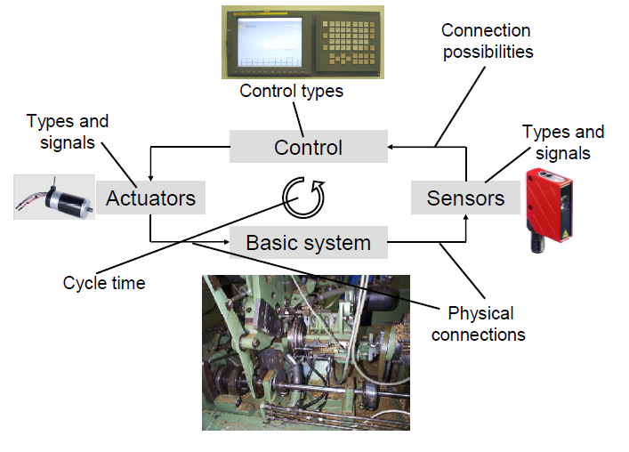
System Overview

Slide 8
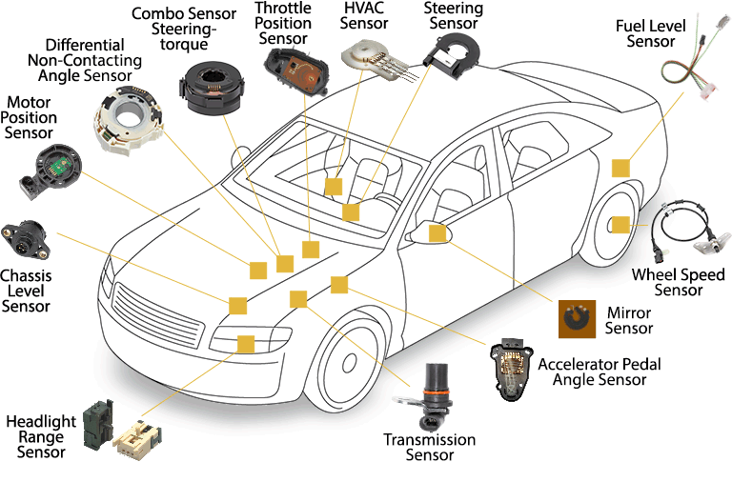

Slide 9
Transducer
A device which converts one form of energy to another
When input is a physical quantity and output electrical → Sensor
When input is electrical and output a physical quantity → Actuator
Sensors
Actuators
e.g. Piezoelectric:
Force -> voltage
Voltage-> Force
Physical parameter
Electrical Input
Electrical Output
Physical Output

Slide 10
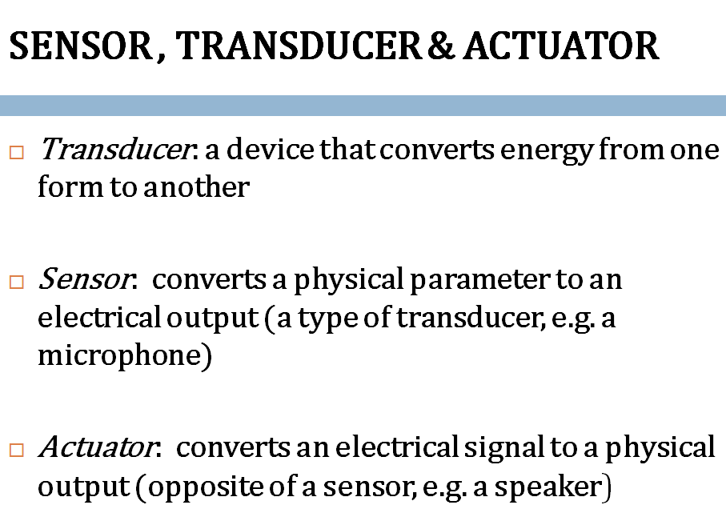

Slide 11
SENSORS, ACTUATORS, AND SMART OBJECTS
A sensor: It senses
More specifically, a sensor measures some physical quantity and converts that measurement reading into a digital representation.
That digital representation is typically passed to another device for transformation into useful data that can be consumed by intelligent devices or humans
Sensors are not limited to human-like sensory data.
They are able to provide an extremely wide spectrum of rich and diverse measurement data with far greater precision than human senses

Slide 12
Categories
Active or passive:
Sensors can be categorized based on whether they produce an energy output and typically require an external power supply (active) or
Whether they simply receive energy and typically require no external power supply (passive).
Invasive or non-invasive:
Sensors can be categorized based on whether a sensor is part of the environment it is measuring (invasive) or
External to it (non-invasive).

Slide 13
Contact or no-contact:
Sensors can be categorized based on whether they require physical contact with what they are measuring (contact) or not (no-contact).
Absolute or relative:
Sensors can be categorized based on whether they measure on an absolute scale (absolute) or based on a difference with a fixed or variable reference value (relative).

Slide 14
Area of application:
Sensors can be categorized based on the specific industry
or vertical where they are being used.
How sensors measure:
Sensors can be categorized based on the physical mechanism used to measure sensory input (for example, thermoelectric, electrochemical, piezoresistive, optic, electric, fluid mechanic, photoelastic).

Slide 15
What sensors measure:
Sensors can be categorized based on their applications
or what physical variables they measure.
Note that this is by no means an exhaustive list, and there are many other classification and taxonomic schemes for sensors, including those based on material, cost, design, and other factors

Slide 16
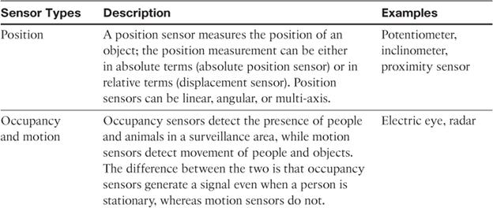
Categorization based on what physical phenomenon a sensor is measuring

Slide 17
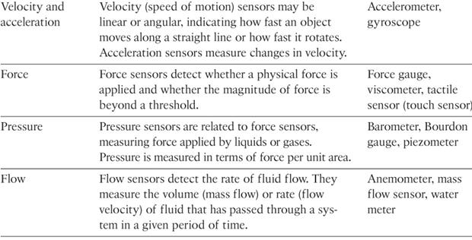
11

Slide 18
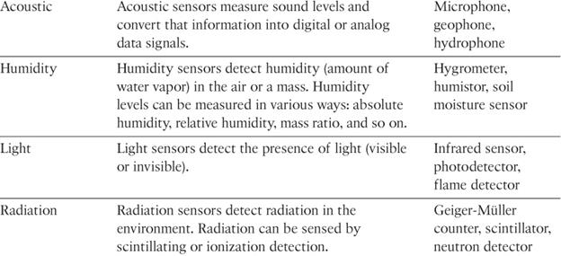

Slide 19
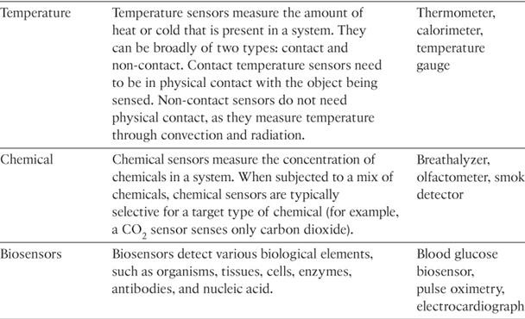

Slide 20
Precision agriculture (smart farming)
which uses a variety of technical advances to improve the efficiency, sustainability, and profitability of traditional farming practices.
This includes the use of GPS and satellite aerial imagery for determining field viability; robots for high-precision planting, harvesting, irrigation, and so on; and real-time analytics and artificial intelligence to predict optimal crop yield, weather impacts, and soil quality.
Among the most significant impacts of precision agriculture are those dealing with sensor measurement of a variety of soil characteristics. These include real- time measurement of soil quality, pH levels, salinity, toxicity levels, moisture levels for irrigation planning, nutrient levels for fertilization planning, and so on.
All this detailed sensor data can be analyzed to provide highly valuable and
actionable insight to boost productivity and crop yield.

Slide 21
IoT Use Case: Area of precision agriculture (smart farming)
biodegradable, passive microsensors to measure soil and crop and conditions
.
These sensors, developed at North Dakota State University (NDSU), can be planted directly in the soil and left in the ground to biodegrade without any harm to soil quality.

Slide 22
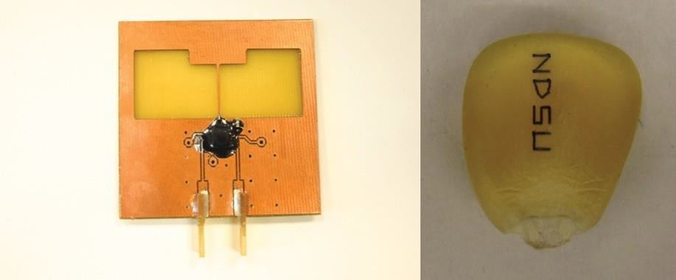
Figure 3-1 Biodegradable Sensors Developed by NDSU for Smart Farming

Slide 23
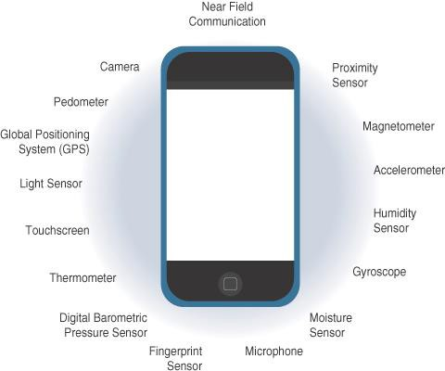
Sensors in a Smart Phone

Slide 24
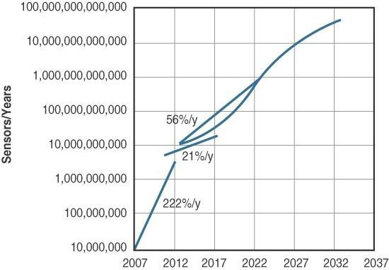
Figure 3-3 Growth and Predictions in the Number of Sensors

Slide 25
Actuators
Actuators are natural complements to sensors
Sensors are designed to sense and measure practically any measurable variable in the physical world.
They convert their measurements (typically analog) into electric signals or digital representations that can be consumed by an intelligent agent (a device or a human).
Actuators, on the others hand, receive some type of control signal (commonly an electric signal or digital command) that triggers a physical effect, usually some type of motion, force, and so on.
Sensors provide the information, actuators provide the action

Slide 26
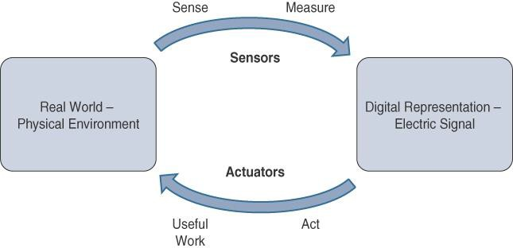

Slide 27
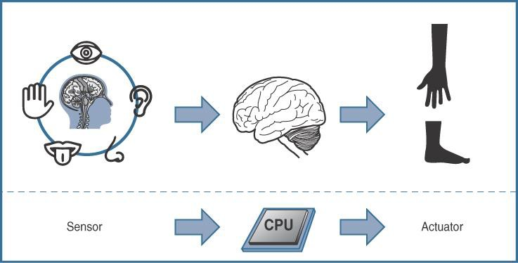

Slide 28
Actuators also vary greatly in function, size, design, and so on.
Some common ways that they can be classified include the
following:
Type of motion: Actuators can be classified based on the type of motion they produce (for example, linear, rotary, one/two/three- axes).
Power: Actuators can be classified based on their power output (for example, high power, low power, micro power)
Binary or continuous: Actuators can be classified based on the number of stable-state outputs.
Area of application: Actuators can be classified based on the
specific industry or vertical where they are used.
Type of energy: Actuators can be classified based on their energy type.

Slide 29
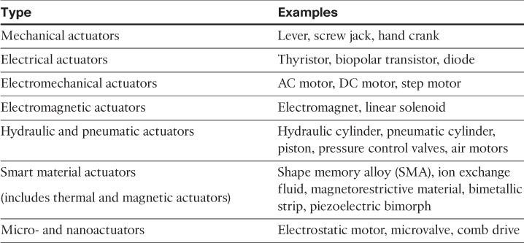
Classification based on energy type

Slide 30
Micro-Electro-Mechanical Systems (MEMS)
Interesting advances in sensor and actuator technologies is in how they are packaged and deployed.
Micro-electro-mechanical systems (MEMS), sometimes referred to as micro-machines, can integrate and combine electric and mechanical elements, such as sensors and actuators, on a very small (millimeter or less) scale.
One of the keys to this technology is a microfabrication technique that is similar to what is used for microelectronic integrated circuits.
This approach allows mass production at very low costs

Slide 31
The combination of tiny size, low cost, and the ability to mass produce makes MEMS an attractive option for a huge number of IoT applications.
MEMS devices have already been widely used in a variety of different applications and can be found in very familiar everyday devices.
For example, inkjet printers use micropump MEMS.
Smart phones also use MEMS technologies for things like accelerometers and gyroscopes.
In fact, automobiles were among the first to commercially introduce MEMS into the mass market, with airbag accelerometers.

Slide 32
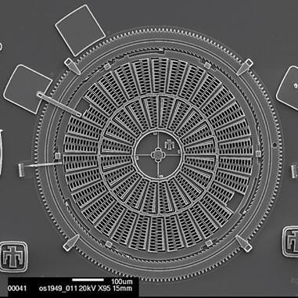
Figure 3-6 Torsional Ratcheting Actuator (TRA) MEMS (Courtesy Sandia National
Laboratories, SUMMiT™ Technologies, www.sandia.gov/mstc.)

Slide 33
Smart Objects
Smart objects are, quite simply, the building blocks of IoT.
They are what transform everyday objects into a network of intelligent objects that are able to learn from and interact with their environment in a meaningful way
The real power of smart objects in IoT comes from being networked together rather than being isolated as standalone objects

Slide 34
If a sensor is a standalone device that simply measures the humidity of the soil, it is interesting and useful, but it isn’t revolutionary
If that same sensor is connected as part of an intelligent network that is able to coordinate intelligently with actuators to trigger irrigation systems as needed based on those sensor readings, we have something far more powerful
Extending that even further, imagine that the coordinated sensor/actuator set is intelligently interconnected with other sensor/actuator sets to further coordinate fertilization, pest control, and so on—and even communicate with an intelligent backend to calculate crop yield potential

Slide 35
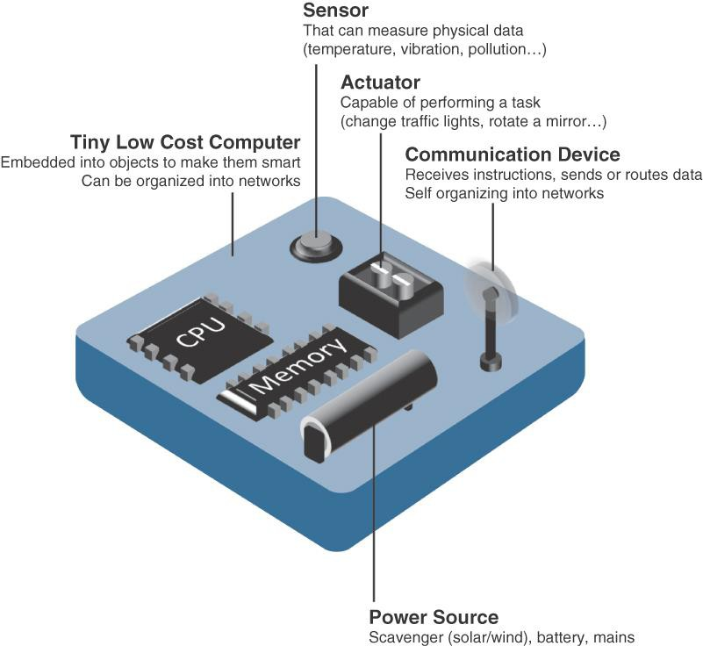
A smart object, is a device that has, at a minimum, the following four defining characteristics

Slide 36
Processing unit:
Some type of processing unit for
Acquiring data,
Processing and analyzing sensing information received by the sensor(s),
Coordinating control signals to any actuators, and
Controlling a variety of functions on the smart object, including the communication and power systems
The most common is a microcontroller because of its small form factor, flexibility, programming simplicity, ubiquity, low power consumption, and low cost

Slide 37
Sensor(s) and/or actuator(s):
A smart object is capable of interacting with the physical world through sensors and actuators
Communication device:
The communication unit is responsible for connecting a smart object with other smart objects and the outside world (via the network).
Communication devices for smart objects can be either
wired or wireless

Slide 38
Power source:
Smart objects have components that need to be powered.
The most significant power consumption usually comes from the communication unit of a smart object

Slide 39
Trends in Smart Objects
Size is decreasing
Power consumption is decreasing
Processing power is increasing
Communication capabilities are improving
Communication is being increasingly standardized

Slide 40
SENSOR NETWORKS
A sensor/actuator network (SANET), is a network of sensors that sense and measure their environment and/or actuators that act on their environment
The sensors and/or actuators in a SANET are capable of communicating and cooperating
Effective and well-coordinated communication and cooperation is a prominent challenge, primarily because the sensors and actuators in SANETs are diverse, heterogeneous, and resource-constrained

Slide 41
SANETs offer highly coordinated sensing and actuation capabilities.
Smart homes are a type of SANET that display this coordination between distributed sensors and actuators
For example, smart homes can have temperature sensors that are strategically networked with heating, ventilation, and air-conditioning (HVAC) actuators.
When a sensor detects a specified temperature, this can trigger an actuator to take action and heat or cool the home as needed.

Slide 42
Advantages and disadvantages that a wireless-based solution offers:
Advantages:
Greater deployment flexibility (especially in extreme environments or hard-to-reach places)
Simpler scaling to a large number of nodes
Lower implementation costs
Easier long-term maintenance
Effortless introduction of new sensor/actuator nodes
Better equipped to handle dynamic/rapid topology changes
Disadvantages:
Potentially less secure (for example, hijacked access points)
Typically lower transmission speeds
Greater level of impact/influence by environment

Slide 43
Wireless Sensor Networks (WSNs)
Wireless sensor networks are made up of wirelessly connected smart objects, which are sometimes referred to as motes.
The fact that there is no infrastructure to consider with WSNs is surely a powerful advantage for flexible
deployments, but there are a variety of design constraints to consider with these wirelessly connected smart objects

Slide 44
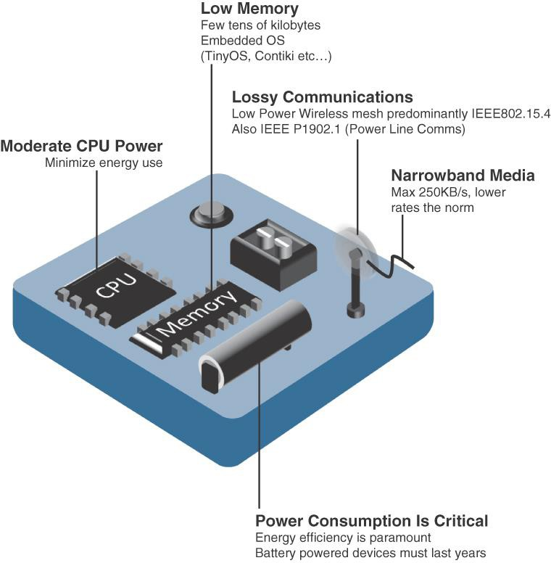

Slide 45
The following are some of the most significant limitations of the smart objects in WSNs:
Limited processing power
Limited memory
Lossy communication
Limited transmission speeds
Limited power
Note
Smart objects with limited processing, memory, power, and so on are often referred to as constrained nodes.

Slide 46
These limitations greatly influence how WSNs are designed, deployed, and utilized.
The fact that individual sensor nodes are typically so limited is a reason that they are often deployed in very large numbers.
As the cost of sensor nodes continues to decline, the ability to deploy highly redundant sensors becomes increasingly feasible.
Because many sensors are very inexpensive and correspondingly inaccurate, the ability to deploy smart objects redundantly allows for increased accuracy

Slide 47
Such large numbers of sensors permit the introduction of hierarchies of smart objects.
Such a hierarchy provides, among other organizational advantages, the ability to aggregate similar sensor readings from sensor nodes that are in close proximity to each other

Slide 48
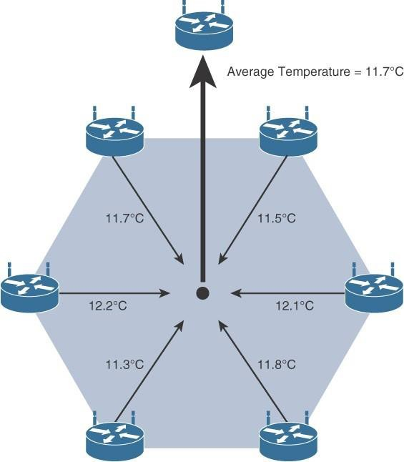
. Figure 3-9 shows an example of such a data aggregation function in a WSN where temperature readings from a logical grouping of temperature sensors are aggregated as an average temperature reading.
Figure 3-9 Data Aggregation in Wireless Sensor Networks

Slide 49
These data aggregation techniques are helpful in reducing the amount of overall traffic (and energy) inWSNs with very large numbers of deployed smart objects.
This data aggregation at the network edges is where fog and mist computing are critical IoT architectural elements needed to deliver the scale and performance required by so many IoT use cases

Slide 50
Wirelessly connected smart objects generally have one of the
following two communication patterns:
Event-driven:
Transmission of sensory information is triggered only when a smart object detects a particular event or predetermined threshold.
Periodic:
Transmission of sensory information occurs only at periodic intervals.
The decision of which of these communication schemes is used depends greatly on the specific application
For example: medical use cases

Slide 51
For example, in some medical use cases, sensors periodically send postoperative vitals, such as temperature or blood pressure readings. In other medical use cases, the same blood pressure or temperature readings are triggered to be sent only when certain critically low or high readings are measured.

Slide 52
Communication Protocols for Wireless Sensor Networks
There are literally thousands of different types of sensors and actuators.
WSNs are becoming increasingly heterogeneous, with more sophisticated interactions.
Any communication protocol must be able to scale to a large number of nodes.
Likewise, when selecting a communication protocol, you must carefully take into account the requirements of the specific application and consider any trade-offs the communication
protocol offers
between power consumption, maximum
transmission speed, range, tolerance for packet loss, topology optimization, security, and so on

Slide 53
They must also enable, as needed, the overlay of autonomous techniques (for example, self-organization, self-healing, self- configuration)
Wireless sensor networks interact with their environment. Sensors often produce large amounts of sensing and measurement data that needs to be processed. This data can be processed locally by the nodes of a WSN or across zero or more hierarchical levels in IoT networks.
Communication protocols need to facilitate routing and message handling for this data flow between sensor nodes as well as from sensor nodes to optional gateways, edge compute, or centralized cloud compute

Slide 54
standardization of communication protocols is a complicated task.
While there isn’t a single protocol solution, there is beginning to be some clear market convergence around several key communication protocols.

Slide 55
Connecting Smart Objects
IoT devices and sensors must be connected to the network for their data to be utilized.
In addition to the wide range of sensors, actuators, and smart objects that make up IoT, there are also a number of different protocols used to connect them

Slide 56
COMMUNICATIONS CRITERIA
Characteristics and attributes you should consider when selecting and dealing with connecting smart objects
Range
Frequency Bands
Power Consumption
Topology
Constrained Devices
Constrained-Node Networks

Slide 57
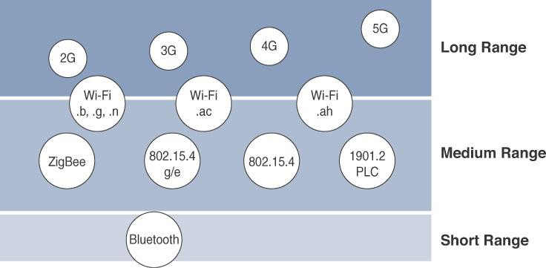
Range
How far does the signal need to be propagated?
That is, what will be the area of coverage for a selected wireless technology?
Should indoor versus outdoor deployments be differentiated?

Slide 58
Short range:
The classical wired example is a serial cable.
Wireless short-range technologies are often considered as an alternative to a serial cable, supporting tens of meters of maximum distance between two devices.
Examples of short-range wireless technologies are IEEE
802.15.1 Bluetooth and IEEE 802.15.7 Visible Light Communications (VLC)

Slide 59
Medium range:
This range is the main category of IoT access technologies.
In the range of tens to hundreds of meters, many specifications and implementations are available.
The maximum distance is generally less than 1 mile between two devices
Examples of medium-range wireless technologies include IEEE 802.11 Wi-Fi, IEEE 802.15.4, and 802.15.4g WPAN.
Wired technologies such as IEEE 802.3 Ethernet and IEEE 1901.2 Narrowband Power Line Communications (PLC)

Slide 60
Long range:
Distances greater than 1 mile between two devices require long-range technologies.
Wireless examples are cellular (2G, 3G, 4G) and some applications of outdoor IEEE 802.11 Wi-Fi and Low Power Wide-Area (LPWA) technologies.
LPWA communications have the ability to communicate over a large area without consuming much power. These technologies are therefore ideal for battery-powered IoT sensors

Slide 61
Frequency Bands
Radio spectrum is regulated by countries and/or organizations, such as the International Telecommunication Union (ITU) and the Federal Communications Commission (FCC).
These groups define the regulations and transmission requirements for various frequency bands
For example, portions of the spectrum are allocated to types of telecommunications such as radio, television, military, and so on.

Slide 62
Focusing on IoT access technologies, the frequency bands leveraged by wireless communications are split between licensed and unlicensed bands.
Licensed spectrum is generally applicable to IoT long- range access technologies
In order to utilize licensed spectrum, users must subscribe to services when connecting their IoT devices
In exchange for the subscription fee, the network operator can guarantee the exclusivity of the frequency usage over the target area and can therefore sell a better guarantee of service.

Slide 63
The ITU has also defined unlicensed spectrum for the industrial, scientific, and medical (ISM) portions of the radio bands.
These frequencies are used in many communications
technologies for short-range devices (SRDs).
Unlicensed means that no guarantees or protections are offered in the ISM bands for device communications
ISM bands for IoT access
2.4 GHz band as used by IEEE 802.11b/g/n WiFi
IEEE 802.15.1 Bluetooth
IEEE 802.15.4 WPAN

Slide 64
Unlicensed spectrum is usually simpler to deploy than licensed because it does not require a service provider.
However, it can suffer from more interference because other devices may be competing for the same frequency in a specific area
The frequency of transmission directly impacts how a signal propagates and its practical maximum range.

Slide 65
Power Consumption
Powered nodes and battery-powered nodes
A powered node has a direct connection to a power source, and communications are usually not limited by power consumption criteria.
However, ease of deployment of powered nodes is limited by the availability of a power source, which makes mobility more complex
Battery-powered nodes bring much more flexibility to IoT devices.
These nodes are often classified by the required lifetimes of their batteries.

Slide 66
For battery-powered
nodes, IoT wireless access
technologies must address the needs of low power consumption and connectivity
A new wireless environment known as Low-Power Wide- Area (LPWA)
Battery-powered nodes are often placed in a “sleep mode”
to preserve battery life when not transmitting
Wired IoT access technologies consisting of powered nodes are not exempt from power optimization

Slide 67
Topology
Among the access technologies available for connecting IoT devices, three main topology schemes are dominant: star, mesh, and peer-to-peer
For long-range and short-range technologies, a star topology is prevalent
Star topologies utilize a single central base station or controller to allow communications with endpoints
For medium-range technologies, a star, peer-to-peer, or mesh topology is common
Peer-to-peer topologies allow any device to communicate with any other device as long as they are in range of each other

Slide 68
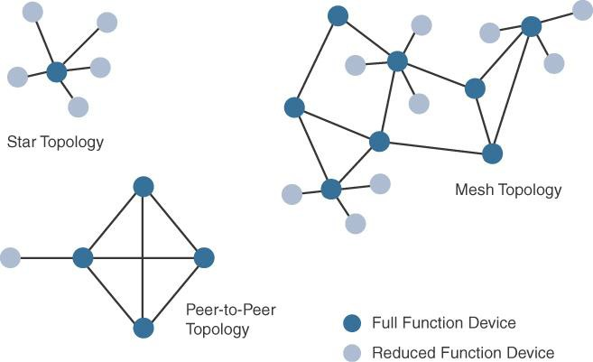
Ex: Indoor Wi-Fi deployments and Outdoor Wi-Fi deployments

Slide 69
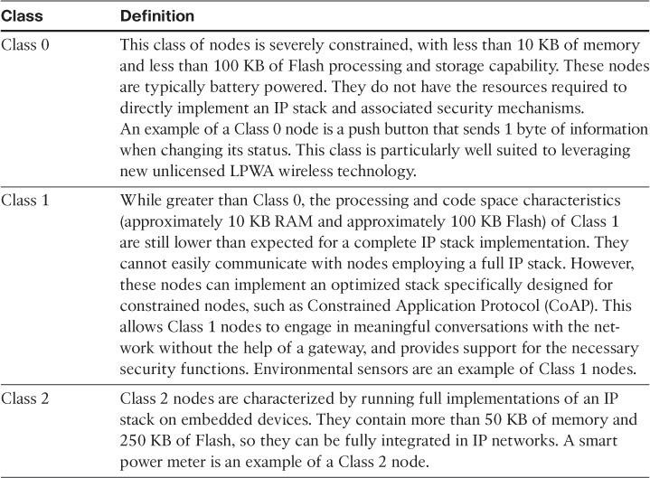
Constrained Devices

Slide 70
Constrained-Node Networks
IEEE 802.15.4 and 802.15.4g RF, IEEE 1901.2a PLC,
LPWA, and IEEE 802.11ah access technologies
Constrained-node networks are often referred to as low-power and lossy networks (LLNs).
Low power – battery powered constraints
Lossy network -- network performance may suffer from interference and variability due to harsh radio environments
Protocols that can be used for constrained-node networks must be evaluated in the context of the following characteristics: data rate and throughput, latency and determinism, and overhead and payload.

Slide 71
Data Rate and Throughput
The data rates available from IoT access technologies range from 100 bps with protocols such as Sigfox to tens of megabits per second with technologies such as LTE and IEEE 802.11ac
However, the actual throughput is less
Therefore, understanding the bandwidth requirements of a particular technology, its applicability to given use cases, the capacity planning rules, and the expected real throughput are important for proper network design and successful production deployment

Slide 72
Technologies not particularly designed for IoT, such as cellular and Wi-Fi, match up well to IoT applications with high bandwidth requirements
For example, nodes involved with video analytics have a need for high data rates, IoT endpoints are not constrained in terms of computing or network bandwidth, the design guidelines tend to focus on application requirements, such as latency and determinism

Slide 73
Short-range technologies can also provide medium to high data rates that have enough throughput to connect a few endpoints.
For example, Bluetooth sensors that are now appearing on connected wearables fall into this category.
In this case, the solutions focus more on footprint and battery lifetime than on data rate.
The IoT access technologies developed for constrained nodes are optimized for low power consumption, but they are also limited in terms of data rate

Slide 74
Another characteristic of IoT devices is that a majority of them initiate the communication.
Upstream traffic toward an application server is usually more common than downstream traffic from the application server.
Understanding this behavior also helps when deploying an IoT access technology, such as cellular, that is asymmetrical because the upstream bandwidth must be considered a key parameter for profiling the network capacity

Slide 75
Latency and Determinism
Latency expectations of IoT applications should be known when selecting an access technology
This is particularly true for wireless networks, where packet loss and retransmissions due to interference, collisions, and noise are normal behaviors
On constrained networks, latency may range from a few milliseconds to seconds, and applications and protocol stacks must cope with these wide-ranging values

Slide 76
Overhead and Payload
When considering constrained access network technologies, it is important to review the MAC payload size characteristics required by applications
You should be aware of any requirements for IP.
The minimum IPv6 MTU size is expected to be 1280 bytes.
Therefore, the fragmentation of the IPv6 payload has to be taken into account by link layer access protocols with smaller MTUs

Slide 77
IoT Access Technologies
The following topics are addressed for each IoT access technology:
Standardization and alliances:
The standards bodies that maintain the protocols for a technology
Physical layer:
The wired or wireless methods and relevant frequencies
MAC layer:
Considerations at the Media Access Control (MAC) layer, which bridges the physical layer with data link control
Topology:
The topologies supported by the technology
Security:
Security aspects of the technology
Competitive technologies:
Other technologies that are similar and may be suitable alternatives to the given technology

Slide 78
IoT Access Technologies
IEEE 802.15.4
IEEE 802.15.4g and 802.15.4e
IEEE 1901.2a
IEEE 802.11ah
LoRaWAN
NB-IoT and other LTE Variations

Slide 79
IEEE 802.15.4
Wireless access technology for low-cost and low-data-rate devices that are powered or run on batteries
This access technology enables easy installation while remaining both simple and flexible
IEEE 802.15.4 is commonly found in the following types of deployments:
Home and building automation
Automotive networks
Industrial wireless sensor networks
Interactive toys and remote controls

Slide 80
Drawbacks of this includes MAC reliability, unbounded latency,
and susceptibility to interference and multipath fading
The negatives around reliability and latency often have to do with the Collision Sense Multiple Access/Collision Avoidance (CSMA/CA) algorithm.
CSMA/CA is an access method in which a device “listens” to make sure no other devices are transmitting before starting its own transmission.
If another device is transmitting, a wait time (which is usually
random) occurs before “listening” occurs again
Interference and multipath fading occur with IEEE 802.15.4 because it lacks a frequency-hopping technique

Slide 81
Standardization and Alliances
IEEE 802.15.4 or IEEE 802.15 Task Group 4 defines low- data-rate PHY and MAC layer specifications for wireless personal area networks (WPAN).
This is a well-known solution for low complexity wireless devices with low data rates that need many months or even years of battery life.
IEEE 802.15.4-2003, 802.15.4-2006, 802.15.4-2011 and
802.15.4-2015

Slide 82
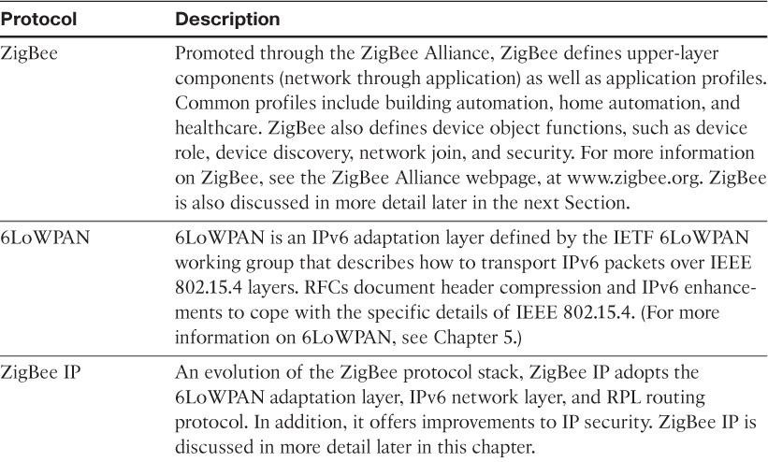
Protocol Stacks Utilizing IEEE 802.15.4

Slide 83
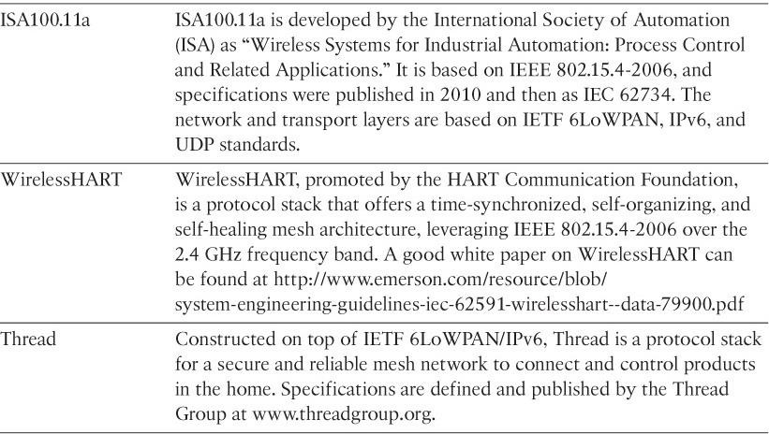

Slide 84
ZigBee
ZigBee solutions are aimed at smart objects and sensors that have low bandwidth and low power needs.
Furthermore, products that are ZigBee compliant and certified by the ZigBee Alliance should interoperate even though different vendors may manufacture them
The Zigbee specification has undergone several revisions.
In the 2006 revision, sets of commands and message types were introduced, and increased in number in the 2007 (called Zigbee pro) iteration, to achieve different functions for a device, such as metering, temperature, or lighting control

Slide 85
The main areas where ZigBee is the most well-known include automation for commercial, retail, and home applications and smart energy
In the industrial and commercial automation space, Zigbee based devices can handle various functions, from measuring temperature and humidity to tracking assets.
For home automation, ZigBee can control lighting, Zigbee Smart Energy brings together a variety of interoperable products, such as smart meters, that can monitor and control the use and delivery of utilities, such as electricity and water

Slide 86
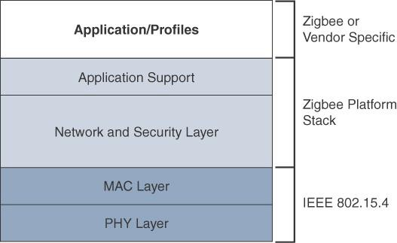
The traditional ZigBee stack

Slide 87
The ZigBee network and security layer provides mechanisms for network startup, configuration, routing, and securing communications.
This includes calculating routing paths in what is often a changing topology, discovering neighbors, and managing the routing tables as devices join for the first time.
The network layer is also responsible for forming the appropriate topology, which is often a mesh but could be a star or tree as well.
From a security perspective, ZigBee utilizes 802.15.4 for security at the MAC layer, using the Advanced Encryption Standard (AES) with a 128-bit key and also provides security at the network and application layers.

Slide 88
ZigBee uses Ad hoc On-Demand Distance Vector (AODV) routing across a mesh network.
Interestingly, this routing algorithm does not send a message until a route is needed.
Assuming that the next hop for a route is not in its routing table, a network node broadcasts a request for a routing connection.
This causes a burst of routing related traffic, but after a comparison of various responses, the path with the lowest number of hops is determined for the connection.

Slide 89
The application support layer interfaces the lower portion of the stack dealing with the networking of ZigBee devices with the higher-layer applications.
ZigBee predefines many application profiles for certain industries, and vendors can optionally create their own custom ones at this layer.
As mentioned previously, Home Automation and Smart Energy are two examples of popular application profiles.

Slide 90
ZigBee IP
With the introduction of ZigBee IP, the support of IEEE
802.15.4 continues, but the IP and TCP/UDP protocols and various other open standards are now supported at the network and transport layers.
The ZigBee-specific layers are now found only at the top of the protocol stack for the applications

Slide 91
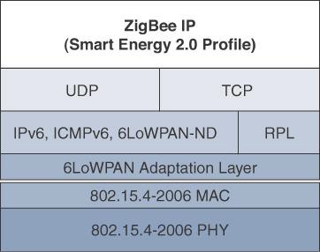
The ZigBee IP stack

Slide 92
ZigBee IP supports 6LoWPAN as an adaptation layer.
The 6LoWPAN mesh addressing header is not required as ZigBee IP utilizes the mesh-over or route-over method for forwarding packets.
ZigBee IP requires the support of 6LoWPAN’s fragmentation and
header compression schemes.
At the network layer, all ZigBee IP nodes support IPv6, ICMPv6, and 6LoWPAN Neighbor Discovery (ND), and utilize RPL for the routing of packets across the mesh network.
Both TCP and UDP are also supported, to provide both
connection-oriented and connectionless service.

Slide 93
Physical Layer
The 802.15.4 standard supports an extensive number of PHY options that range from 2.4 GHz to sub-GHz frequencies in ISM bands
The original IEEE 802.15.4-2003 standard specified only three PHY options based on direct sequence spread spectrum (DSSS) modulation.
DSSS is a modulation technique in which a signal is intentionally spread in the frequency domain, resulting in greater bandwidth.

Slide 94
Modulation
In the modulation process, some parameter of the carrier wave (such as amplitude, frequency or phase ) is varied in accordance with the modulating signal . This modulated signal is then transmitted by the transmitter
In the modulation process, two signals are used namely the modulating signal and the carrier
The modulating signal is nothing but the baseband signal or information signal while the carrier is a high frequency sinusoidal signal

Slide 95
Advantages of Modulation
Reduction in the height of antenna
Avoids mixing of signals
Increases the range of communication
Multiplexing is possible
Improves quality of reception

Slide 96
For the transmission of radio signals, the antenna height must be multiple of λ/4 ,where λ is the wavelength .
λ = c /f
where c : is the velocity of light
f: is the frequency of the signal to be transmitted
The minimum antenna height required to transmit a baseband signal of f = 10 kHz is calculated as follows:

Slide 97
The original physical layer transmission options were as follows:
2.4 GHz, 16 channels, with a data rate of 250 kbps
915 MHz, 10 channels, with a data rate of 40 kbps
868 MHz, 1 channel, with a data rate of 20 kbps
IEEE 802.15.4-2006, 802.15.4- 2011, and IEEE 802.15.4-2015

Slide 98
Introduced additional PHY communication options, including the following:
OQPSK PHY
This is DSSS PHY, employing offset quadrature phase shift keying (OQPSK) modulation. OQPSK is a modulation technique that uses four unique bit values signalled by phase changes.
An offset function that is present during phase shifts allows data to be transmitted more reliably.

Slide 99
BPSK PHY:
This is DSSS PHY, employing binary phase-shift keying (BPSK) modulation.
BPSK specifies two unique phase shifts as its data encoding
scheme.
ASK PHY:
This is parallel sequence spread spectrum (PSSS) PHY, employing amplitude shift keying (ASK) and BPSK modulation.
PSSS is an advanced encoding scheme that offers increased range, throughput, data rates, and signal integrity compared to DSSS.
ASK uses amplitude shifts instead of phase shifts to signal different bit values

Slide 100
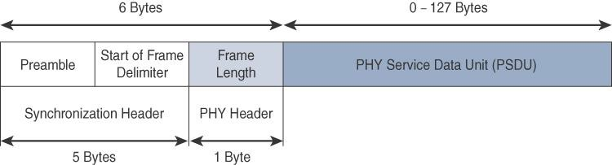
The frame for the 802.15.4 physical layer
The synchronization header for this frame is composed of the
Preamble and the Start of Frame Delimiter fields
The Preamble field is a 32-bit 4-byte pattern that identifies the start of the frame and is used to synchronize the data transmission
The Start of Frame Delimiter field informs the receiver that frame
contents start immediately after this byte

Slide 101
The PHY Header portion of the PHY frame is frame length value. It lets the receiver know how much total data to expect in the PHY service data unit (PSDU) portion of the
802.4.15 PHY.
The PSDU is the data field or payload
The maximum size of the IEEE 802.15.4 PSDU is 127 bytes.This size is significantly smaller than the lowest MTU setting of other upper-layer protocols, such as IPv6, which has a minimum MTU setting of 1280 bytes. Therefore, fragmentation of the IPv6 packet must occur at the data link layer for larger IPv6 packets to be carried over IEEE 802.15.4 frames.

Slide 102
MAC Layer
At this layer, the scheduling and routing of data frames are coordinated
The 802.15.4 MAC layer performs the following tasks:
Network beaconing for devices acting as coordinators (New devices use beacons to join an 802.15.4 network)
PAN association and disassociation by a device
Device security
Reliable link communications between two peer MAC entities

Slide 103
The MAC layer achieves these tasks by using various predefined frame types
Four types of MAC frames are specified in 802.15.4:
Data frame:
Handles all transfers of data
Beacon frame:
Used in the transmission of beacons from a PAN coordinator
Acknowledgement frame:
Confirms the successful reception of a frame
MAC command frame:
Responsible for control communication between devices

Slide 104
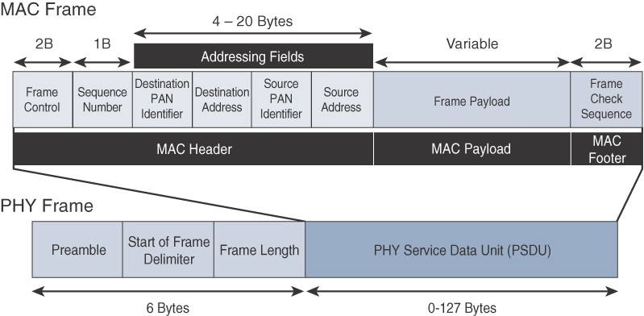
IEEE 802.15.4 MAC Format

Slide 105
The MAC Header field is composed of the Frame Control, Sequence Number and the Addressing fields.
The Frame Control field defines attributes such as frame type, addressing modes, and other control flags.
The Sequence Number field indicates the sequence identifier for the frame.
The Addressing field specifies the Source and Destination PAN Identifier fields as well as the Source and Destination Address fields

Slide 106
The MAC Payload field varies by individual frame type.
For example, beacon frames have specific fields and payloads related to beacons, while MAC command frames have different fields present.
The MAC Footer field is nothing more than a frame check sequence (FCS).
An FCS is a calculation based on the data in the frame that is used by the receiving side to confirm the integrity of the data in the frame.

Slide 107
IEEE 802.15.4 requires all devices to support a unique 64-bit extended MAC address, based on EUI-64.
However, because the maximum payload is 127 bytes, 802.15.4 also defines how a 16-bit “short address” is assigned to devices.
This short address is local to the PAN and substantially reduces the frame overhead compared to a 64-bit extended MAC address

Slide 108
Topology
IEEE 802.15.4–based networks can be built as star, peer-to- peer, or mesh topologies.
Mesh networks tie together many nodes.
This allows nodes that would be out of range if trying to communicate directly to leverage intermediary nodes to transfer communications.
Every 802.15.4 PAN should be set up with a unique ID.
All the nodes in the same 802.15.4 network should use the same PAN ID

Slide 109
Network Topology Models
Mesh
Star
PAN coordinator (PANC)
Cluster Tree
Full Function Device (FFD,Router)
Reduced Function Device (RFD)

Slide 110
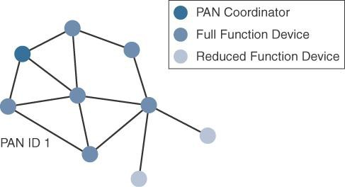
PAN (Personal Area Network ) coordinator is nothing but a sink node which processes the data received by it and takes necessary decisions. Its a FFD (fully functional device) which means it can send requests for data that is in Pull Mode and it can also receive data from all other neighboring nodes that is when in Push Mode

Slide 111
A minimum of one FFD acting as a PAN coordinator is required to deliver services that allow other devices to associate and form a cell or PAN.
A single PAN coordinator is identified for PAN ID 1.
FFD devices can communicate with any other devices, whereas RFD devices can communicate only with FFD devices.

Slide 112
The IEEE 802.15.4 specification does not define a path selection within the MAC layer for a mesh topology.
This function can be done at Layer 2 and is known as mesh- under.
The routing function can occur at Layer 3, using a routing protocol, such as the IPv6 Routing Protocol for Low Power and Lossy Networks (RPL).
This is referred to as mesh-over

Slide 113
Security
The IEEE 802.15.4 specification uses Advanced Encryption Standard (AES) with a 128-bit key length as the base encryption algorithm for securing its data
AES is a block cipher, which means it operates on fixed-size blocks of data
symmetric key - means that the same key is used for both the encryption and decryption of the data
In addition to encrypting the data, AES in 802.15.4 also validates the data that is sent.
This is accomplished by a message integrity code (MIC), which is calculated for the entire frame using the same AES key that is used for encryption

Slide 114
Using the Security Enabled field in the Frame Control portion of the 802.15.4 header is the first step to enabling AES encryption.
This field is a single bit that is set to 1 for security.
Once this bit is set, a field called the Auxiliary Security Header is created after the Source Address field, by stealing some bytes from the Payload field.

Slide 115
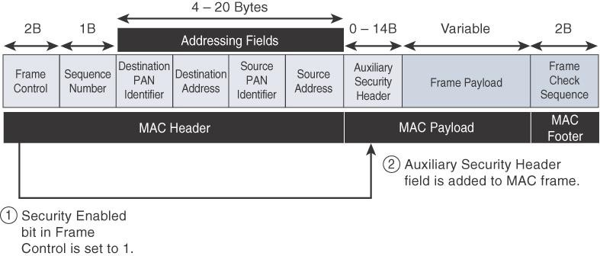
Frame Format with the Auxiliary Security Header Field for 802.15.4- 2006 and Later Versions

Slide 116
IEEE 802.15.4g and 802.15.4e
The IEEE 802.15.4e amendment of 802.15.4-2011 expands the MAC layer feature set to remedy the disadvantages associated with 802.15.4, including MAC reliability, unbounded latency, and multipath fading
Also made improvements to better cope with certain application domains, such as factory and process automation and smart grid
IEEE 802.15.4e-2012 enhanced the IEEE 802.15.4 MAC layer capabilities in the areas of frame format, security, determinism mechanism, and frequency hopping

Slide 117
IEEE 802.15.4g-2012 is also an amendment to the IEEE 802.15.4-2011 standard
The focus of this specification is the smart grid or, more specifically, smart utility network communication.
802.15.4g seeks to optimize large outdoor wireless mesh networks for field area networks (FANs)

Slide 118
This technology applies to IoT use cases such as the following:
Distribution automation and industrial supervisory control and data acquisition (SCADA) environments for remote monitoring and control
Public lighting
Environmental wireless sensors in smart cities
Electrical vehicle charging stations
Smart parking meters
Microgrids
Renewable energy

Slide 119
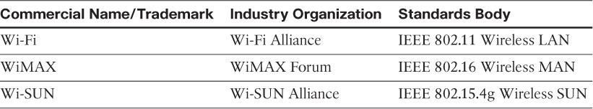
Standardization and Alliances
To guarantee interoperability, the Wi-SUN Alliance was formed. (SUN stands for Smart Utility Network.)

Slide 120
Physical Layer
PSDU or payload size of 127 bytes was increased for the SUN PHY to 2047 bytes
This provides a better match for the greater packet sizes found in many upper-layer protocols.
For example, the default IPv6 MTU setting is 1280 bytes.
Fragmentation is no longer necessary at Layer 2 when IPv6 packets are transmitted over IEEE 802.15.4g MAC frames.
The error protection was improved in IEEE 802.15.4g by evolving the CRC from 16 to 32 bits

Slide 121
The SUN PHY, as described in IEEE 802.15.4g-2012, supports multiple data rates in bands ranging from 169 MHz to 2.4 GHz.
These bands are covered in the unlicensed ISM frequency spectrum
Within these bands, data must be modulated onto the frequency using at least one of the following PHY mechanisms to be IEEE 802.15.4g compliant:
Multi-Rate and Multi-Regional Frequency Shift Keying (MR-FSK)
Offers good transmit power efficiency due to the constant envelope of the transmit signal

Slide 122
Multi-Rate and Multi-Regional Orthogonal Frequency Division Multiplexing (MR-OFDM)
Provides higher data rates but may be too complex for low- cost and low-power devices
Multi-Rate and Multi-Regional Offset Quadrature Phase-Shift Keying (MR-O-QPSK)
Shares the same characteristics of the IEEE 802.15.4-2006 O-QPSK PHY, making multi-mode systems more cost- effective and easier to design
Enhanced data rates and a greater number of channels for channel hopping are available, depending on the frequency bands and modulation

Slide 123
MAC Layer
Time-Slotted Channel Hopping (TSCH):
It is an IEEE 802.15.4e-2012 MAC operation mode that works to guarantee media access and channel diversity.
Channel hopping, also known as frequency hopping, utilizes different channels for transmission at different times.
TSCH divides time into fixed time periods, or “time slots,”
which offer guaranteed bandwidth and predictable latency.
In a time slot, one packet and its acknowledgement can be transmitted, increasing network capacity because multiple nodes can communicate in the same time slot, using different channels

Slide 124
A number of time slots are defined as a “slot frame,” which is regularly repeated to provide “guaranteed access.”
The transmitter and receiver agree on the channels and the timing for switching between channels through the combination of a global time slot counter and a global channel hopping sequence list

Slide 125
Information elements:
Information elements (IEs) allow for the exchange of information at the MAC layer in an extensible manner, either as header IEs (standardized) and/or payload IEs (private).
Specified in a tag, length, value (TLV) format, the IE field allows frames to carry additional metadata to support MAC layer services
These services may include IEEE 802.15.9 key management, Wi-SUN 1.0 IEs to broadcast and unicast schedule timing information, and frequency hopping synchronization information for the 6TiSCH architecture.

Slide 126
Enhanced beacons (EBs):
EBs extend the flexibility of IEEE 802.15.4 beacons to allow the construction of application-specific beacon content.
This is accomplished by including relevant IEs in EB frames.
Some IEs that may be found in EBs include network metrics, frequency hopping broadcast schedule, and PAN information version.

Slide 127
Enhanced beacon requests (EBRs):
Like enhanced beacons, an enhanced beacon request (EBRs) also leverages IEs.
The IEs in EBRs allow the sender to selectively specify the request of information.
Beacon responses are then limited to what was requested in the EBR.
For example, a device can query for a PAN that is allowing new devices to join or a PAN that supports a certain set of MAC/PHY capabilities

Slide 128
Enhanced Acknowledgement:
The Enhanced Acknowledgement frame allows for the integration of a frame counter for the frame being acknowledged.
This feature helps protect against certain attacks that occur when Acknowledgement frames are spoofed.

Slide 129
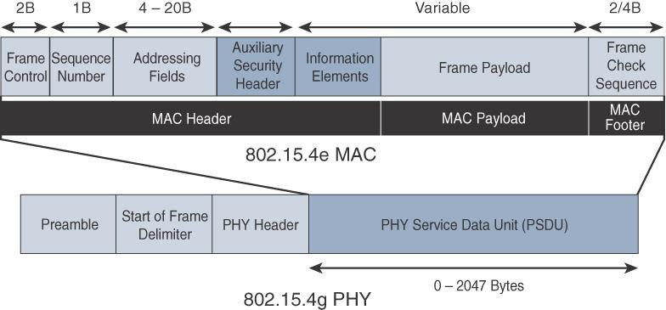
IEEE 802.15.4g/e MAC Frame Format

Slide 130
The main changes shown in the IEEE 802.15.4e header are the presence of the Auxiliary Security Header and Information Elements field.
The Auxiliary Security header provides for the encryption of the data frame
The IE field contains one or more information elements that allow for additional information to be exchanged at the MAC layer.

Slide 131
Topology
Deployments of IEEE 802.15.4g-2012 are mostly based on a mesh topology
Mesh topology is typically the best choice for use cases in the industrial and smart cities areas
A mesh topology allows deployments to be done in urban or rural areas, expanding the distance between nodes that can relay the traffic of other nodes.

Slide 132
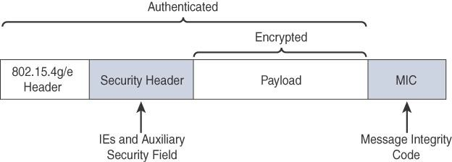
Security
Both IEEE 802.15.4g and 802.15.4e inherit their security attributes from the IEEE 802.15.4-2006 specification.
Encryption is provided by AES, with a 128-bit key.
In addition to the Auxiliary Security Header field initially defined in 802.15.4-2006, a secure acknowledgement and a secure Enhanced Beacon field complete the MAC layer security

Slide 133
The full frame gets authenticated through the MIC at the end of frame.
The MIC is a unique value that is calculated based on the frame contents.
The Security Header field denoted is composed of the Auxiliary Security field and one or more Information Elements fields.
Integration of the Information Elements fields allows for the adoption of additional security capabilities, such as the IEEE
802.15.9 Key Management Protocol (KMP) specification.
KMP provides a means for establishing keys for robust datagram
security

Slide 134
IEEE 1901.2a
IEEE 1901.2a-2013 is a wired technology that is an update to the original IEEE 1901.2 specification.
This is a standard for Narrowband Power Line Communication (NB-PLC).
NB-PLC leverages a narrowband spectrum for low power, long range, and resistance to interference over the same wires that carry electric power.

Slide 135
NB-PLC is often found in use cases such as the following:
Smart metering:
NB-PLC can be used to automate the reading of utility meters, such as electric, gas, and water meters
Distribution automation:
NB-PLC can be used for distribution automation, which involves monitoring and controlling all the devices in the power grid.

Slide 136
Public lighting:
A common use for NB-PLC is with public lighting—the lights found in cities and along streets, highways, and public areas such as parks.
Electric vehicle charging stations:
NB-PLC can be used for electric vehicle charging stations, where the batteries of electric vehicles can be recharged.
Microgrids:
NB-PLC can be used for microgrids, local energy grids that can disconnect from the traditional grid and operate independently.
Renewable energy:
NB-PLC can be used in renewable energy applications, such as solar, wind power, hydroelectric, and geothermal heat.

Slide 137
LoRaWAN
Low-Power Wide-Area (LPWA) adapted for long-range and battery powered endpoints
LoRaWAN is unlicensed-band LPWA technology
LoRa was a physical layer, or Layer 1, modulation that was developed by a French company named Cycleo
Later, Cycleo was acquired by Semtech
Optimized for long-range, two-way communications and low power consumption

Slide 138
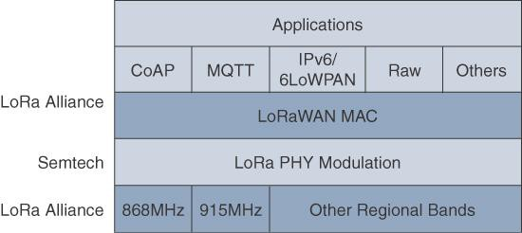
LoRaWAN Layers

Slide 139
Physical Layer
Semtech LoRa modulation is based on chirp spread spectrum modulation
Chirp - Compressed High Intensity Radar Pulse
Lower data rate and increase the communication distance

Slide 140
Understanding LoRa gateways is critical to understanding a LoRaWAN system.
A LoRa gateway is deployed as the center hub of a star network architecture.
It uses multiple transceivers and channels and can demodulate multiple channels at once or even demodulate multiple signals on the same channel simultaneously.
LoRa gateways serve as a transparent bridge relaying data between endpoints, and the endpoints use a single-hop wireless connection to communicate with one or many gateways.

Slide 141
The data rate in LoRaWAN varies depending on the frequency bands and adaptive data rate (ADR).
ADR is an algorithm that manages the data rate and radio signal for each endpoint.
The ADR algorithm ensures that packets are delivered at the best data rate possible and that network performance is both optimal and scalable.
Endpoints close to the gateways with good signal values transmit with the highest data rate, which enables a shorter transmission time over the wireless network, and the lowest transmit power.
Meanwhile, endpoints at the edge of the link budget communicate
at the lowest data rate and highest transmit power.

Slide 142
An important feature of LoRa is its ability to handle various data rates via the spreading factor.
Devices with a low spreading factor (SF) achieve less distance in their communications but transmit at faster speeds, resulting in less airtime.
A higher SF provides slower transmission rates but achieves a higher reliability at longer distances.

Slide 143
MAC Layer
The MAC layer is defined in the LoRaWAN specification.
This layer takes advantage of the LoRa physical layer and classifies LoRaWAN endpoints to optimize their battery life and ensure downstream communications to the LoRaWAN endpoints.
The LoRaWAN specification documents three classes of LoRaWAN devices:
Class A:
This class is the default implementation. Optimized for battery powered nodes, it allows bidirectional communications, where a given node is able to receive downstream traffic after transmitting.
Two receive windows are available after each transmission

Slide 144
Class B:
This class was designated “experimental” in LoRaWAN 1.0.1 until it can be better defined.
A Class B node or endpoint should get additional receive windows compared to Class A, but gateways must be synchronized through a beaconing process
Class C:
This class is particularly adapted for powered nodes.
This classification enables a node to be continuously listening by keeping its receive window open when not transmitting.

Slide 145

LoRaWAN messages, either uplink or downlink, have a PHY payload composed of a 1-byte MAC header, a variable-byte MAC payload, and a MIC that is 4 bytes in length.
The MAC payload size depends on the frequency band and the data rate, ranging from 59 to 230 bytes for the 863–870 MHz band and 19 to 250 bytes for the 902–928 MHz band

Slide 146
In version 1.0.x, LoRaWAN utilizes six MAC message types.
LoRaWAN devices use join request and join accept messages for activation and joining the network.
The other message types are unconfirmed data up/down and
confirmed data up/down.
A “confirmed” message is one that must be acknowledged, and “unconfirmed” signifies that the end device does not need to acknowledge.
“up/down” is simply a directional notation identifying whether the
message flows in the uplink or downlink path.
Uplink messages are sent from endpoints to the network server and are relayed by one or more LoRaWAN gateways.
Downlink messages flow from the network server to a single endpoint and are relayed by only a single gateway

Slide 147
LoRaWAN endpoints are uniquely addressable througha variety of methods, including the following:
An endpoint can have a global end device ID or DevEUI represented as an IEEE EUI-64 address.
An endpoint can have a global application ID or AppEUI represented as an IEEE EUI-64 address that uniquely identifies the application provider, such as the owner, of the end device

Slide 148
In a LoRaWAN network, endpoints are also known by their end device address, known as a DevAddr, a 32-bit address.
The 7 most significant bits are the network identifier (NwkID), which identifies the LoRaWAN network.
The 25 least significant bits are used as the network address (NwkAddr) to identify the endpoint in the network.

Slide 149
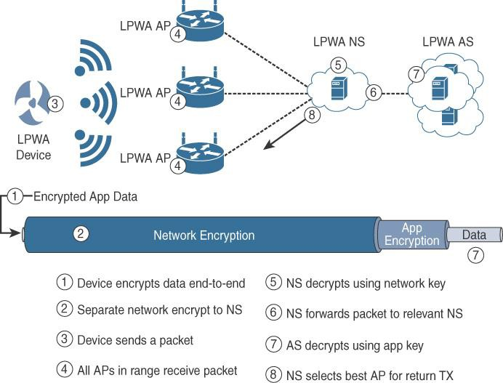
Security

Slide 150
LoRaWAN endpoints must implement two layers of security, protecting communications and data privacy across the network.
The first layer, called “network security” but applied at the MAC layer, guarantees the authentication of the endpoints by the LoRaWAN network server.
Also, it protects LoRaWAN packets by performing encryption based on AES

Slide 151
Each endpoint implements a network session key (NwkSKey), used by both itself and the LoRaWAN network server.
The NwkSKey ensures data integrity through computing and checking the MIC of every data message as well as encrypting and decrypting MAC-only data message payloads
The second layer is an application session key (AppSKey), which performs encryption and decryption functions between the endpoint and its application server

Slide 152
LoRaWAN endpoints attached to a LoRaWAN network must get registered and authenticated.
This can be achieved through one of the two join mechanisms:
Activation by personalization (ABP):
Endpoints don’t need to run a join procedure as their individual details, including DevAddr and the NwkSKey and AppSKey session keys, are preconfigured and stored in the end device.
This same information is registered in the LoRaWAN network server

Slide 153
Over-the-air activation (OTAA):
Endpoints are allowed to dynamically join a particular LoRaWAN
network after successfully going through a join procedure.
The join procedure must be done every time a session context is renewed.
During the join process, which involves the sending and receiving of MAC layer join request and join accept messages, the node establishes its credentials with a LoRaWAN network server, exchanging its globally unique DevEUI, AppEUI, and AppKey.
The AppKey is then used to derive the session NwkSKey and
AppSKey keys

Slide 154
NB-IoT and Other LTE Variations
Existing cellular technologies, such as GPRS, Edge, 3G, and 4G/LTE, are not particularly well adapted to battery- powered devices and small objects specifically developed for the Internet of Things
LTE -M
The new LTE-M device category was not sufficiently closeto LPWA capabilities
A new narrowband radio access technology called Narrowband IoT (NB-IoT)

Slide 155
It addresses the requirements of a massive number of low- throughput devices, low device power consumption, improved indoor coverage, and optimized network architecture

Slide 156
LTE Cat 0
The first enhancements to better support IoT devices in 3GPP occurred in LTE Release 12.
A new user equipment (UE) category, Category 0, was added, with devices running at a maximum data rate of 1 Mbps
Category 0 includes important characteristics to be supported by both the network and end devices

Slide 157
Power saving mode (PSM)
This new device status minimizes energy consumption
PSM is defined as being similar to “powered off ” mode, but the
device stays registered with the network.
By staying registered, the device avoids having to reattach or re- establish its network connection
The device negotiates with the network the idle time after which it will wake up.
When it wakes up, it initiates a tracking area update (TAU), after which it stays available for a configured time and then switches back to sleep mode or PSM.
A TAU is a procedure that an LTE device uses to let the network know its current tracking area, or the group of towers in the network from which it can be reached

Slide 158
Half-duplex mode
This mode reduces the cost and complexity of a device’s
implementation because a duplex filter is not needed.
Most IoT endpoints are sensors that send low amounts of data that do not have a full duplex communication requirement.

Slide 159
LTE-M
LTE Release 13
Lower receiver bandwidth
Bandwidth has been lowered to 1.4 MHz versus the usual 20 MHz.This further simplifies the LTE endpoint
Lower data rate
Data is around 200 kbps for LTE-M, compared to 1 Mbps for Cat 0.

Slide 160
Half-duplex mode
Just as with Cat 0, LTE-M offers a half-duplex mode that decreases node complexity and cost
Enhanced discontinuous reception (eDRX)
This capability increases from seconds to minutes the amount
of time an endpoint can “sleep” between paging cycles

