Slide 2
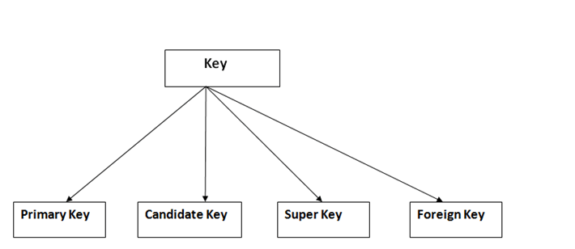
Keys
It is used to uniquely identify any record or row of data from the table. It is also used to establish and identify relationships between tables.

Slide 3
Primary key
It is the first key which is used to identify one and only one instance of an entity uniquely
Candidate Key
A candidate key is an attribute or set of an attribute which can uniquely identify a tuple.
The remaining attributes except for primary key are considered as a candidate key. The candidate keys are as strong as the primary key.

Slide 4
Super Key
Super key is a set of an attribute which can uniquely identify a tuple. Super key is a superset of a candidate key.
Foreign key
Foreign keys are the column of the table which is used to point to the primary key of another table.

Slide 5
Generalization
Generalization is like a bottom-up approach in which two or more entities of lower level combine to form a higher level entity if they have some attributes in common.
In generalization, an entity of a higher level can also combine with the entities of the lower level to form a further higher level entity.
Generalization is more like subclass and superclass system, but the only difference is the approach. Generalization uses the bottom-up approach.

Slide 6
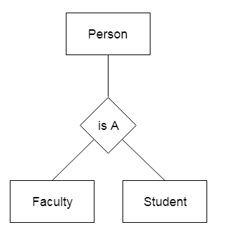

Slide 7
Specialization
Specialization is a top-down approach, and it is opposite to Generalization. In specialization, one higher level entity can be broken down into two lower level entities.
Specialization is used to identify the subset of an entity set that shares some distinguishing characteristics.
Normally, the superclass is defined first, the subclass and its related attributes are defined next, and relationship set are then added.

Slide 8
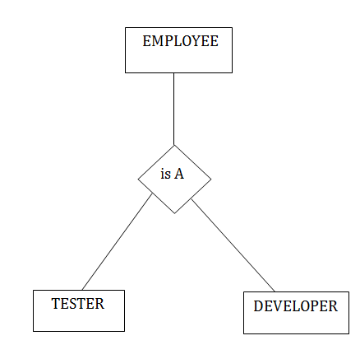

Slide 9
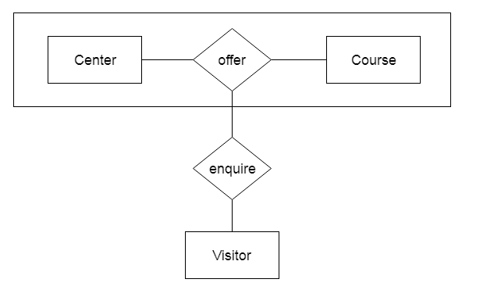
Aggreggation
Aggregation in DBMS (Database Management System) is a process of combining two or more entities to form a more meaningful new entity

Slide 10
Relational Model
Relational model can represent as a table with columns and rows. Each row is known as a tuple. Each table of the column has a name or attribute.
Domain: It contains a set of atomic values that an attribute can take.
Attribute: It contains the name of a column in a particular table. Each attribute Ai must have a domain, dom(Ai)
Relational instance: In the relational database system, the relational instance is represented by a finite set of tuples. Relation instances do not have duplicate tuples.
Relational schema: A relational schema contains the name of the relation and name of all columns or attributes.
Relational key: In the relational key, each row has one or more attributes. It can identify the row in the relation uniquely.

Slide 11
Properties of Relations
Name of the relation is distinct from all other relations.
Each relation cell contains exactly one atomic (single) value
Each attribute contains a distinct name
Attribute domain has no significance
tuple has no duplicate value
Order of tuple can have a different sequence

Slide 12
