Slide 2
Concurrency Control
Used for
Controlling and managing the concurrent execution of database operations .
Try to achieve serializability
Avoiding the inconsistencies in the database
Ensure the atomicity, consistency, isolation, durability and serializability

Slide 3
Concurrency Control Protocols
Lock Based Concurrency Control Protocol
Time Stamp Concurrency Control Protocol
Validation Based Concurrency Control Protocol

Slide 4
Lock-Based Protocol
In this type of protocol, any transaction cannot read or write data until it acquires an appropriate lock on it. There are two types of lock:
1. Shared lock:
It is also known as a Read-only lock. In a shared lock, the data item can only read by the transaction.
It can be shared between the transactions because when the transaction holds a lock, then it can't update the data on the data item.
2. Exclusive lock:
In the exclusive lock, the data item can be both reads as well as written by the transaction.
This lock is exclusive, and in this lock, multiple transactions do not modify the same data simultaneously.

Slide 5
Issue
Can’t achieve serializability each time.
Issue may rise as irrecoverability, Deadlock, Starvation

Slide 6
1. Simplistic lock protocol
It is the simplest way of locking the data while transaction. Simplistic lock-based protocols allow all the transactions to get the lock on the data before insert or delete or update on it. It will unlock the data item after completing the transaction
2. Pre-claiming Lock Protocol
Pre-claiming Lock Protocols evaluate the transaction to list all the data items on which they need locks.
Before initiating an execution of the transaction, it requests DBMS for all the lock on all those data items.
If all the locks are granted then this protocol allows the transaction to begin. When the transaction is completed then it releases all the lock.
If all the locks are not granted then this protocol allows the transaction to rolls back and waits until all the locks are granted.

Slide 7
3. Two-phase locking (2PL)
The two-phase locking protocol divides the execution phase of the transaction into three parts.
In the first part, when the execution of the transaction starts, it seeks permission for the lock it requires.
In the second part, the transaction acquires all the locks. The third phase is started as soon as the transaction releases its first lock.
In the third phase, the transaction cannot demand any new locks. It only releases the acquired locks.

Slide 8
There are two phases of 2PL:
Growing phase: In the growing phase, a new lock on the data item may be acquired by the transaction, but none can be released.
Shrinking phase: In the shrinking phase, existing lock held by the transaction may be released, but no new locks can be acquired.
In the below example, if lock conversion is allowed then the following phase can happen:
Upgrading of lock (from S(a) to X (a)) is allowed in growing phase.
Downgrading of lock (from X(a) to S(a)) must be done in shrinking phase.

Slide 9
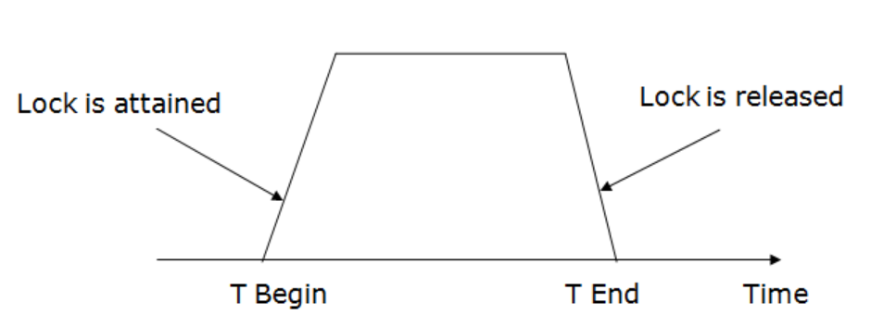

Slide 10
Strict Two-phase locking (Strict-2PL)
The first phase of Strict-2PL is similar to 2PL. In the first phase, after acquiring all the locks, the transaction continues to execute normally.
The only difference between 2PL and strict 2PL is that Strict-2PL does not release a lock after using it.
Strict-2PL waits until the whole transaction to commit, and then it releases all the locks at a time.
Strict-2PL protocol does not have shrinking phase of lock release.
It should satisfy basic 2PL and all Exclusive locks should hold until Commit or Abort
In Rigorous one all Exclusive and shared locks should hold until Commit or Abort

Slide 11
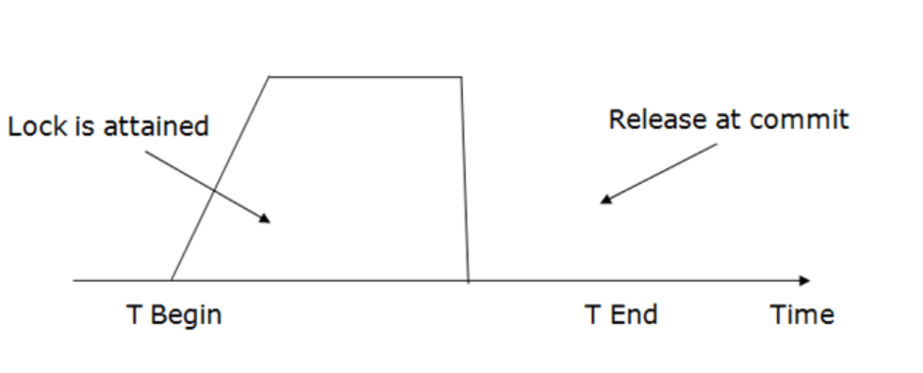

Slide 12
Advantage
Produce cascade and strict recoverable schedule.
Disadvantage
Deadloack
Starvation
Can be resolved by Conservative 2PL.(lock on all variables before transaction)

Slide 13
Casecade and cascadeless
Casecade Schedule
One event can trigger multiple event
On fail of T1, need to rollback T2, T3,T4….
Wastage of CPU allotment.
Cascade less
Once T1 commit only then T2, T3,T4 start.

Slide 14
Timestamp Ordering Protocol
The Timestamp Ordering Protocol is used to order the transactions based on their Timestamps. The order of transaction is nothing but the ascending order of the transaction creation.
The priority of the older transaction is higher that's why it executes first. To determine the timestamp of the transaction, this protocol uses system time or logical counter.
The lock-based protocol is used to manage the order between conflicting pairs among transactions at the execution time. But Timestamp based protocols start working as soon as a transaction is created.
Let's assume there are two transactions T1 and T2. Suppose the transaction T1 has entered the system at 007 times and transaction T2 has entered the system at 009 times. T1 has the higher priority, so it executes first as it is entered the system first.
The timestamp ordering protocol also maintains the timestamp of last 'read' and 'write' operation on a data.

Slide 15
Some variables
TS(TI) denotes the timestamp/transaction-no of the transaction Ti.
R_TS(X) denotes the Read time-stamp of data-item X
Latest transaction no which perform read successfully.
W_TS(X) denotes the Write time-stamp of data-item X.
Latest transaction no which perform write successfully.

Slide 17
Basic Timestamp ordering protocol works as follows:
1. Check the following condition whenever a transaction Ti issues a Read (X) operation:
If W_TS(X) >TS(Ti) then the operation is rejected and Rollback Ti.
If W_TS(X) <= TS(Ti) then the operation is executed and
Set R_TS(X)= Max { R_TS(X) , TS(Ti) }
2. Check the following condition whenever a transaction Ti issues a Write(X) operation:
If TS(Ti) < R_TS(X) then the operation is rejected Rollback Ti
If TS(Ti) < W_TS(X) then the operation is rejected and Rollback Ti
else the operation is executed and W_TS(X) >TS(Ti)

Slide 18
Deferred database modification
deferred-modification technique ensures transaction atomicity by recording all database modifications in thelog, but deferring the execution of all write operations of a transaction until the transaction partially commits.Recall that a transaction is said to be partially committed once the final action of the transaction has been•executed.The version of the deferred-modification technique that we describe in this section assumes that transactions•are executed serially.The execution of transaction Ti proceeds as follows. Before Ti starts its execution, a record <Ti start> is written•to the log.A write(X) operation by Ti results in the writing of a new record to the log. Finally, when Ti partially commits,•a record <Ti commit> is written to the log.When transaction Ti partially commits, the records associated with it in the log are used in executing the deferred•writes. Since a failure may occur while this updating is taking place, we must ensure that, before the start ofthese updates, all the log records are written out to stable storage.To illustrate, r

Slide 19
To illustrate, reconsider our simplified banking system. Let T0 be a transaction that transfers $50 from account•A to account B:T0: read(A);A := A − 50;write(A);read(B);B := B + 50;write(B).Let T1 be a transaction that withdraws $100 from account C:•T1: read(C);C := C − 100;write(C)

Slide 20
Immediate database modificationThe immediate-modification technique allows database modifications to be output to the database while the transactionis still in the active state.Data modifications written by active transactions are called uncommitted modifications.•Before a transaction Ti starts its execution, the system writes the record <Ti start> to the log.•During its execution, any write(X) operation by Ti is preceded by the writing of the appropriate new update•record to the log. When Ti partially commits, the system writes the record <Ti commit> to the log.

