Slide 1


Relational Algebra: 5 Basic Operations
Selection ( ) Selects a subset of rows from relation (horizontal).
Projection ( ) Retains only wanted columns from relation (vertical).
Cross-product (x) Allows us to combine two relations.
Set-difference (–) Tuples in r1, but not in r2.
Union (∪ ) Tuples in r1 and/or in r2.
Since each operation returns a relation, operations can be composed! (Algebra is “closed”.)

Slide 2
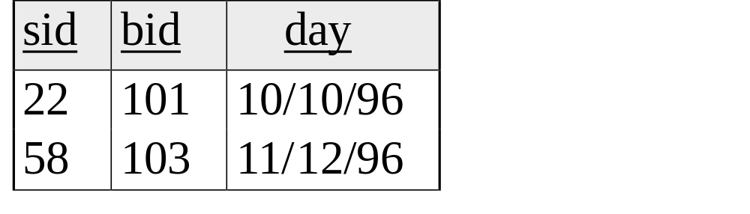
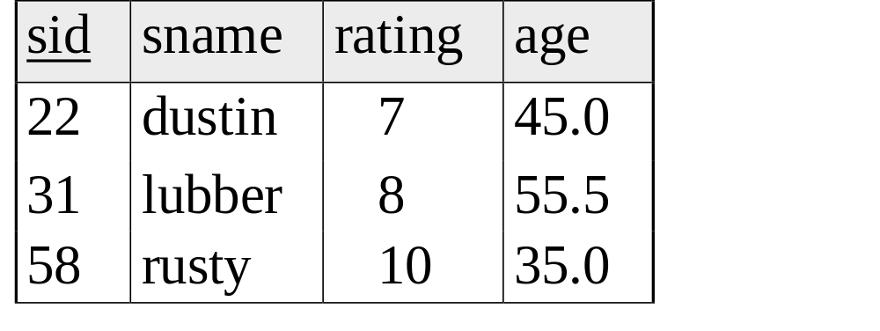
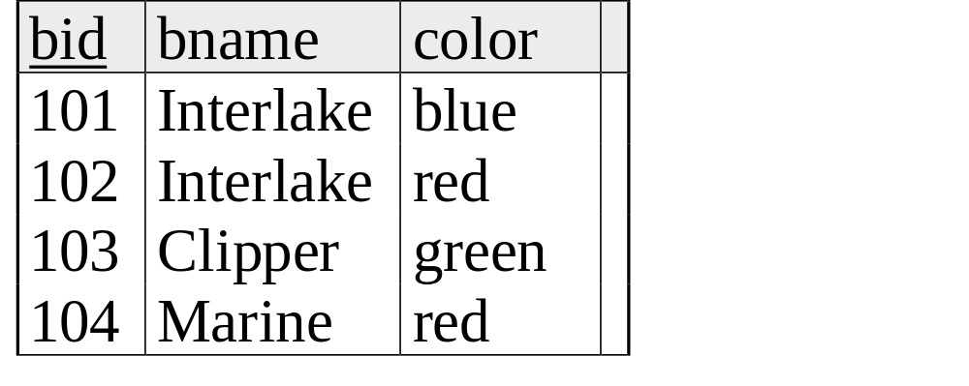
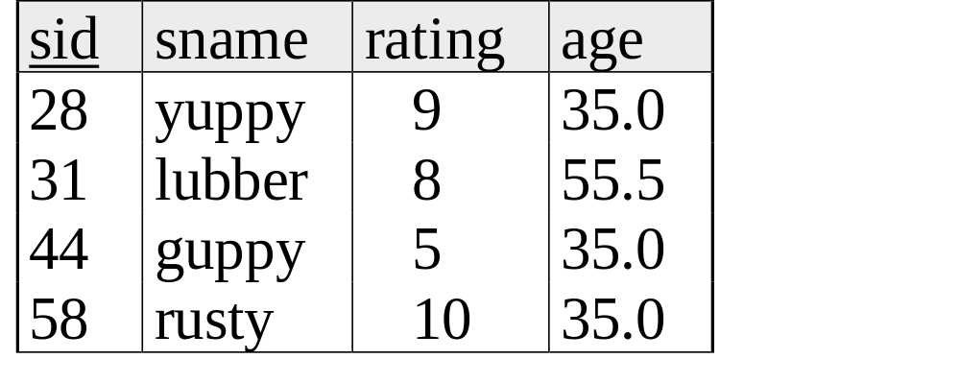
Example Instances
R1
S1
S2
Boats

Slide 3
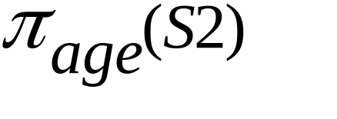
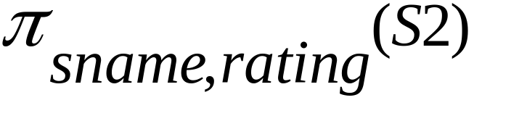
Projection
Examples: ;
Retains only attributes that are in the “projection list”.
Schema of result:
  exactly the fields in the projection list, with the same names that they had in the input relation.
Projection operator has to eliminate duplicates (How do they arise? Why remove them?)
  Note: real systems typically don’t do duplicate elimination unless the user explicitly asks for it. (Why not?)

Slide 4
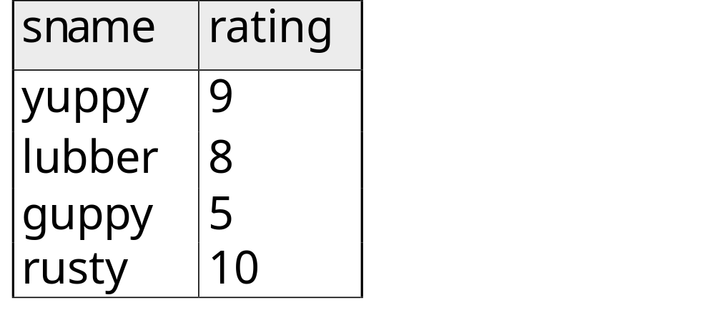
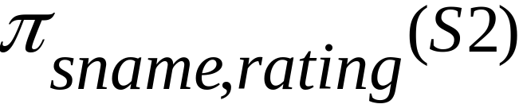
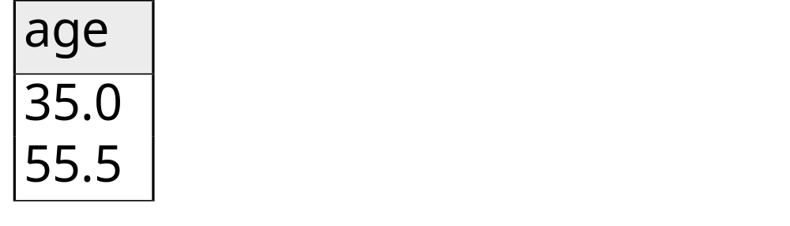
Projection
S2

Slide 5
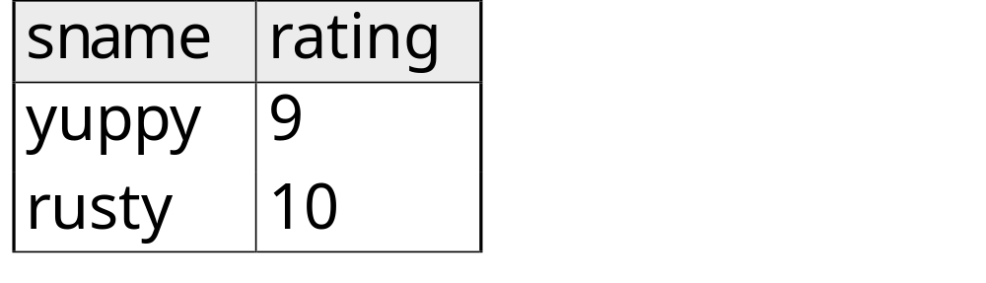
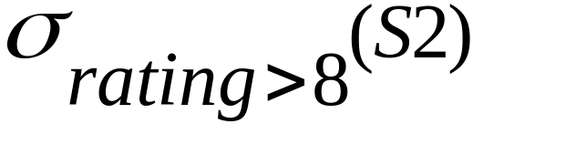
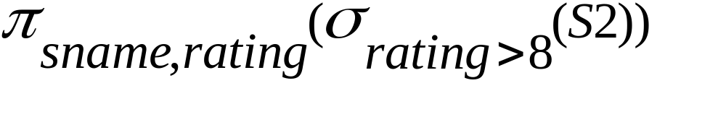
Selection (σ)
Selects rows that satisfy selection condition.
Result is a relation.
  Schema of result is same as that of the input relation.
Do we need to do duplicate elimination?

Slide 6
Union and Set-Difference
All of these operations take two input relations, which must be union-compatible:
  Same number of fields.
  `Corresponding’ fields have the same type.
For which, if any, is duplicate elimination required?

Slide 7
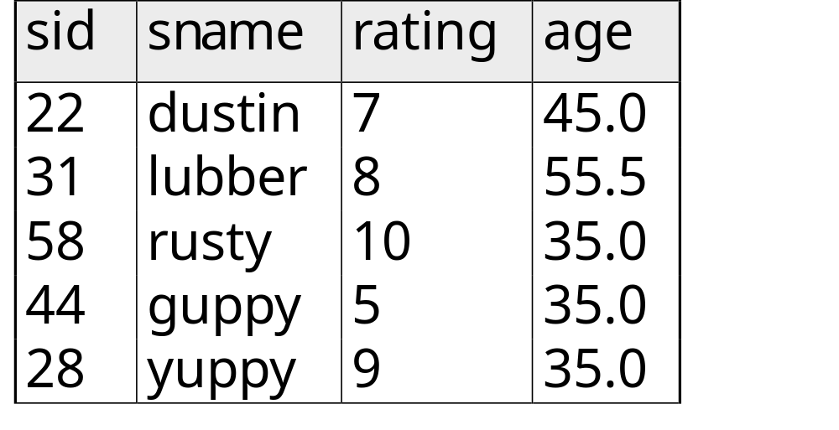
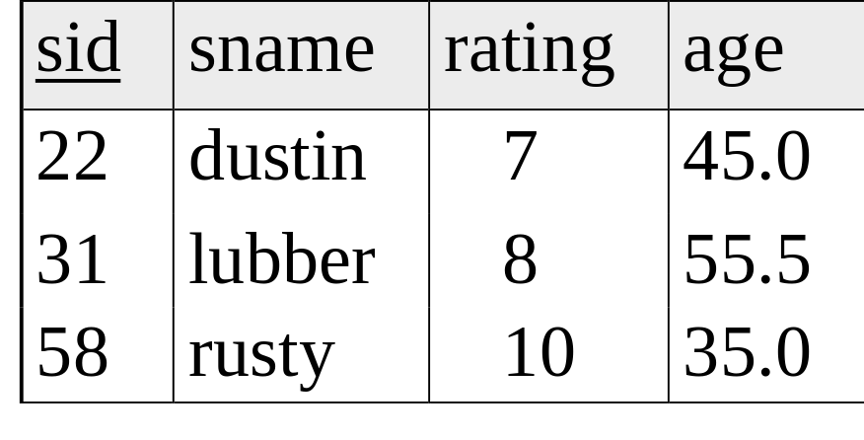

Union
S1
S2

Slide 8
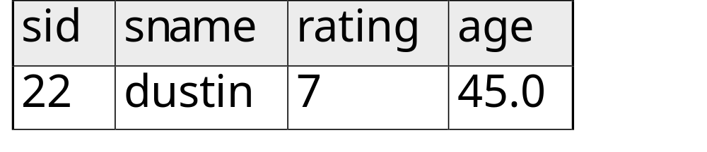

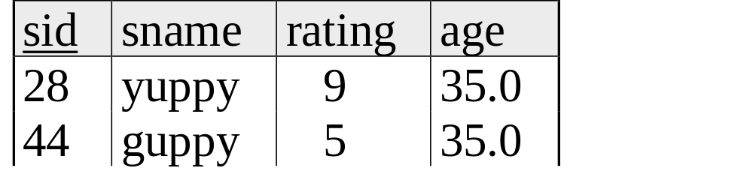
Set Difference
S1
S2 – S1
S2

Slide 9
Cross-Product
S1 x R1: Each row of S1 paired with each row of R1.
Q: How many rows in the result?
Result schema has one field per field of S1 and R1, with field names `inherited’ if possible.
  May have a naming conflict: Both S1 and R1 have a field with the same name.
  In this case, can use the renaming operator:

Slide 10
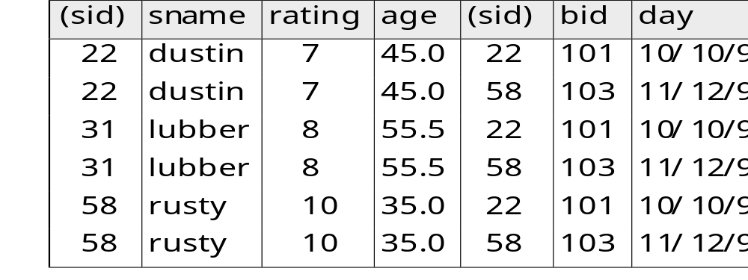
Cross Product Example
R1
S1
R1 X S1 =

Slide 11
Compound Operator: Intersection
In addition to the 5 basic operators, there are several additional “Compound Operators”
  These add no computational power to the language, but are useful shorthands.
  Can be expressed solely with the basic ops.
Intersection takes two input relations, which must be union-compatible.
Q: How to express it using basic operators?
R ∩ S = R − (R − S)

Slide 12
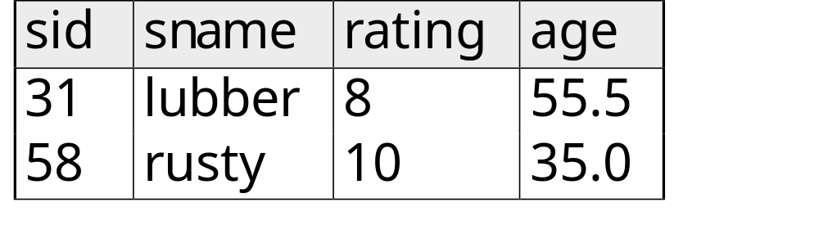

Intersection
S1
S2

Slide 13
Compound Operator: Join
Joins are compound operators involving cross product, selection, and (sometimes) projection.
Most common type of join is a “natural join” (often just called “join”). R S conceptually is:
  Compute R X S
  Select rows where attributes that appear in both relations have equal values
  Project all unique atttributes and one copy of each of the common ones.
Note: Usually done much more efficiently than this.
Useful for putting “normalized” relations back together.

Slide 14
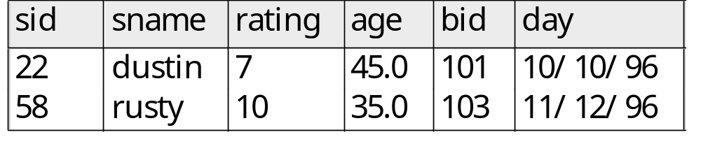
Natural Join Example
R1
S1
R1 S1 =

Slide 15

Other Types of Joins
Condition Join (or “theta-join”):
Result schema same as that of cross-product.
May have fewer tuples than cross-product.
Equi-Join: Special case: condition c contains only conjunction of equalities.

Slide 16
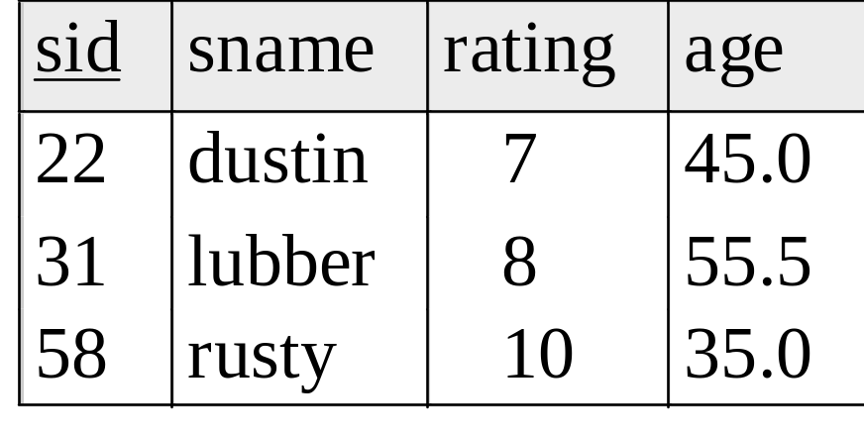
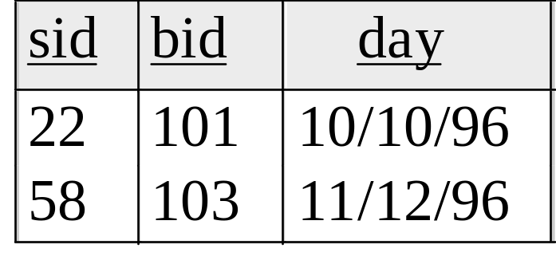
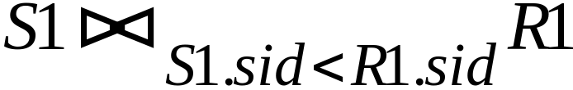
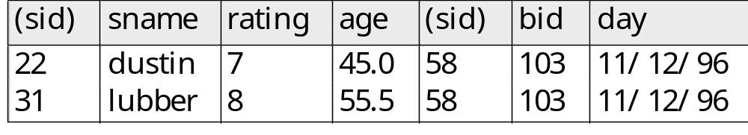
“Theta” Join Example
R1
S1
=

Slide 17
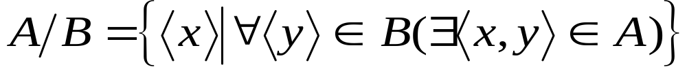
Compound Operator: Division
Useful for expressing “for all” queries like: Find sids of sailors who have reserved all boats.
For A/B attributes of B are subset of attrs of A.
  May need to “project” to make this happen.
E.g., let A have 2 fields, x and y; B have only field y:
  A/B contains all x tuples such that for every y tuple in B, there is an xy tuple in A.

Slide 18
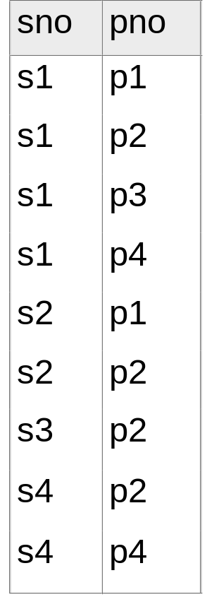
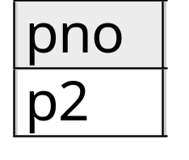
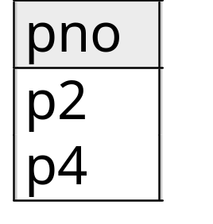
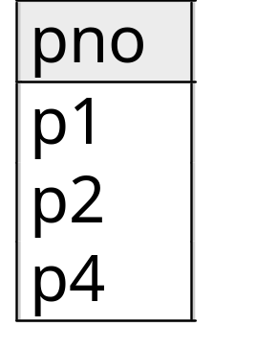
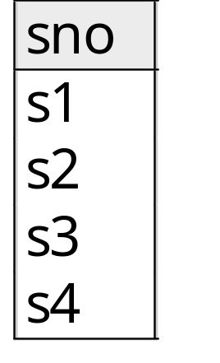
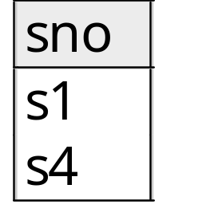
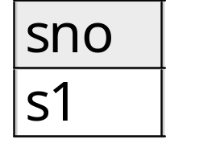
Examples of Division A/B
B1
B2
B3
A
A/B1
A/B2
A/B3

Slide 19
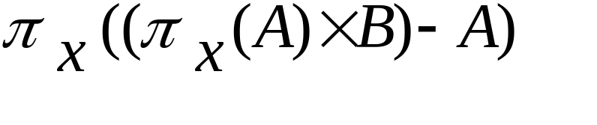
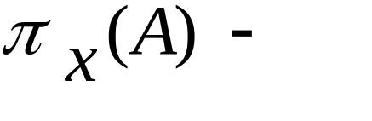
Expressing A/B Using Basic Operators
Division is not essential op; just a useful shorthand.
  (Also true of joins, but joins are so common that systems implement joins specially.)
Idea: For A/B, compute all x values that are not `disqualified’ by some y value in B.
  x value is disqualified if by attaching y value from B, we obtain an xy tuple that is not in A.
  Disqualified x values:
A/B:
Disqualified x values

Slide 20

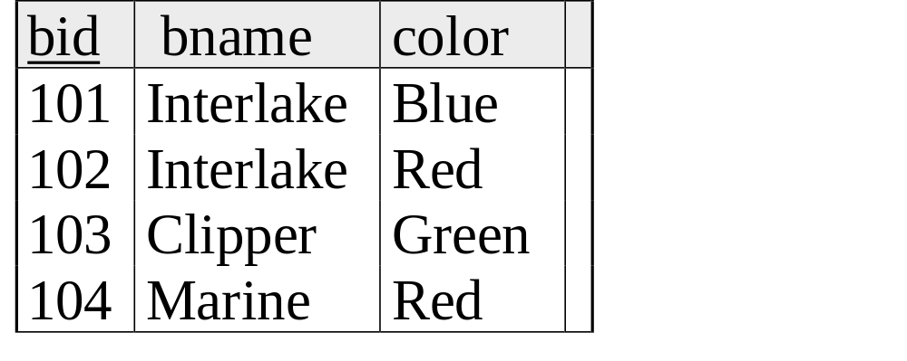
Examples
Reserves
Sailors
_x0016_
Boats

Slide 21
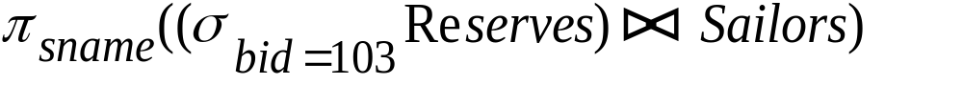
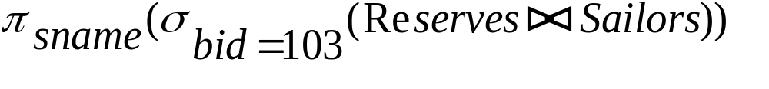
Find names of sailors who’ve reserved boat #103
Solution 1:
Solution 2:

Slide 22
Find names of sailors who’ve reserved a red boat
Information about boat color only available in Boats; so need an extra join:
A more efficient (???) solution:
A query optimizer can find this given the first solution!

Slide 23
Find sailors who’ve reserved a red or a green boat
Can identify all red or green boats, then find sailors who’ve reserved one of these boats:

Slide 24
Find sailors who’ve reserved a red and a green boat
Previous approach won’t work! Must identify sailors who’ve reserved red boats, sailors who’ve reserved green boats, then find the intersection (note that sid is a key for Sailors):

Slide 25
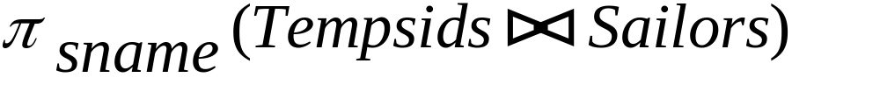
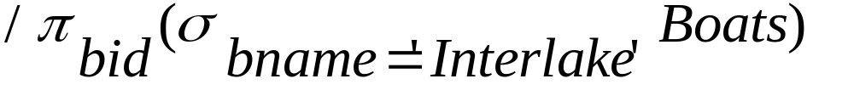
Find the names of sailors who’ve reserved all boats
Uses division; schemas of the input relations to / must be carefully chosen:
To find sailors who’ve reserved all ‘Interlake’ boats:
.....

