Slide 1

JOB RECOMMENDER SYSTEM
TEAM – THE HATER’S
PROBLEM STATEMENT – DK180 (Govt. of Puducherry)

Slide 2




ABOUT PROJECT
Job Recommender System :-
It is a web application. It is made in Django framework. This will get you job recommended. You can find the job you want with the help of this web application. You can easily find a job according to your desire. You have to create an account here. You must have made a good and attrative profile. Which can be liked by any company or organization.
For any job, you have to give an exam. According to which you will have job recommendation. If you give any exam related to web development then you will have web development job recommendation.
Create Account
Search Job
Give Exam
Apply For Job

Slide 3

FRAMEWORK
Django is a high-level Python Web framework that encourages rapid development and clean, pragmatic design. Built by experienced developers, it takes care of much of the hassle of Web development, so you can focus on writing your app without needing to reinvent the wheel. It’s free and open source.
Ridiculously fast.
Django was designed to help developers take applications from concept to completion as quickly as possible.
Reassuringly secure.
Django takes security seriously and helps developers avoid many common security mistakes.
Exceedingly scalable.
Some of the busiest sites on the Web leverage Django’s ability to quickly and flexibly scale.

Slide 4

FRONTEND
HTML provides the basic structure of sites, which is enhanced and modified by other technologies like CSS and JavaScript.
CSS is used to control presentation, formatting, and layout.
JavaScript is used to control the behavior of different elements.

Slide 5
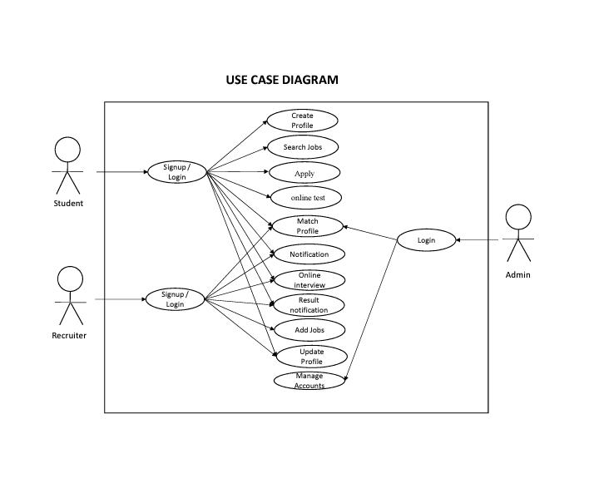

Slide 6
CONTENT
1. Registration (Sign up/ Log in)
- Student/Job Seeker
- Company/Recruiter
2. Make Profile
- Student/Job Seeker
3. Choose Job Category
- By Location
- By Search
- Or Popular Cities
4. Give Exam and Apply Job

Slide 7
INTRODUCTION OF TOPICS
How to Register as a student .
How to Resigter as a company or Recruiter.
How to Make Profile.
How to Give Exam.
How to Apply For Job.

Slide 8
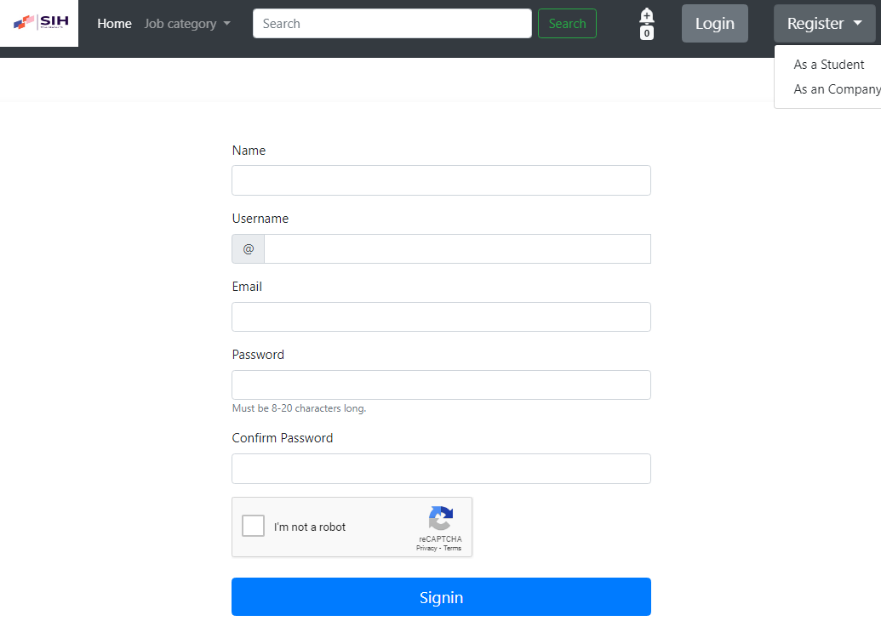

REGISTRATION
1. Type
Student :-
a. Create Account
b. Sign in
RAHUL
RAHUL123
rahul123@gmail.com
……..
………..

Slide 9
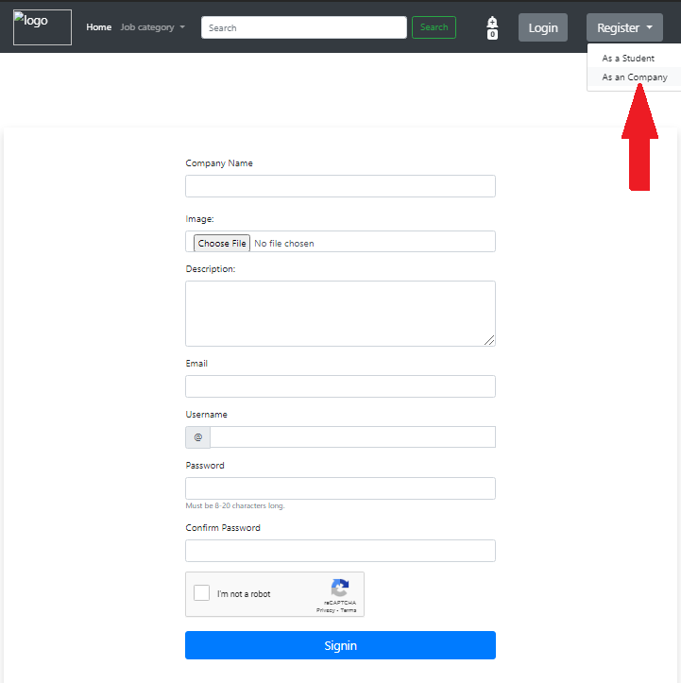

REGISTRATION
Type :-
- Company/ Recruiter
a. Create Account
b. Sign in
TCS INDORE
Img.jpg
The TCS Indore Campus will be located on a 100-acre property allotted by the Madhya Pradesh government. ... The TCS Indore campus will be a state-of-the-art
example@gmail.com
examlpe123
……………………
……………………

Slide 10
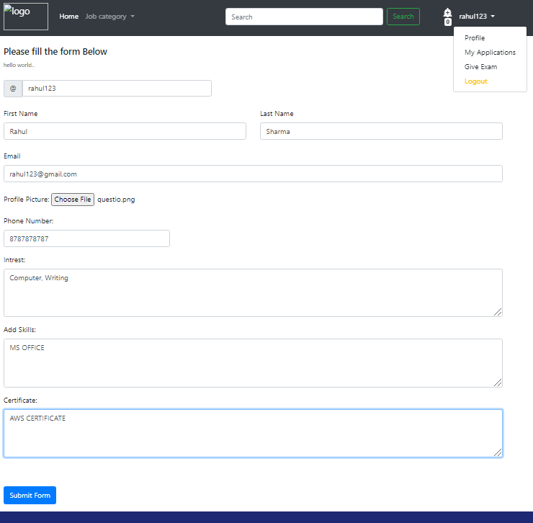
PROFILE
Student

Slide 11

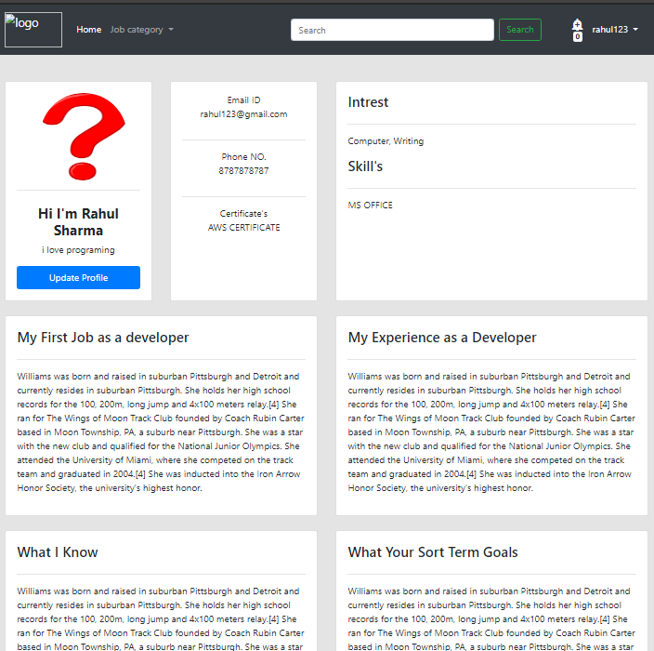
COMPLETE PROFILE

Slide 12

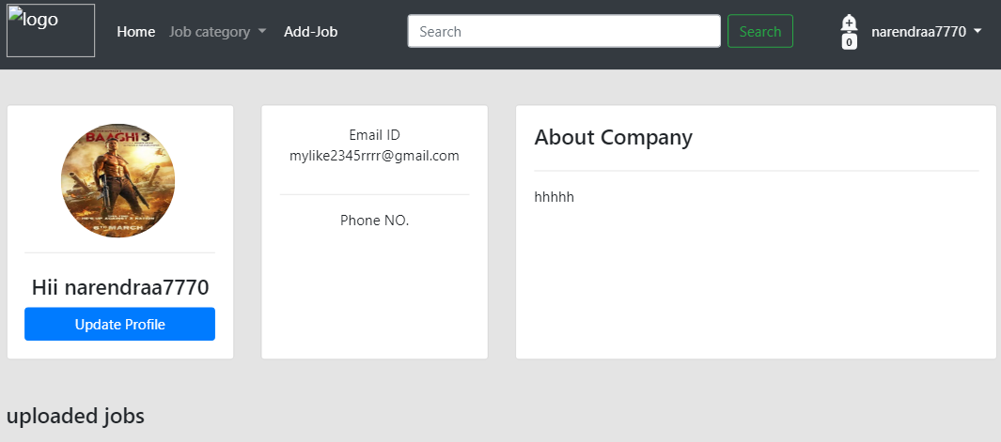
COMPANY COMPLETE PROFILE

Slide 13
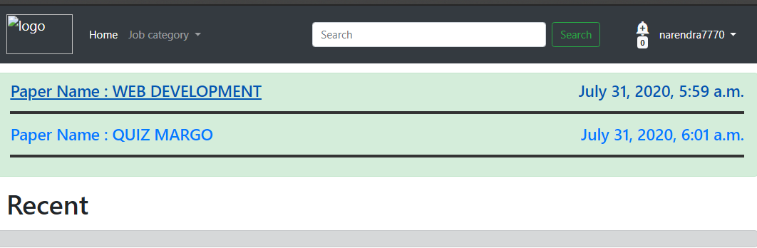
GIVE TEST
1. Choose Test category.
2. Many Test will visible
like Web development, Android Development Etc.
3. As choosen Web Development If you pass this exam then you can apply for
web development job.

Slide 14
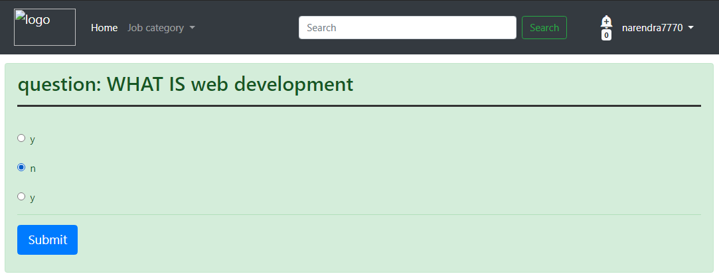
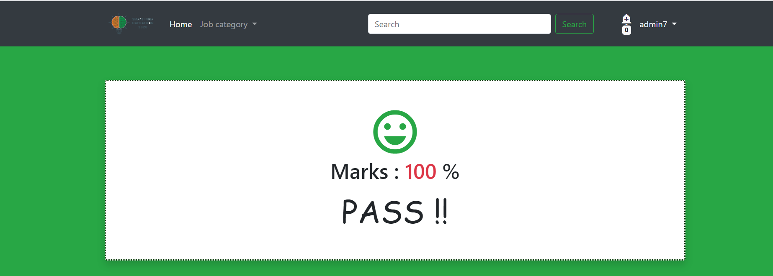

Slide 15
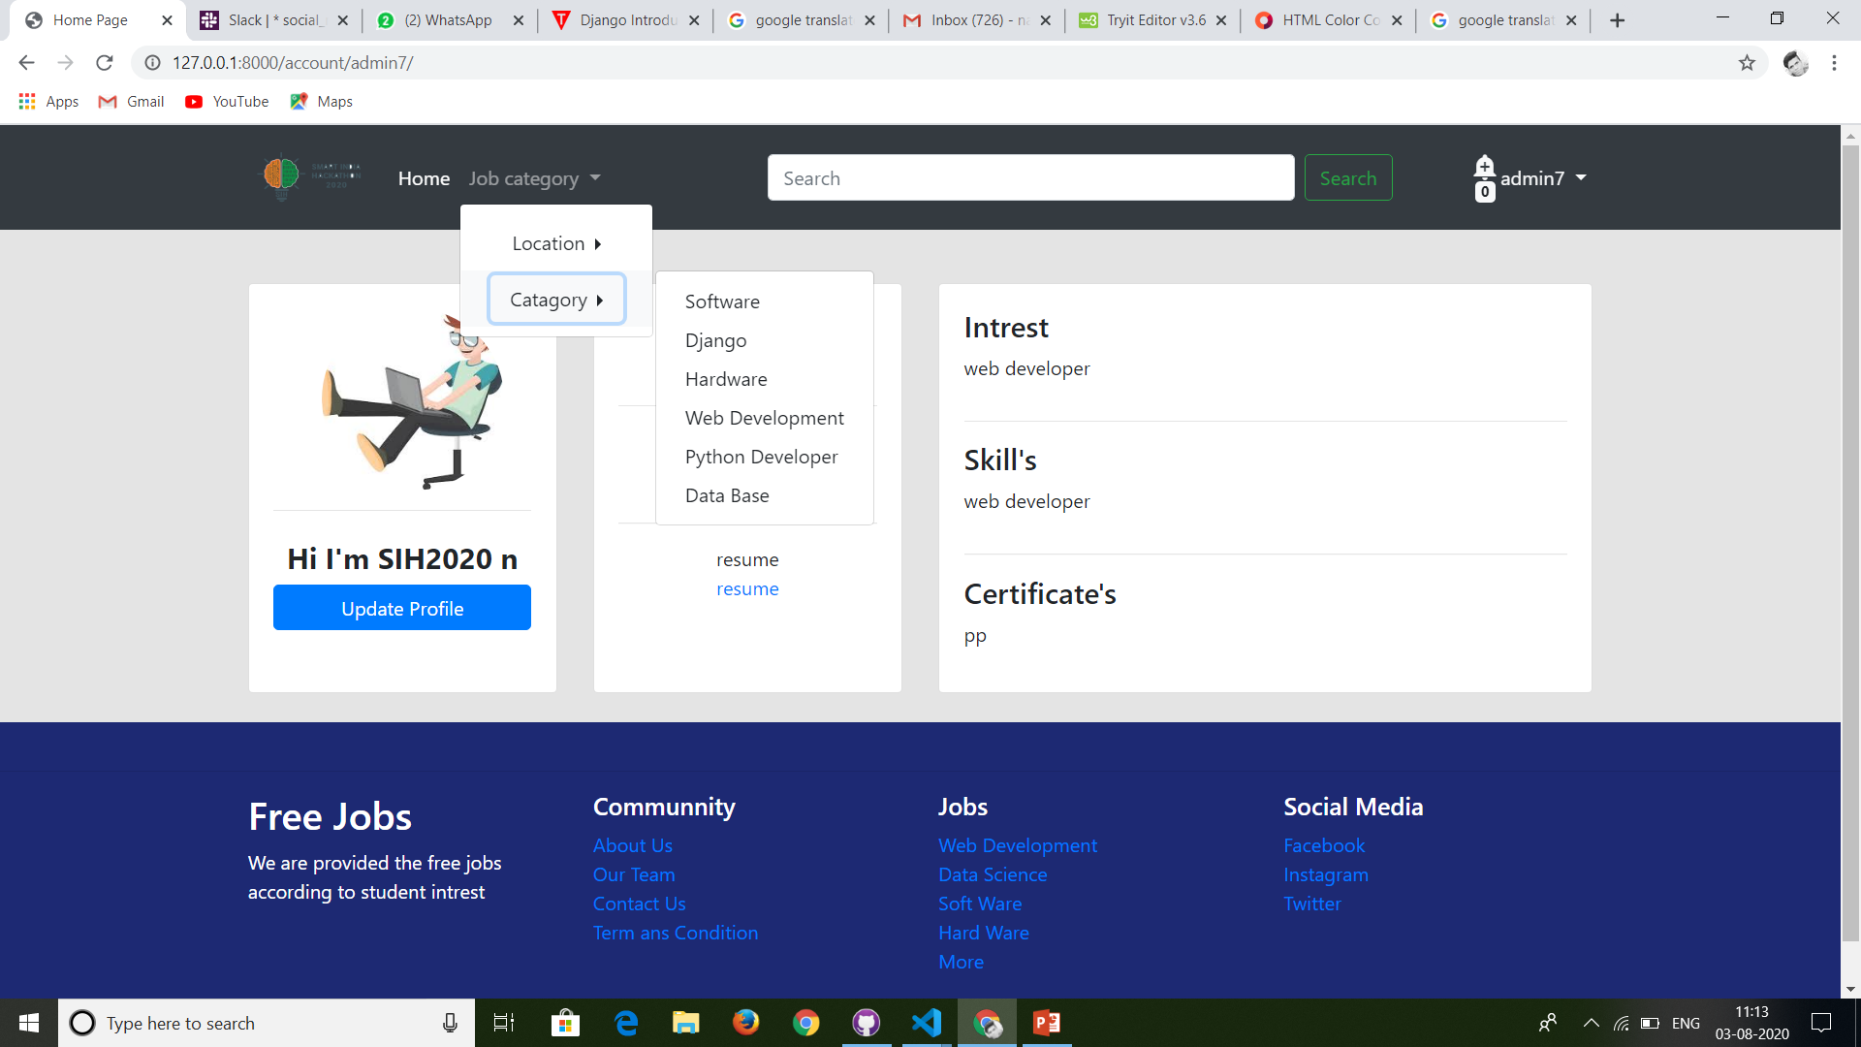
JOB CATEGORY

Slide 16
INTEREST JOB CATEGORY

Slide 17
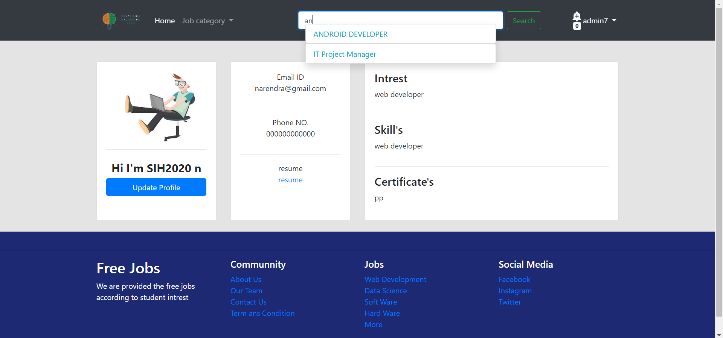
JOB BY SEARCH HISTORY

Slide 18
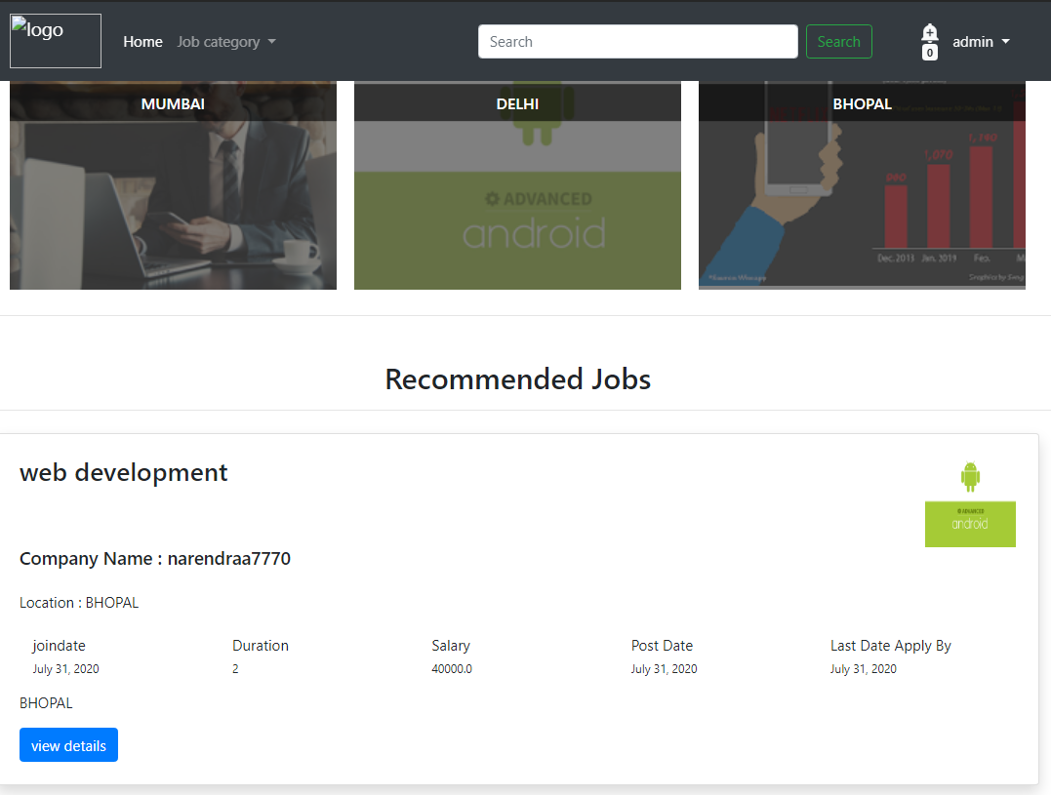
APPLY JOB

Slide 19
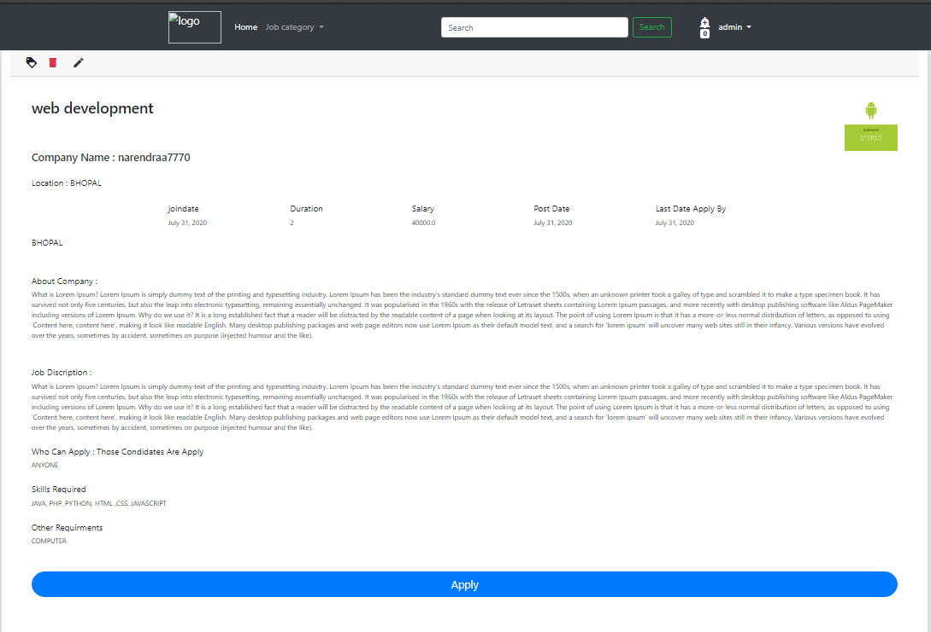

Slide 20
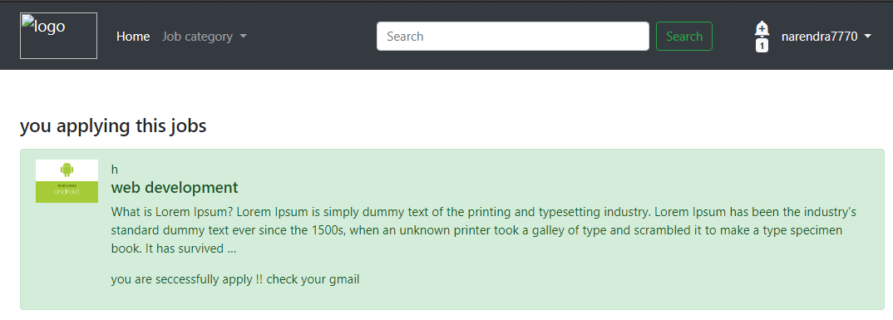

Slide 21
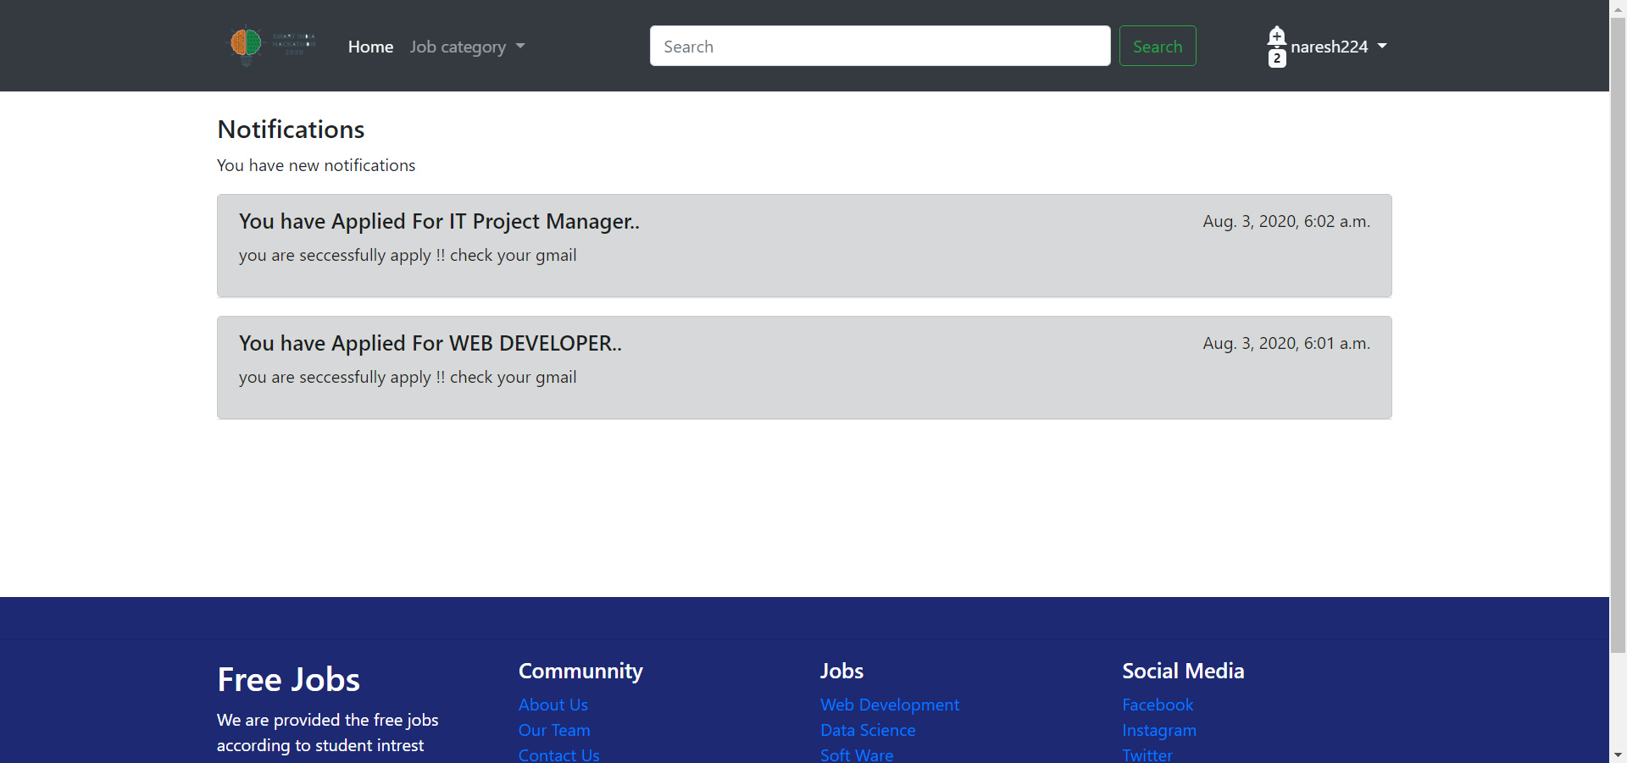
NOTIFICATIONS

Slide 22
FEATURES
1. According to your profile the job will be recommended on your homepage.
2. You can choose your job as per your interests.
3. Short Quiz session to test your skill.
4. Job seeker can apply easily.
5.The job will recommended according to the search history of the job seeker.
6.The job will recommended according to the skill and interest of the job seeker.
7. Test will recommended according to skill and interest only.
8. Test timer limit.

Slide 23

BACKEND

Slide 24
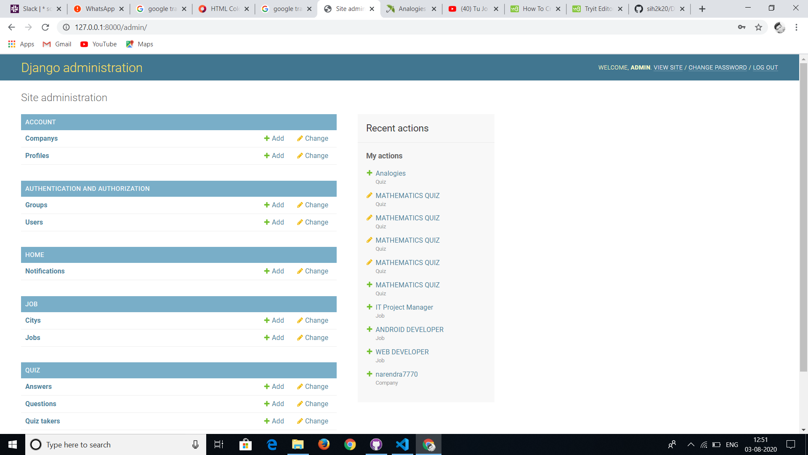
BACKEND

Slide 25
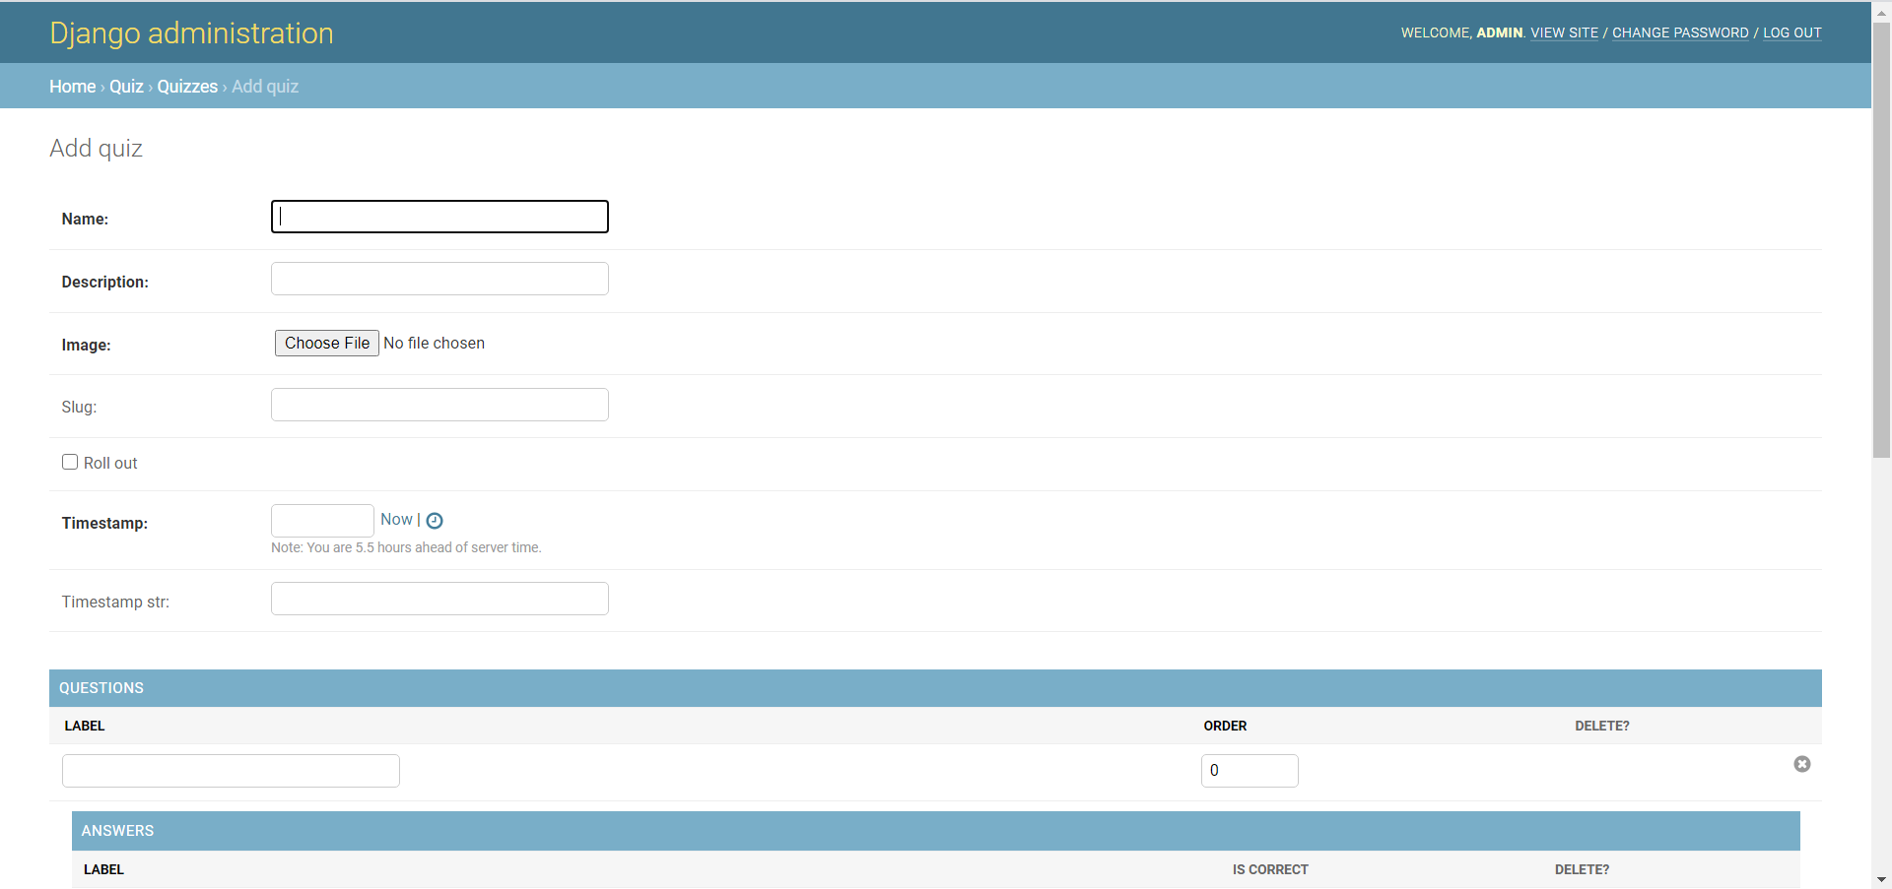
DJANGO BACKEND SQL

Slide 26
THANK YOU 😊😊

