Slide 1
Team – 2 Project on Payroll Management System
“RMS Mark ll”
By
Tinu – 4920140
Rupesh – 4920130
Deepak - 4920108

Slide 2
Introduction
Our project i.e. ‘Payroll Management System→”RMS Mark ll”’Is a simple system which takes Employee code , number and designation as input from the users and then calculates the salary of those employees based on the different values/factors provided by the programmer.

Slide 3
Working of Project
The working of our project is demonstrated in upcoming slides with the help of pictures to clarify the users about various options and operations present in our system.

Slide 4
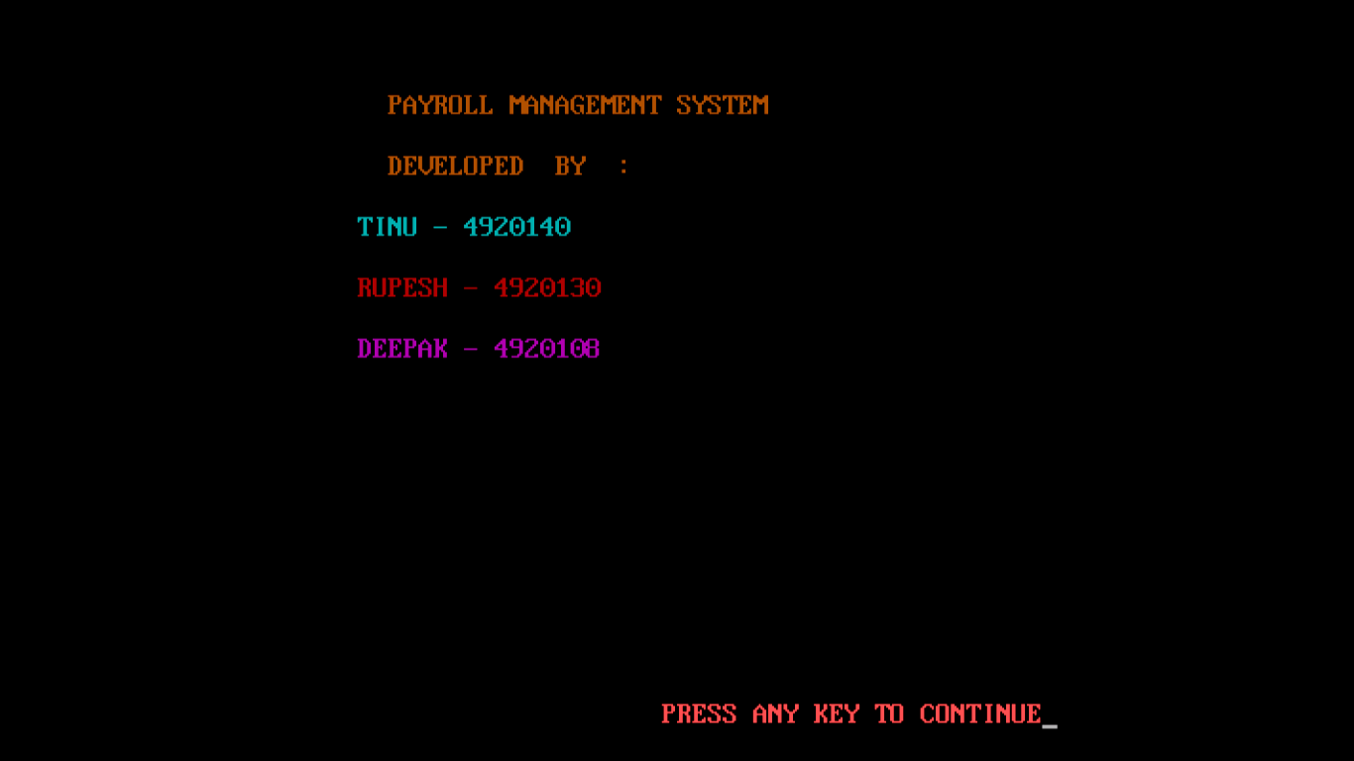
Starting project

Slide 5
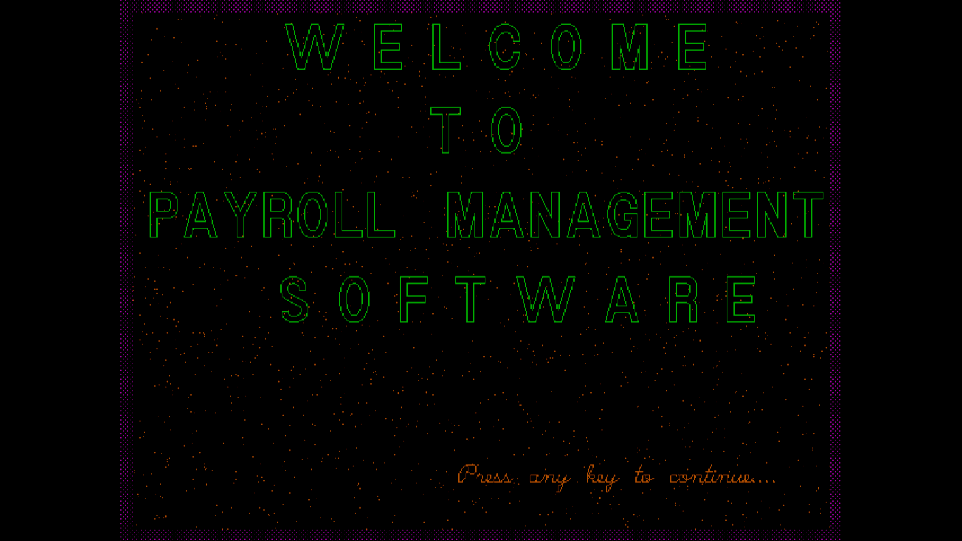
Intro Window

Slide 6
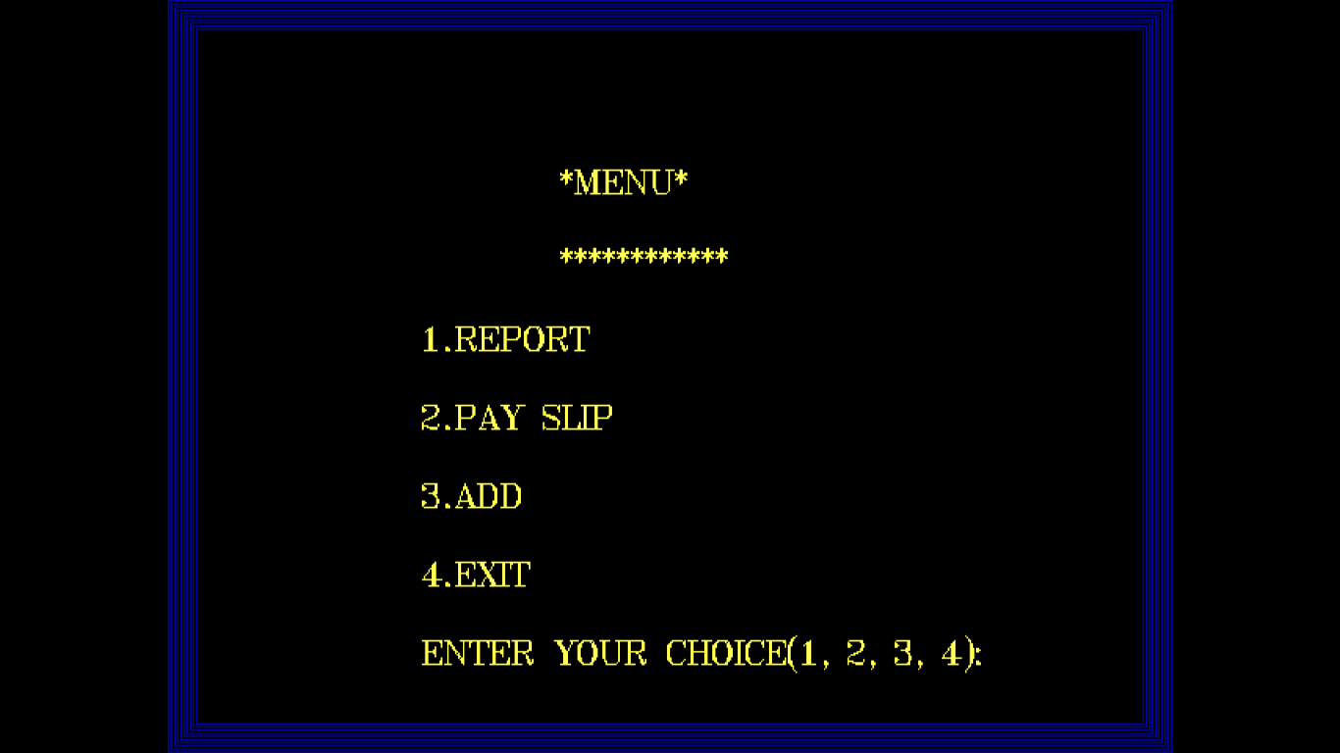
Main Menu :

Slide 7
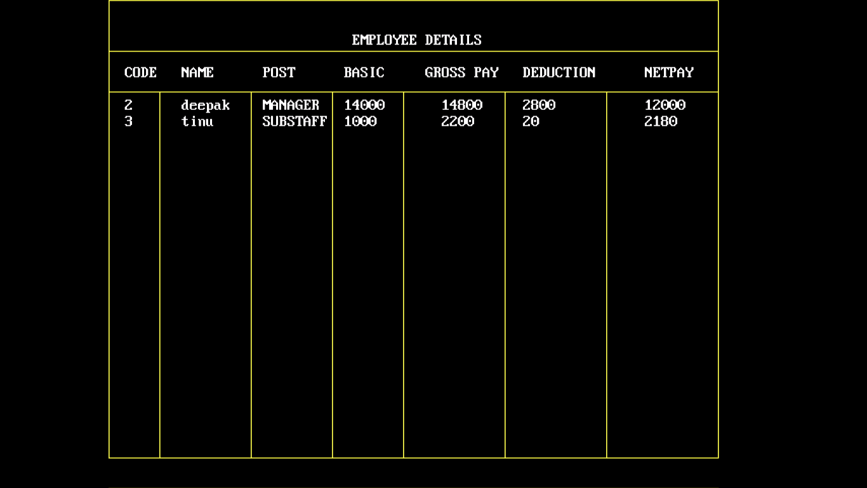
Initaial Data :

Slide 8
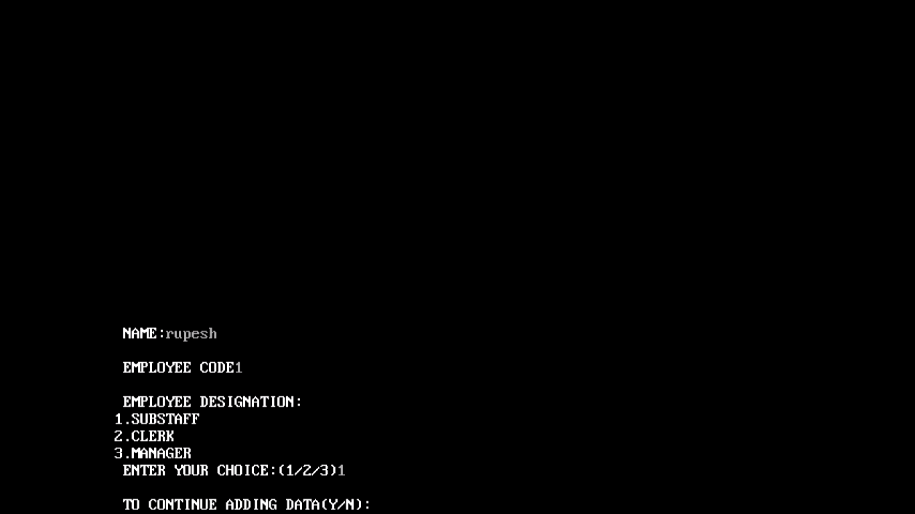
Addition of new employee :

Slide 9
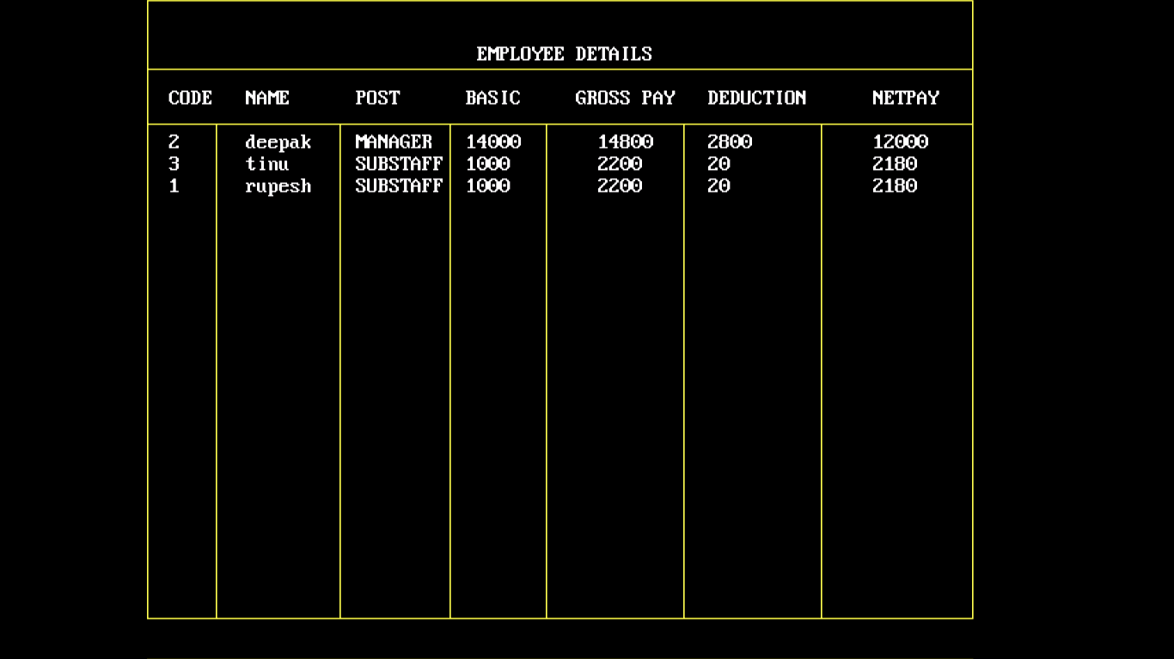
Final Data :

Slide 10
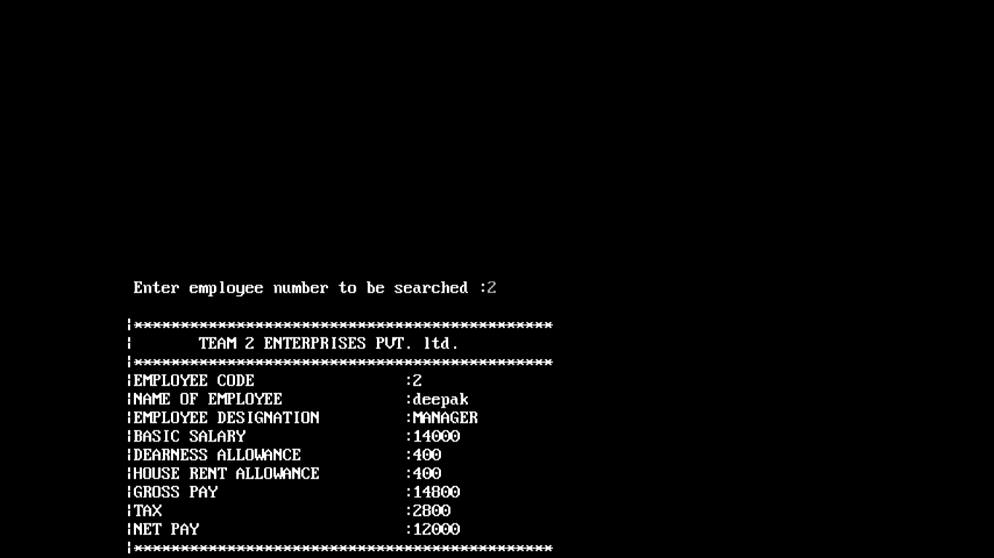
Pay Slip of a particular Employee :

Slide 11
Thanking You !!!

