Slide 1
Probability Concepts and Random Number Generation (5 hrs)
5.1 Probability concepts in simulation - Stochastic variable
5.2 Discrete Probability function
5.3 Continuous Probability function
5.4 Random numbers
5.5 Properties of random numbers
5.6 Pseudo random number
5.7 Technique for generation of random number
5.8 Test for Random number generation
5.8.1 Uniformity test (K-S test and Chi-square test)
5.8.2 Independence test (Runs test and Auto Correlation test)

Slide 2
5.1 Probability concepts in simulation
Probability is the measure of the likelihood of an event happening. It is a number between 0 and 1, where:
0 means the event will never happen.
1 means the event will always happen.
Tossing a coin: The probability of getting heads is 0.5 (50% chance).
Rolling a die: The probability of getting a "6" is 1/6.
Probability helps us deal with uncertainty and make predictions about future events.

Slide 3
5.1 Probability concepts in simulation ...cont
we constantly encounter situations of uncertainty:
Will it rain tomorrow?
Will I pass the exam?
Example: If a weather forecast says there is a 40% chance of rain tomorrow, it means the probability of rain is 0.4.

Slide 4
A bag contains 5 red balls and 5 blue balls. Two balls are drawn one after the other without replacement. What is the probability of:
(a) Drawing two red balls?
(b) Drawing one red and one blue ball?
A box has 3 defective items and 7 non-defective items. If two items are chosen at random, what is the probability that:
(a) Both items are defective?
(b) One item is defective and one is non-defective?

Slide 5
Deterministic vs. Stochastic
Deterministic Process:
The process on which, the outcome of an activity can be described completely in terms of its input is deterministic and the activity is said to be deterministic activity.
The outcome is fixed and predictable because there is no randomness involved.
Eg: A machine programmed to produce 50 parts per hour will always produce exactly 50 parts per hour, assuming no errors.

Slide 6
Deterministic vs. Stochastic
Stochastic process:
when the outcome of an activity is random, i.e. there can be various possible outcomes, the activity is said to be stochastic activity.
The outcome is random or uncertain, meaning it can vary even under the same conditions.
Eg: In case of an automatic machine, the output per hour is deterministic, while in a repair shop the number of machines repaired will vary from hour to hour, in a random fashion.
A repair shop fixes machines. Some hours they fix 2 machines, some hours 5. The number of machines repaired varies randomly.
Deterministic outcomes are fixed, while stochastic outcomes involve randomness.

Slide 7
1.Discrete Random Variable:
A discrete random variable is a type of random variable that can take on a finite or countably infinite number of distinct values. These values are usually integers or whole numbers, and they are separated from each other. Discrete random variables are often associated with counting processes.
Example: The number of students in a class, the number of heads when flipping a coin multiple times, or the number of cars in a parking lot.
Possible values: x1,x2,x3,......,xn (e.g., 0, 1, 2, …)

Slide 8
2. Continuous Random Variable:
A continuous random variable, on the other hand, can take on any value within a continuous range or interval. The set of possible values is not countable and can include all real numbers within that range.
Example: The time it takes to run a race, the height of an individual, or the amount of rainfall on a given day.
Range space: An interval such as [0,10][0,10], (−∞,∞)(−∞,∞), or any set of intervals.
Summary:
Discrete random variables take distinct, separate values.
Continuous random variables take any value within a range.

Slide 9

Discrete Probability Function:
If a random variable X is discrete (i.e., it can take a countably infinite number of values), its probability distribution is called the Discrete Probability Distribution.
The two conditions for a valid discrete probability distribution are:
Non-negative probabilities: 𝑃(𝑋𝑖) ≥ 0
Sum of probabilities is 1:

Slide 10
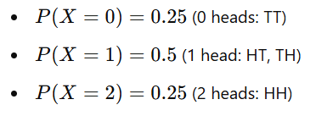
Example: If a coin is flipped twice, the possible outcomes (sample space) are HH, HT, TH, TT. Let 𝑋be the random variable representing the number of heads: X ,can take values 0, 1, or 2.
The probability distribution of 𝑋is:

Slide 11
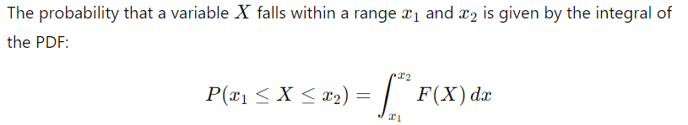
Continuous Probability Function:
If a random variable is continuous (i.e., it can take any value in a continuous range), its probability distribution is called the Continuous Probability Distribution.
Continuous variables are described by a function 𝐹(𝑋) known as the Probability Density Function (PDF), which satisfies F(X)≥0
​
Continuous distributions are used to model quantities that can take any value within an interval (e.g., time, height, weight).

Slide 12
Random Numbers:
A random number is a number generated by a process, whose outcome is unpredictable, and which cannot be subsequentially reliably reproduced. Random numbers are the basic building blocks for all simulation algorithms.

Slide 13
Properties of Random Numbers:
The two important statistical properties are:
1. Uniformity : Every value in the range of random numbers is equally likely to occur.
2. Independence : Each random number is independent of the others, meaning one number does not influence the generation of the next.

Slide 14

Each random number Ri is an independent sample drawn from a continuous uniform distribution between 0 and 1. The probability density function (pdf) is given as:
This means:
The probablity density is constant f(x)=1 for all x in [0,1]
Outside this range x<0 or x>1, the probablity is zero.

Slide 15


Expected Value (E(R)):
The expected value (mean) is the average value we expect if we repeatedly sample random numbers from this distribution.
Solving this integral:

Slide 16
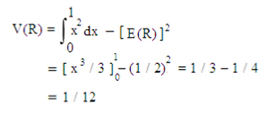
Variance measures the spread of random numbers around the mean.The variance is given by
The consequences of uniformity and independence properties are:
1. If the interval (0, 1) is divided into n classes or subintervals of equal length, then the expected number of observations in each interval is N / n, where N is the total number of observations.

Slide 17
For example:
If N=1000 random numbers are generated and the interval [0,1] is divided into n=10 equal subintervals, then the expected number of observations in each subinterval is: N/n = 1000/10 =100
2. The probability of observing a value in a particular interval is independent of previous values drawn.

Slide 18
Applications of Random Number:
Monte Carlo Simulations
Hypothesis Testing
Modeling Random Phenomena
Queueing Theory

Slide 19
Pseudo-Random Numbers:
What is pseudo-random numbers?
The term "pseudo" means "not entirely true." In this context, it implies that the numbers are generated through deterministic processes (arithmetic operations or algorithms) and are not truly random.
These numbers are predictable if the method (algorithm) and the starting point (seed) are known.
Uses
True random numbers are hard to generate, especially with computers. Pseudo-random numbers, while not perfectly random, are good enough for most practical purposes like simulations, cryptography, gaming, and machine learning.

Slide 20
How are they generated?
Pseudo-random numbers are typically generated using mathematical formulas such as linear congruential generators (LCG) or Combined Linear Congruential Generators (CLCG)
Properties:
They are reproducible: If you use the same algorithm and seed, you’ll get the same sequence of numbers.
They can approximate randomness well, fulfilling statistical properties like uniformity and independence.

Slide 21
1. The generated random numbers may not be uniformly distributed.
2. The generated random numbers may not be continuous.
3. The mean of the generated numbers may be too high or too low.
4. The variance may be too high or too low.

Slide 22
Generation of Random Number:
In computer simulation where a very large number of random numbers is generally required, can be obtained by the following method.
1. Random numbers maybe drawn from the random number tables stored in a memory of the computer. The process is neither practical nor economical. It is a very slow process and the number occupied considerable space of computer memory. Above all, in the real system many time more random number than available in the table.

Slide 23
2 An electronic device may be constructed as a part of a digital computer to generate truly random numbers. This, however, is considered very expensive. Pseudo-random numbers may be generated using some arithmetic operation.
3. These methods must commonly specify a procedure starting with an initial number, the second number is generated and from that a third number and so on. A number of the recursive procedure are used for generating random numbers.

Slide 24
Qualities of an Efficient Random Number Generator:
It should have a sufficiently long cycle i.e. it should generate a sufficiently long sequence of random numbers before beginning to repeat the sequence.
The random numbers generated should be replicable i.e. by specifying the starting condition, it should numbers as and when desired. Many times common random numbers are required for the comparison of two systems.
The generated random numbers should fulfil the requirement of uniformity and independence. The random number generator should be fast and cost-effective.
It should be portable to different computers and ideally to a different programming language.

Slide 25
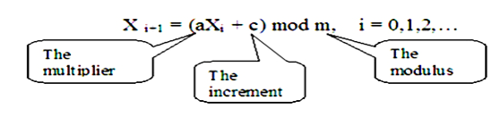
Techniques for Generation of Random Numbers:
The most widely used techniques for generating random numbers are:
1. Linear Congruential Method (LCM):
The most widely used technique for generating random numbers, initially proposed by Lehmer [1951]. This method produces a sequence of integers, X1, X2 … between 0 and m- 1 by following a recursive relationship:

Slide 26

The initial value X0 is called seed. The selection of the values for a, c, m, and X0 drastically affects the statistical properties and the cycle length.
a. If c ≠ 0 in the above equation, then it is called as Mixed Congruential method.
b. If c = 0 the form is known as the Multiplicative Congruential method.
The random numbers (Ri) between 0 and 1 can be generated by

Slide 27
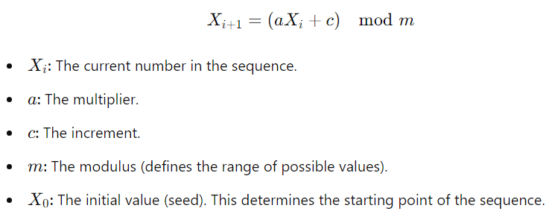
The LCM generates a sequence of numbers using the following recurrence relation:

Slide 28
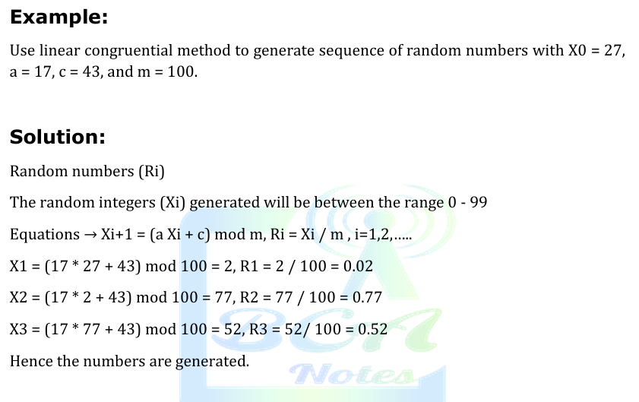

Slide 29
a. Maximum Density:
Maximum Density means values assumed by Ri, i = 1, 2… leave no large gaps on the interval [0, 1].
Problem: The values generated from Ri = Xi / m, is discrete on integers instead of continuous.
Solution: A very large integer for modulus m.
b. Maximum Period:
To achieve Maximum density and avoid cycling, the generator should have the largest possible period. Most digital computers use a binary representation of numbers. Speed and efficiency is aided by a modulus m, to be (or close to) a power of 2. The maximal period is achieved by proper choice of a, c, m and X0.

Slide 30
NEXT CLASS
Tests for Random Number Generation:
1. Testing for Uniformity:
2. Testing for Independence:

Slide 31
Uniformity Test (Frequency Test)
The test of uniformity or frequency tests is a basic test that should always be performed to validate a random number generator. The uniformity test counts how often numbers in a given range occur in the sequence to ensure that the numbers are uniformly distributed. Two frequency tests are available and they are:
Kolmogorov-Smirnov test i.e., K-S test
Chi-Square test

Slide 32
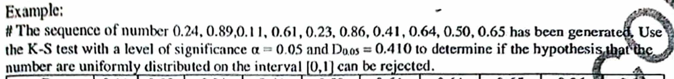
Assignment 3

Slide 33
