Slide 1
Color Shade Finder

Slide 2
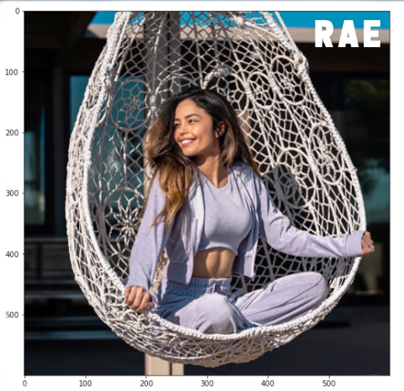
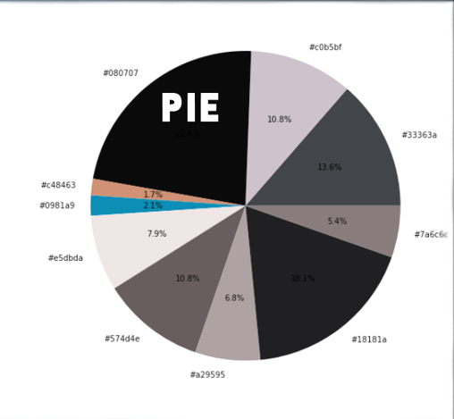

Slide 3
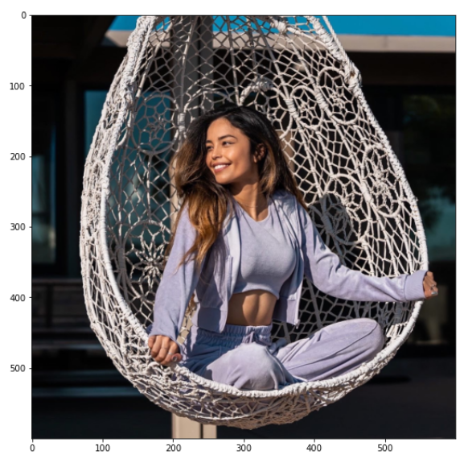
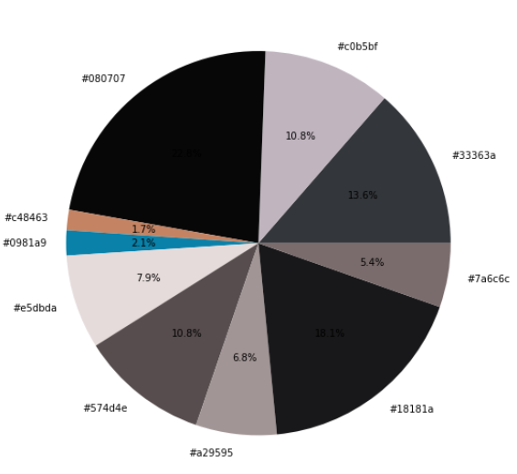
K-Means to create clusters
Read the image
using opencv
Reshape into a 2D array
Count the centroid occurrence and sort the result
Rae
Plot the Pie chart to show the distribution
Convert all centroids from RGB into hex
Pie

Slide 4
THANK YOU

