Slide 1
Memory

Slide 2


Document
Loader
Text
Splitter
Text chunks
PDF
Loaded PDF
embedding model
Embeddings
Memory
Vector Database
Prompt
embedding model
Retriever
+
Final output
user query
Embeddings
Semantic search
Result chunks + user query
LLM

Slide 3
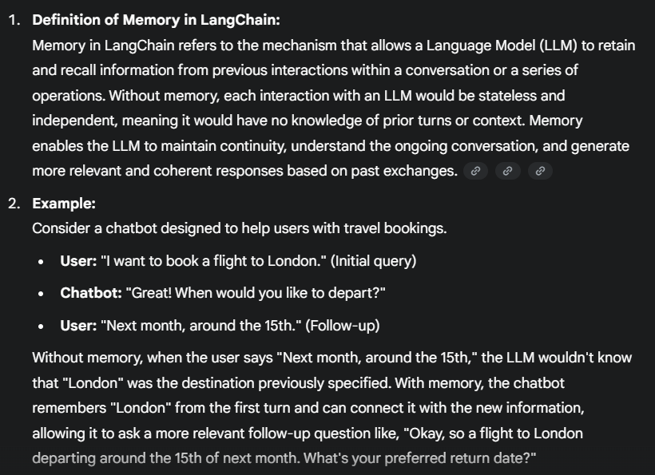

Slide 4
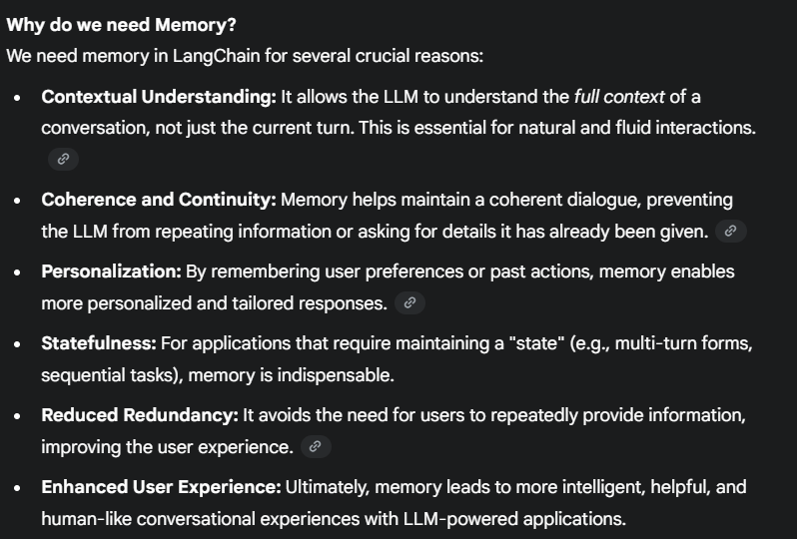

Slide 5
ConversationBufferMemory
ConversationBufferWindowMemory
ConversationSummaryMemory
Memory
ConversationSummaryBufferMemory
ConversationEntityMemory
VectorStoreRetrieverMemory
ConversationKGMemory

Slide 6
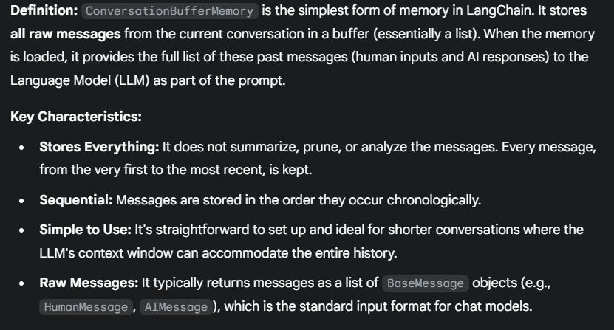
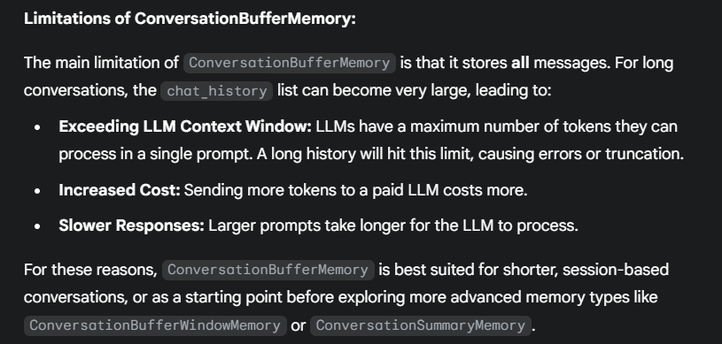
ConversationBufferMemory

Slide 7
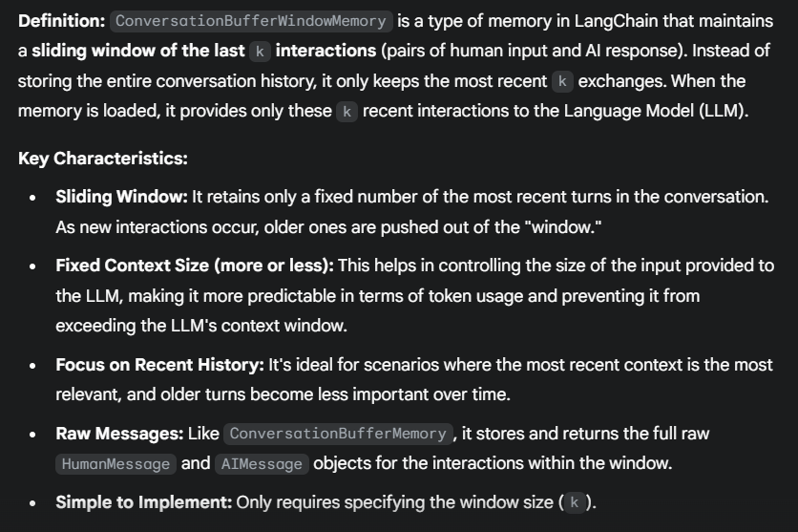
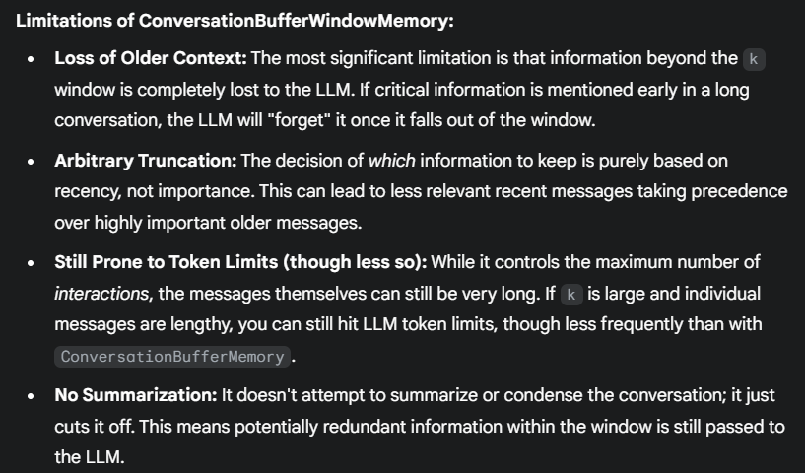
ConversationBufferWindowMemory

Slide 8
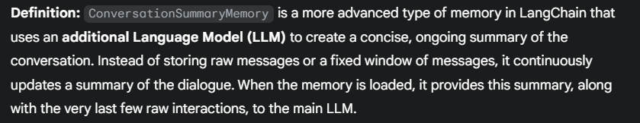
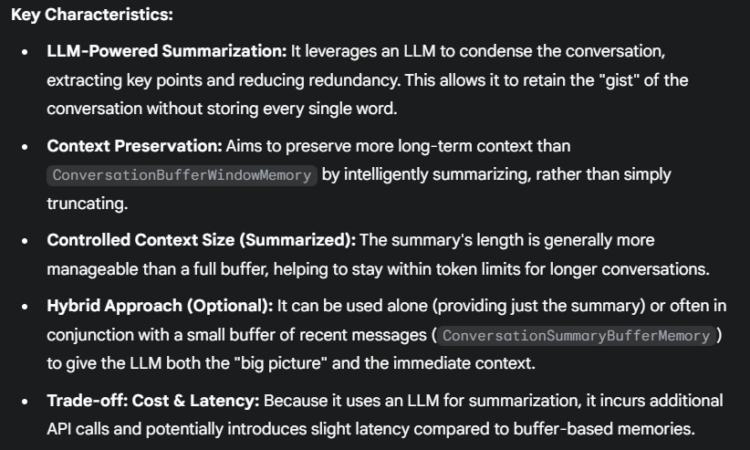
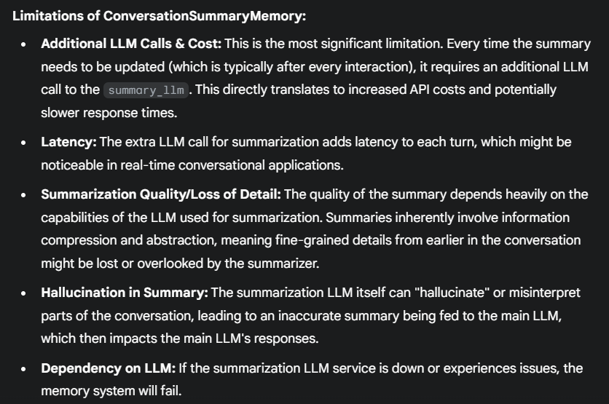
ConversationSummaryMemory

Slide 9
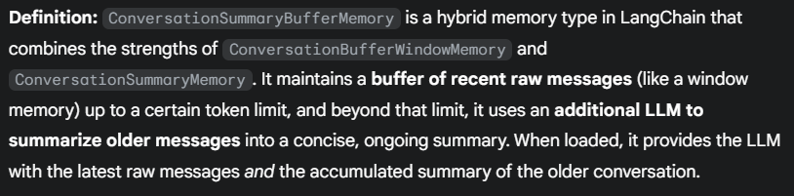
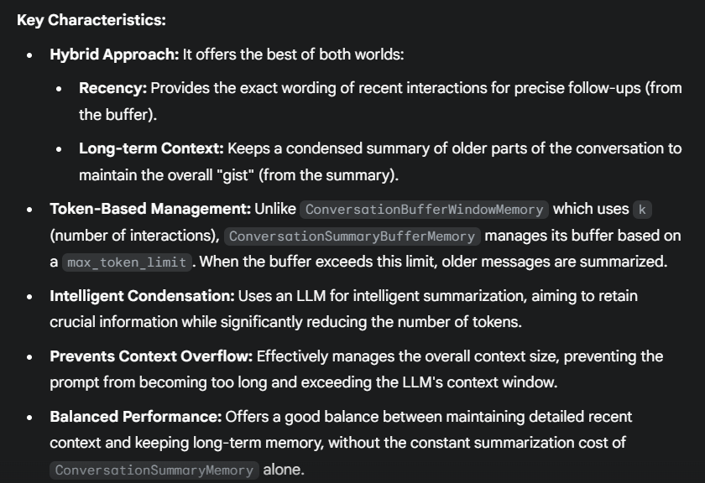
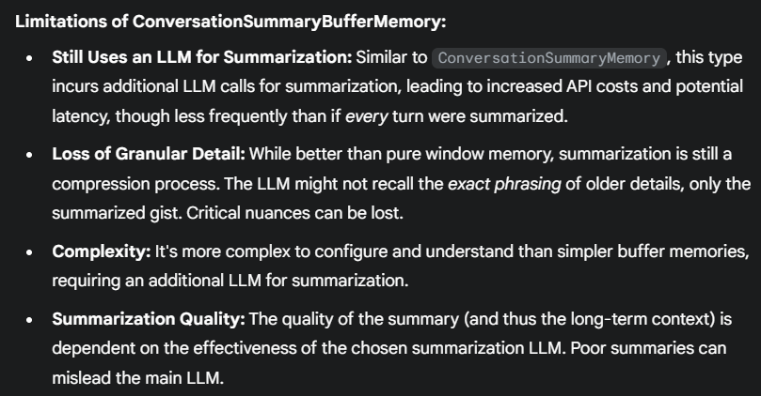
ConversationSummaryBufferMemory

Slide 10
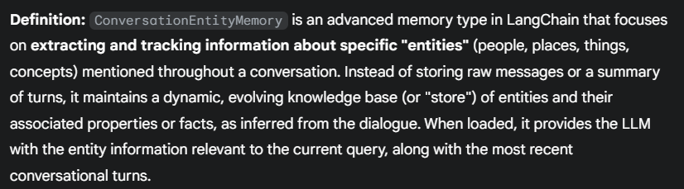
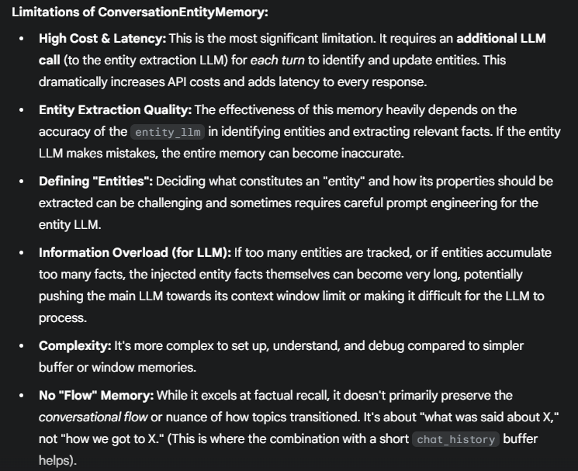
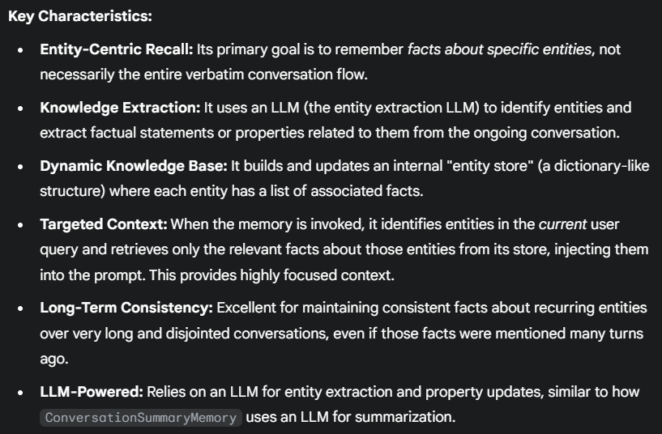
ConversationEntityMemory

Slide 11
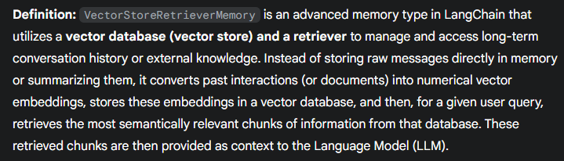
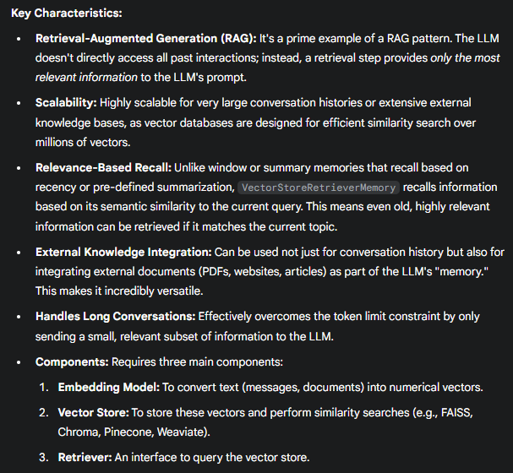
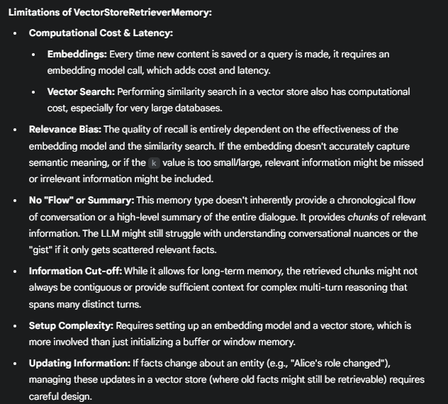
VectorStoreRetrieverMemory

Slide 12
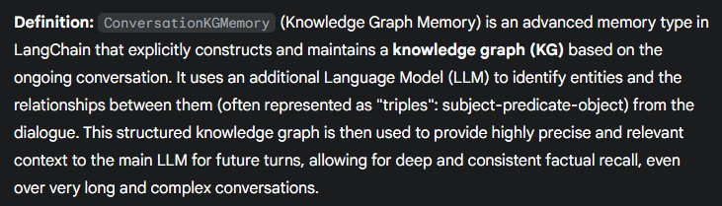
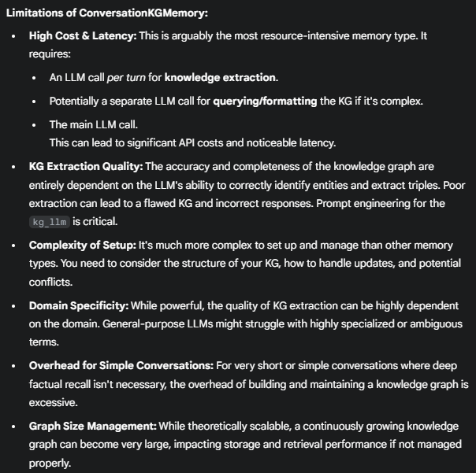
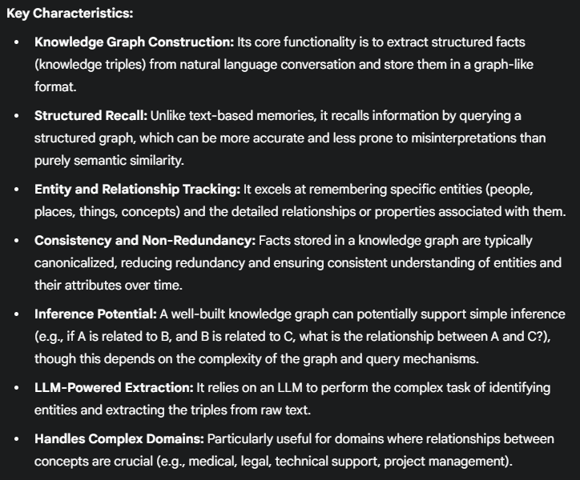
ConversationKGMemory

