Slide 1
RAG

Slide 2




Model Pretraining
?
1/1/2025
Question about events happened after 1/1/2025
About our private domain specific data
May hallucinate and give random answer
Unable to explain the source of it’s answer
Model Family | Developer | Primary Training Data | Knowledge Cut-off Date
GPT-4 & GPT-4o | OpenAI | A massive dataset of text and code from the internet (e.g., Common Crawl), books, and licensed data. | GPT-4o: October 2023
Llama 3 | Meta | A new mix of publicly available online data, reportedly seven times larger than the dataset used for Llama 2. It includes a larger portion of non-English data and code. | 8B model: March 2023 70B model: December 2023
Gemini | Google | A multimodal dataset that includes a diverse and vast collection of text from the web, books, code, as well as image, audio, and video data. | Varies by version, but generally around early 2023 for Gemini 1.0. Newer versions have more recent data.
Claude 3 & 3.5 | Anthropic | A proprietary mix of publicly available information from the internet, data from third parties, and data generated internally by Anthropic. They explicitly state they do not use user data. | Claude 3 family: August 2023 Claude 3.5 Sonnet: April 2024
Mistral | Mistral AI | Publicly available data from the internet. The exact composition is not fully detailed but is known to be a large and diverse web scrape. | Varies significantly by model, with newer models having more recent cut-offs.
Fine-Tuning
Solutions before RAG
Pretraining with new data
Few-Shot Learning

Slide 3
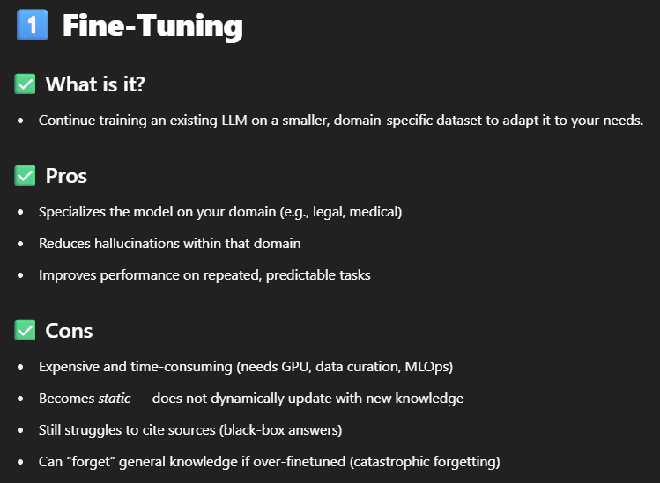

Slide 4
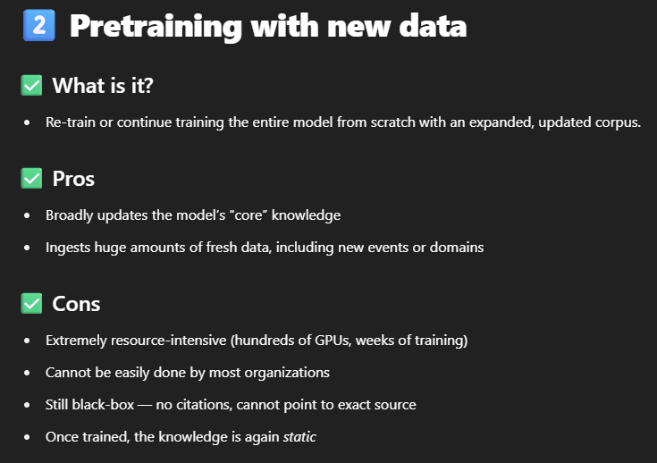

Slide 5
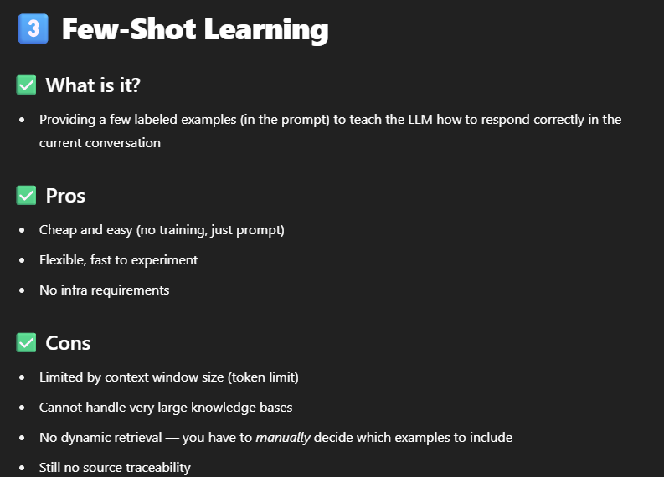
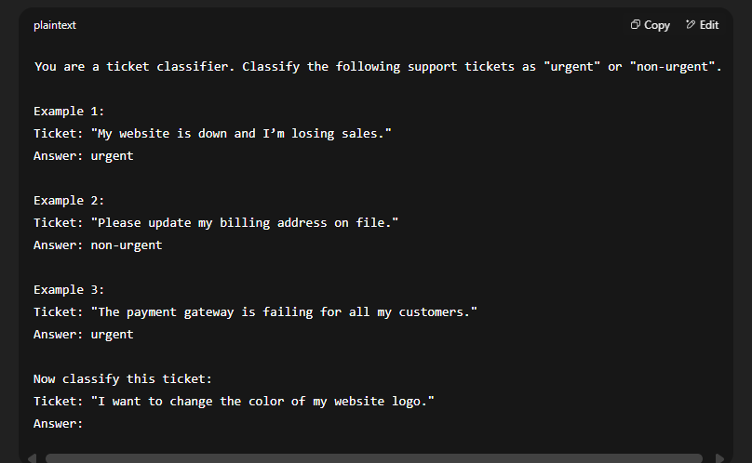

Slide 6
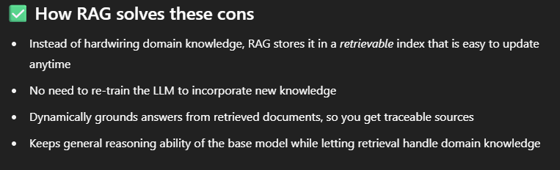
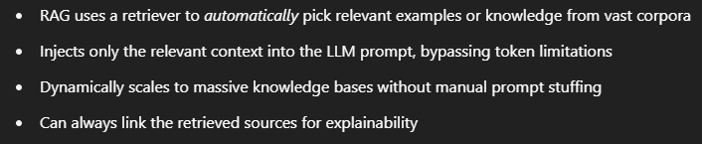

Slide 7




Document
Loader
Text
Splitter
Text chunks
RAG
PDF
Loaded PDF
embedding model
Retrieval Augmented Generation
Embeddings
Memory
Vector Database
Prompt
embedding model
Retriever
+
Final output
user query
Embeddings
Semantic search
Result chunks + user query
LLM

