Slide 1
Runnable & Chain

Slide 2
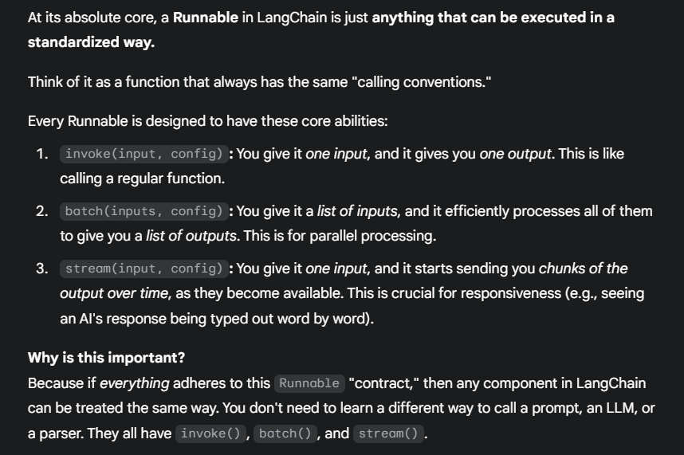

Slide 3
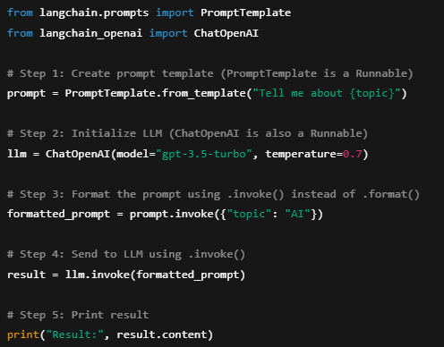
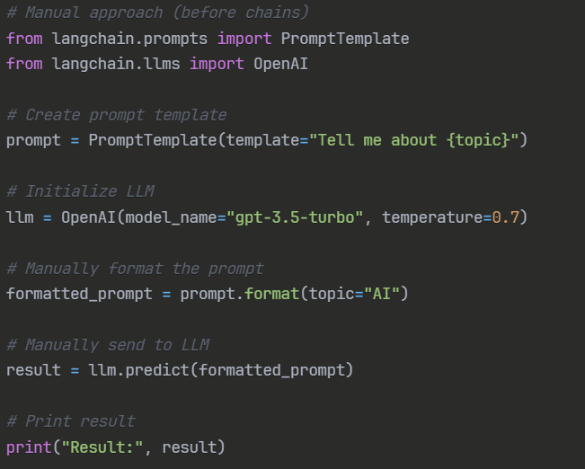
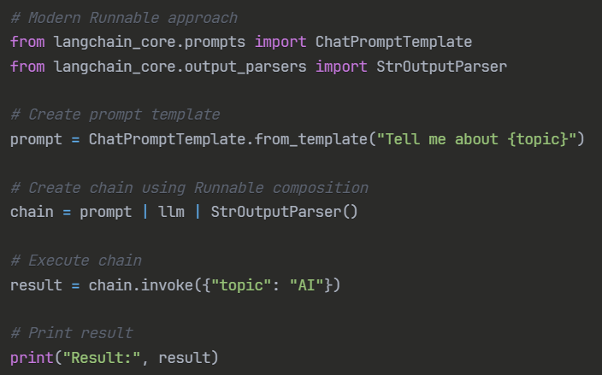
Using runnables
Manual process

Slide 4

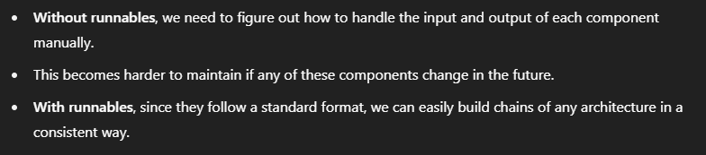

Document
Loader
Text
Splitter
Text chunks
PDF
Loaded PDF
embedding model
Embeddings
Vector Database
Prompt
embedding model
Retriever
+
Final output
user query
Embeddings
Semantic search
Result chunks + user query
LLM

Slide 5
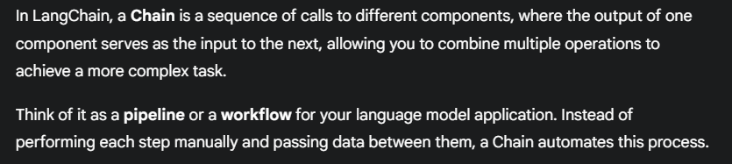
This format of creating chain using ‘|’ (pipe operator) is known as LangChain's Expression Language (LCEL)
Chain

Slide 6
RunnableSequence
RunnableParallel
Runnables
RunnablePassthrough
RunnableLambda
RunnableBranch

Slide 7
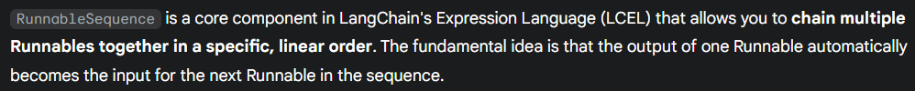
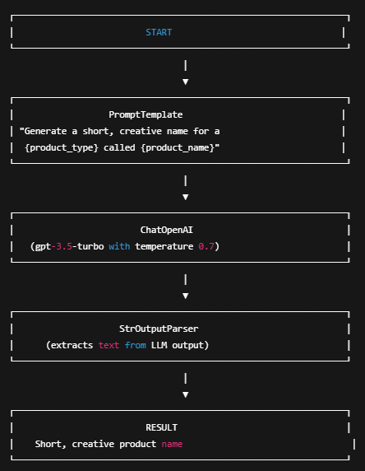
RunnableSequence

Slide 8
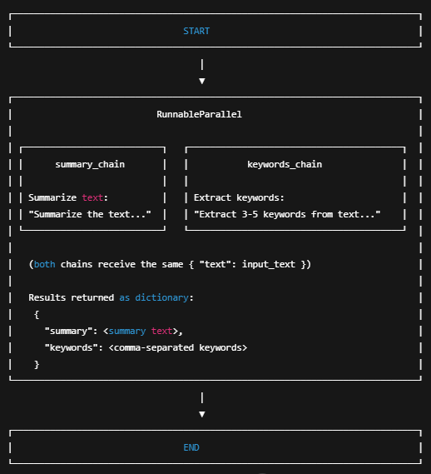
RunnableParallel

Slide 9
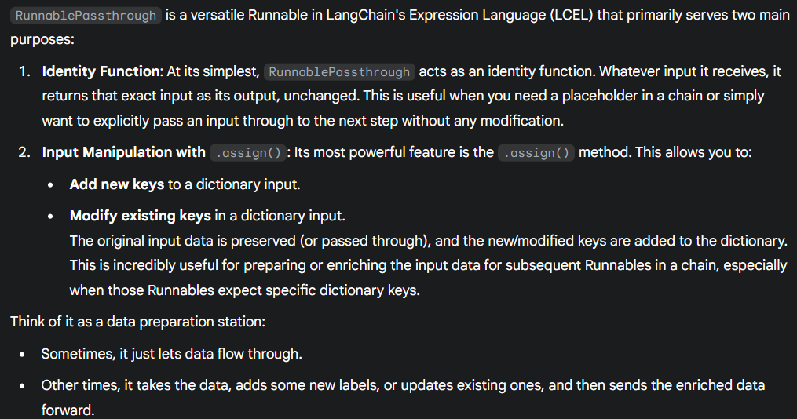
RunnablePassthrough

Slide 10
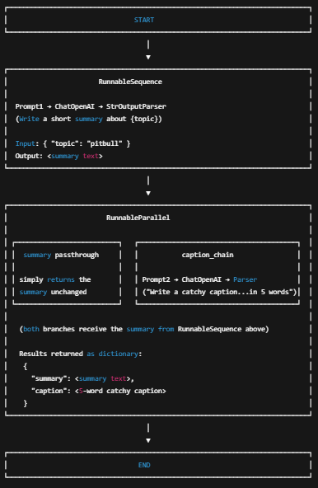
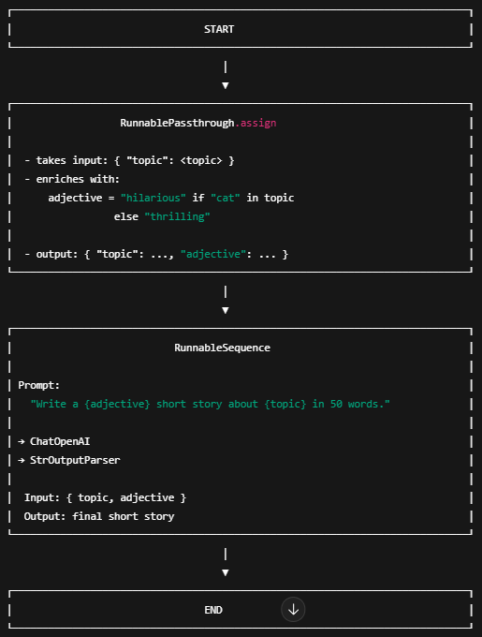

Slide 11
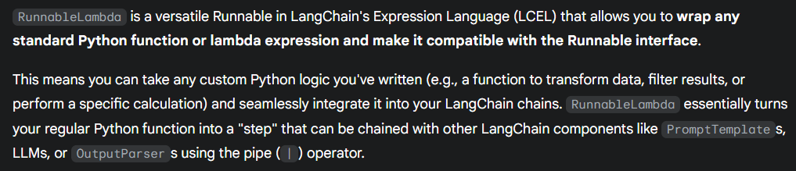
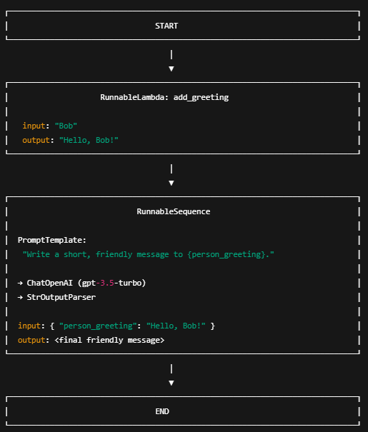
RunnableLambda

Slide 12
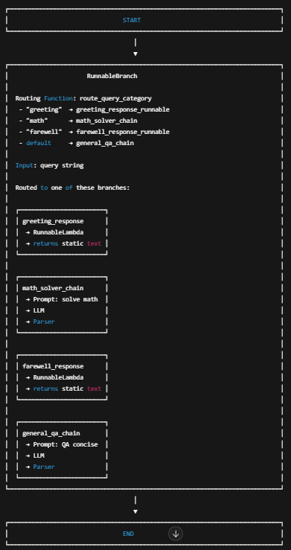
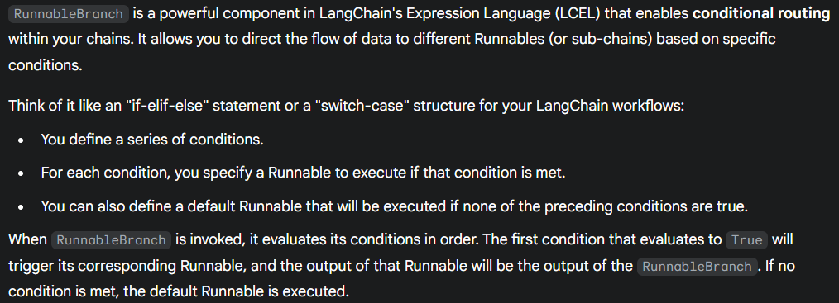
RunnableBranch

