Slide 1
Tools & Tool Calling

Slide 2
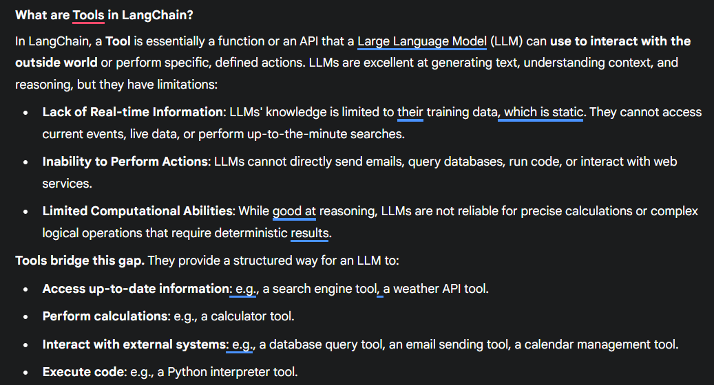

Slide 3

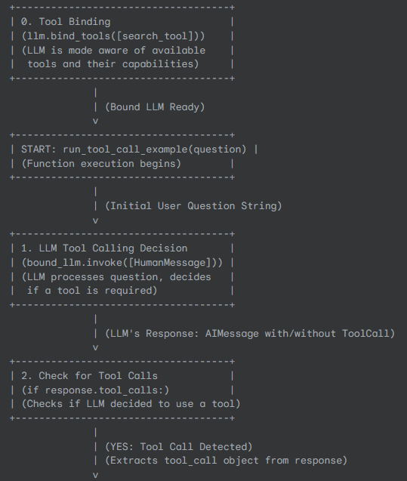
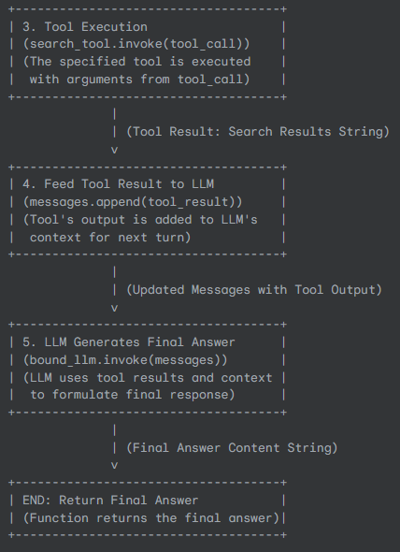

Slide 4
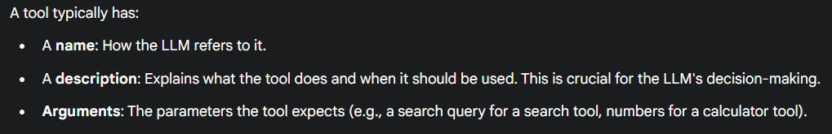
All available tools: https://python.langchain.com/docs/integrations/tools/

Slide 5
A custom tool in LangChain is a function or piece of code that you define yourself, allowing your Large Language Models (LLMs) to perform specific actions or access information beyond their inherent knowledge. Instead of relying solely on pre-built LangChain tools, you can create custom ones tailored to your unique application needs.
@tool
StructuredTool + pydantic
How to create custom tool?
BaseTool

Slide 6
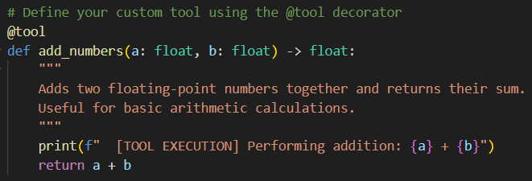

custom tool using @tool decorator
Tool name: add_numbers
add type hints
add @tool decorator
add duck string
What does LLM see?

Slide 7
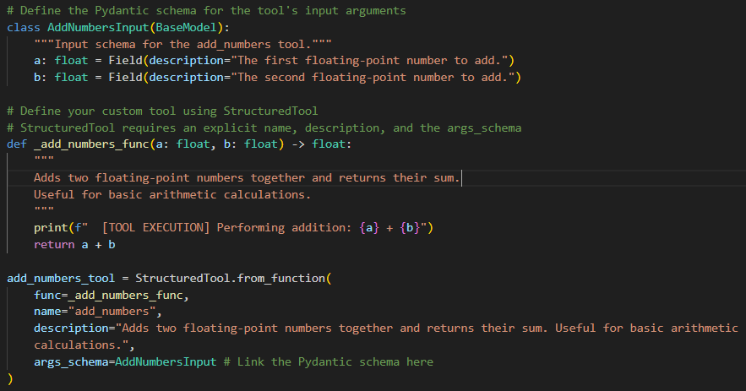
custom tool using StructuredTool + pydantic
Pydentic schema
Custom function
StructuredTool

Slide 8
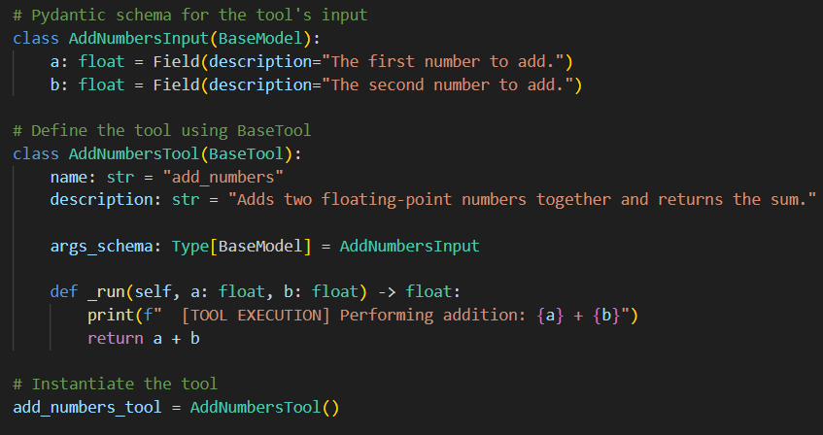
custom tool using BaseTool+ pydantic
Pydentic schema
BaseTool

