Slide 1
Agents

Slide 2
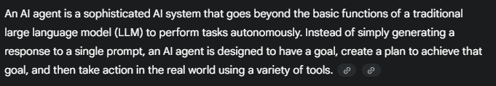
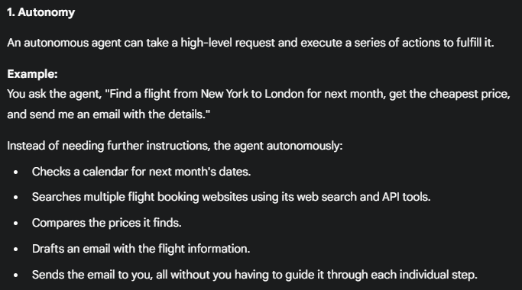

Slide 3
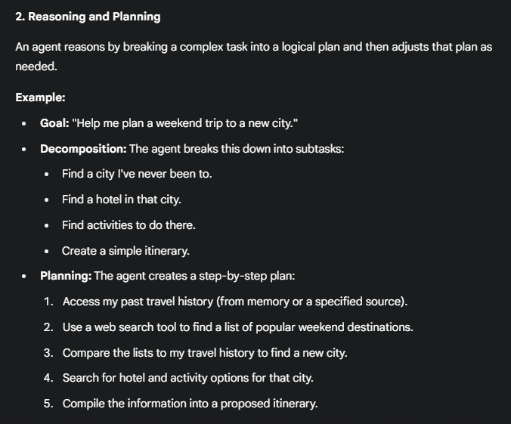

Slide 4
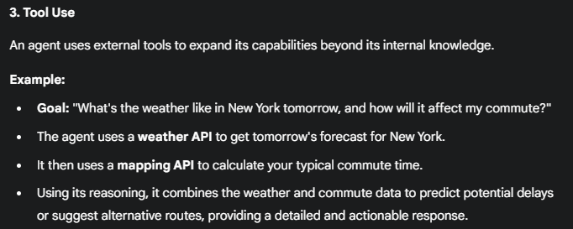

Slide 5
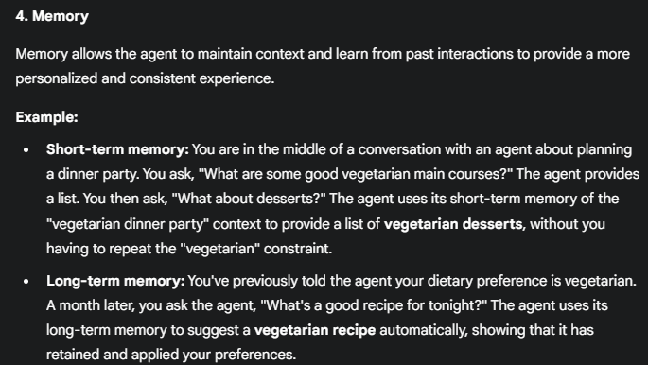

Slide 6
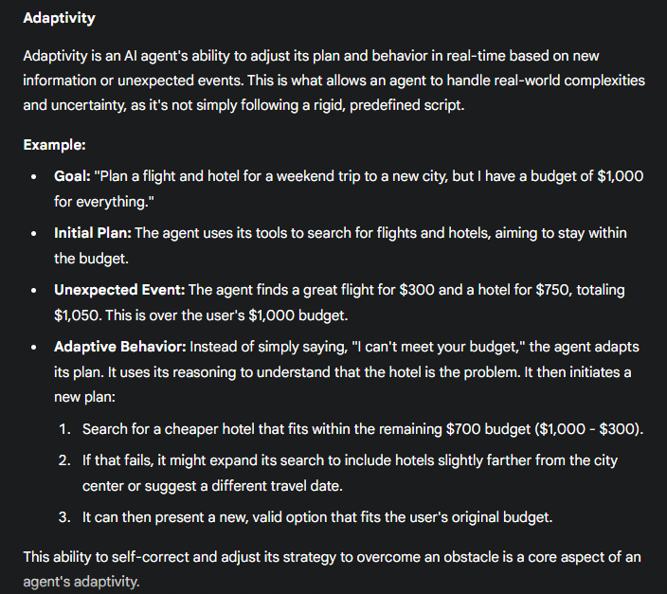

Slide 7
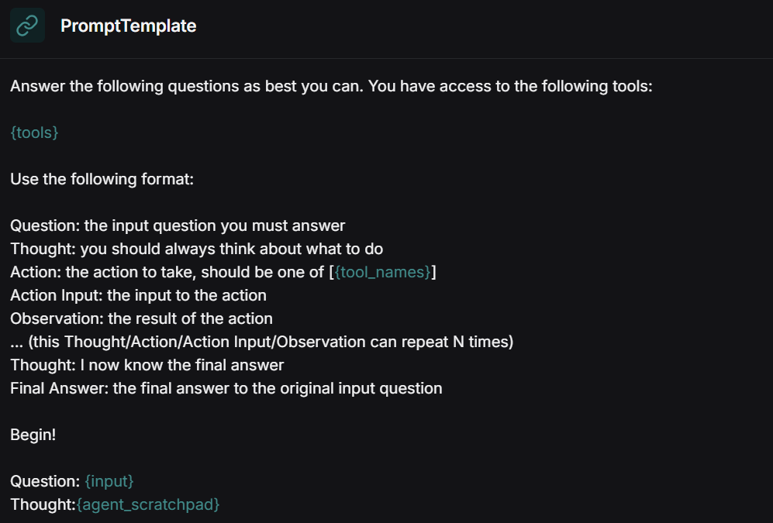
https://smith.langchain.com/hub Different agent design patterns
The ReAct (Reasoning and Acting) design pattern is a core concept for building advanced agents in LangChain. It's a method that enables a large language model (LLM) to become a more capable and autonomous agent by making it think and act in an interleaved, human-like manner.
Instead of generating a final answer in a single step, a ReAct agent follows a cyclical process that combines reasoning (generating thoughts) and acting (using tools). https://smith.langchain.com/hub/hwchase17/react

Slide 8
ReAct [Thought/Action/Observation] process:
User query
task = "Find the current population of the capital of India."
agent_scratchpad + user query
AGENT
Agent Action
Agent Finish
Execute Tool
Final Output
Collect Observation
Update agent_scratchpad

Slide 9
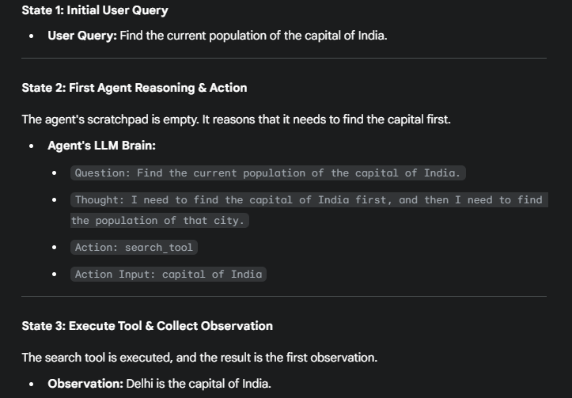
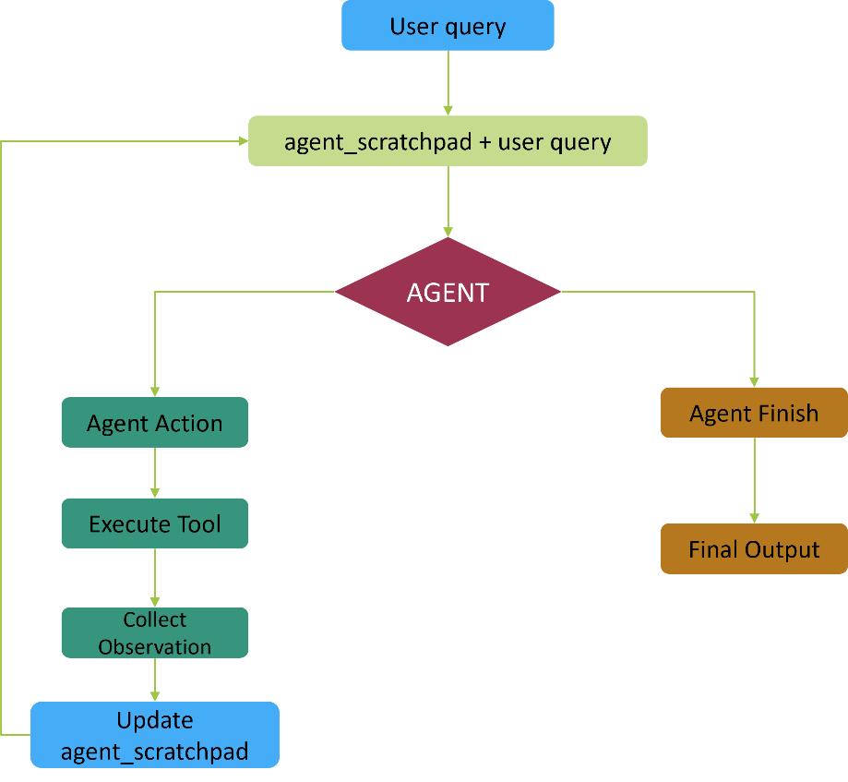

Slide 10
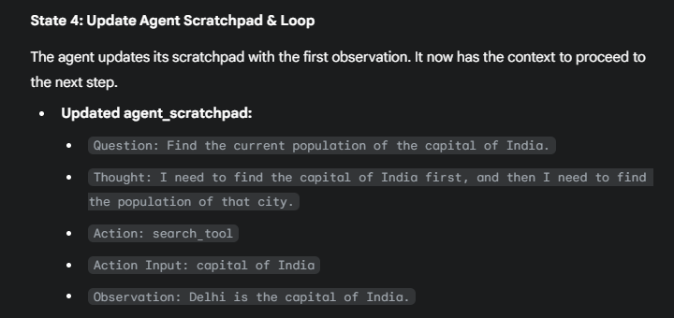

Slide 11
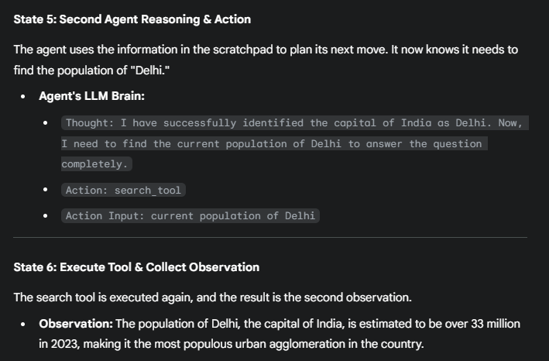

Slide 12
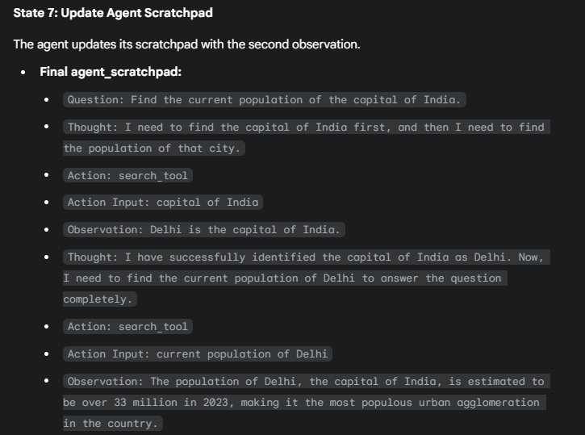

Slide 13
