Slide 1
Embeddings

Slide 2


Document
Loader
Text
Splitter
Text chunks
PDF
Loaded PDF
embedding model
Embeddings
Vector Database
embedding model
Retriever
+
Final output
user query
Embeddings
Semantic search
Result chunks + user query
LLM

Slide 3
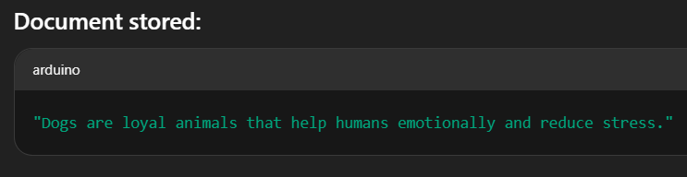
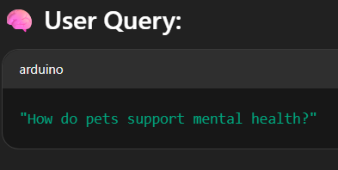
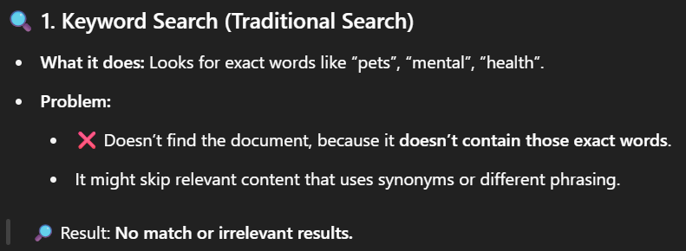
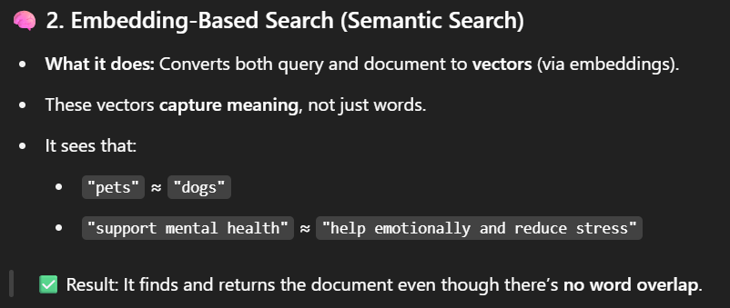
In LangChain, embeddings are numerical vector representations of text that capture the semantic meaning of words, sentences, or documents.
Doc -1
Cosine Similarity match
Doc-2
query

Slide 4
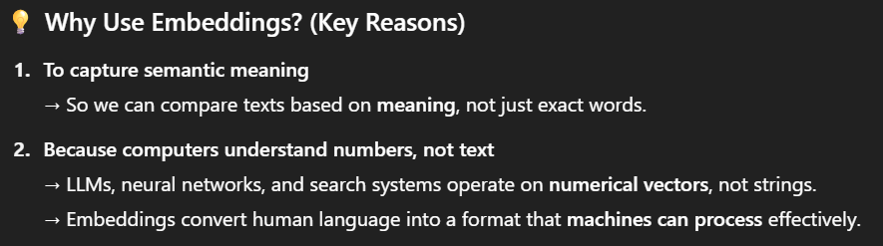
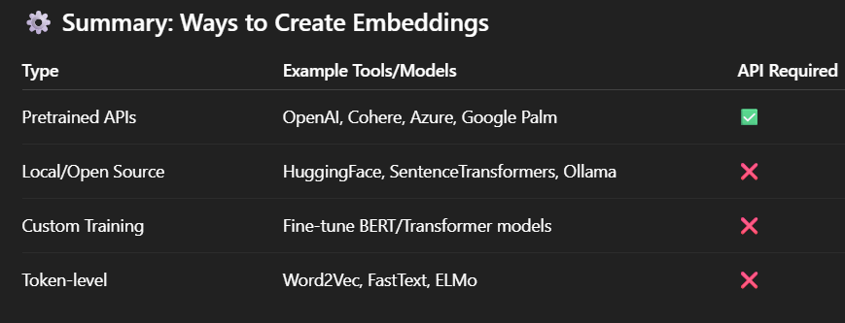
https://python.langchain.com/docs/concepts/embedding_models/

Slide 5
THANK YOU FOR YOUR TIME

