Slide 1
Retriever

Slide 2

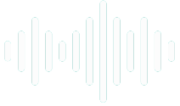
Document
Loader
Text
Splitter
Text chunks
PDF
Loaded PDF
embedding model
Embeddings
Vector Database
embedding model
Retriever
+
Final output
user query
Embeddings
Semantic search
Result chunks + user query
LLM

Slide 3
In LangChain and Retrieval-Augmented Generation (RAG) systems, a retriever is a component that fetches relevant documents or chunks from a knowledge source (like a vector store) based on a user query. It is easily pluggable in langchain pipeline.
All available retrievers: https://python.langchain.com/docs/integrations/retrievers/
WikipediaRetriever
Vector Store
MMR
Retrievers
ContextualCompressionRetriever
MultiQueryRetriever

Slide 4
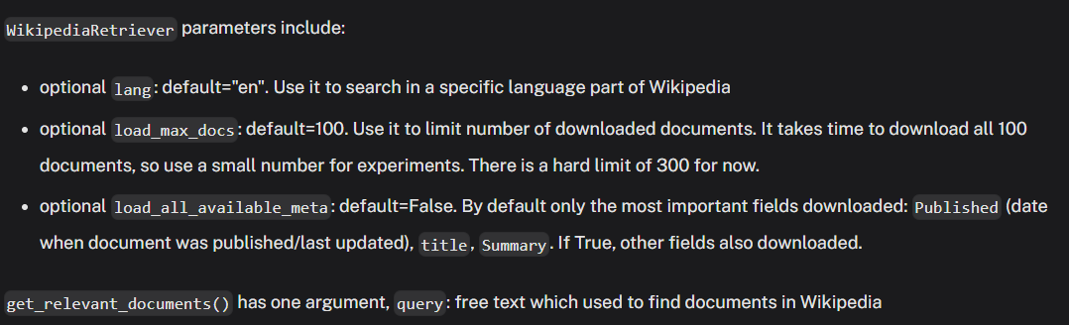
WikipediaRetriever
The WikipediaRetriever is a retriever class in LangChain that fetches relevant content from Wikipedia in response to a user query. Instead of searching your local documents, it queries Wikipedia's online API in real time to retrieve contextual information based on the query.

Slide 5
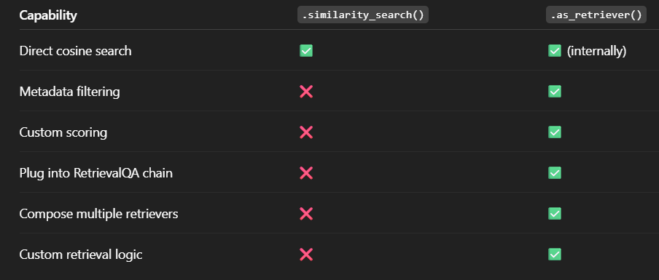
Vector Store Retriever
A Vector Store Retriever in LangChain is a retriever that wraps around a vector database (like FAISS, Chroma, Pinecone, etc.) and provides a standardized way to retrieve documents using embeddings.
Why You Need Retrievers (when You Have similarity_search)

Slide 6
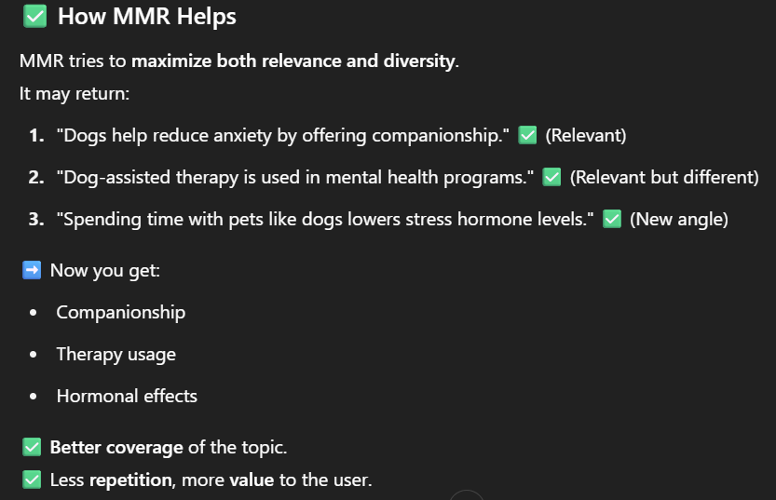
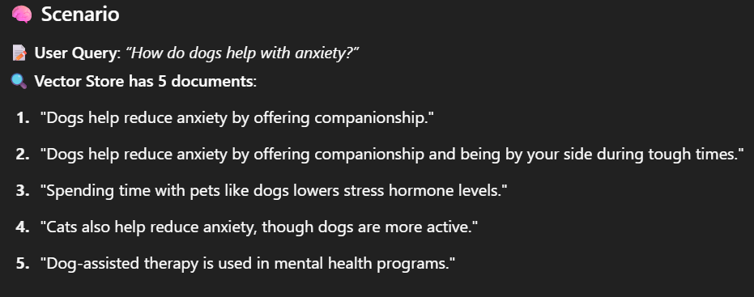
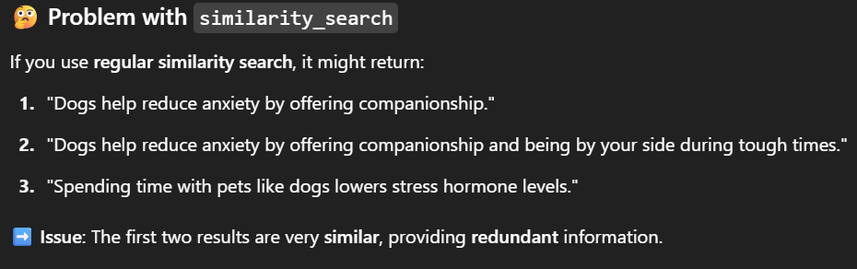
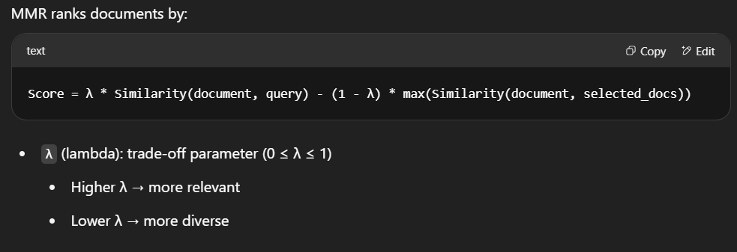
Maximum Marginal Relevance - MMR
MMR-based Retriever in LangChain uses Maximal Marginal Relevance (MMR) to retrieve documents that are not only relevant to the query but also diverse from each other.

Slide 7
The ContextualCompressionRetriever is a special kind of retriever that compresses or filters the retrieved documents based on a user query, to return only the most relevant parts of each document.
ContextualCompressionRetriever
chunks = [
"Beagles are small hounds with tricolored coats. They were bred in England for rabbit hunting.",
"These dogs have floppy ears and expressive eyes. Their excellent nose helped hunters track prey.",
"The Beagle's compact build and short legs make it agile. It’s also known for being playful and vocal.",
"Known for their loyalty, Beagles are also easily recognizable by their white-tipped tails and sturdy bodies.",
"Though they need regular exercise, their coat pattern and droopy ears make them stand out visually."
]
User query:
"What does a Beagle look like?"
Appearance info
Extra info
"Beagles are small hounds with tricolored coats. They were bred in England for rabbit hunting.“
2. "These dogs have floppy ears and expressive eyes. Their excellent nose helped hunters track prey.“
3. "The Beagle's compact build and short legs make it agile. It’s also known for being playful and vocal.“
4. "Though they need regular exercise, their coat pattern and droopy ears make them stand out visually."
ContextualCompressionRetriever
1. "Beagles are small hounds with tricolored coats."
2. "These dogs have floppy ears and expressive eyes."
3. "The Beagle's compact build and short legs make it agile."
4. "Their coat pattern and droopy ears make them stand out visually."

Slide 8
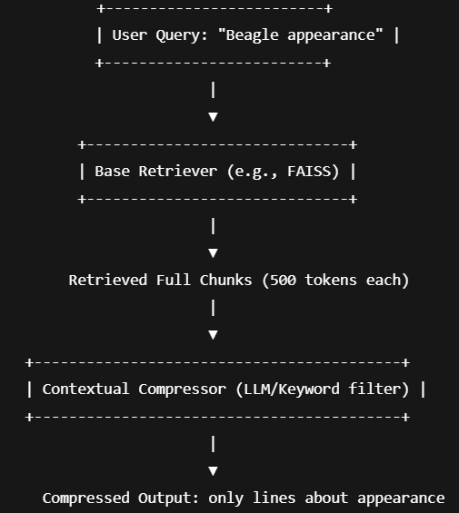

Slide 9
MultiQueryRetriever is a clever and powerful tool in LangChain designed to improve the recall of your retrieval system by leveraging LLMs to generate multiple diverse and semantically similar queries from a single user query.
It then performs retrieval for each of those queries, merges and deduplicates the results to provide a richer and more complete answer set.
MultiQueryRetriever
“What does a beagle look like?” vs “Describe the physical appearance of a beagle.”
Same meaning. User can ask question in any format. Not restricted to a particular format
Meaning can be any one of the followings: (Ambiguity & Multiple Interpretations)
1. "Describe the physical appearance of a Beagle.“
2. "What are the visual characteristics of Beagles?“
3. "How can you identify a Beagle dog by its looks?"
"What does a Beagle look like?"

Slide 10
