Slide 1
Prompt

Slide 2


Document
Loader
Text
Splitter
Text chunks
PDF
Loaded PDF
embedding model
Embeddings
Vector Database
Prompt
embedding model
Retriever
+
Final output
user query
Embeddings
Semantic search
Result chunks + user query
LLM

Slide 3
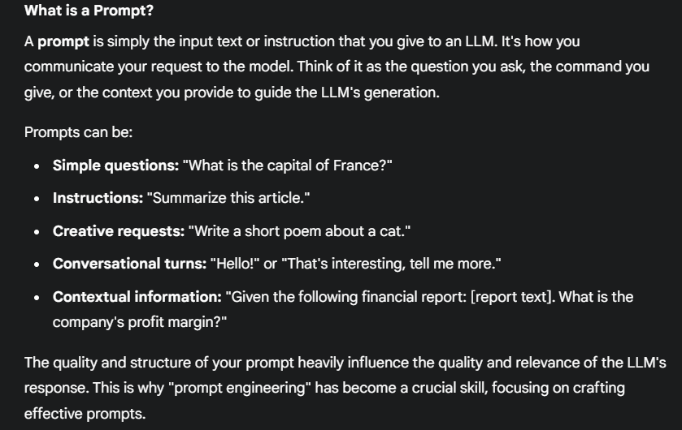
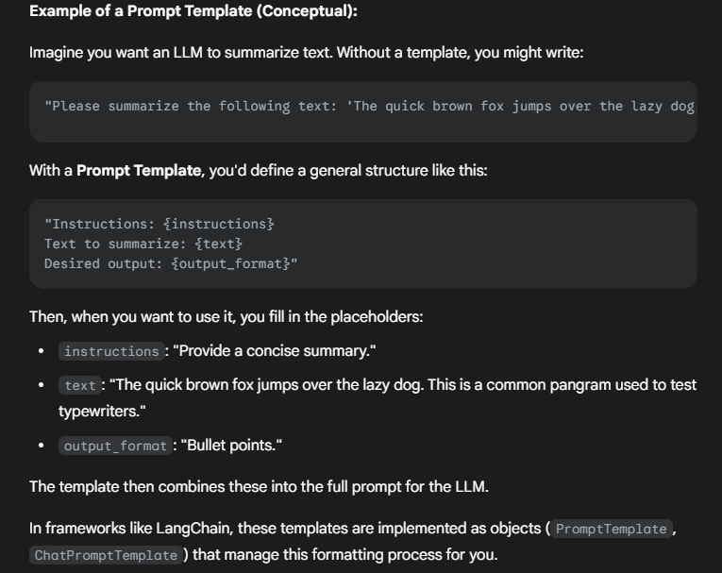
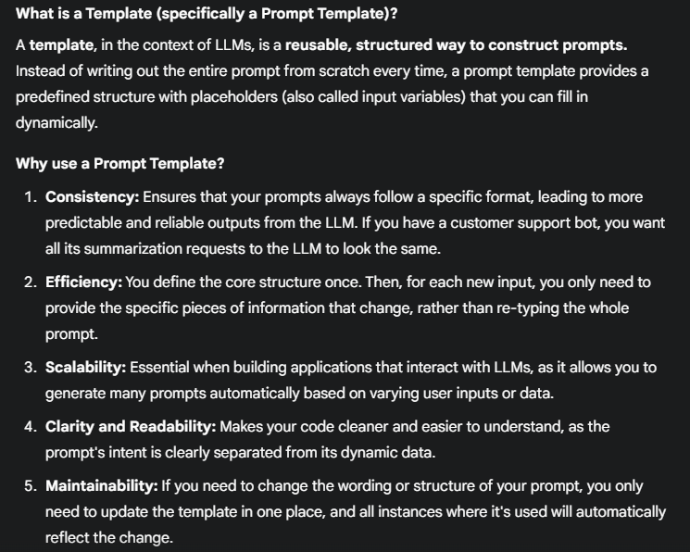
Place holders

Slide 4
PromptTemplate
Templates
ChatPromptTemplate

Slide 5
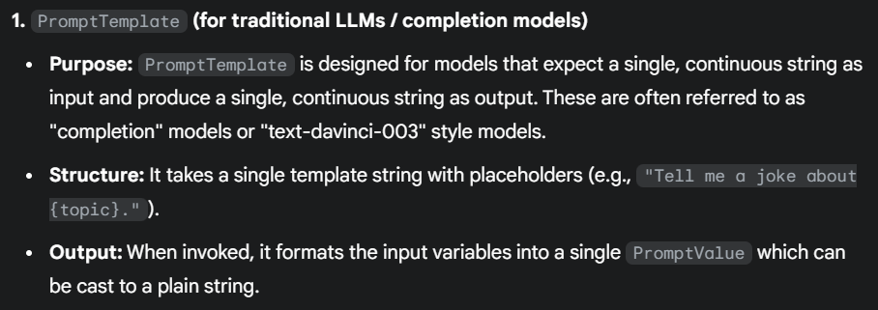
PromptTemplate

Slide 6
PromptTemplate example
With PromptTemplate, you construct a single, continuous string that includes both your instructions and the content you want the LLM to process.
Best For: Simple, one-off tasks with LLMs that primarily handle string-in, string-out operations (older models or those not specifically fine-tuned for chat).
placeholders
prompt = PromptTemplate(
template='create a 20 words summary on {dog} using\n {dog_essay}',
input_variables=["dog", 'dog_essay']
)
final_prompt = prompt.invoke({'dog_essay':docs[0].page_content,"dog":"husky"})
Values for placeholders

Slide 7
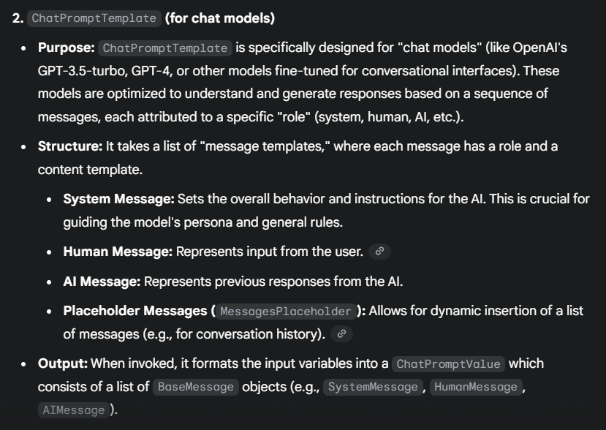
ChatPromptTemplate

Slide 8
chat_summary_prompt_template = ChatPromptTemplate([
# System message: Role "system", content is the instruction string
("system", "You are an expert news summarizer. Your task is to provide a concise summary, strictly limited to 50 words, ensuring accuracy and neutrality."),
# Human message: Role "human", content is the template string with placeholder
("human", "Here is the news article to summarize:\n{article_text}")
])
role
final_chat_messages =chat_summary_prompt_template.invoke({"article_text":news_article_content})

Slide 9
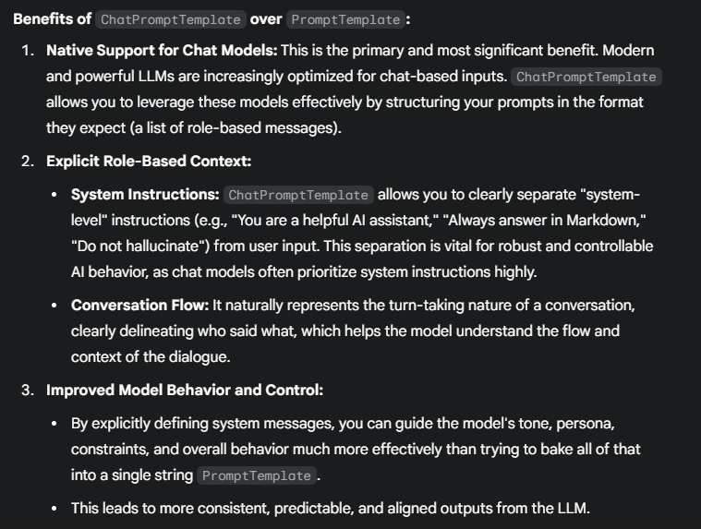

Slide 10
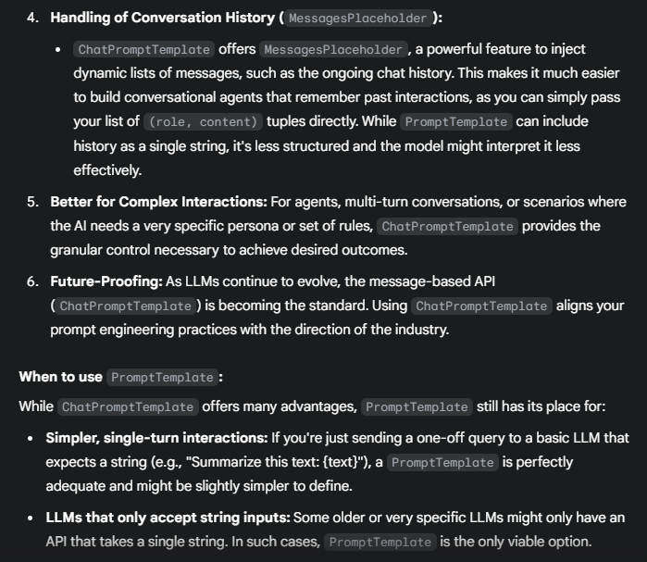

Slide 11
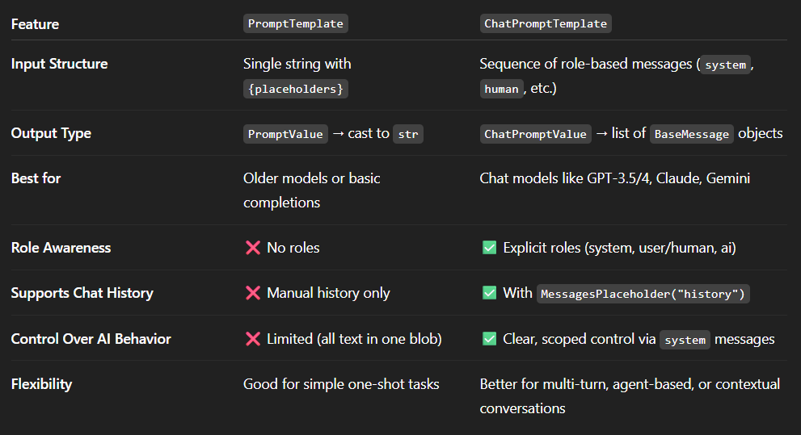

Slide 12
MessagesPlaceholder is a special component used inside a ChatPromptTemplate that allows you to dynamically inject a list of chat messages (i.e., conversation history) into your prompt at runtime.
chat_prompt = ChatPromptTemplate.from_messages([
("system", "You are an expert news summarizer. Your task is to provide a concise summary, strictly limited to 50 words, ensuring accuracy and neutrality."),
MessagesPlaceholder(variable_name="chat_history"),
("human", "{user_input}")
])

