Slide 1
Models

Slide 2


Document
Loader
Text
Splitter
Text chunks
PDF
Loaded PDF
embedding model
Embeddings
Vector Database
Prompt
embedding model
Retriever
+
Final output
user query
Embeddings
Semantic search
Result chunks + user query
LLM

Slide 3
The model component in LangChain is a core part of the framework designed to facilitate interactions with various language models and embedding models. It provides a standard interface to interact with these models, so you can plug them into chains and agents easily — regardless of provider (OpenAI, Hugging Face, Cohere, etc.)
Models
String --- > Vector (List[float])
Language models
Embedding models
String prompt --- > String output
List of role-based messages --- > Message-based response
text-embedding-3-large
embed-english-v3.0
bge-small-en-v1.5
sentence-transformers/all-MiniLM-L6-v2
intfloat/e5-base-v2
GritLM-7B
LLMs
Chat models
text-davinci-003
command-xlarge
Claude 1 (v1)
GPT-J
Falcon 7B (base)
LLaMA 2 (base)
GPT-4
Claude 3
Gemini
Mistral 7B Instruct
Phi-2 (chat-tuned)

Slide 4
Feature / Aspect | LLM (Base Model) | Chat Model
1. What is it? | A large language model trained to complete or generate text given a single prompt string. | Conversational AI models specifically designed for multi-turn dialogue. They understand conversation context and can maintain coherent exchanges with users.
2. Input/Output | string → string | List[BaseMessage] → AIMessage (role-aware structured output)
3. Purpose | Designed for single-shot or one-turn completions like summarization, translation, and basic Q&A. | Built for ongoing conversations, instruction-following, and interactive dialogue.
4. Training | Trained on large text corpora without specific structure or role context. | Fine-tuned on conversation datasets with roles: system, user, ai.
5. Memory Support | No inherent support for memory; developers must stitch previous prompts/responses manually. | Native memory integration using MessagesPlaceholder or memory components in LangChain.
6. Role Awareness | ❌ Lacks concept of roles like "system", "user", or "ai". Treats all text as flat input. | ✅ Fully aware of roles; can distinguish instructions, questions, and replies based on message type.
7. Example Models | - text-davinci-003 (OpenAI) - GPT-J (EleutherAI) - MPT-7B (MosaicML) | - gpt-4 / gpt-3.5-turbo (OpenAI) - Claude 3 (Anthropic) - Mistral-Instruct, LLaMA 2 Chat
8. Use Cases | - One-shot summarization - Text classification - Creative writing - Code generation | - Chatbots - Conversational agents with memory - RAG pipelines - Tool-using AI agents

Slide 5
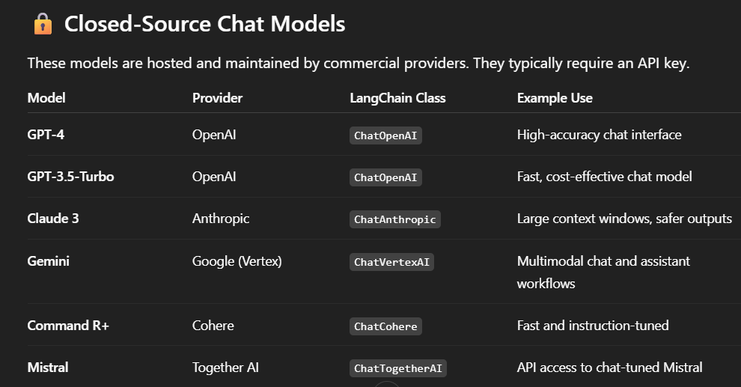
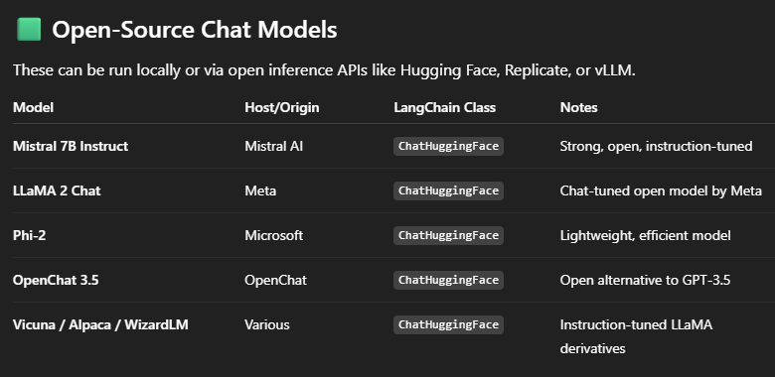
What Is a Chat Model?
Chat models are language models designed to interact through structured role-based messages (e.g., system, user, ai). LangChain provides wrappers that make it easy to use them with standardized APIs. These models are ideal for multi-turn conversations, where the model must maintain context, obey system instructions, and respond based on role semantics.

Slide 6
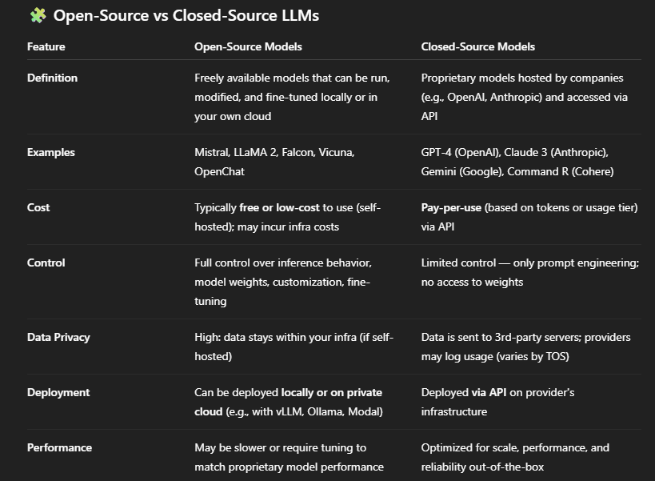

Slide 7
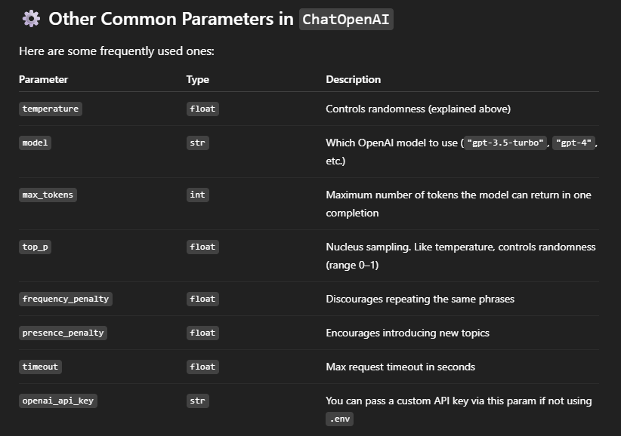
OpenAI models: https://platform.openai.com/docs/models https://python.langchain.com/docs/integrations/chat/openai/
from langchain_openai import ChatOpenAI
# Load the LLM
llm = ChatOpenAI(model="gpt-3.5-turbo", temperature=0.0)
API creation:
https://platform.openai.com/settings/organization/api-keys
https://aistudio.google.com/apikey
https://huggingface.co/settings/tokens
https://console.anthropic.com/dashboard

Slide 8
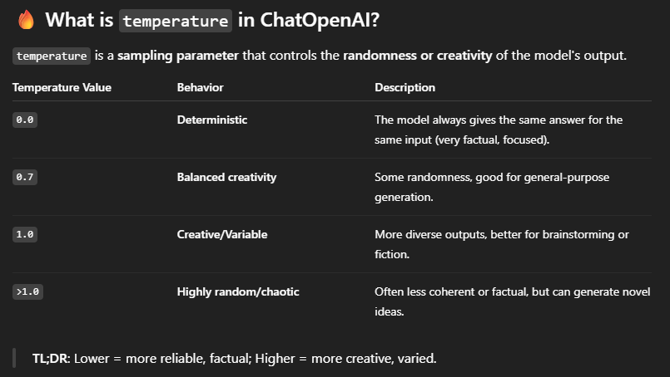
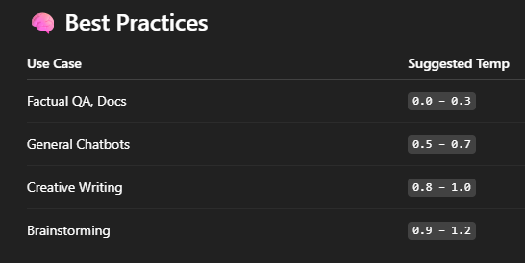

Slide 9
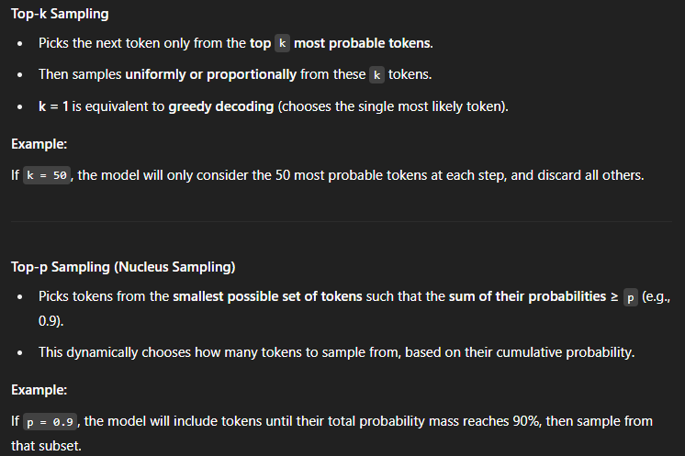
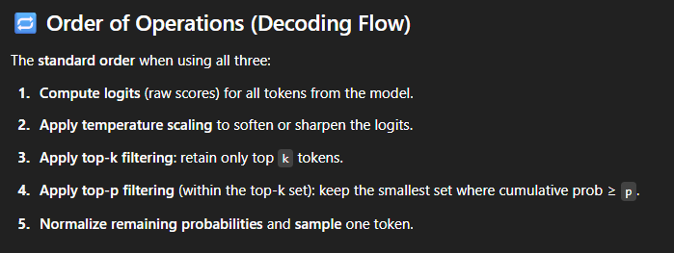

Slide 10
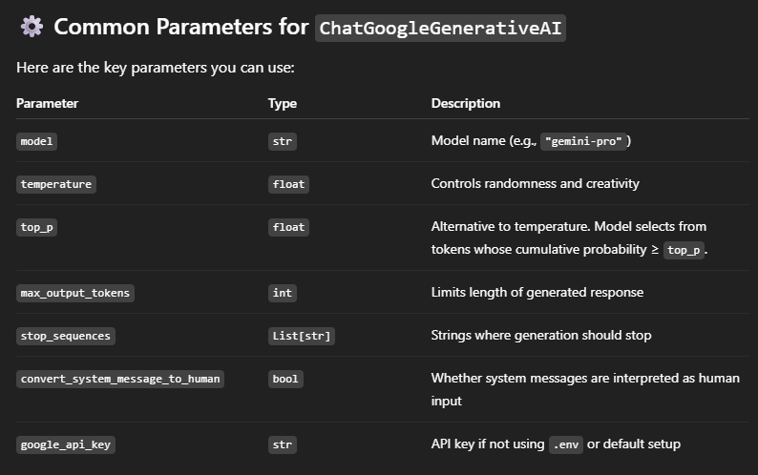
Gemini API: https://aistudio.google.com/apikey
from langchain_google_genai import ChatGoogleGenerativeAI
# Load the LLM
llm = ChatGoogleGenerativeAI(model='gemini-1.5-pro', temperature=0.0)

Slide 11
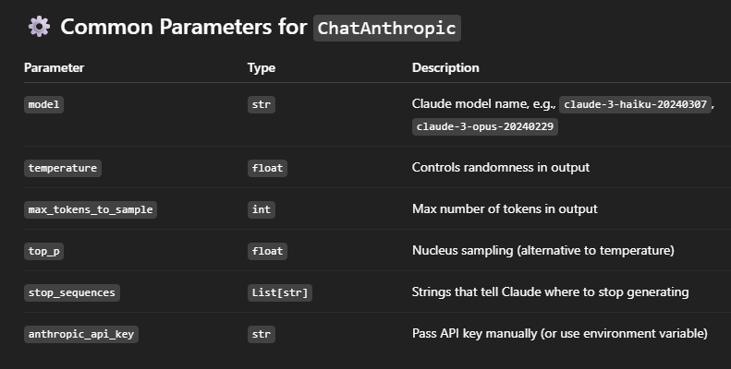
Anthropic: https://docs.anthropic.com/en/docs/about-claude/models/overview
from langchain_anthropic import ChatAnthropic
# Load the LLM
llm =ChatAnthropic(model='claude-sonnet-4-20250514', temperature=0.0)

Slide 12
Huggingface models
Using HF API
Download and run locally
llm = HuggingFaceEndpoint(
repo_id="HuggingFaceH4/zephyr-7b-beta",
task="text-generation",
temperature=0.7,
max_new_tokens=512,
huggingfacehub_api_token=os.getenv("HUGGINGFACEHUB_ACCESS_TOKEN")
)
# === Load Local HuggingFace Model ===
os.environ['HF_HOME'] = 'E:/YOUTUBE_CODES/40_LLMs/hugging_face'
llm = HuggingFacePipeline.from_model_id(
model_id='HuggingFaceH4/zephyr-7b-beta',
task='text-generation',
pipeline_kwargs=dict(
temperature=0.7,
max_new_tokens=512
)
)

Slide 13
