Slide 1
Output Parsers

Slide 2


Document
Loader
Text
Splitter
Text chunks
PDF
Loaded PDF
embedding model
Embeddings
Vector Database
Prompt
embedding model
Retriever
+
Final output
user query
Embeddings
Semantic search
Result chunks + user query
LLM

Slide 3
Output parsers in LangChain are crucial components that take the raw string output from a Large Language Model (LLM) and transform it into a more structured and usable format.
Structured output
Type: <class 'langchain_core.messages.ai.AIMessage'>
Full object: content="Hello there, furry friend! It's so nice to see your wagging tail and bright eyes today. Let's have some fun and go on an adventure together!" additional_kwargs={'refusal': None} response_metadata={'token_usage': {'completion_tokens': 33, 'prompt_tokens': 19, 'total_tokens': 52, 'completion_tokens_details': {'accepted_prediction_tokens': 0, 'audio_tokens': 0, 'reasoning_tokens': 0, 'rejected_prediction_tokens': 0}, 'prompt_tokens_details': {'audio_tokens': 0, 'cached_tokens': 0}}, 'model_name': 'gpt-3.5-turbo-0125', 'system_fingerprint': None, 'id': 'chatcmpl-BohO5nJmCbPFvGcVhKi42XUIFyl8q', 'service_tier': 'default', 'finish_reason': 'stop', 'logprobs': None} id='run--a4cf1b34-09f3-4d30-9303-94102dce238b-0' usage_metadata={'input_tokens': 19, 'output_tokens': 33, 'total_tokens': 52, 'input_token_details': {'audio': 0, 'cache_read': 0}, 'output_token_details': {'audio': 0, 'reasoning': 0}}
'Hey there, furry friend! Hope you're having a pawsome
day full of tail wags and belly rubs. Woof woof!'
result: content="Introducing the latest in cutting-edge technology, the XYZ Smartphone is a must-have device for anyone looking to stay connected and organized on the go. With its sleek and modern design, this smartphone is not only visually appealing but also packed with powerful features.\n\nFeaturing a vibrant 6.5-inch HD display, you can enjoy crystal-clear visuals whether you're streaming videos, browsing social media, or playing games. The XYZ Smartphone also boasts a fast and responsive processor, ensuring smooth performance for all your multitasking needs.\n\nCapture every moment with stunning clarity with the XYZ Smartphone's high-quality dual camera system. Whether you're taking selfies, landscape shots, or close-ups, you can expect sharp and detailed photos every time. Plus, with 128GB of storage space, you'll never have to worry about running out of space for your photos and videos.\n\nStay connected with friends, family, and colleagues with the XYZ Smartphone's advanced communication features. From crystal-clear voice calls to lightning-fast data speeds, you can rely on this smartphone to keep you connected no matter where your day takes you.\n\nExperience the future of mobile technology with the XYZ Smartphone - the perfect blend of style, performance, and innovation." additional_kwargs={'refusal': None} response_metadata={'token_usage': {'completion_tokens': 239, 'prompt_tokens': 15, 'total_tokens': 254, 'completion_tokens_details': {'accepted_prediction_tokens': 0, 'audio_tokens': 0, 'reasoning_tokens': 0, 'rejected_prediction_tokens': 0}, 'prompt_tokens_details': {'audio_tokens': 0, 'cached_tokens': 0}}, 'model_name': 'gpt-3.5-turbo-0125', 'system_fingerprint': None, 'id': 'chatcmpl-BohQcBP82VzKxIklyxZpYFeFhtfYE', 'service_tier': 'default', 'finish_reason': 'stop', 'logprobs': None} id='run--493bc80a-43c2-4ccc-a172-8d01391223ba-0' usage_metadata={'input_tokens': 15, 'output_tokens': 239, 'total_tokens': 254, 'input_token_details': {'audio': 0, 'cache_read': 0}, 'output_token_details': {'audio': 0, 'reasoning': 0}}
result: {'product_name': 'Samsung Galaxy S20’,
'price': '$999’,
'category': 'Smartphone’,
'rating': '4.5’,
'features': '6.2-inch AMOLED display, 5G connectivity, 64MP triple camera system, 128GB storage, 12GB RAM, Exynos 990 processor'}

Slide 4
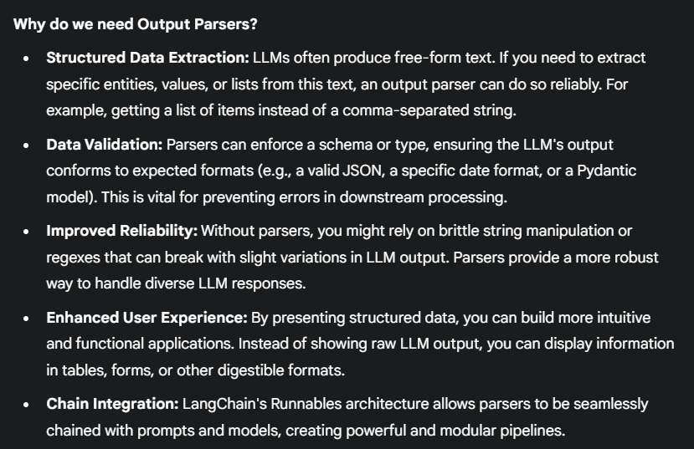
str
result: {'product_name': 'Samsung Galaxy S20’,
'price': '$999’,
'category': 'Smartphone’,
'rating': '4.5’,
'features': '6.2-inch AMOLED display, 5G connectivity, 64MP triple camera system, 128GB storage, 12GB RAM, Exynos 990 processor'}
float
chain = template1 | model | output parser | template2 | model | output parser

Slide 5
StrOutputParser
ListOutputParser
JsonOutputParser
Output Parsers
StructuredOutputParser
PydanticOutputParser
customOutputParser

Slide 6
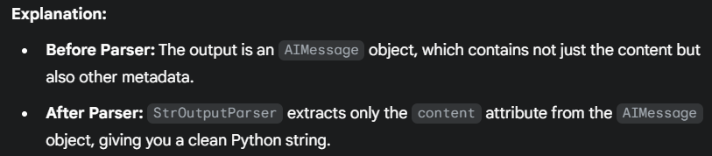
StrOutputParser
This parser returns the raw string output from the LLM. It's often used as a baseline or when no specific parsing is needed beyond converting the LLM's AIMessage object to a string.
Type: <class 'langchain_core.messages.ai.AIMessage'>
Full object: content="Hello there, furry friend! It's so nice to see your wagging tail and bright eyes today. Let's have some fun and go on an adventure together!" additional_kwargs={'refusal': None} response_metadata={'token_usage': {'completion_tokens': 33, 'prompt_tokens': 19, 'total_tokens': 52, 'completion_tokens_details': {'accepted_prediction_tokens': 0, 'audio_tokens': 0, 'reasoning_tokens': 0, 'rejected_prediction_tokens': 0}, 'prompt_tokens_details': {'audio_tokens': 0, 'cached_tokens': 0}}, 'model_name': 'gpt-3.5-turbo-0125', 'system_fingerprint': None, 'id': 'chatcmpl-BohO5nJmCbPFvGcVhKi42XUIFyl8q', 'service_tier': 'default', 'finish_reason': 'stop', 'logprobs': None} id='run--a4cf1b34-09f3-4d30-9303-94102dce238b-0' usage_metadata={'input_tokens': 19, 'output_tokens': 33, 'total_tokens': 52, 'input_token_details': {'audio': 0, 'cache_read': 0}, 'output_token_details': {'audio': 0, 'reasoning': 0}}
'Hey there, furry friend! Hope you're having a pawsome
day full of tail wags and belly rubs. Woof woof!'

Slide 7
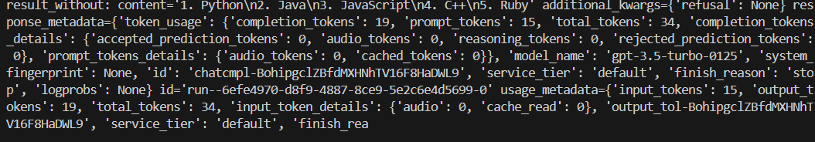
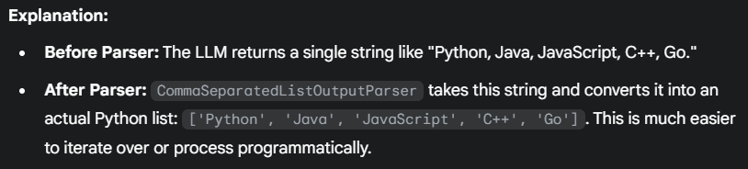
ListOutputParser
This parser is used when you expect the LLM to output a list of items, often comma-separated or newline-separated. It converts the string into a Python list.

Slide 8
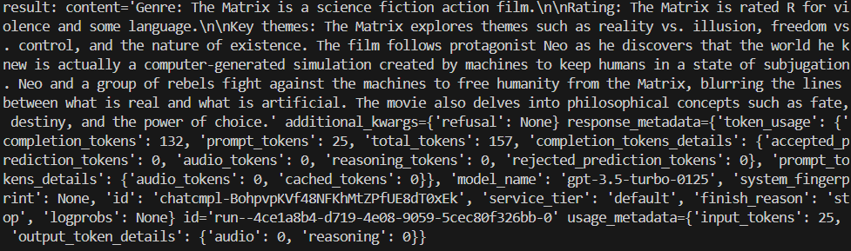
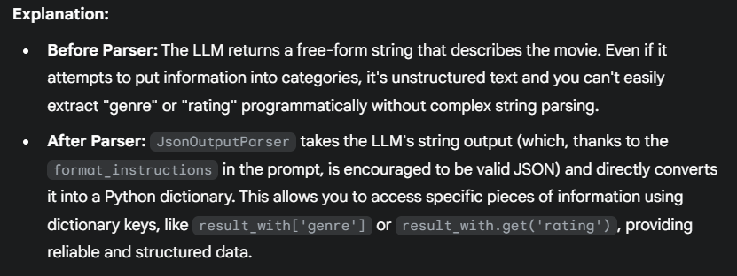
By default, LLMs produce free-form textual responses. A JSON Output Parser allows you to reliably convert these responses into structured JSON data, making it: Easy to handle programmatically, Reliable (consistent format), Integratable directly into apps, APIs, and databases.
JsonOutputParser

Slide 9
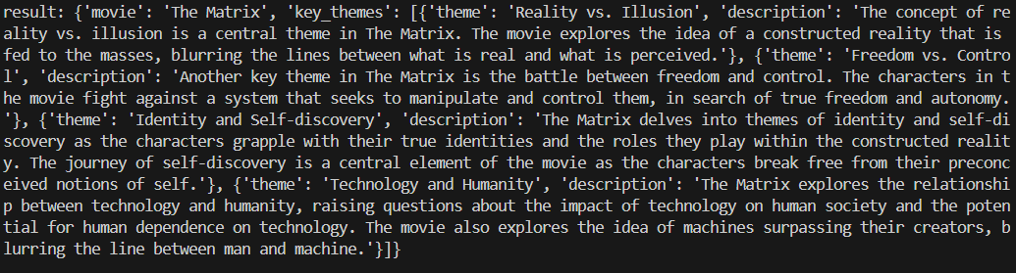
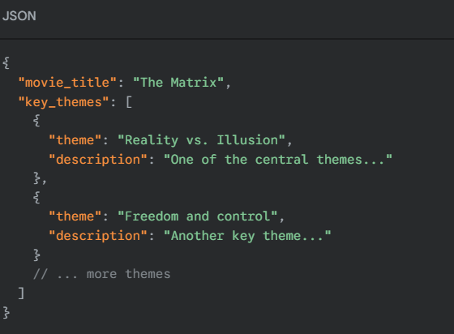
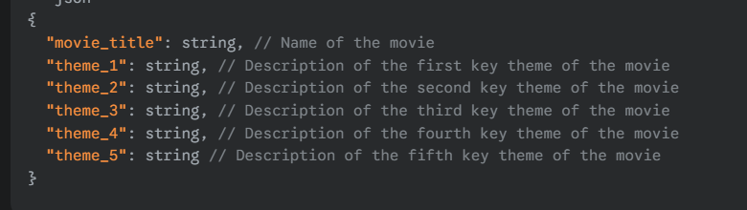
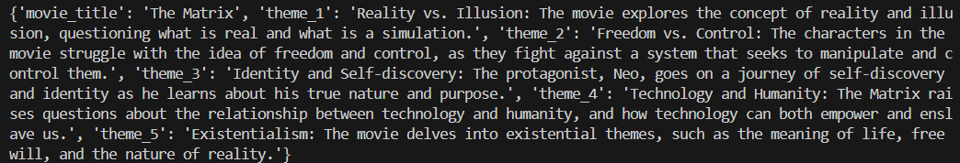
JsonOutputParser can not enforce schema.

Slide 10
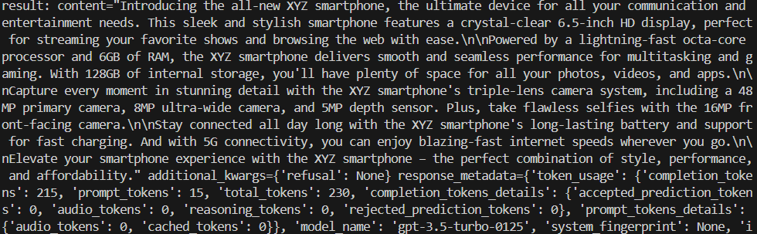
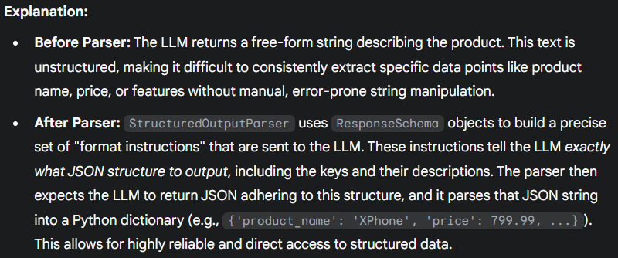
StructuredOutputParser is a LangChain output parser that defines an expected JSON structure using ResponseSchema objects and then parses the LLM's output (which is instructed to be JSON following that schema) into a Python dictionary. It's designed to give you more control over the exact keys and their descriptions that you expect from the LLM's structured output.
StructuredOutputParser

Slide 11
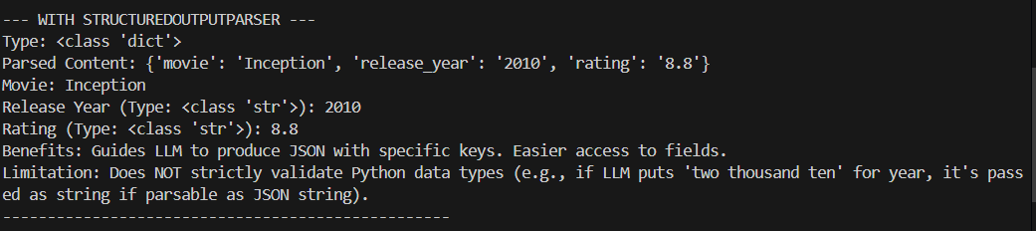
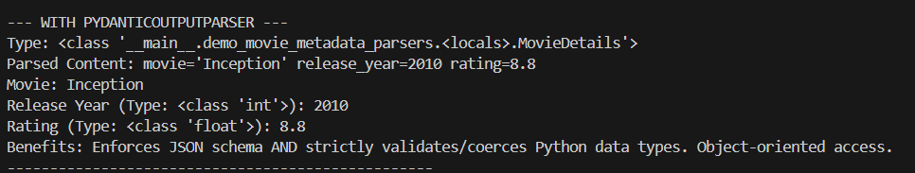
StructuredOutputParser can enforce schema but can not validate datatype.

Slide 12
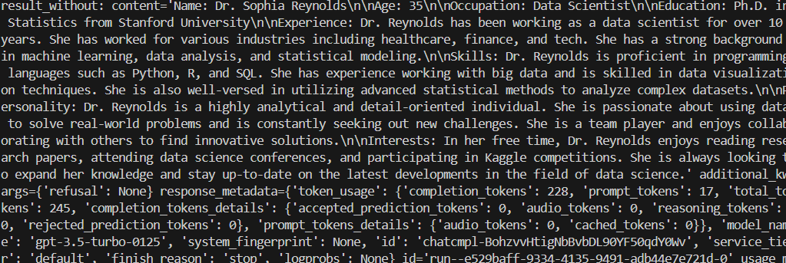
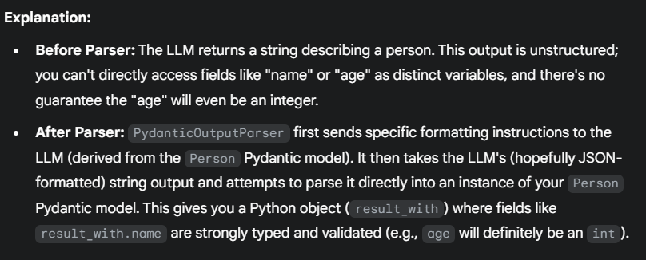
PydanticOutputParser is a LangChain output parser that strictly validates and parses the LLM's output into a Python object defined by a Pydantic BaseModel. This provides robust type checking and data validation, ensuring the LLM's response conforms precisely to a defined schema.
PydanticOutputParser

Slide 13
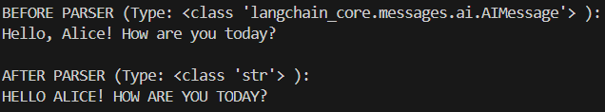
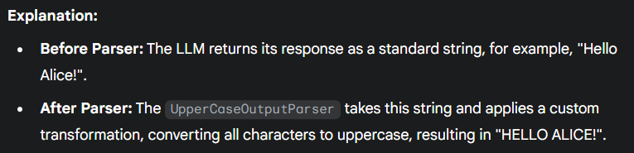
This is a custom output parser that inherits from BaseOutputParser. It's designed to perform a specific, user-defined transformation on the LLM's raw string output; in this example, it converts the entire output to uppercase.
CustomOutputParser

