Slide 1
MINITRACK • IMPLEMENTATION WALKTHROUGH
React frontend architecture
Updated diagrams and a guided tour of mt_frontend_react
Source branch: deepakbabel23/minitrack • mt_frontend_react
Notes:
Open by explaining that the original diagrams were architectural proposals. The code is now the source of truth, so this walkthrough shows what stayed stable, what changed, and why the final structure is still sound.

Slide 2
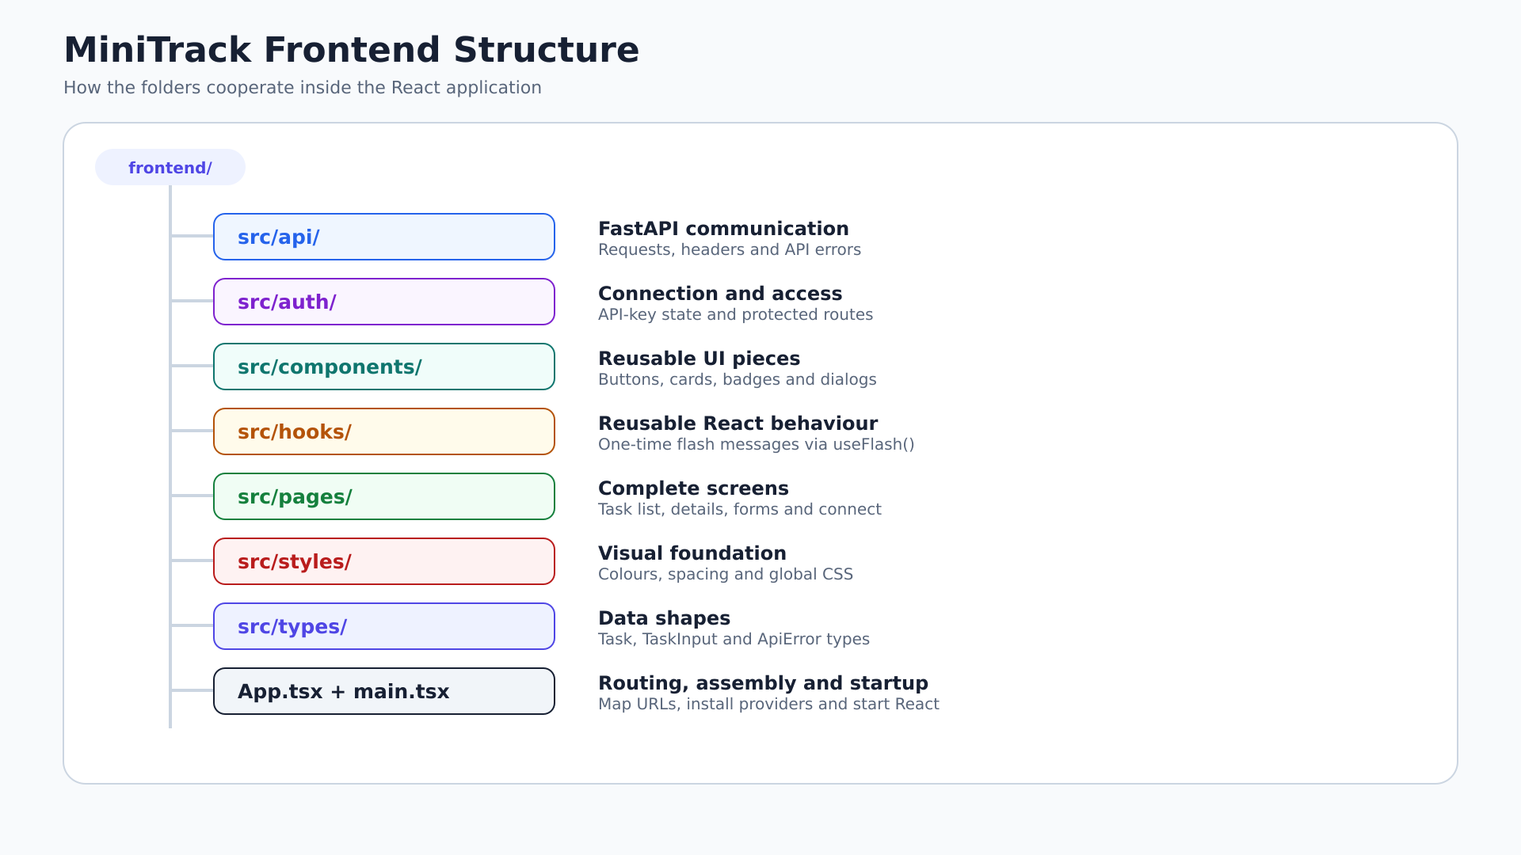
Notes:
Use this slide to introduce the actual src/ structure. Call out hooks/, the absence of routes/, and the combined routing/startup responsibility of App.tsx and main.tsx.

Slide 3
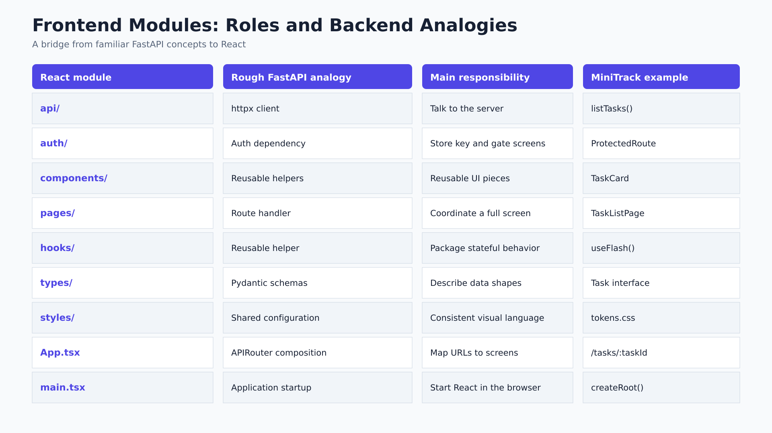
Notes:
Walk left to right through each row. Relate the frontend API layer to an httpx client and frontend types to Pydantic schemas. Highlight that App.tsx now owns URL mapping.

Slide 4
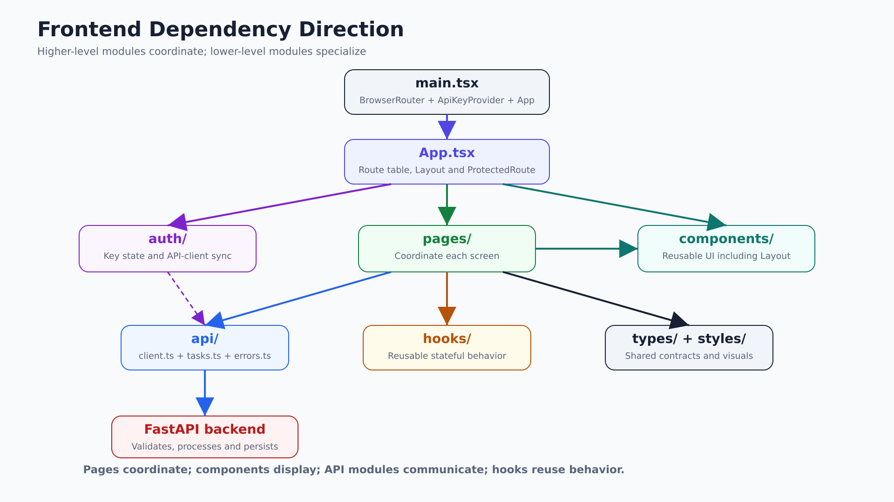
Notes:
Start at main.tsx and follow arrows downward. Explain that pages coordinate, components display, API modules communicate, and hooks package reusable stateful behavior.

Slide 5
Startup lives in main.tsx; URL mapping lives in App.tsx
Two small composition roots make navigation and authentication easy to trace.
main.tsx installs application-wide providers
App.tsx owns the route table
/connect
/tasks
/tasks/new
/tasks/:taskId
/tasks/:taskId/edit
*
BrowserRouter
└─ ApiKeyProvider
└─ App
ProtectedRoute wraps all task routes.
Routing and API-key state become available to every screen.
deepakbabel23/minitrack • mt_frontend_react
07
07
Notes:
Explain why this is simpler than creating a routes folder: App.tsx is still short and is the natural composition root. Point out that ProtectedRoute improves navigation, while FastAPI remains the real security boundary.

Slide 6
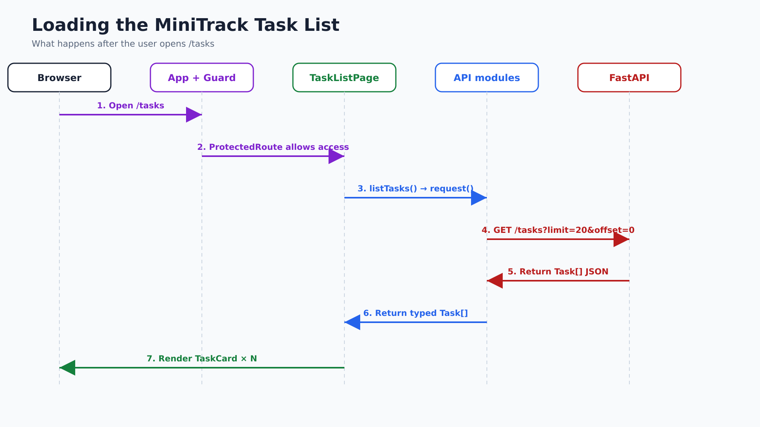
Notes:
Walk through the seven numbered steps. Stress that listTasks() knows the endpoint, request() knows HTTP and authentication, and the page only coordinates state and rendering.

Slide 7
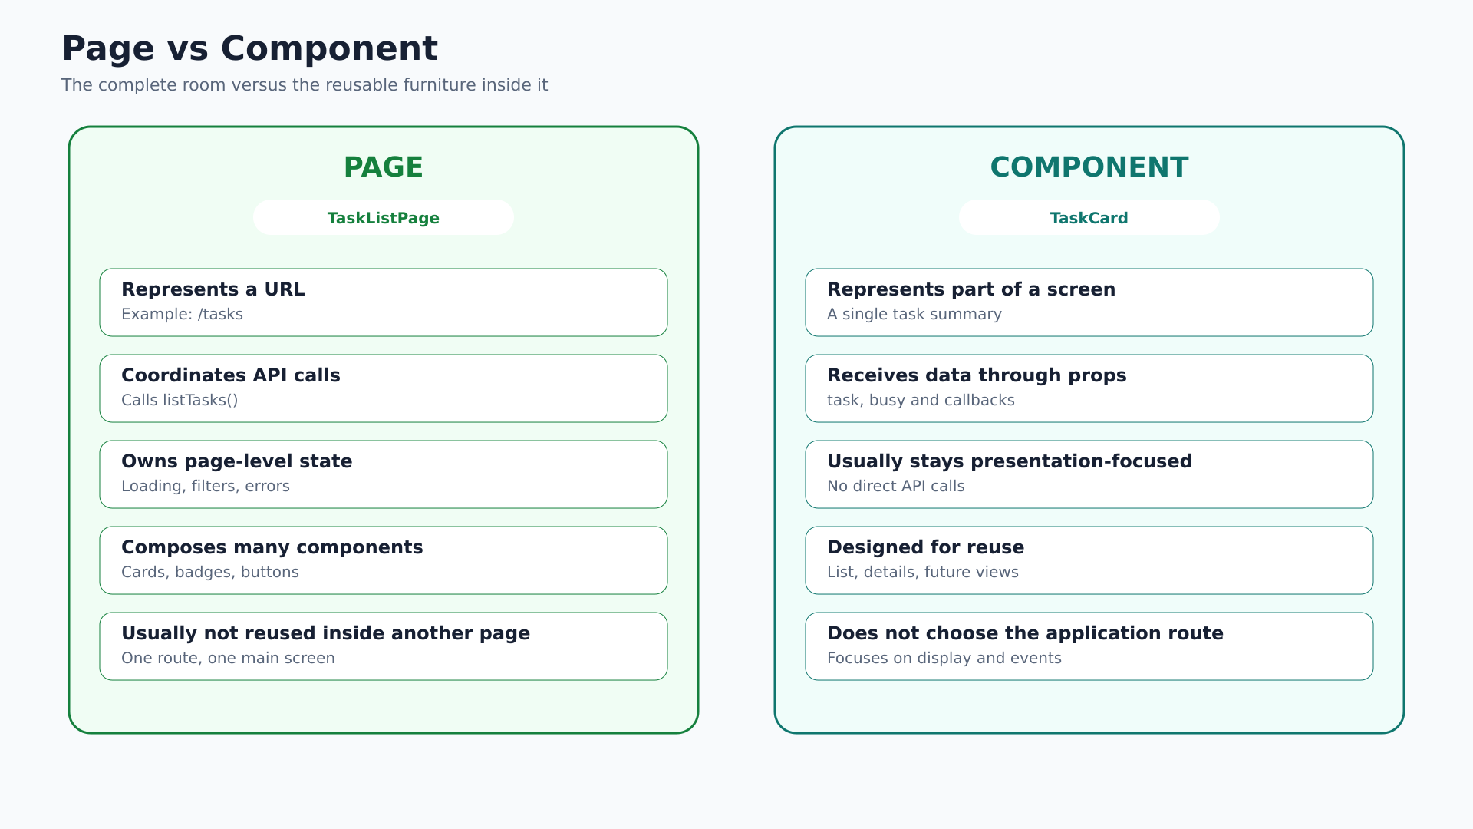
Notes:
Use TaskListPage and TaskCard as the concrete examples. The page owns loading, filters and API calls. TaskCard receives props and emits callbacks without calling FastAPI.

Slide 8
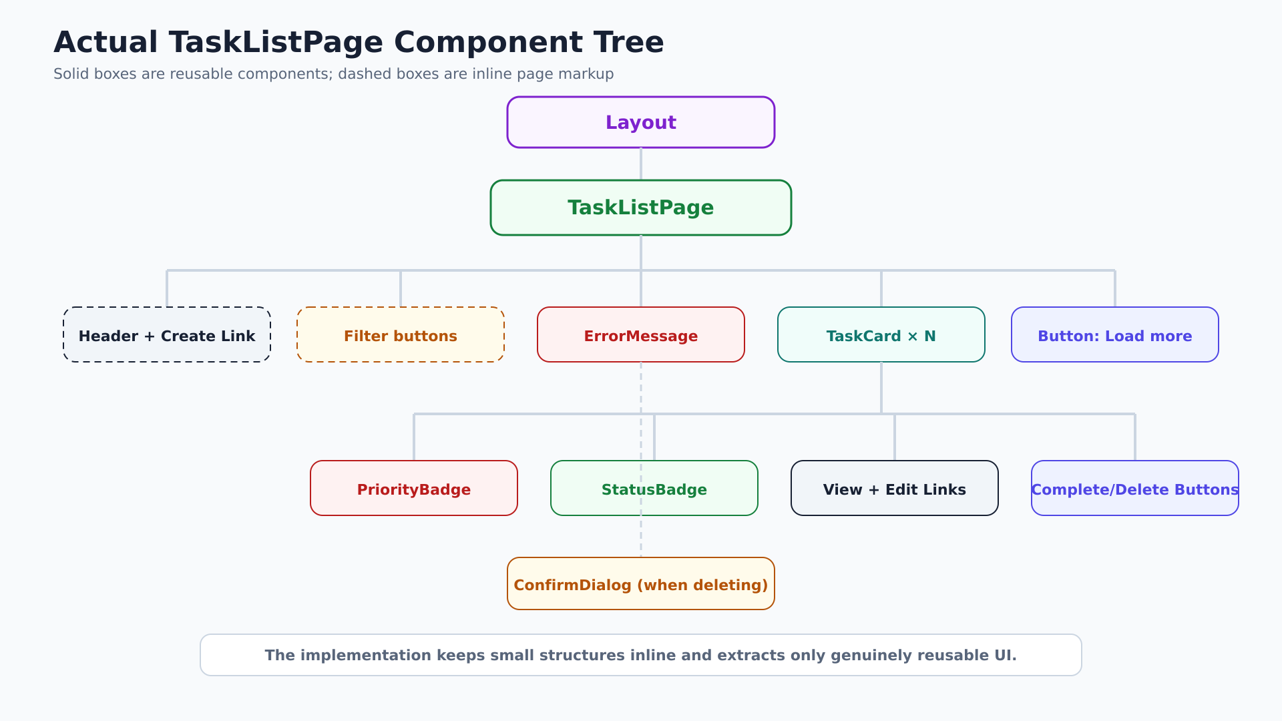
Notes:
Explain the legend first. Dashed boxes show markup kept inline because it is small and single-use. Solid boxes are reusable components extracted because they have a stable responsibility.

Slide 9
Selective extraction made TaskListPage easier to navigate—not more fragmented
The proposal anticipated more components than the current feature set needs.
Proposed
Implemented
AppHeader component
Header, filters and list markup remain inside TaskListPage.
Reusable behavior is extracted into TaskCard, ErrorMessage, ConfirmDialog, Button and useFlash.
FilterBar component
TaskList wrapper component
LoadMoreButton component
Extract on reuse or complexity—not by default.
deepakbabel23/minitrack • mt_frontend_react
11
11
Notes:
Compare the two columns. Explain that the implementation is not monolithic: important reusable elements were extracted. It simply avoided creating wrapper components with no independent behavior.

Slide 10
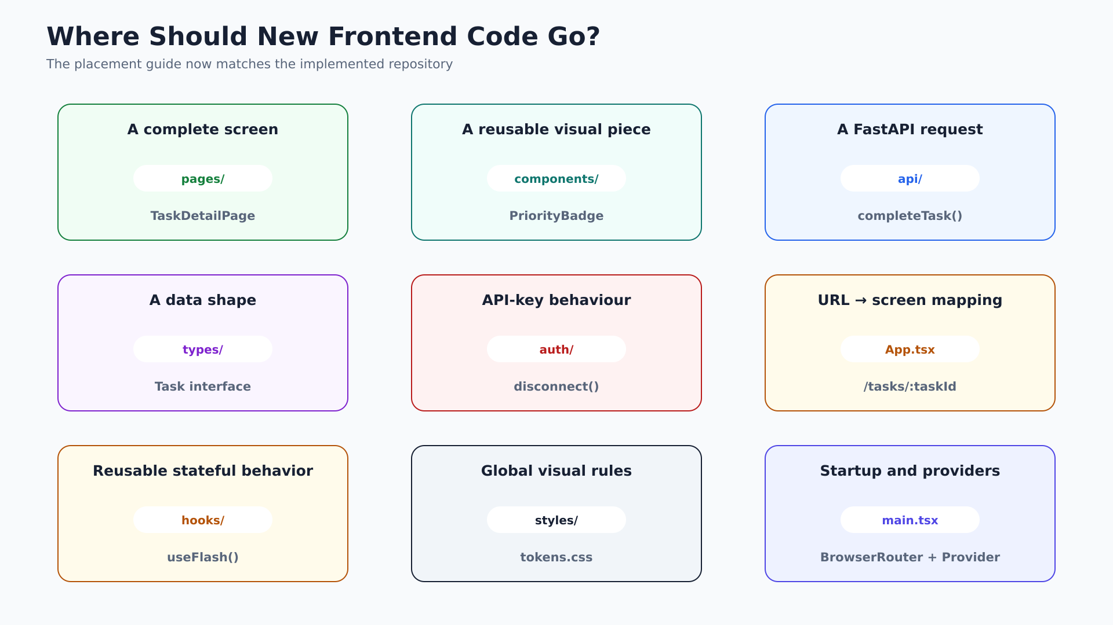
Notes:
Use this as the practical reference slide. Point out the two corrections: App.tsx for URL mapping and hooks/ for reusable stateful behavior.

Slide 11
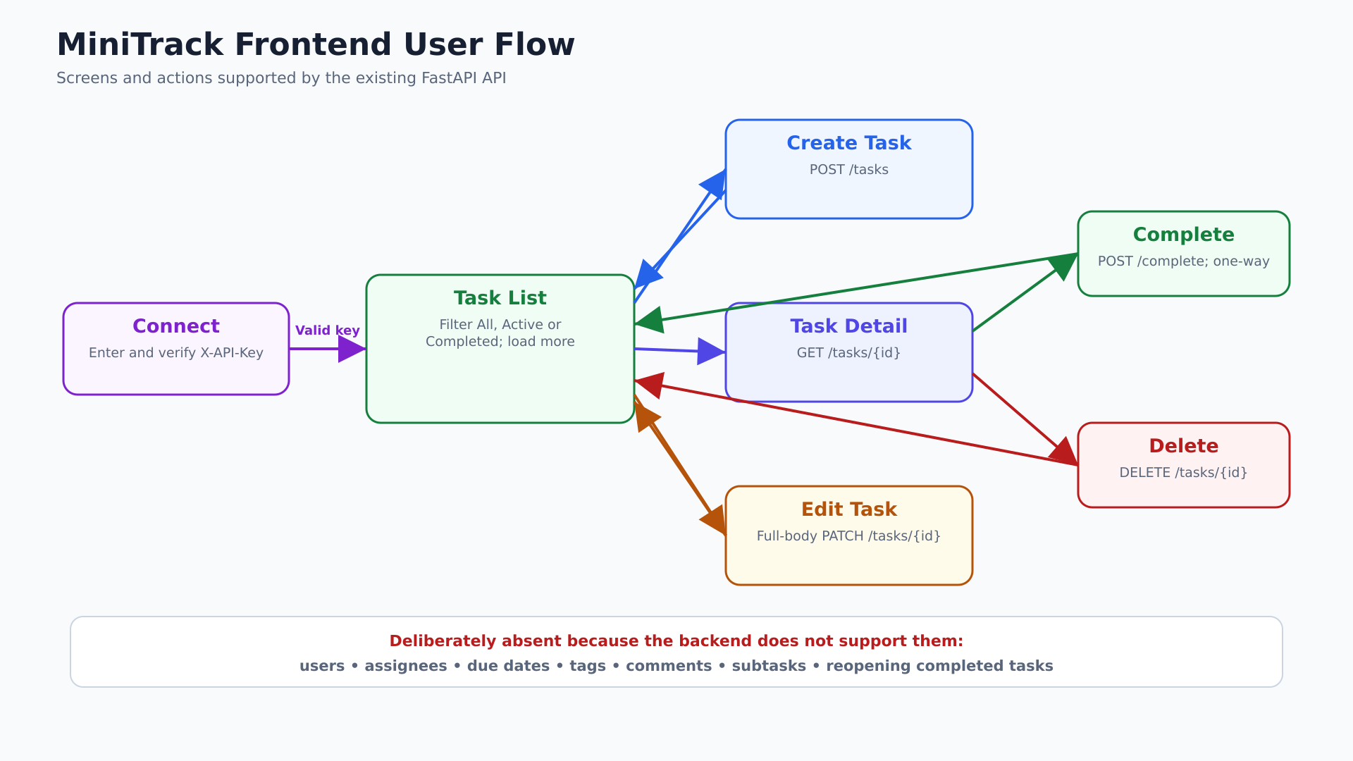
Notes:
Walk through the user journey from API-key connection to CRUD actions. Reinforce that completion is one-way because the backend has no reopen endpoint.

Slide 12
The finished frontend includes verification and learning assets—not only runtime code
The repository evolved into a training-quality implementation with executable checks and written guidance.
Component tests
Infrastructure tests
ConnectPage, TaskListPage, TaskDetailPage and TaskFormPage
API client and ProtectedRoute behavior
Manual verification
Design and contracts
MANUAL_TESTING.md documents end-to-end checks
design.md and frontend/spec.md preserve intent
deepakbabel23/minitrack • mt_frontend_react
14
14
Notes:
Explain that architecture includes maintainability mechanisms. Tests clarify expected behavior, while design.md and spec.md explain why the UI and API integration work the way they do.

Slide 13
Add the next feature by following ownership—not by growing one page
Before writing code, decide which responsibility is changing.
✓
New FastAPI endpoint?
Add a typed function in api/.
✓
New server data shape?
Update types/ to mirror the backend contract.
✓
New full screen?
Create a page and register its URL in App.tsx.
✓
Reusable visual element?
Extract it into components/ with colocated CSS.
✓
Repeated stateful behavior?
Create a focused hook in hooks/.
✓
Authentication rule changed?
Update auth/ and keep backend enforcement.
deepakbabel23/minitrack • mt_frontend_react
15
15
Notes:
Use this as the closing practical checklist. Invite the audience to name a future feature and walk through which modules would change.

