Slide 1

User Segmentation of FreeAqua Inspired App using K-Means Clustering
AIML Minor Project – Phase 1
Your Name – Deepak Balu M
Date – 24th April 2025

Slide 2

🔍 Problem Statement
The FreeAqua Inspired App collects user behavior data, but lacks insights on categorizing users.
Goal: Segment users using K-Means Clustering.
Outcome: Deliver personalized features, improve user experience, and drive engagement.

Slide 3
📊 Dataset Overview
Source: Synthetic dataset inspired by FreeAqua users.
Features: Age, Monthly Income, App Usage Time (hrs/day), Health Awareness (%).
No. of Entries: (To be updated).
Sample shown below (via df.head()).

Slide 4
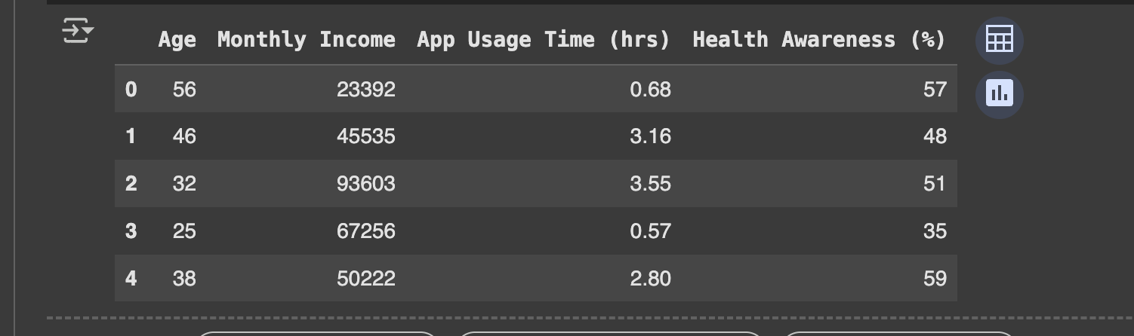
Sample Top 5 Dataset

Slide 5
🧹 Preprocessing & Feature Scaling
StandardScaler used to normalize data.
Important to treat all features equally.
Prevents income from dominating clustering.

Slide 6
🔗 K-Means Clustering Implementation
Used KMeans(n_clusters=3).
Clustered based on Age, Income, App Usage, and Health Awareness.
Assigned cluster labels to each user.
Scatter plot visualizes Age vs. Monthly Income.

Slide 7
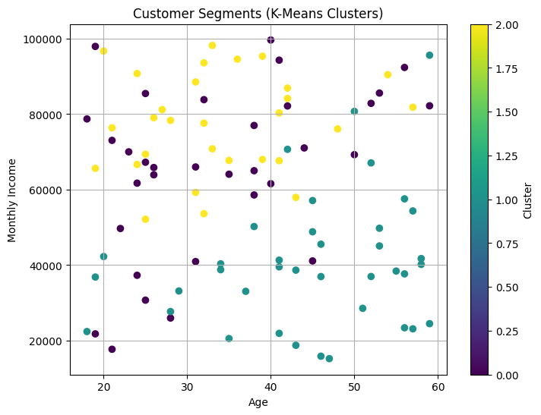
Kluster Visualization

Slide 8
👥 User Personas Identified
Persona 1: The Busy Executive (Cluster 0)- Age: ~33, Income: ₹65K, Usage: Low, Awareness: Low
Persona 2: Health-Conscious Elder (Cluster 1)- Age: ~45, Income: ₹40K, Usage: High, Awareness: High
Persona 3: Techy Spender (Cluster 2)- Age: ~33, Income: ₹77K, Usage: High, Awareness: Low

Slide 9
📈 Cluster Analysis & Strategic Suggestions
Cluster | Avg Age | Income | App Usage | Health Awareness | Strategy
0 | 33 | ₹65K | Low | Low | Push notifications, health nudges
1 | 45 | ₹40K | High | High | Promote premium subscriptions
2 | 33 | ₹77K | High | Low | Gamified fitness plans

Slide 10
🛠 Tools & Technologies Used
Platform: Google Colab
Language: Python
Libraries: Pandas, Sklearn, Matplotlib

Slide 11
DashBoard And Insights
Using Streamlit, an interactive dashboard was created to visualize and analyse the clustered data of Aquafit users. Key insights from the dashboard include:
Cluster 0: Younger individuals (~33 yrs), higher income, but low app usage and health awareness.
Cluster 1: Older individuals (~44 yrs), medium income, highest health awareness and consistent app usage.
Cluster 2: Young users (~33 yrs) with highest income and high app usage, but low health awareness.
These insights help Aquafit understand user behaviour and tailor features for different user types.

Slide 12
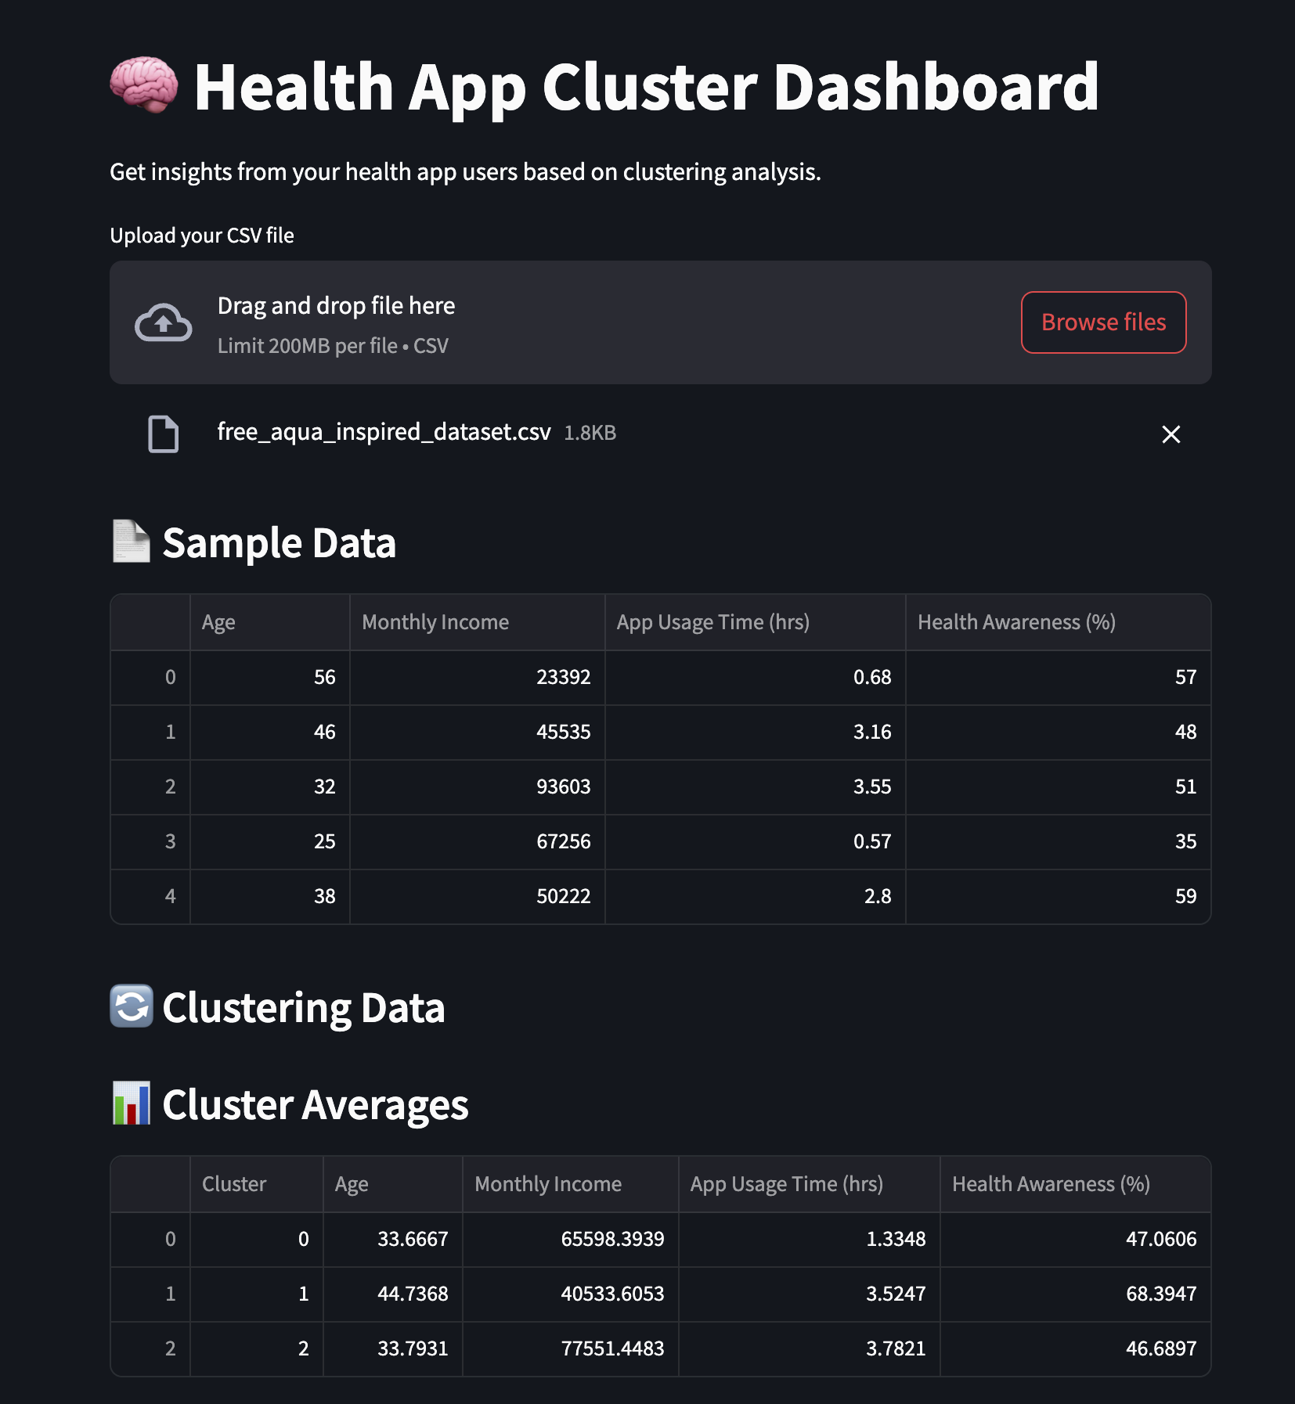
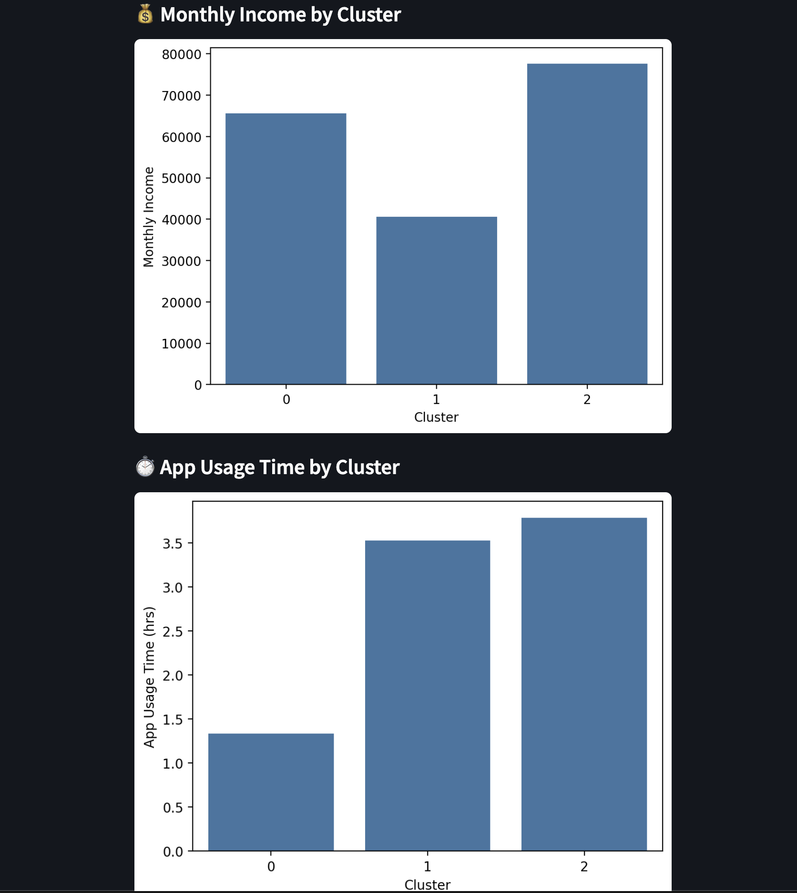
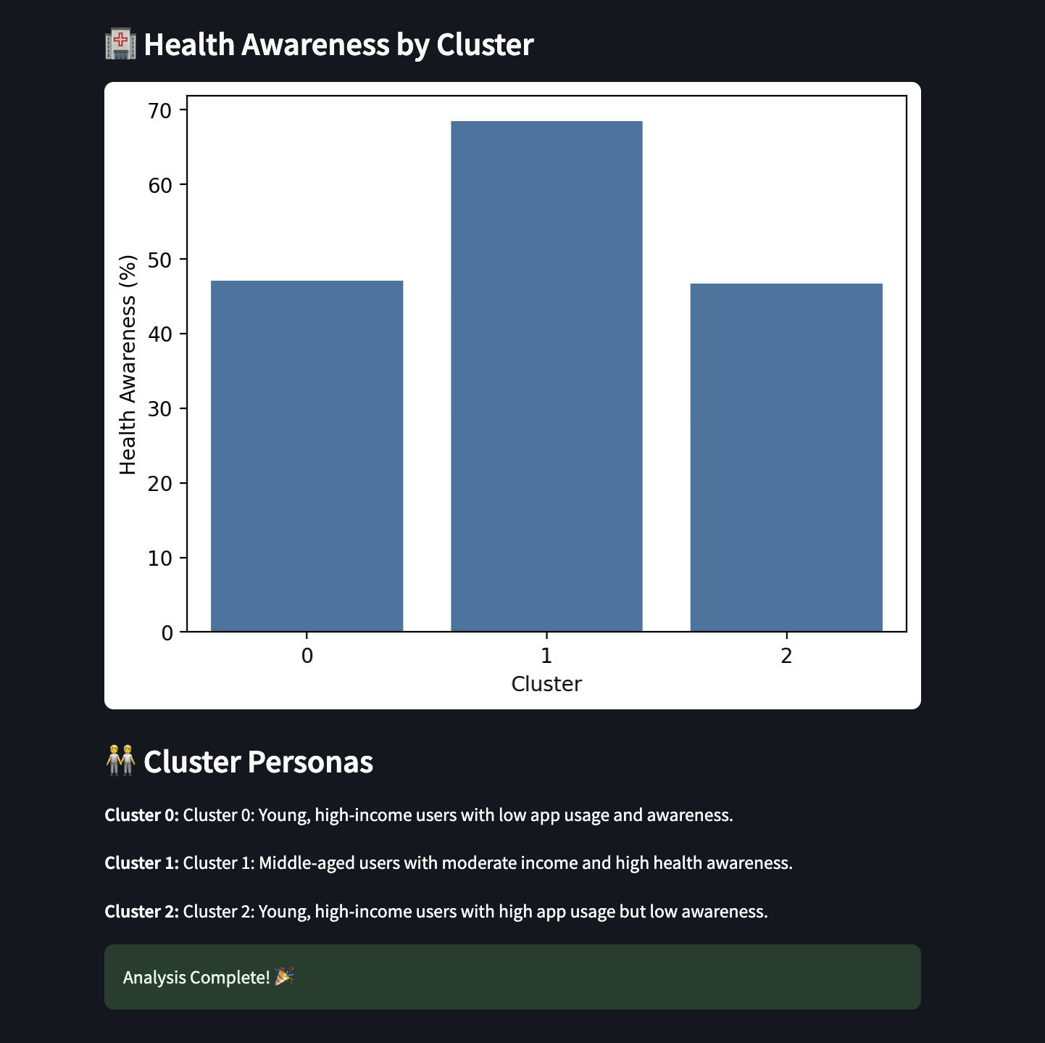
Screenshots

Slide 13
User Personas Based on Clustering
Cluster Summary Table: 📊
Cluster | Average Age | Monthly Income (INR) | App Usage (hrs/day) | Health Awareness (%)
0 | 33.67 | 65,598 | 1.33 | 47%
1 | 44.74 | 40,533 | 3.52 | 68%
2 | 33.79 | 77,551 | 3.78 | 46%

Slide 14
Persona 1: Rahul (Cluster 0) 👨‍💼
Age: 34 🎂
Monthly Income: ₹65,000 💰
App Usage: 1.3 hours/day 📱
Health Awareness: Moderate (47%) ⚖️
Profile: Rahul is a working professional in his early 30s with a good income. He is moderately health-aware but not very engaged with health apps. He prefers traditional health habits over tech-based solutions.

Slide 15
Persona 2: Meena (Cluster 1) 👩‍🏫
Age: 45 🎂
Monthly Income: ₹40,000 💸
App Usage: 3.5 hours/day 📲
Health Awareness: High (68%) 🧘‍♀️
Profile: Meena is a mid-40s health-conscious woman who actively uses the app for wellness tracking. Despite a modest income, she is invested in her well-being, frequently exploring features like diet logs, sleep monitoring, and yoga routines

Slide 16
Persona 3: Arjun (Cluster 2) 👨‍💻
Age: 34 🎂
Monthly Income: ₹77,000 🏦
App Usage: 3.8 hours/day 📲
Health Awareness: Low (46%) 😅
Profile: Arjun is a young tech-savvy individual with high income. He uses the app intensively, but mostly for social and competitive aspects rather than improving health. He represents users who are engaged but need motivation to focus on health improvement.

