Slide 1


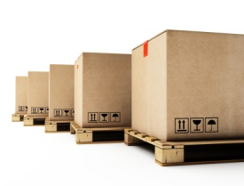
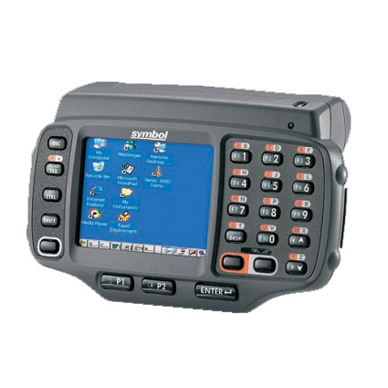

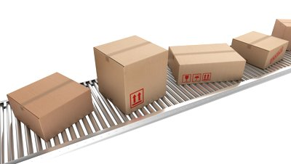
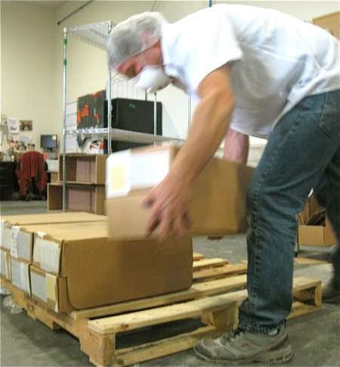
ScanToPallet
Move Pallets

Slide 2

Log into Ring Scanner

Slide 3
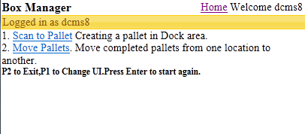
Box Manager Home Page

Slide 4
Scan To Pallet UI
For creating Pallets choose option ScanToPallet

Slide 5


Scan To Pallet

Slide 6
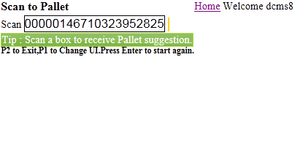
Scan Box
Start scanning boxes as they arrive in conveyor.
PJ051911

Slide 7
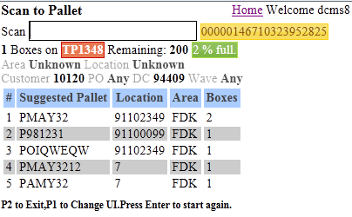
Scan Box Contd.
Scanning a box which is not on any pallet creates a staging pallet in the system. The UI provides you details of the staging pallet and provides pallet suggestions.
Staging Pallet
Pallet Suggestions
Last scanned Box
Pallet percent full

Slide 8
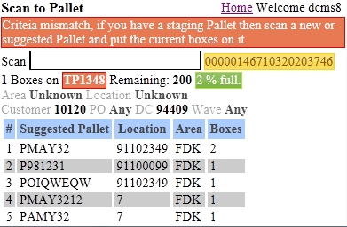
Scan Box contd..
You keep scanning boxes until a box of different criteria arrives. UI gives you warning and asks you to scan a new pallet.
Criteria mismatch warning.

Slide 9
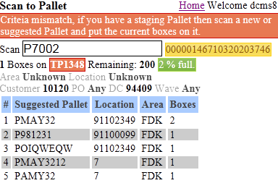

Scan Pallet
Scan a pallet on which you want to keep these staging boxes. Suggestions are provided in the UI to help you find a suitable pallet.

Slide 10
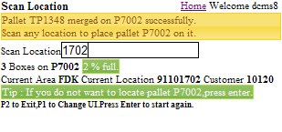

Scan Location
Staging boxes are successfully placed on pallet. now scan location to keep the pallet on it.
Scan Location

Slide 11
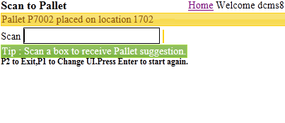
Pallet Creation complete
Pallet successfully placed on the scanned location.
TO ESCAPE TO PREVIOUS SCREEN- ESC KEY AND ENTER

Slide 12
Now if you want to move the last created pallet then You can press P1 button on ring scanner to go to the Move Pallet UI.

Slide 13
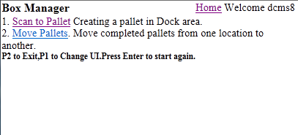
Move Pallets UI
Choose the option Move Pallets

Slide 14
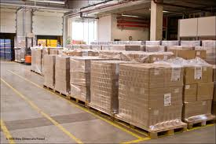
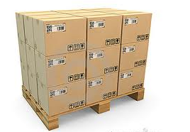
Move Pallet

Slide 15
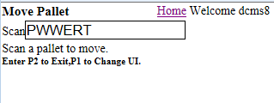
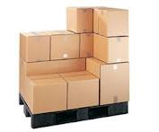
Pallet Scan
Scan a pallet so that the pallet can be moved to another
location.

Slide 16
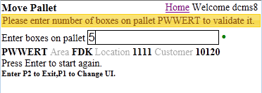
Boxes on pallet count
Enter box count which are place on pallet to validate pallet.
Green indicator tells you that no boxes of same criteria are about to come. You can move this pallet to a destination location.

Slide 17
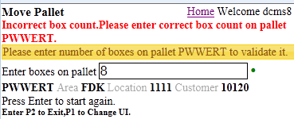
Boxes on pallet count
Box count incorrect.
Enter box count again which are place on pallet to validate pallet.

Slide 18
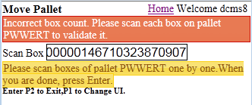
Scan box on pallet
Again box count incorrect.
Now scan box one by one which is place on pallet.

Slide 19
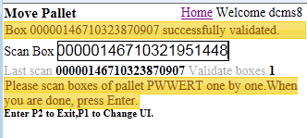
Scan box on pallet
Scan all box which are place on pallet one by one.

Slide 20
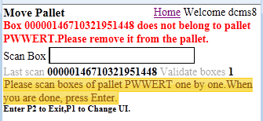
Scan box on pallet
When scan box is not belong to pallet then UI gave error to remove
it from pallet.

Slide 21
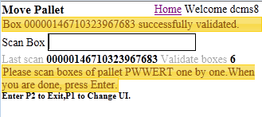
Scan box on pallet
Scan all boxes which are place on pallet one by one and
then press enter.

Slide 22
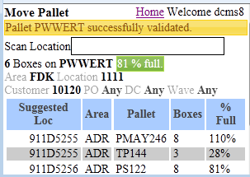
Pallet Scan
Location suggestions are provided to help you locate the pallet.

Slide 23
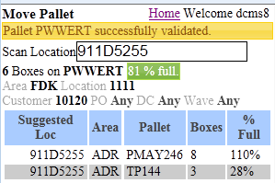

Location Scan
Scan the suggested location or a location of your own choice.

Slide 24
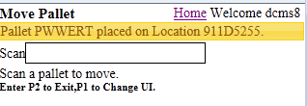
Pallet Location Complete
Pallet successfully placed on the scanned
location.

Slide 25

Merging Of Pallets

Slide 26
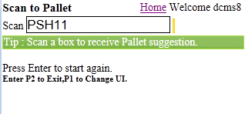
Scan Source pallet

Slide 27
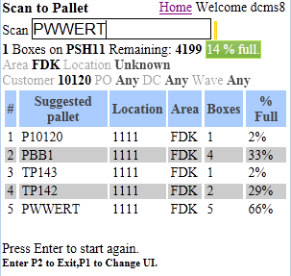
Scan Destination pallet

Slide 28
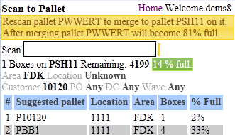
Confirmation pallet scan
Program needs confirmation scan

Slide 29
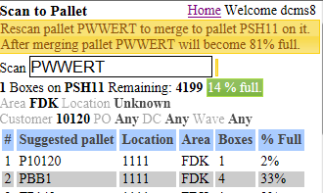
Rescan Destination Pallet
Rescan Destination Pallet

Slide 30
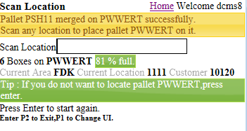
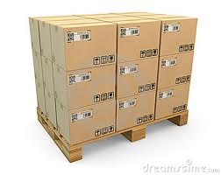
Source pallet successfully merged on the destination pallet
Merged Pallet

Slide 31



