Slide 1



VAS IMPLEMENTATION

Slide 2
VAS Configuration UI

Slide 3
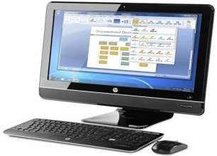
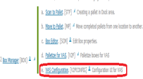

Log in to the system and go to VAS configuration UI in the DCMS connect Home.

Slide 4
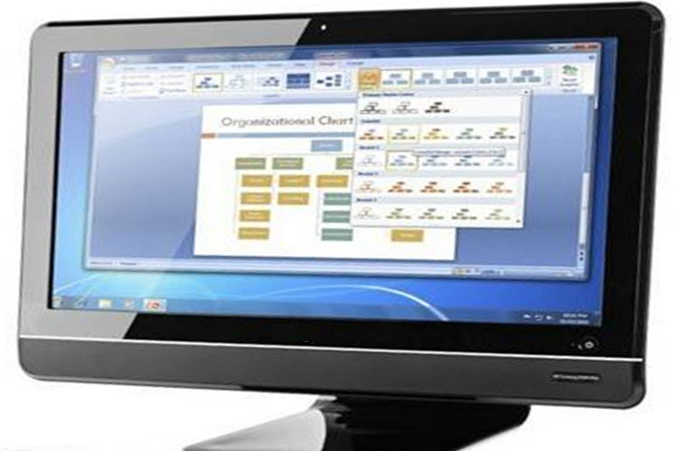
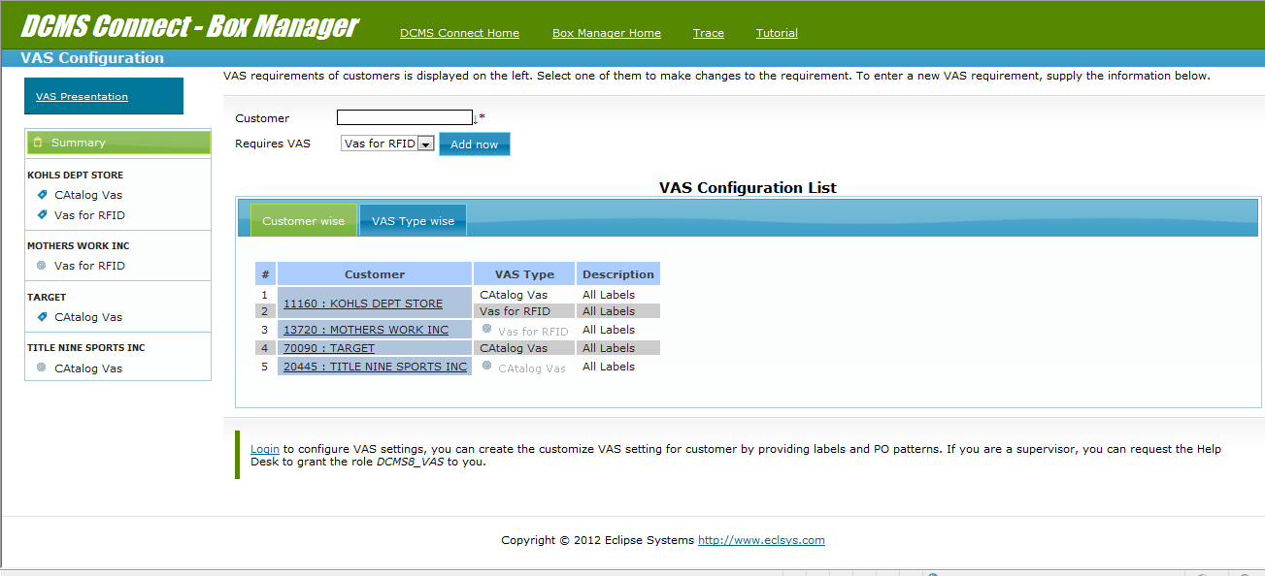
VAS configuration UI will come up showing all the VAS related configurations for different customers.

Slide 5
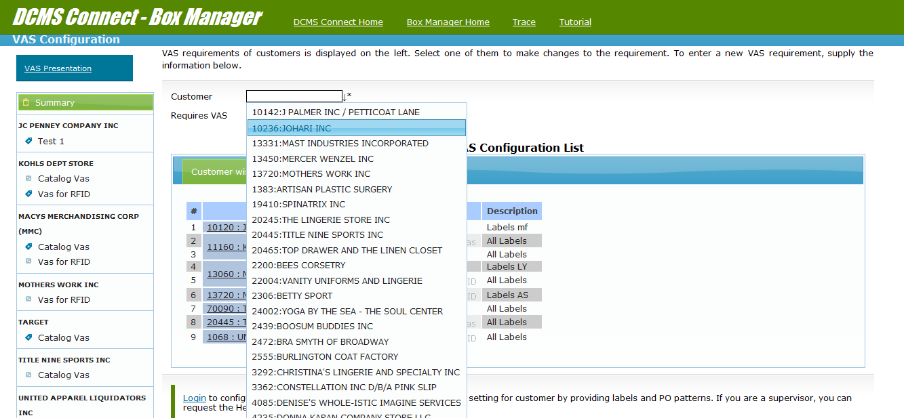
Select Customer for creating VAS rule.

Slide 6
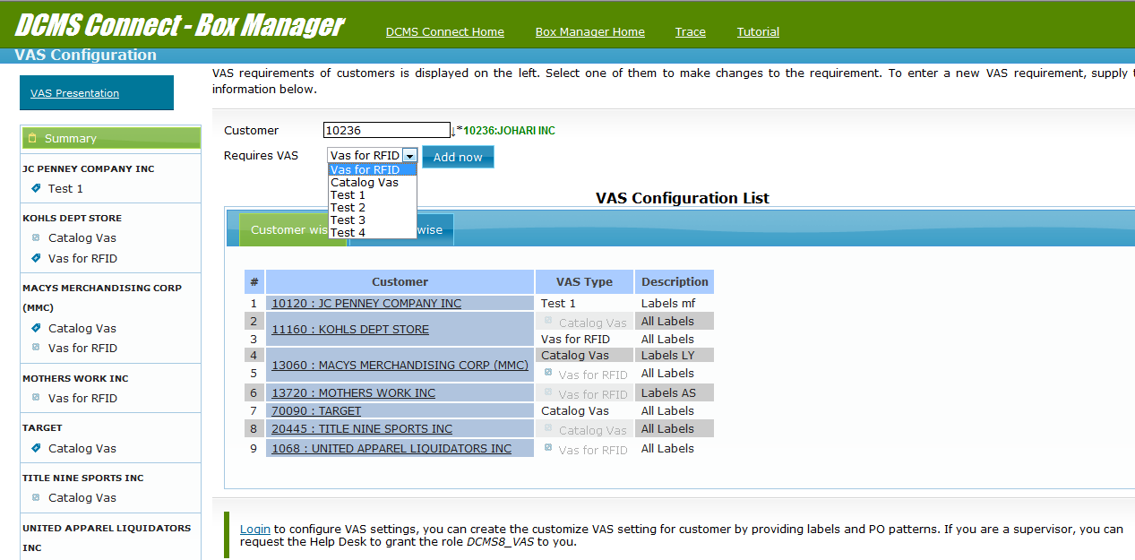
Select desired VAS that needs to be applied on customer’s order

Slide 7
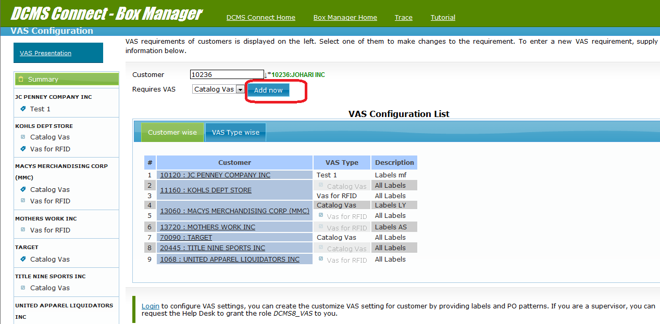
Now click on highlighted option “Add now”.

Slide 8
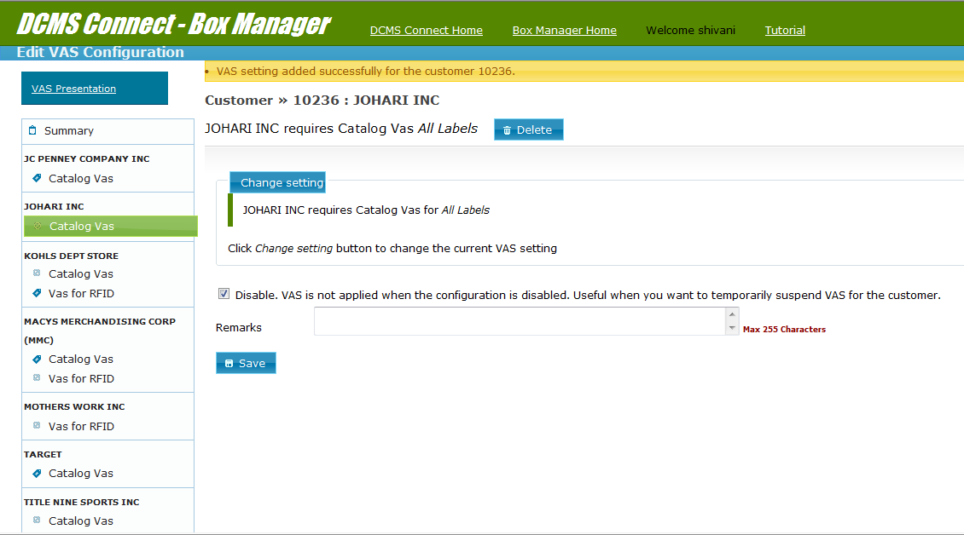
Vas setting has been created successfully
For enabling or disabling check un-check or check this check box.
Add remarks here
After making any changes click on this button for saving the changes.

Slide 9
Changing VAS Settings

Slide 10
Changing created VAS configuration:-
Click this button for making any changes
to this settings.
Rules created can be seen in this zone. You can also select rules
directly by clicking on any rule here.

Slide 11
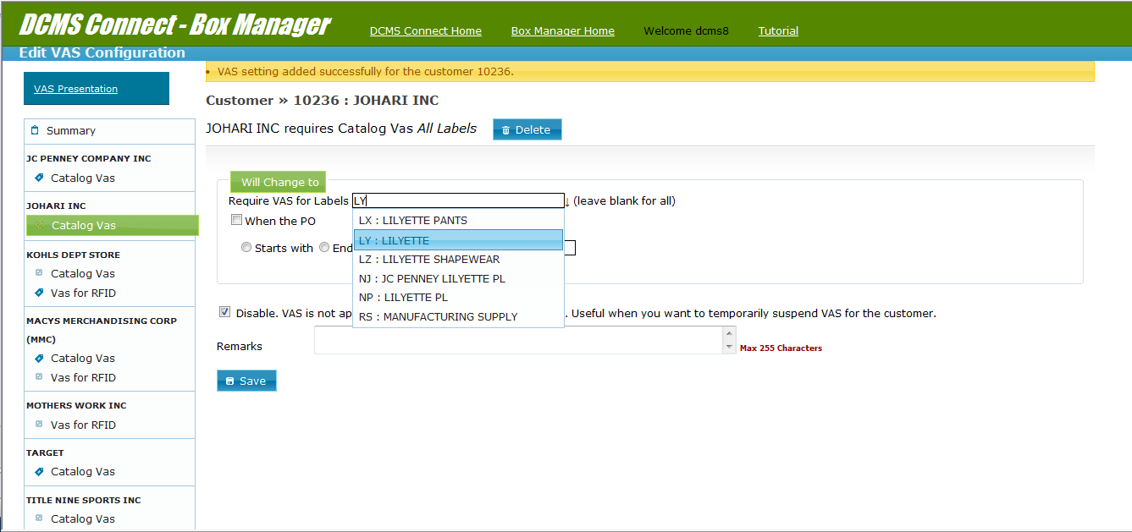
Type first character of the Label For getting suggestion list for the Label.
Choose the desired label from the Suggestion list and press enter key from key board. Same way you can choose multiple labels.

Slide 12
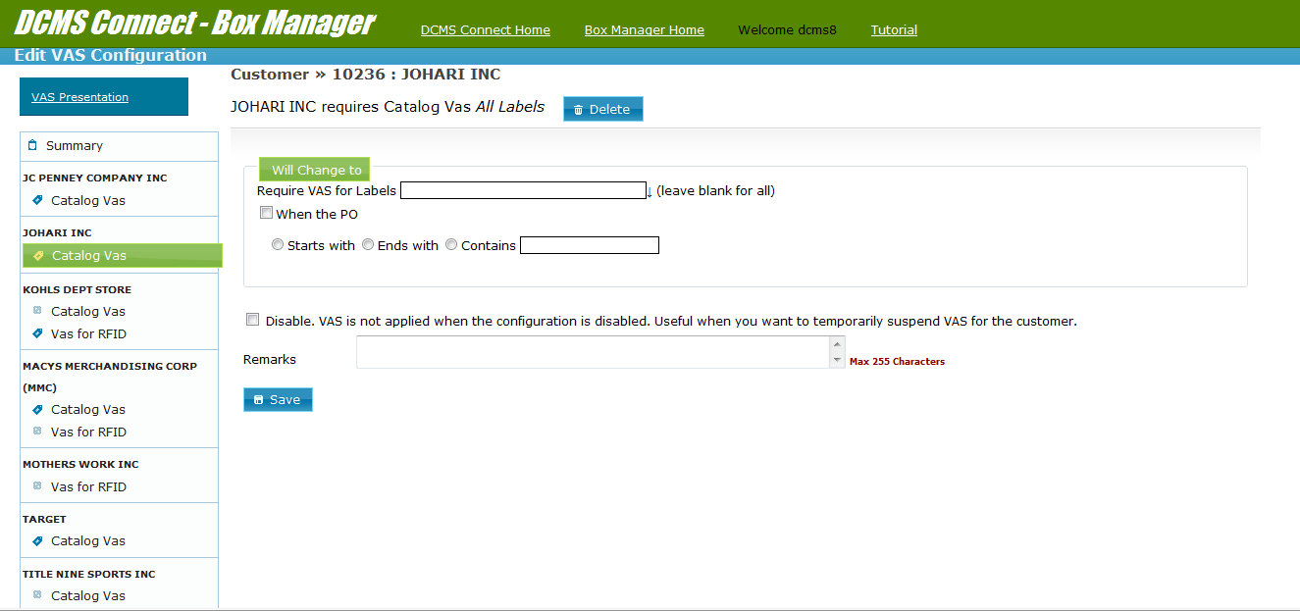
You can specify label for which you wants to
apply VAS.
Condition data should be mention here.
For creating VAS configuration based on a PO pattern you can check this check box.
Choose condition of PO pattern here

Slide 13
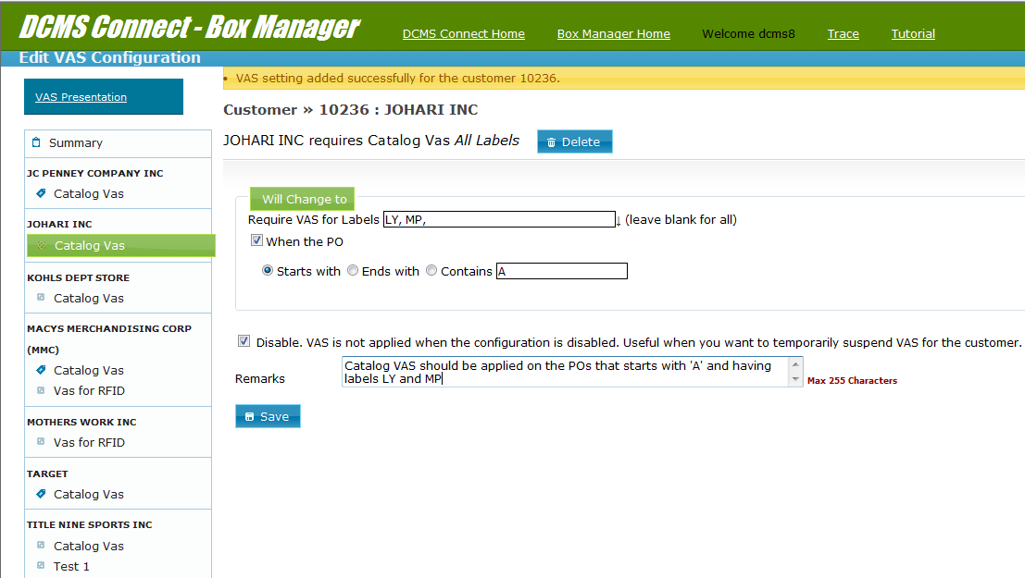
All the desired changes are done
Click to save the VAS rule.
After clicking on save button click on Summary so that all the rules can be visible.

Slide 14
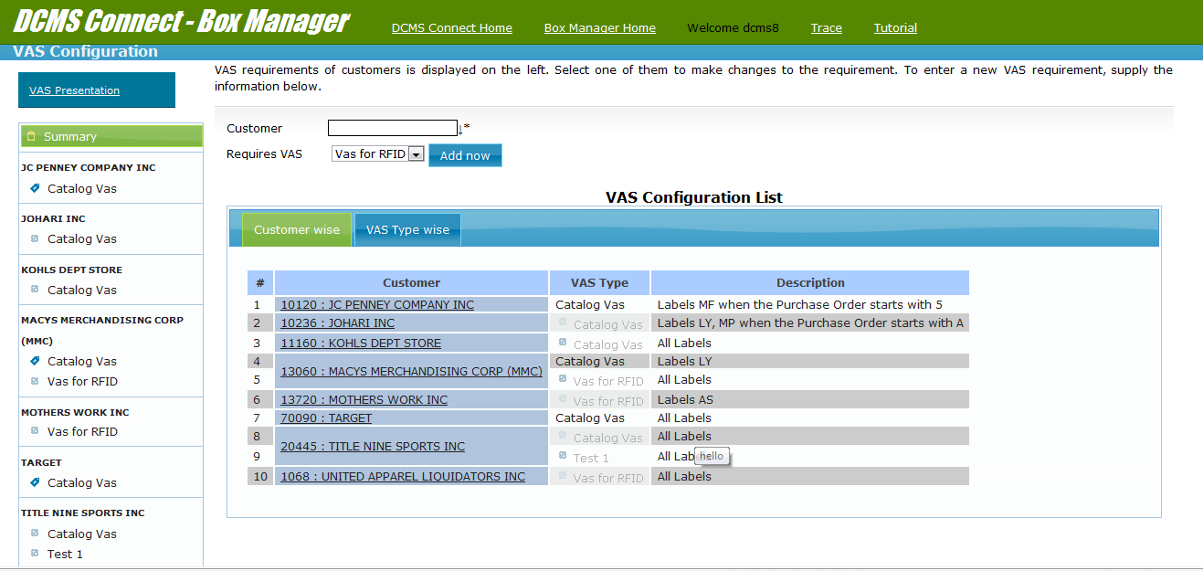
VAS configuration has been created

Slide 15
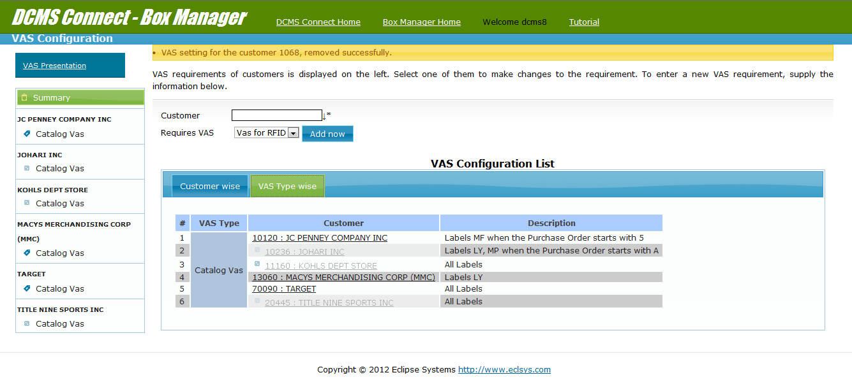
Disabled customers is telling that rule is inactive for now.
This tab is for showing VAS wise created rules.

Slide 16
Making VAS rule active or
inactive

Slide 17
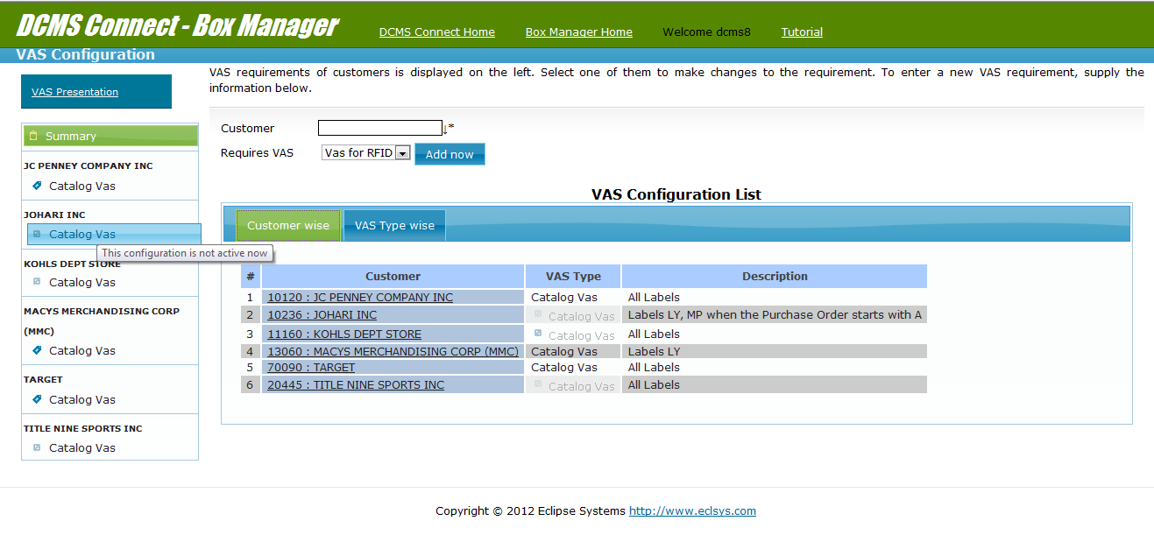
These are inactive VAS rules
Click on customers VAS configuration for making the rule active.

Slide 18
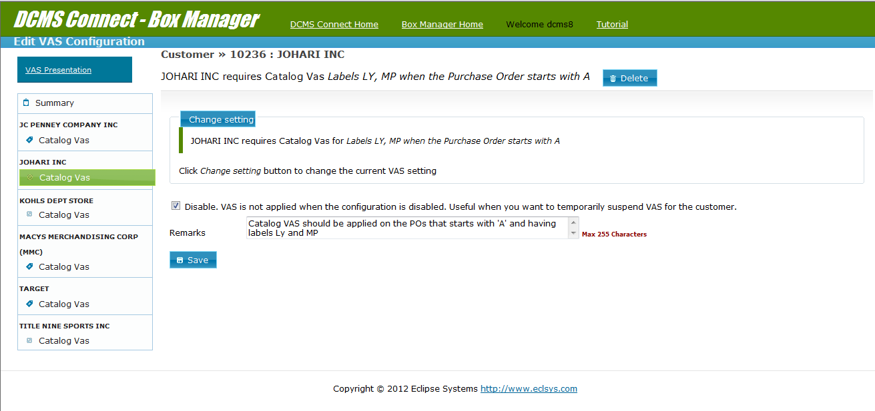
Un check this to make this rule active.
After un checking click here to save. On this rule will become active

Slide 19
VAS Boxes Indications

Slide 20
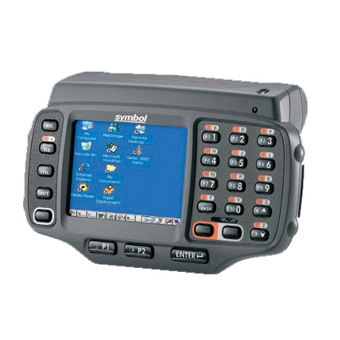

Pitching UI
When a pitcher will complete pitching on an MPC at that time before completing
pitching program will inform user that box needs VAS implementation.

Slide 21

MPC will be marked completed after indicating VAS

Slide 22
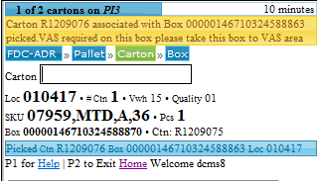
If a ADR pulling box require VAS then while pulling program BOXPICK will
Indicate user to take the box to VAS area.

Slide 23


After pitching or Pulling
VAS boxes
must be taken to
VAS area
VAS area Boxes

Slide 24
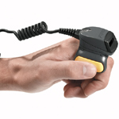

Palletizing VAS boxes
V2P

Slide 25
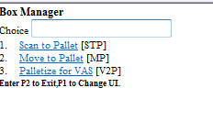
Select V2P program by choosing the option 3 in the box manager UI

Slide 26
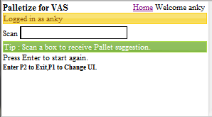
After successful log in you will get following screen in the ring scanner. Start scanning VAS area boxes one by one.

Slide 27
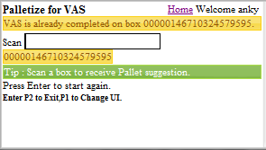
Scan Box
If VAS is already completed on the box then program will inform user regarding this through a message in the screen.
PJ051911

Slide 28
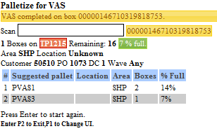
Scan Box Contd.
Scanning a box which is not on any pallet creates a staging pallet in the system. The UI provides you details of the staging pallet and provides pallet suggestions.
Staging Pallet
Program will mark VAS competed in the system
On successful box palletization.
Pallet Suggestions
Pallet percent full

Slide 29
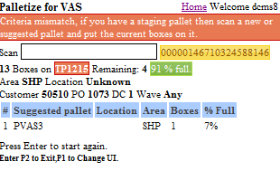
Scan Box contd..
You keep scanning boxes until a box of different criteria arrives. UI gives you warning and asks you to scan a new pallet.
Criteria mismatch warning.

Slide 30
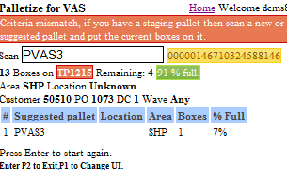

Scan Pallet
Scan a pallet on which you want to keep these staging boxes. Suggestions are provided in the UI to help you find a suitable pallet.

Slide 31
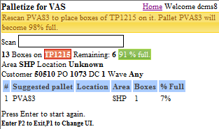
Program will ask user to rescan pallet on which user wants to put boxes of the staging
pallet

Slide 32
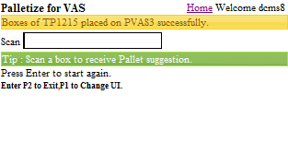
Pallet Creation complete
Pallet successfully placed on the scanned pallet.
TO ESCAPE TO PREVIOUS SCREEN- ESC KEY AND ENTER

Slide 33

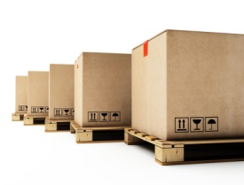


VAS are pallets are ready
For VAS implementation
Apply VAS on these boxes on pallets

Slide 34
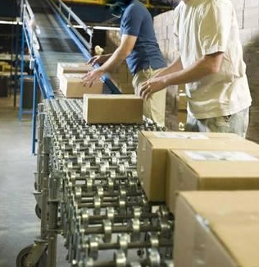
After VAS implementation put the VAS boxes on the validation conveyor

Slide 35
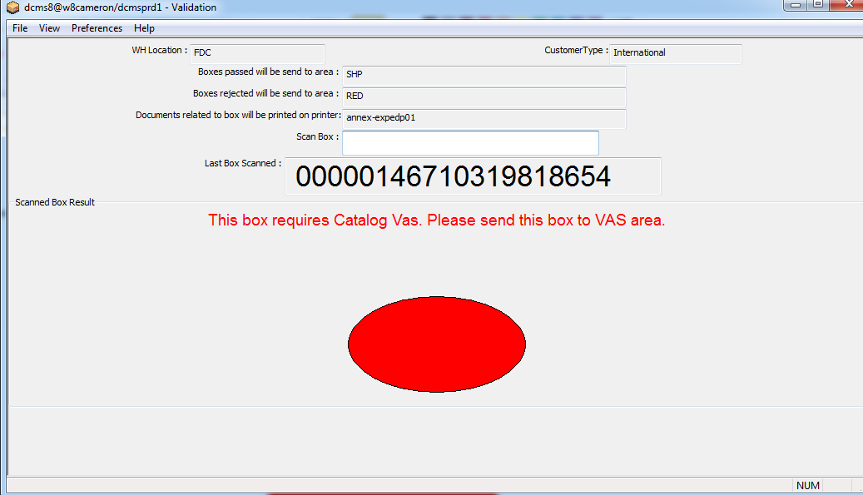
VAS Box reached to Validation station without completing VAS process. Such boxes will be
Sent to RED area. Later on there boxes should be marked green by using the program SCM
So that they can reach to VAS area for VAS implementation..

Slide 36
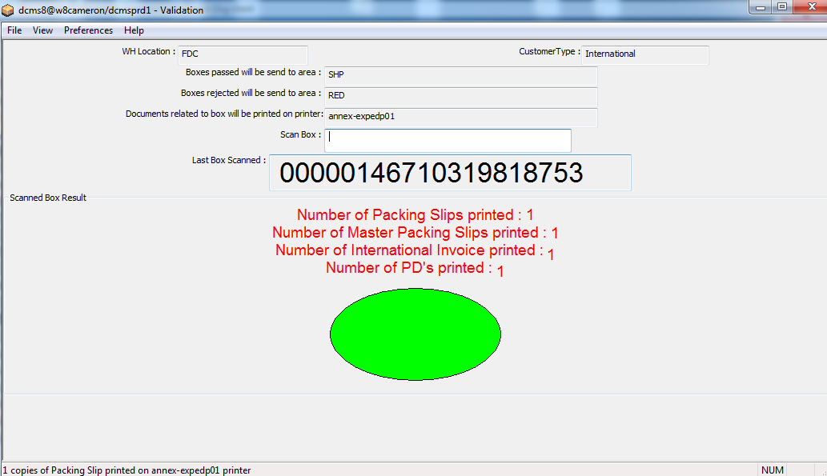
Validation will pass VAS boxes only when the box passed through V2P process

Slide 37
VAS implementation
is completed now

Slide 38



