Slide 1

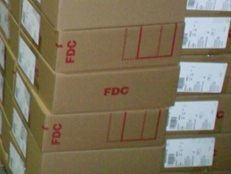
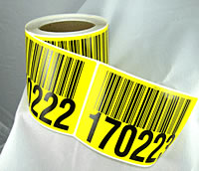
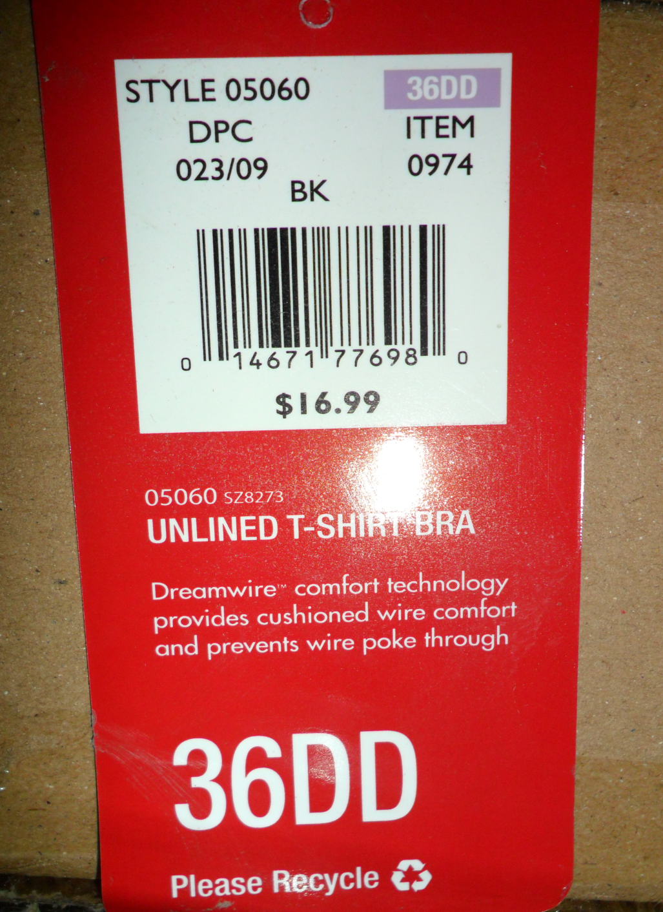
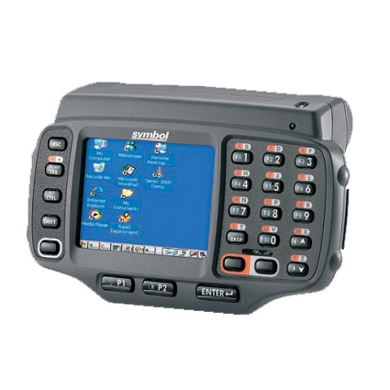

INVENTORY
INQUIRY MENU
RING SCANNER
9136001001

Slide 2

Log into RING SCANNER

Slide 3
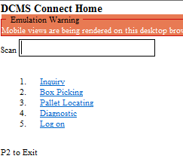
PALLET INQUIRY FUNCTION
TO ESCAPE TO PREVIOUS SCREEN- ESC KEY AND ENTER

Slide 4
CHOOSE OPTION ONE (1)
TO ESCAPE TO PREVIOUS SCREEN- ESC KEY AND ENTER

Slide 5
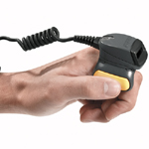
SCAN PALLET ID
PJ051911
TO ESCAPE TO PREVIOUS SCREEN- ESC KEY AND ENTER

Slide 6
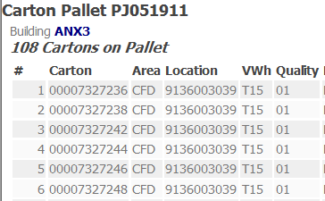
PALLET INQUIRY REFLECTS THE FOLLOWING INFORMATION
TO ESCAPE TO PREVIOUS SCREEN- ESC KEY AND ENTER

Slide 7
CASE INQUIRY FUNCTION
TO ESCAPE TO PREVIOUS SCREEN- ESC KEY AND ENTER

Slide 8
CHOOSE OPTION ONE (1)
TO ESCAPE TO PREVIOUS SCREEN- ESC KEY AND ENTER

Slide 9
SCAN CARTON NUMBER
00007392330
TO ESCAPE TO PREVIOUS SCREEN- ESC KEY AND ENTER

Slide 10
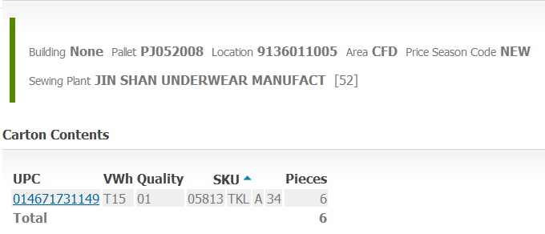
CASE INQUIRY REFLECTS THE FOLLOWING INFORMATION
THIS WILL APPEAR ON THE RING SCANNER SCREEN
TO ESCAPE TO PREVIOUS SCREEN- ESC KEY AND ENTER

Slide 11
THIS WILL APPEAR ON THE RING SCANNER SCREEN
DEFINITIONS:
1.PALLET (pid) # 2. LOCATION. (9136011005) 3.AREA- CFD (BEGINS WITH # 913)
4. UPC (Universal Product Code)
014671731149
5. VIRTUAL WAREHOUSE (VWh) ANNEX 3 =T15
8. DIMENSION (A)
10. PIECES- Amount of units packed in case.(6)
9. SIZE (A)
6. SKU ( Stock Keeping Unit)
05813
7. COLOR (TKL)

Slide 12
CHOOSE OPTION ONE (1)

Slide 13
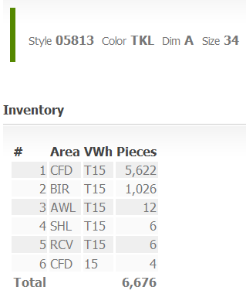
SCAN UPC # ON CASE-
THE SCREEN WILL SHOW BELOW
*Needs to show 10 oldest pallets and locations stored example CFD 913-6014-001

Slide 14
CHOOSE OPTION ONE (1)
TO ESCAPE TO PREVIOUS SCREEN- ESC KEY AND ENTER

Slide 15
Carton Location 9136001001
9136001001
9136001001
TO ESCAPE TO PREVIOUS SCREEN- ESC KEY AND ENTER

Slide 16
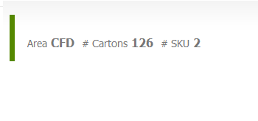
The Location Inquiry will show on the Ring Scanner the screen below
*NEEDS Pallet IDS separate BY PID and CASE COUNT AND SKU with DATE SCANNED
WITH USER NAME THAT LOCATED
TO ESCAPE TO PREVIOUS SCREEN- ESC KEY AND ENTER

Slide 17
LOCATING PALLETS IN THE CFD
CHOOSE OPTION ONE (3)
TO ESCAPE TO PREVIOUS SCREEN- ESC KEY AND ENTER

Slide 18
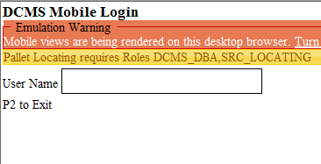
LOCATING PALLETS IN THE CFD
Scan ID Badge
TO ESCAPE TO PREVIOUS SCREEN- ESC KEY AND ENTER

Slide 19
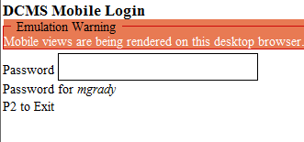
LOCATING PALLETS IN THE CFD
ENTER PASS WORD

Slide 20
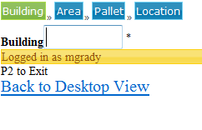
LOCATING PALLETS IN THE CFD
ENTER BUILDING AN3

Slide 21
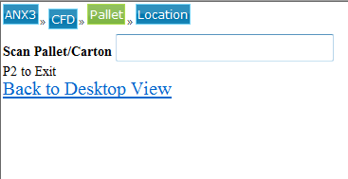
LOCATING PALLETS IN THE CFD
SCAN PALLET ID OR CARTON NUMBER

Slide 22
LOCATING PALLETS IN THE CFD
SCAN LOCATION

