Slide 1
Forward Pick Replenishment
Sharad Singhal
22 Aug 2012

Slide 2
Today’s Overview
1
2
Algorithm
3
Dashboard
Top Features
4
Puller Experience
Notes:
This is another option for an Overview slide.

Slide 3
Top Features
Notes:
Use a section header for each of the topics, so there is a clear transition to the audience.

Slide 4
Replenishment Reimagined
New replenishment is no longer based on pull requests
Cartons to pull are determined in real time.
Pulling is restock aisle based.
You can manually increase Sku priority to replenish any Sku first.
Comprehensive Dashboard improves visibility.
Notes:
A puller will never be allowed to mix restock aisles within the same pallet.
Real time means that the suggestion list always contains only those cartons which are pullable at the time the list is presented. If one of the suggested cartons is pulled by someone else, a different carton will be suggested to the user. If an SKU priority is increased, the pullers will see that SKU in front of their list.
The suggestions are displayed in order of user priority followed by wave priority and travel sequence. If high priority pulls exist, atleast one of these pulls is guaranteed to be displayed. The puller always has he option to focus on high priority cartons only. This could be useful if the high priority cartons are needed urgently.

Slide 5
algorithm
Notes:
Use a section header for each of the topics, so there is a clear transition to the audience.

Slide 6
Which SKUs to Replenish
SKU | Location | Restock Aisle | Pieces Required
07127,BCF,B,36 : C15 | 911FA07AA06 | 911FAFB | 72
Enumerate locations with SKU assignments.
Check what is at the location and compare to capacity.
If the location has space, add it to the table.

Slide 7
Which Cartons Can Be Pulled
Carton | Location | SKU | Pieces
00008038782 | 020202 | 07127,BCF,B,36 : C15 | 36
00008038788 | 020207 | 07127,BCF,B,36 : C15 | 36
00008038785 | 020209 | 07127,BCF,B,36 : C15 | 36
Enumerate cartons in BIR containing the SKUs needed
Ignore damaged and suspense cartons
Consider order quality cartons only
Cartons must be assigned to some location.
Ignore cartons already assigned to manual requests
Ignore cartons already assigned to waves.
Add all qualifying cartons to the list.

Slide 8
Pruning Carton List Based on FIFO
Carton | Location | SKU | Pieces
00008038782 | 020202 | 07127,BCF,B,36 : C15 | 36
00008038788 | 020207 | 07127,BCF,B,36 : C15 | 36
If there are too many eligible cartons for some SKUs, oldest carton will be replenished first.

Slide 9
Which aisle to pull first
1. Aisle with Sku priority set by user will be given highest preference
2. If no priority is set by user then aisle with wave priority Skus are replenished first
3. The aisle which will satisfy maximum waves will be considered first.
4. The aisles with maximum work will be considered next.

Slide 10
Which SKUs to Pull First
SKU | Best Wave Priority | Number of Waves
07127,BCF,B,36 : C15 | 5 | 10
07127,BCF,F,38 : C15 | 5 | 7
Enumerate all SKUs in pick waves ready for pitching and add them to the list above.
SKUs with user priority set are pulled first followed by Skus with wave priority set.
Required SKUs not on this list are pulled last.

Slide 11
Replenishment Overview
Building | Pull From | Pull To | Restock In | # Cartons | # SKU | Pieces
FDC | BIR | RST | FPK | 300 | 30 | 3000
Displays requirements per building.
Each building can and should have its own FPK, RST and BIR.
Each building can now have multiple pick areas.

Slide 12
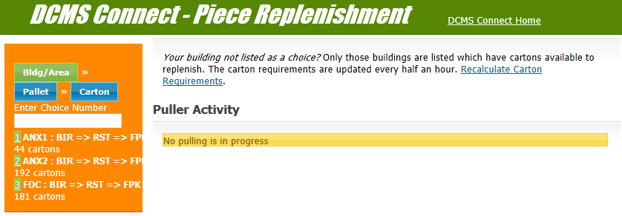
Replenishment Overview Screenshot
For each building, the replenishment requirements are listed.
This screenshot states that in Building FDC, 181cartons need to be pulled from BIR to RST for restocking in FPK.

Slide 13
Pull Requirements per SKU
Building FDC: SKU Requirements in FPK
Priority | SKU | Aisles | Capacity | Pieces Awaiting Restock | Pieces at Locations | Pullable Pieces | # Cartons
High | S1 | Aisle 1 | 2000 | 300 | 500 | 1000 | 34
Requirements are displayed per SKU.
Table makes inventory shortages evident.
SKUs with insufficient inventory which can be replenished are displayed.

Slide 14
Replenishment Dashboard
1. Displays skus to be replenished per aisle.
The highest priority skus are displayed on top of the screen.
2. Only skus that have shortages and have cartons available for pulling are displayed on dashboard.
3. Each aisle reflects inventory status, current pullers, highlights skus currently being pulled and skus next in line.

Slide 15
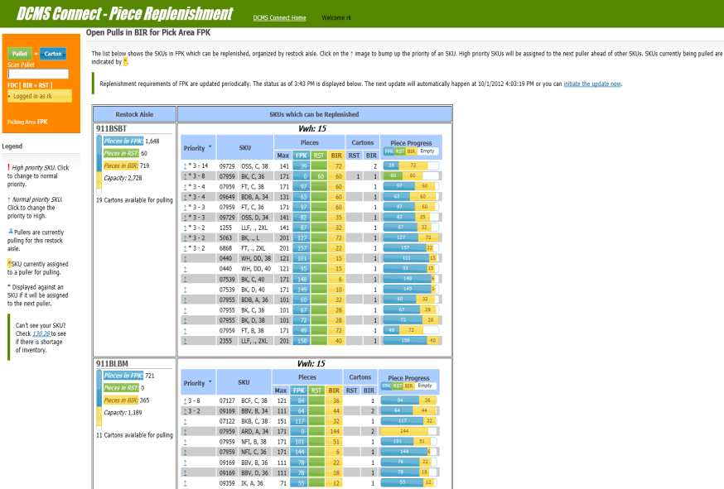
SKUs to Pull from FDC-> BIR->RST

Slide 16
Puller Experience
Notes:
Use a section header for each of the topics, so there is a clear transition to the audience.

Slide 17
Replenishment Pulling
Aisles are never mixed.
You can pull from any area, not just BIR. You can even pull from AWL.
Priority mixing is allowed, you can pick cartons needed on higher priority with normal priority cartons.
No pallet limit imposed, you can pull cartons till you have space left on your pallet.
Travel sequence is honored while pulling. Puller will always move ahead from his current location.
Notes:
Higher priority cartons are always suggested first followed by lower priority cartons.
When choosing a restock aisle to suggest, we prefer those aisles for which no one is pulling.
The algorithm attempts to spread pullers over different aisles.
Min work for puller. We assign a puller to an in progress restock aisle only if the aisle has at least min work for him.

Slide 18
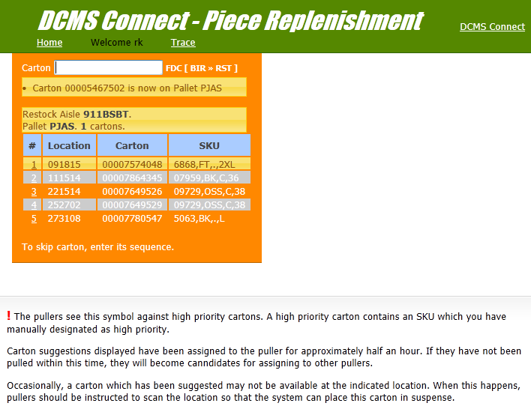
Pulling Screenshot(Desktop view)

Slide 19
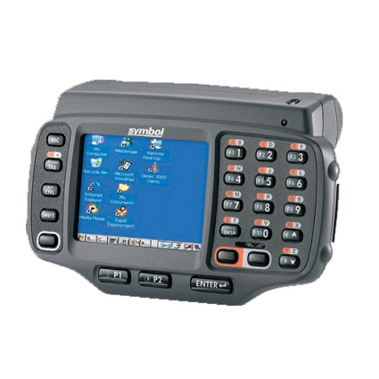
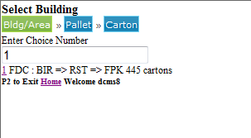
Pulling Screenshot(Mobile view)
For each building, the replenishment requirements are listed.
The screenshot shows that in Building FDC, 445 cartons are to be pulled from BIR area for restocking in FPK.

Slide 20
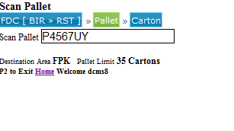
Pulling Screenshot cont.
You scan the pallet on which you want to pull cartons.

Slide 21
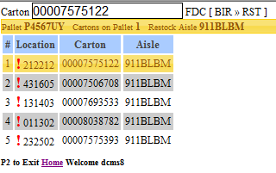
Suggested Cartons
After you scan the pallet, the program displays a list of suggested cartons . Scan a carton from the list to pull that carton.

Slide 22
Dynamic Carton Suggestions
When SKU priority changes, it immediately reflects in the cartons being proposed to active pullers.
High priority cartons are suggested before normal priority cartons.
This could compromise pull path but it is a good trade off.
Pullers are aware of carton priority and can choose to pull high priority only.
Notes:
Note that bucket priority change is not immediately reflected.
Carton Substitution?

Slide 23
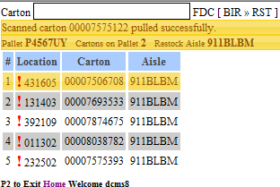
Pull Confirmation Message
After the carton is successfully pulled a confirmation message is displayed on the UI. You are now ready to pull the next carton from the list.

Slide 24
Forthcoming feature
Fighting MPC shortages
We are currently working on this feature.Our goal is to pull skus which have encountered MPC shortages first in replenishment so as to minimize the need of manually setting the priority.

Slide 25
Questions?

Slide 26
Thank You

