Slide 1


An Industrial Training Presentation
1
Prepared By:
Vini Patel (201603100910008)
Deepak Bhavsar (201703100920019)
Saumya Bhatt (201703100920007)
B.Tech. (8th Semester) (CE)
CGPIT.
Guided By:
- Dr. Devendra Thakor
Head Of Department (CE)
CGPIT.

Slide 2
Outline
Company Profile
Timeline Chart
Training Work
Future Work
Technologies

Slide 3
Company Profile
History of Company
2005
1Rivet started from the year 2005 and was originally named as SIC Consulting. Secured AOL was the first client .
2012
In the year 2012 they expanded offices to New York and Operated in five states and Washington, D.C.
2019
Increased 1Lab offshore innovation centre capabilities with over 50+ new technologies like DevOps, Machine Learning, etc.

Slide 4
Technologies
1Rivet has spread its roots across a huge technological base.
Angular
DevOps
Big Data
Machine Learning
Cloud Computing
Software Testing
Mobile App Development
Data Warehousing and ETL

Slide 5
Timeline Chart
Week 1
Week 2
Week 3
Week 4
Week 5
Week 6
Week 7
Introduction to OOPs Concepts and Project Development Methodology
HTML & CSS, JavaScript and Class Diagram
DDD, Swagger Contracts, Git & JIRA
Object Oriented Python
Start
SOLID principles, basic SQL and scrum & Kanban Methodologies
Python Basics, project definitions and Design Patterns
Introduction to 1Authority, advance python

Slide 6
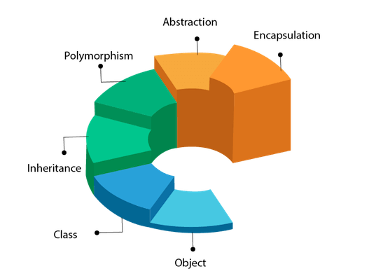
OOPs Concepts

Slide 7
SOLID Principles
SRP
Single Responsibility Principle
OCP
Open Closed Principle
LSP
Liskov Substitution Principle
ISP
Interface Seggregation Principle
DIP
Dependency Inversion Principle

Slide 8
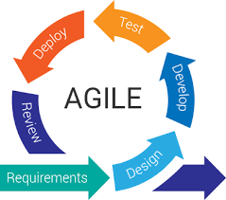
Project Development Methodology
AGILE Methodology

Slide 9
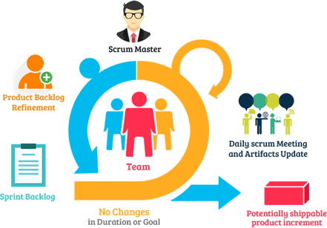
Project Development Methodology
Scrum Process

Slide 10
Design Patterns
GOF Design Patterns
Creational Design Patterns
Factory
Abstract Factory
Structural Design Patterns
Adapter
Bridge
Behavioural Design Patterns
Chain of Responsibility
Command
Prototype
Singleton
Builder
Composite
Proxy
Decorator
Façade
Flyweight
Iterator
Mediator
Memento
Observer
State
Strategy
Template method
Visitor

Slide 11
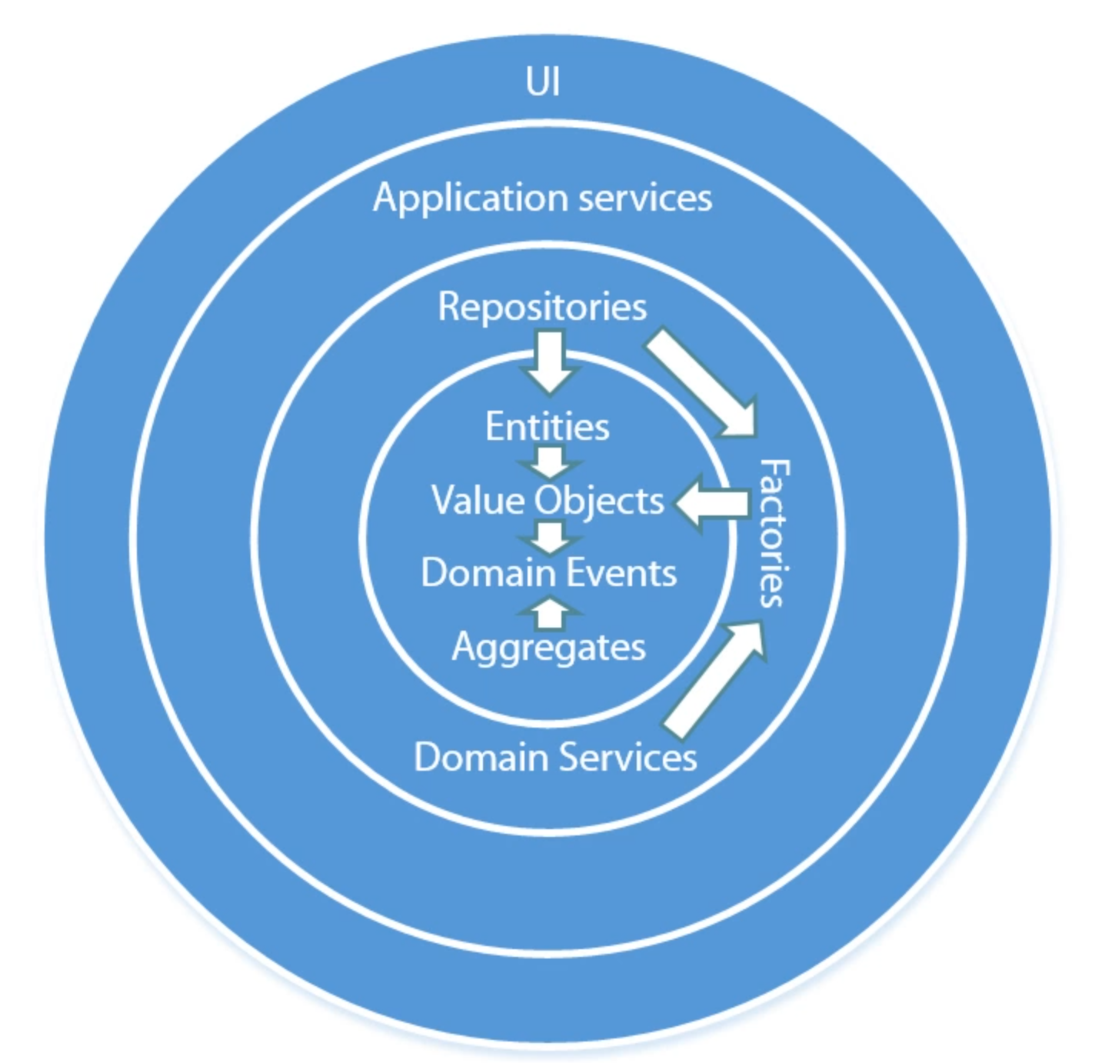
DDD Domain Driven Design
Onion Architecture

Slide 12
DDD Domain Driven Design
Basic Concepts
Domain
Subdomain
Context
Bounded context
Context Map
Ubiquitous Language

Slide 13
Swagger Contracts
What is Swagger ?
Swagger allows you to describe the structure of your APIs.
The framework provides the OpenAPI Specification (formerly known as the Swagger specification) for creating RESTful API documentation formatted in JSON or YAML. a human-friendly superset of JSON.
Why we should use swagger contracts ?
Developing APIs
Interacting with APIs
Documenting API

Slide 14
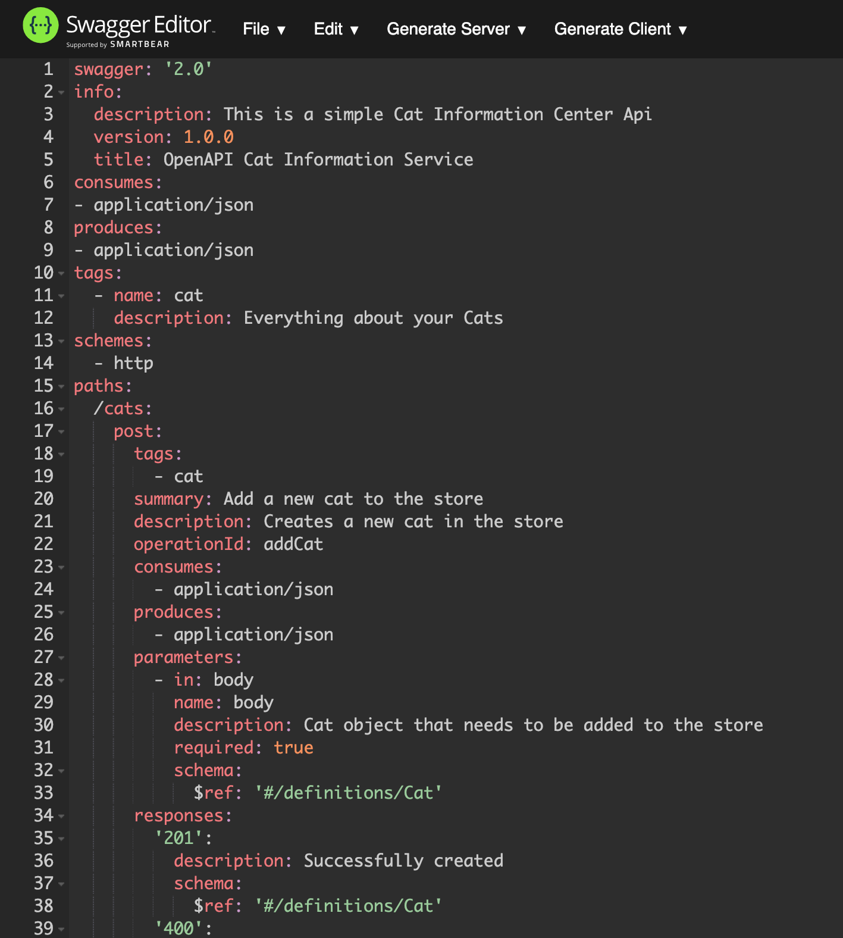
Swagger Contracts
Basic Structure

Slide 15
Git
What is Git ?
Version Control System (VCS)
It is a software that helps software developers to work together.
Listed below are the functions of a VCS −
Allows developers to work simultaneously.
Does not allow overwriting each other’s changes.
Maintains a history of every version.

Slide 16
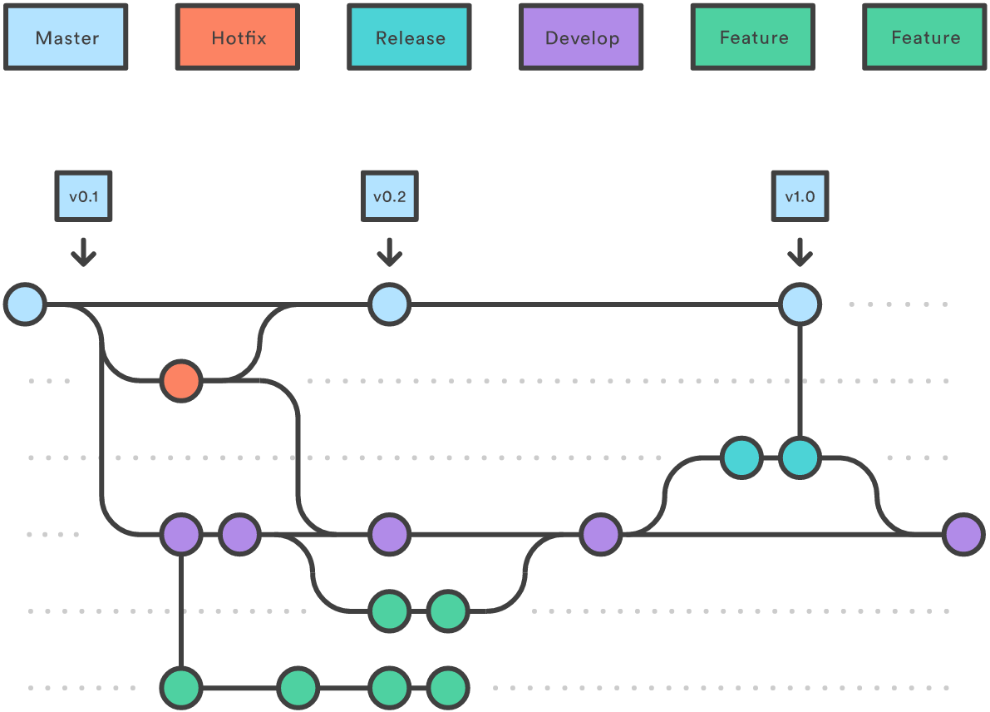
Git flow Workflow

Slide 17
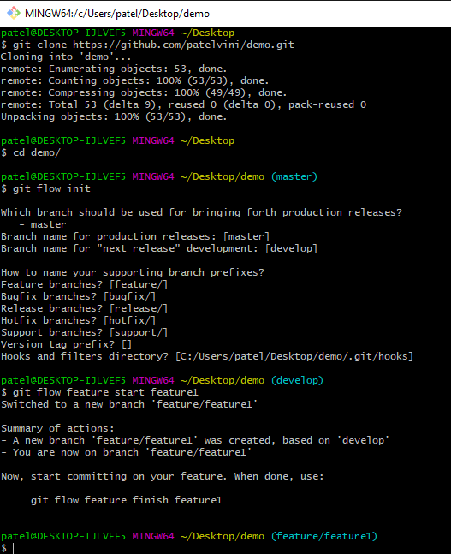
Basic Git Commands

Slide 18
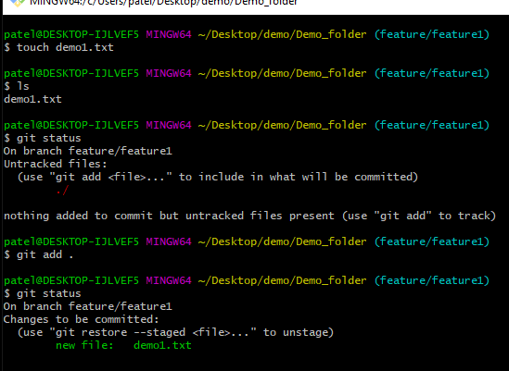
Basic Git Commands

Slide 19
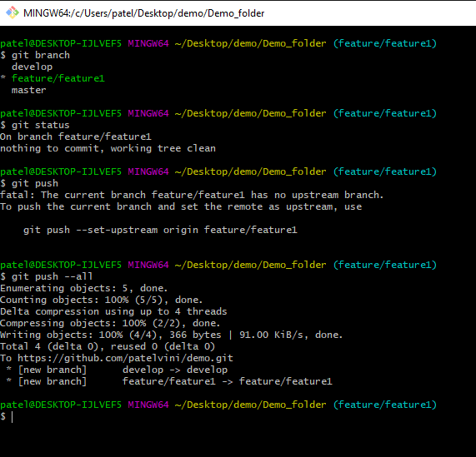
Basic Git Commands

Slide 20
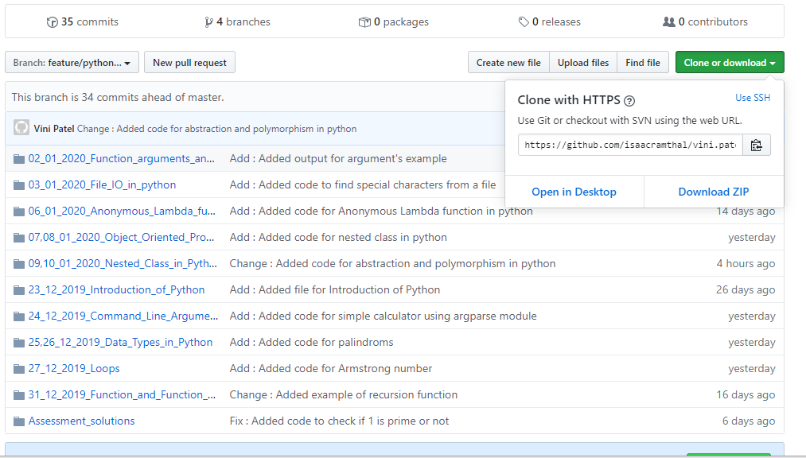
Git Remote Repository

Slide 21

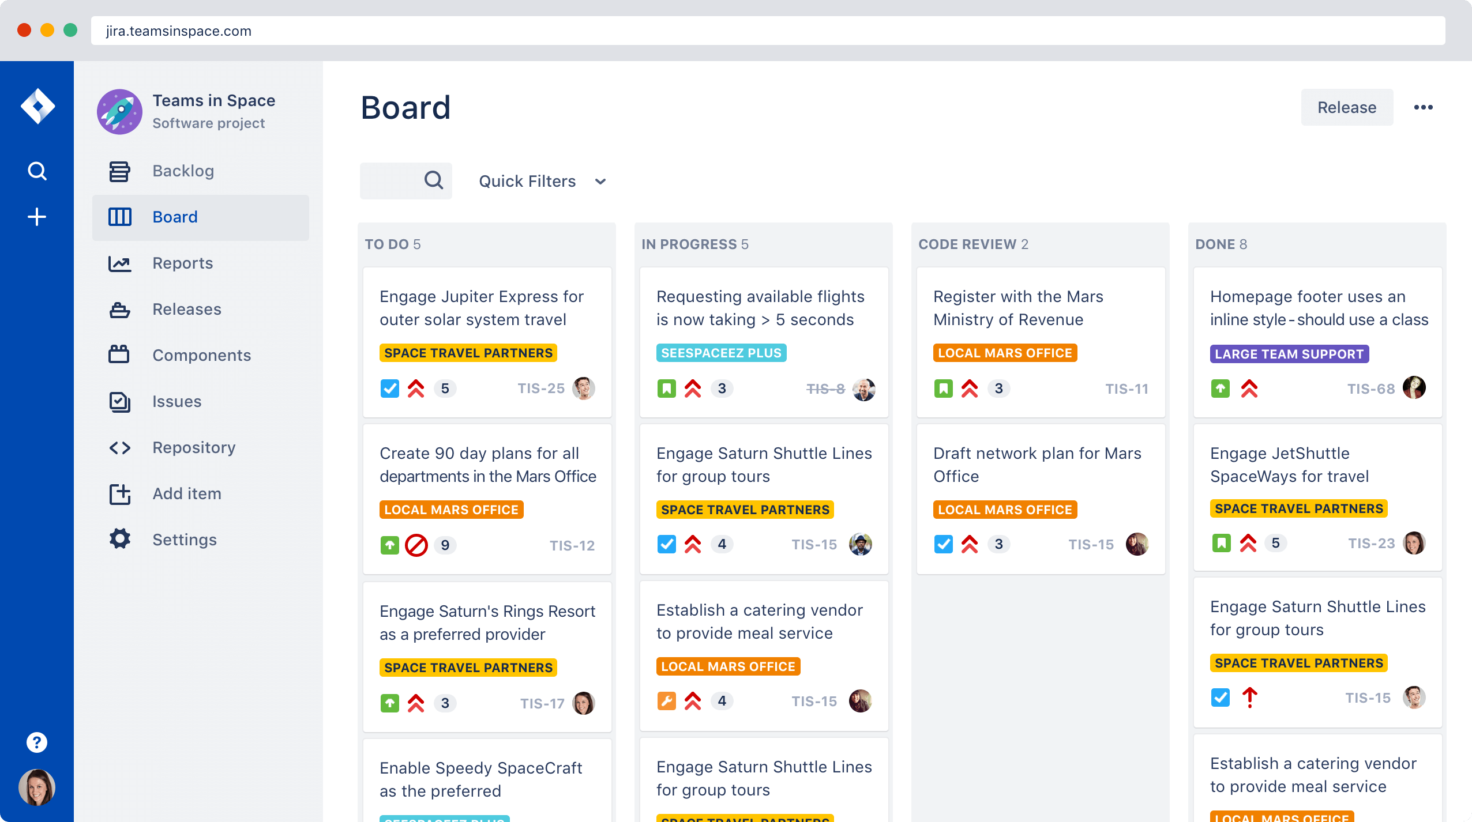
JIRA
JIRA is a tool developed by Australian Company Atlassian.
It is used for bug tracking, issue tracking, and project management.
The name "JIRA" is actually inherited from the Japanese word "Gojira" which means "Godzilla".

Slide 22
Command Line Arguments in Python
Python Command line arguments are input parameters passed to the script when executing them.
There are many options to read python command line arguments. The three most common ones are:
Python sys.argv
Python getopt module
Python argparse module

Slide 23
Command Line Arguments in Python
Sys.argv Module
Python sys module stores the command line arguments into a list, we can access it using sys.argv .
import sys
print(type(sys.argv))
print('The command line arguments are:')
for i in sys.argv:
print(i)
The output of a sample run of above program is as below:
$ python3 CLA.py A B C <class 'list'> The command line arguments are: A B C

Slide 24
Command Line Arguments in Python
argparse Module
Python argparse module is the preferred way to parse command line arguments.
It provides a lot of option such as,
positional arguments
default value for arguments
help message
specifying data type of argument etc.

Slide 25
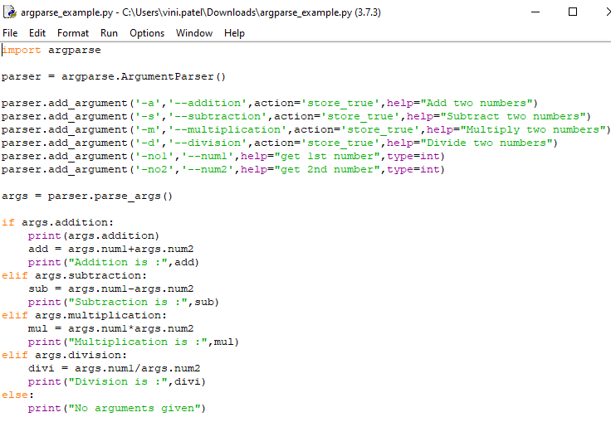
Command Line Arguments in Python
argparse Module Example

Slide 26
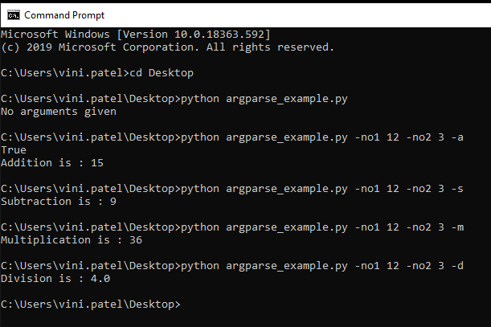
Command Line Arguments in Python
argparse Module Output

Slide 27
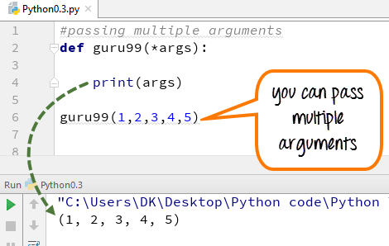
Variable Length Arguments

Slide 28
Thank You

