Slide 1
Design of Line, Circle & Ellipse Algorithms

Slide 2
Basic Math Review
Slope-Intercept Formula For A Line
Given a third point on the line:
P = (x,y)
Slope = (y - y₁)/(x - x₁)
= (y₂ - y₁)/(x₂ - x₁)
Solving For y
y = [(y₂-y₁)/(x₂-x₁)]x
+ [-(y₂-y₁)/(x₂-x₁)]x₁ + y₁
therefore
y = Mx + B
where
M = [(y₂-y₁)/(x₂-x₁)]
B = [-(y₂-y₁)/(x₂-x₁)]y₁ + y₁
Cartesian Coordinate System
6
P = (x,y)
5
4
P2 = (x₂,y₂)
3
2
1
P1 = (x₁,y₁)
1 3 4 5 6 7
SLOPE =
RISE
y₂-y₁
=
RUN
x₂-x₁

Slide 3
Other Helpful Formulas
Length of line segment between P₁ and P₂:
L = sqrt[ (x₂-x₁)² + (y₂-y₁)² ]
Midpoint of a line segment between P₁ and P₃:
P₂ = ( (x₁+x₃)/2 , (y₁+y₃)/2 )
Two lines are perpendicular iff
1) M₁ = -1/M₂
or
2) Cosine of the angle between them is 0.

Slide 4
Parametric Form Of The Equation Of
A 2D Line Segment
Given points P₁ = (x₁, y₁) and P₂ = (x₂, y₂)
x = x₁ + t(x₂-x₁)
y = y₁ + t(y₂-y₁)
t is called the parameter. When
t = 0 we get (x₁,y₁)
t = 1 we get (x₂,y₂)
As 0 < t < 1 we get all the other points on the line segment between (x₁,y₁) and (x₂,y₂).

Slide 5
Basic Line and Circle Algorithms
1. Must compute integer coordinates of pixels which lie on or near a line or circle.
2. Pixel level algorithms are invoked hundreds or thousands of times when an image is created or modified.
3. Lines must create visually satisfactory images.
    Lines should appear straight
    Lines should terminate accurately
    Lines should have constant density
    Line density should be independent of line length and angle.
4. Line algorithm should always be defined.

Slide 6
Simple DDA Line Algorithm
{Based on the parametric equation of a line}
Procedure DDA(X1,Y1,X2,Y2 :Integer);
Var Length, I :Integer;
X,Y,Xinc,Yinc :Real;
Begin
Length := ABS(X2 - X1);
If ABS(Y2 - Y1) > Length Then
Length := ABS(Y2-Y1);
Xinc := (X2 - X1)/Length;
Yinc := (Y2 - Y1)/Length;
X := X1;
Y := Y1;
DDA (digital differential analyzer) creates good lines but it is too time
consuming due to the round function and long operations on real values.
For I := 0 To Length Do
Begin
Plot(Round(X), Round(Y));
X := X + Xinc;
Y := Y + Yinc
End {For}
End; {DDA}

Slide 7
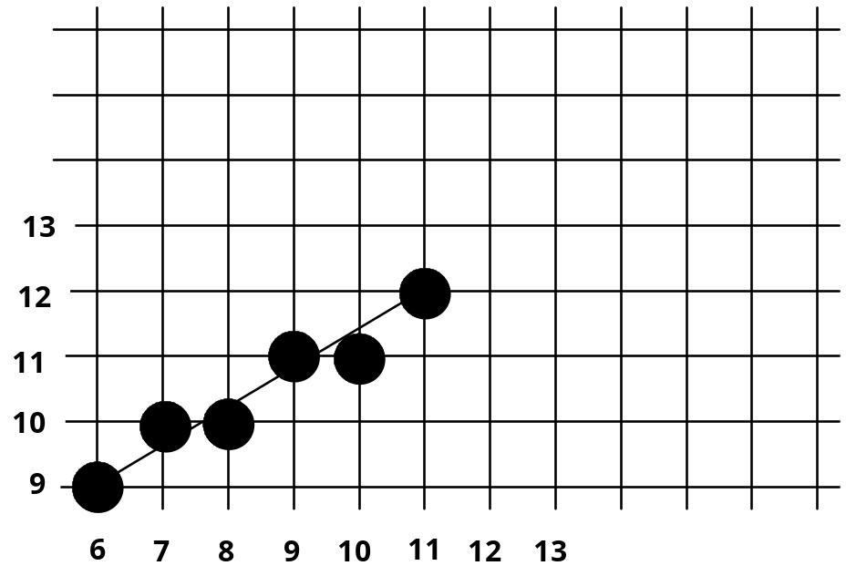
DDA Example
Compute which pixels should be turned on to represent the line from (6,9) to (11,12).
Length := Max of (ABS(11-6), ABS(12-9)) = 5
Xinc := 1
Yinc := 0.6
Values computed are:
(6,9), (7,9.6),
(8,10.2), (9,10.8),
(10,11.4), (11,12)

Slide 8
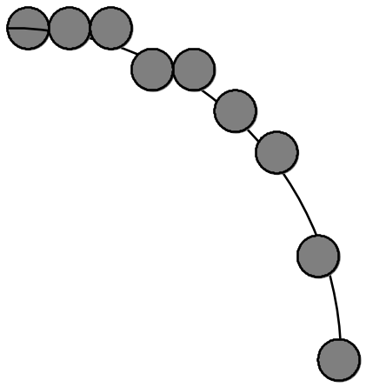
Simple Circle Algorithms
Since the equation for a circle on radius r centered at (0,0) is
x² + y² = r²,
an obvious choice is to plot
y = ±sqrt(r² - x²)
for -r <= x <= r.
This works, but is inefficient because of the
multiplications and square root
operations. It also creates large gaps in the
circle for values of x close to R (and clumping for x near 0).
A better approach, which is still inefficient but avoids the gaps is to plot
x = r cosø
y = r sinø
as ø takes on values between 0 and 360 degrees.

Slide 9
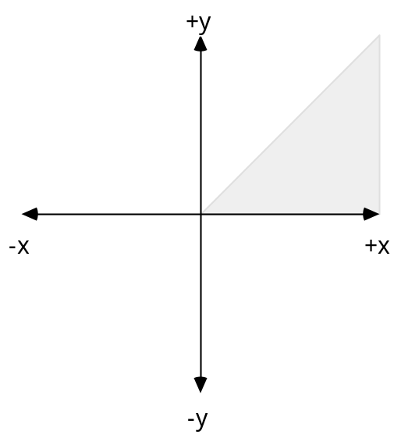
Fast Lines Using The Midpoint Method
Assumptions: Assume we wish to draw a line between points (0,0) and (a,b) with slope M between 0 and 1 (i.e. line lies in first octant).
The general formula for a line is y = Mx + B where M is the slope of the line
and B is the y-intercept. From our assumptions M = b/a and B = 0.
Therefore y = (b/a)x + 0 is f(x,y) = bx – ay = 0 (an equation for the line).
If (x₁,y₁) lie on the line with M = b/a and B = 0, then
f(x₁,y₁) = 0.
(a,b)
(0,0)

Slide 10
Fast Lines (cont.)
For lines in the first octant, the next
pixel is to the right or to the right
and up.
Assume:
Distance between pixels centers = 1
Having turned on pixel P at (x_{i}, y_{i}), the next pixel is T at (x_{i}+1, y_{i}+1) or S at (x_{i}+1, y_{i}). Choose the pixel closer to the line f(x, y) = bx - ay = 0.
The midpoint between pixels S and T is (x_{i} + 1,y_{i} + 1/2). Let e be the difference between the midpoint and where the line actually crosses between S and T. If e is positive the line crosses above the midpoint and is closer to T. If e is negative, the line crosses below the midpoint and is closer to S. To pick the correct point we only need to know the sign of e.
T = (x_{i} + 1, y_{i} + 1)
(x_{i} +1, y_{i} + 1/2 + e)
e
(x_{i} +1,y_{i} + 1/2)
P = (x_{i},y_{i} )
S = (x_{i} + 1, y_{i} )

Slide 11
Fast Lines - The Decision Variable
f(x_{i}+1,y_{i}+ 1/2 + e) = b(x_{i}+1) - a(y_{i}+ 1/2 + e) = b(x_{i} + 1) - a(y_{i} + 1/2) -ae = f(x_{i} + 1, y_{i} + 1/2) - ae = 0
Let d_{i} = f(x_{i} + 1, y_{i} + 1/2) = ae; d_{i} is known as the decision variable.
Since a >= 0, d_{i} has the same sign as e.
Algorithm:
If d_{i} >= 0 Then
Choose T = (x_{i} + 1, y_{i} + 1) as next point
d_{i+1} = f(x_{i+1} + 1, y_{i+1} + 1/2) = f(x_{i} +1+1,y_{i} +1+1/2)
= b(x_{i} +1+1) - a(y_{i} +1+1/2) = f(x_{i} + 1, y_{i} + 1/2) + b - a
= d_{i} + b - a
Else
Choose S = (x_{i} + 1, y_{i}) as next point
d_{i+1} = f(x_{i+1} + 1, y_{i+1} + 1/2) = f(x_{i} +1+1,y_{i} +1/2)
= b(x_{i} +1+1) - a(y_{i} +1/2) = f(x_{i} + 1, y_{i} + 1/2) + b
= d_{i} + b

Slide 12
Fast Line Algorithm
x := 0;
y := 0;
d := b - a/2;
For i := 0 to a do
Plot(x,y);
If d >= 0 Then
x := x + 1;
y := y + 1;
d := d + b – a
Else
x := x + 1;
d := d + b
End
End
The initial value for the decision variable, d0, may be calculated directly from the formula at point (0,0).
d0 = f(0 + 1, 0 + 1/2) = b(1) - a(1/2) = b - a/2
Therefore, the algorithm for a line from (0,0) to (a,b) in the first octant is:
Note: The only non-integer value is a/2. If we then multiply by 2 to get d' = 2d, we can do all
integer arithmetic using only the operations +, -, and left-shift. The algorithm still works since we
only care about the sign, not the value of d.

Slide 13
Bresenham’s Line Algorithm
We can also generalize the
algorithm to work for lines
beginning at points other than
(0,0) by giving x and y the proper
initial values.
This results in Bresenham's Line
Algorithm.
Begin {Bresenham for lines with slope between 0 and 1}
a := ABS(xend - xstart);
b := ABS(yend - ystart);
d := 2*b - a;
Incr1 := 2*(b-a);
Incr2 := 2*b;
If xstart > xend Then
x := xend;
y := yend
Else
x := xstart;
y := ystart
End
For I := 0 to a Do
Plot(x,y);
x := x + 1;
If d >= 0 Then
y := y + 1;
d := d + incr1
Else
d := d + incr2
End
End {For Loop}
End {Bresenham}
Note: This algorithm only works for lines with
Slopes between 0 and 1

Slide 14
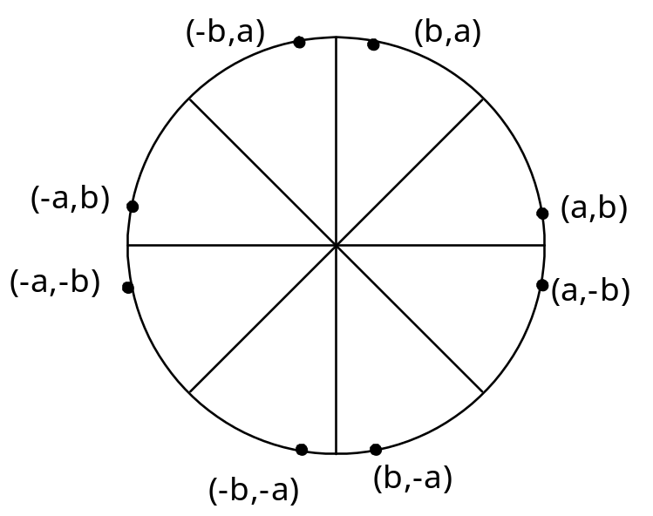
Circle Drawing Algorithm
We only need to calculate the values on the border of the circle in the first octant. The other values may be determined by symmetry. Assume a circle of radius r with center at (0,0).
Procedure Circle_Points(x,y :Integer);
Begin
Plot(x,y);
Plot(y,x);
Plot(y,-x);
Plot(x,-y);
Plot(-x,-y);
Plot(-y,-x);
Plot(-y,x);
Plot(-x,y)
End;

Slide 15
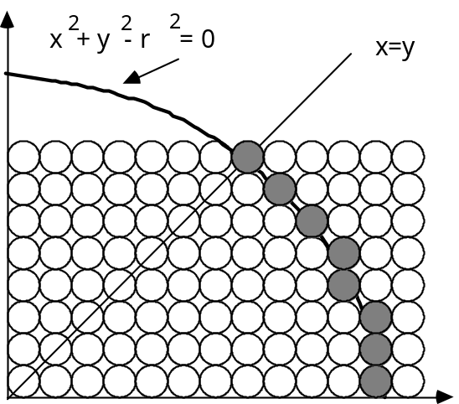
Fast Circles
Consider only the first octant of a circle of radius r centered on the origin. We begin by plotting point (r,0) and end when x < y.
The decision at each step is whether to choose the pixel directly above the current pixel or the pixel which is above and to the left.
Assume P_{i} = (x_{i}, y_{i}) is the current pixel.
T_{i} = (x_{i}, y_{i} +1) is the pixel directly above
S_{i} = (x_{i} -1, y_{i} +1) is the pixel above and to the left.

Slide 16
Fast Circles - The Decision Variable
f(x,y) = x² + y² - r² = 0
f(x_{i} - 1/2 + e, y_{i} + 1)
= (x_{i} - 1/2 + e)² + (y_{i} + 1)² - r²
= (x_{i}- 1/2)² + (y_{i}+1)² - r² + 2(x_{i}-1/2)e + e²
= f(x_{i} - 1/2, y_{i} + 1) + 2(x_{i} - 1/2)e + e² = 0
Let d_{i} = f(x_{i} - 1/2, y_{i}+1) = -2(x_{i} - 1/2)e - e² Thus,
If e < 0 then d_{i} > 0 so choose point S = (x_{i} - 1, y_{i} + 1).
d_{i+1} = f(x_{i} - 1 - 1/2, y_{i} + 1 + 1) = ((x_{i} - 1/2) - 1)² + ((y_{i} + 1) + 1)² - r²
= d_{i} - 2(x_{i} -1) + 2(y_{i} + 1) + 1
= d_{i} + 2(y_{i+1}- x_{i+1}) + 1
If e >= 0 then d_{i} <= 0 so choose point T = (x_{i}, y_{i} + 1).
d_{i+1} = f(x_{i} - 1/2, y_{i} + 1 + 1)
= d_{i} + 2y_{i+1} + 1
(x_{i} -1/2, y_{i} + 1)
T = (x_{i} ,y_{i} +1)
e
S = (x_{i} -1,y_{i} +1)
P = (x_{i} ,y_{i} )

Slide 17
Fast Circles - Decision Variable (cont.)
The initial value of d_{i} is
d₀ = f(r - 1/2, 0 + 1) = (r - 1/2)² + 1² - r²
= 5/4 - r {1-r can be used if r is an integer}
When point S = (x_{i} - 1, y_{i} + 1) is chosen then
d_{i+1} = d_{i} + -2x_{i+1} + 2y_{i+1} + 1
When point T = ( x_{i} , y_{i} + 1) is chosen then
d_{i+1} = d_{i} + 2y_{i+1} + 1

Slide 18
Fast Circle Algorithm
Begin {Circle}
x := r;
y := 0;
d := 1 - r;
Repeat
Circle_Points(x,y);
y := y + 1;
If d <= 0 Then
d := d + 2*y + 1
Else
x := x - 1;
d := d + 2*(y-x) + 1
End
Until x < y
End; {Circle}
Procedure Circle_Points(x,y :Integer);
Begin
Plot(x,y);
Plot(y,x);
Plot(y,-x);
Plot(x,-y);
Plot(-x,-y);
Plot(-y,-x);
Plot(-y,x);
Plot(-x,y)
End;

Slide 19
Fast Ellipses
The circle algorithm can be generalized to work for an ellipse but only four way symmetry can be used.
F(x,y) = b²x² + a²y² -a²b² = 0
(0,b)
(-x, y)
(x, y)
(-a,0)
(a,0)
(-x, -y)
(x, -y)
(0,-b)

Slide 20
Fast Ellipses
The circle algorithm can be generalized to work for an ellipse but only four way symmetry can be used.
F(x,y) = b²x² + a²y² -a²b² = 0
All the points in one quadrant must be computed. Since Bresenham's algorithm is
restricted to only one octant, the computation must occur in two stages.
The changeover occurs when the point on the ellipse is reached where the tangent line
has a slope of ±1. In the first quadrant, this is where the line y = x intersects the
ellipses.
(0,b)
(x, y)
y = x
(-x, y)
(-a,0)
(a,0)
(x, -y)
(-x, -y)
(0,-b)

Slide 21
Line and Circle References
Bresenham, J.E., "Ambiguities In Incremental Line Rastering," IEEE Computer Graphics And Applications, Vol. 7, No. 5, May 1987.
Eckland, Eric, "Improved Techniques For Optimising Iterative Decision- Variable Algorithms, Drawing Anti-Aliased Lines Quickly And Creating Easy To Use Color Charts," CSC 462 Project Report, Department of Computer Science, North Carolina State University (Spring 1987).
Foley, J.D. and A. Van Dam, Fundamentals of Interactive Computer Graphics, Addison-Wesley 1982.
Newman, W.M and R.F. Sproull, Principles Of Interactive Computer Graphics, McGraw-Hill, 1979.
Van Aken J. and Mark Novak, "Curve Drawing Algorithms For Raster Display," ACM Transactions On Graphics, Vol. 4, No. 3, April 1985.

