Slide 1
Simulation of Black Hole Attack in NS-3
Group : CS-14 Deepak Bulani 20153026 Gaurav Agarwal 20154097 Bonthu Harsha Vardhan Reddy 20154148 Avichal Verma 20154085 Amit Ranjan 20154101 Under the guidance of Dr. Dinesh Singh MNNIT Allahabad May 3rd 2018

Slide 2
Outline Of The Project
Mobile Ad Hoc Networks (MANET)
Working Of AODV Protocol
Vulnerabilities of AODV Protocol
Black hole Attack in AODV
Integration of Sumo with NS-3
Conclusion
References

Slide 3
MANET
Mobile Ad Hoc Networks are formed dynamically by an autonomous system of mobile nodes that are connected by and an autonomous system of mobile nodes that are connected via wireless links.
No existing fixed infrastructure or centralized administration.
Each node works as a router.
Vehicular Ad Hoc Network is a special type of MANET and form a key part of Intelligent Transportation System(ITS).

Slide 4
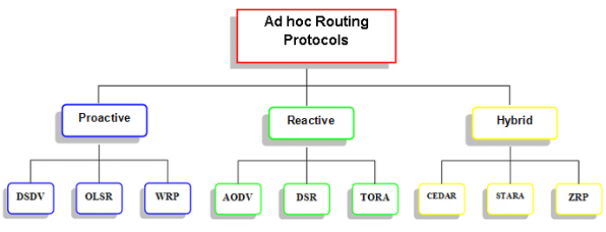
Routing Protocols in MANET

Slide 5
AODV PROTOCOL
AODV is a packet routing protocol designed for use in mobile ad hoc networks (MANET).
This protocol establishes routes to destinations on demand and supports both unicast and multicast routing.
Networks are silent until connections are established . Network nodes that need connections broadcast a request for connection.
The remaining AODV nodes forward the message and record the node that requested a connection.
Each node maintains a routing table that contains information about reaching destination nodes.

Slide 6
RREQ Message
A
Route discovery process begins with the creation of a Route Request Packet (RREQ) . The packet contains source node’s IP address, source node’s current sequence number, destination IP address, destination sequence number.
B?
B?
B?
B?
B?
B?
B?
B
Notes:
Make sure you explain how an intermediate node distinguishes between copies of the same RREQ. In your graph, the node in the middle receives two copies of the RREQ. In this case, the hop count from the source (A) is the same, so it doesn’t matter how its own routing back to A is updated.
If you look at the example graph I included in the overview, you see that node B and the destination node F both receive multiple copies of the RREQ. In both cases, each copy followed a different route to get to the respective node. Therefore, B and F must choose the correct version of the message to use for updating their own routing tables and also for forwarding. The hop count field is the key that allows them to decide which message to keep and which message to throw away.

Slide 7
RREP Message
A
Destination node sends a Route Reply Packet (RREP). It contains IP address of source and destination, current sequence number of destination, hop count and lifetime of packet
A
A
A
B

Slide 8
Vulnerabilities in AODV
AODV possesses some limitations due to which it is easily attacked by the external intruders.
This protocol is exposed to a variety of attacks, some of these attacks can cause a breakdown of the network connectivity, increasing the end-to-end delay, increasing the number of the loss packets, or shutting down some nodes by consuming all the energy left in there batteries.
Black hole attack is an attack in which malicious node uses its routing protocol to advertise itself for having the shortest path with minimum hops to the destination node whose data packet it wants to take away. In this way attacker node is always available to the nodes whose packets it wants to retain.

Slide 9
Black hole Attack in AODV
Black hole is a simple but certainly effective Denial of Service attack in which a malicious node, through its routing protocol, advertises itself for having the shortest path to the destination node or to the node whose packets it wants to intercept.
It pretends to have enough of fresh routes for a certain destination. The source node assumes it to be true and the data packets are forwarded to a node which actually does not exist, causing the data packets to be lost.
When a source node wants to initiate the communication, it broadcasts a RREQ message for route discovery. As soon as the malicious node receives this RREQ packet, it immediately responds with a false RREP message to the respective node advertising itself as the destination or having the shortest path for that destination.

Slide 10
Since the malicious node needs not to check its routing table before responding to a routing request, it is often the first one to reply compared to other nodes.
When the requesting node receives this RREP, it terminates its routing discovery process and ignores all other RREP messages coming from other nodes. Thus the data packets are sent to such a “hole” from where they are not sent anywhere and absorbed by the malicious node.
Often many nodes send RREQ simultaneously; the attacker node is still able to respond immediately with false RREP to all requesting nodes and thus easily takes access to all the routes. In this way source nodes are bluffed by malicious node which gulps a lot of network traffic to itself resulting severe loss of data.

Slide 11


How Black hole attack works
A
RREQ
RREQ
M
D
RREP
RREP
S
RREQ
RREQ
C
B
RREQ

Slide 12
Timeline of the Project
Study of VANET and it’s protocols
Got familiar with Network Simulator-3
Integration of SUMO with NS-3
Generated map of Civil Lines, Allahabad using OpenStreetMaps and simulated it on SUMO
Applied AODV protocol on the mobility file generated by SUMO using NS-3 and viewed it’s simulation on PyViz and NetAnim.
Studied Black hole attack and it’s effect on AODV protocol
Simulated Black hole attack in NS-3 and performed throughput analysis using Flowmonitor

Slide 13
Network Simulator (NS-3)
NS-3 is a discrete-event network simulator whose goal is to develop a preferred, open simulation environment for networking research.
NS-3 software infrastructure encourages the development of simulation models which are sufficiently realistic to allow NS-3 to be used as a real-time network emulator, interconnected with the real world and which allows many existing real-world protocol implementations to be reused within NS-3.
A simple NS-3 script can be written in either C++ or Python language. NS-3 is built on both-C++ and Python bindings. We’re using C++ scripts in our simulation as we’re more familiar with C++

Slide 14
Simulation of Urban Mobility (SUMO)
Simulation of Urban Mobility (SUMO) is an open source traffic simulation package including net import and demand modelling components.
SUMO helps to investigate several research topics e.g. route choice and traffic light algorithm or simulating vehicular communication. Therefore the framework is used in different projects to simulate automatic driving or traffic management strategies.
Simulations has: space-continuous and time-discrete vehicle movement, different vehicle types, multi-lane streets with lane changing, different right-of-way rules, traffic lights, a fast open GL graphical user interface, manages networks with several edges, fast execution speed, interoperability with other application at run-time, network-wide, edge-based, vehicle-based, and detector based outputs, supports person-based inter-modal trips, high portability and high interoperability.

Slide 15
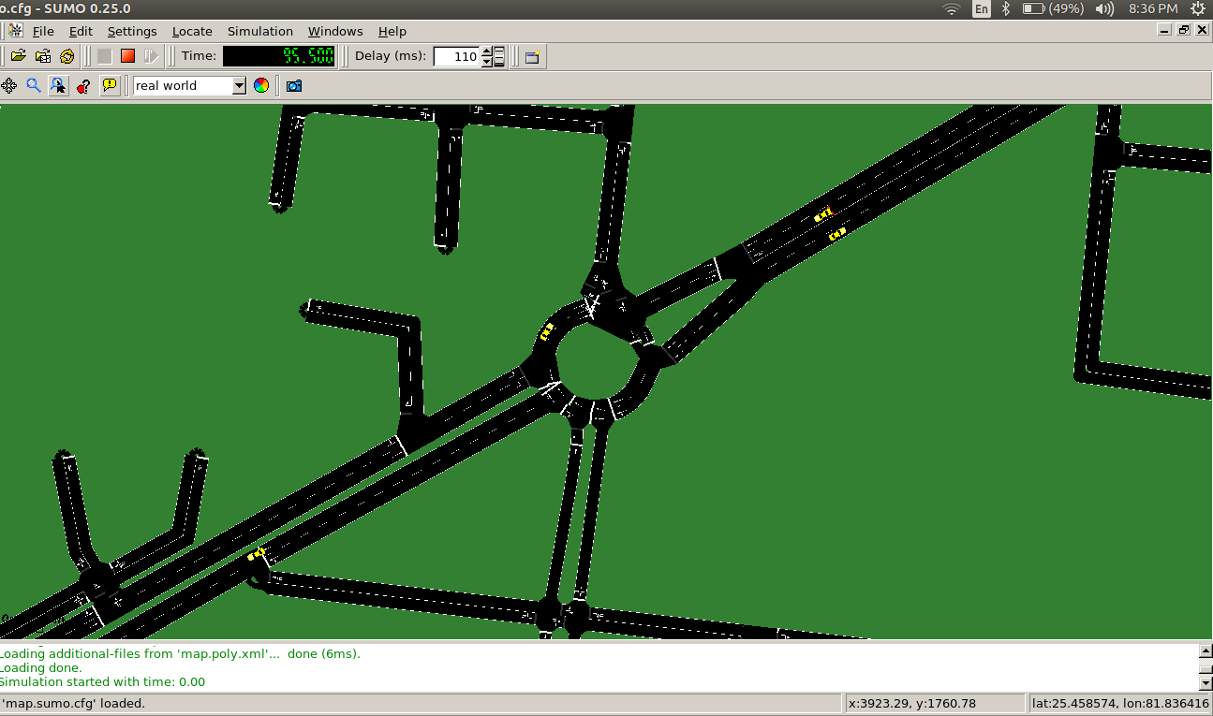
SUMO GUI output for Civil Lines, Allahabad Open Street Map

Slide 16
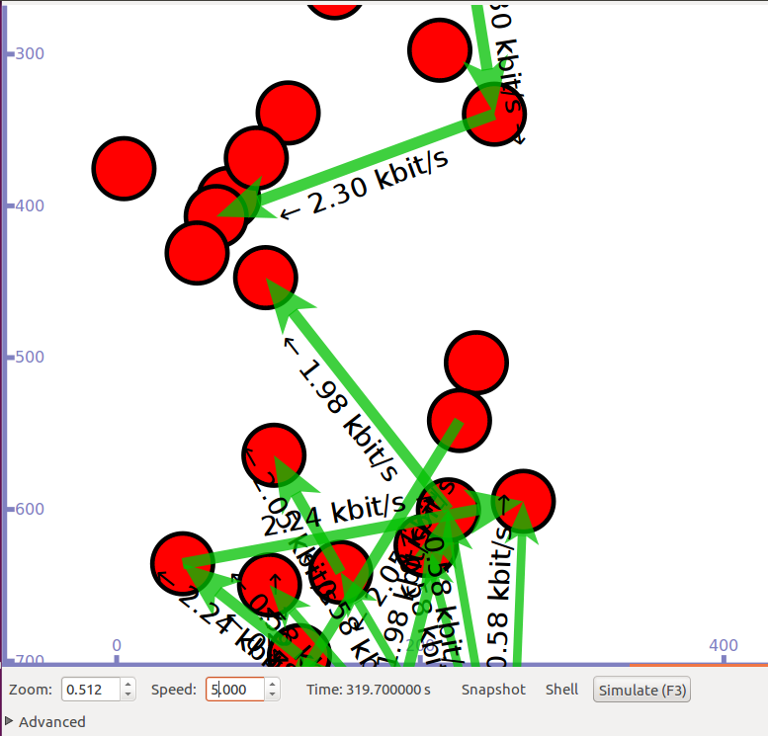
Simulation output of “vanet-routing-compare" using SUMO mobility trace with ns3 and applying AODV routing protocol on mobile nodes.

Slide 17
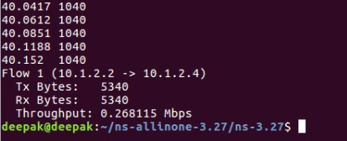
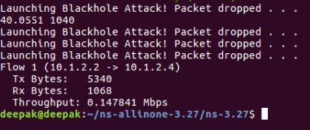
Throughput without malicious(Blackhole) node
Throughput with malicious(Blackhole) node

Slide 18
Conclusion
In our project we simulated Black hole attack in NS3 on AODV Routing protocol. This simulation helped us gain insight in the vulnerabilities of AODV protocol and how well Black hole attack being one of the most powerful attacks on an Ad hoc network can cause a complete failure of the network by dropping all the traffic specially when the nodes are non-mobile. Additionally, we also integrated NS3 with SUMO where we generated real time traffic whose mobility was controlled by the sumo file mobility.tcl and the interaction of the mobile nodes was regulated by AODV protocol.

Slide 19
References
AODV Protocol
Black hole attack in AODV
Network Simulator-3
H. Moudni, M. Er-rouidi, H. Mouncif and B. El Hadadi, "Performance analysis of AODV routing protocol in MANET under the influence of routing attacks," 2016
International Conference on Electrical and Information Technologies (ICEIT), Tangiers, 2016, pp. 536-542.
R. A. R. Mahmood and A. I. Khan, "A survey on detecting black hole attack in AODV-based mobile ad hoc networks," 2007 International Symposium on High Capacity Optical Networks and Enabling Technologies, Dubai, 2007, pp. 1-6.
Understood from : https://www.nsnam.org/documentation

Slide 20
THANK YOU!

