Slide 1
IBM University Engagement Project Submission
“Exploring the Power of Agentic AI with IBM Granite and IBM Bob”

Slide 2

Project Tile : Course Content Simplification Agent
Domain of Project : Agentic AI / Generative AI in Education
Student Name | Recent Passport Photo | Email ID | Mobile number [WhatsApp]
Deepak B |  | deepakbalan26@gmail.com ananthibalan64@gmail.com | + 91 8015170344

Slide 3
Problem Statement : Course Content Simplification Agent
The Challenge – Educational materials often vary in complexity and are not always accessible to learners with different levels of prior knowledge. Students may struggle to grasp key concepts due to jargon heavy or overly advanced explanations in faculty notes and textbooks. The challenge is to develop an AI powered agent that can intelligently analyse academic content and reframe explanations based on the learner's current proficiency—ranging from beginner to expert. This would support more inclusive learning and personalized education delivery at scale
The Objective - Build an AI-powered Course Content Simplification Agent that helps students understand complex academic content by breaking it down into clear, easy-to-read explanations based on their learning level.
The solution should:
Content Simplification — Take difficult textbook chapters, lecture notes, or research papers and rewrite them in simple, understandable language.
Multi-Level Learning — Adjust the explanation based on the student's proficiency — Beginner, Intermediate, Advanced, or Expert — so every learner gets the right depth of content.
Structured Output — Deliver the simplified content in organized sections: a plain explanation, key concepts, important points, a real-world example, and a quick revision summary.
Built-in Demo Mode — Allow students to use the tool even without an IBM Cloud account, using a smart offline educational engine.
IBM Granite AI Integration — Connect to IBM Granite language models through IBM watsonx.ai for high-quality, AI-generated simplifications in live mode.
Download & Study — Let students download the simplified content as study notes in Markdown or plain text format for offline revision.

Slide 4
Proposed Solution :
AI-Powered Course Content Simplification Agent
The proposed solution is an AI-powered agent built using IBM watsonx.ai and IBM Granite Models that converts complex academic content — like textbook chapters, lecture notes, and research papers — into clear, easy-to-understand explanations based on the student's learning level.
The system supports four proficiency levels — Beginner, Intermediate, Advanced, and Expert — and delivers five structured outputs for every simplification:
Simple Explanation — Level-appropriate rewrite of the content
Key Concepts — Most important ideas extracted from the input
Important Points — Critical takeaways to remember
Examples — A real-world analogy for better understanding
Quick Revision — A 1–2 sentence summary for fast review
The solution includes a built-in Demo Mode for offline use and switches to Live IBM Granite Mode automatically when IBM credentials are provided. The interface is built with Streamlit, following a simple four-step workflow — paste content, choose level, simplify, and download study notes.
IBM watsonx.ai handles secure model inference while IBM Granite powers the AI reasoning and content generation — making academic learning more accessible, personalized, and inclusive for every student.

Slide 5
Technology Used :
Technology purpose
Python 3.10+ | Core programming language
Streamlit | Web application interface
IBM watsonx.ai | AI model API platform
IBM Granite (ibm/granite-13b-instruct-v2) | AI language model for content simplification
ibm-watsonx-ai SDK | Python library to connect with IBM Granite
python-dotenv | Loads API credentials securely from .env file
IBM Cloud IAM | API key management and authentication
Watson Studio | Project workspace on IBM Cloud

Slide 6
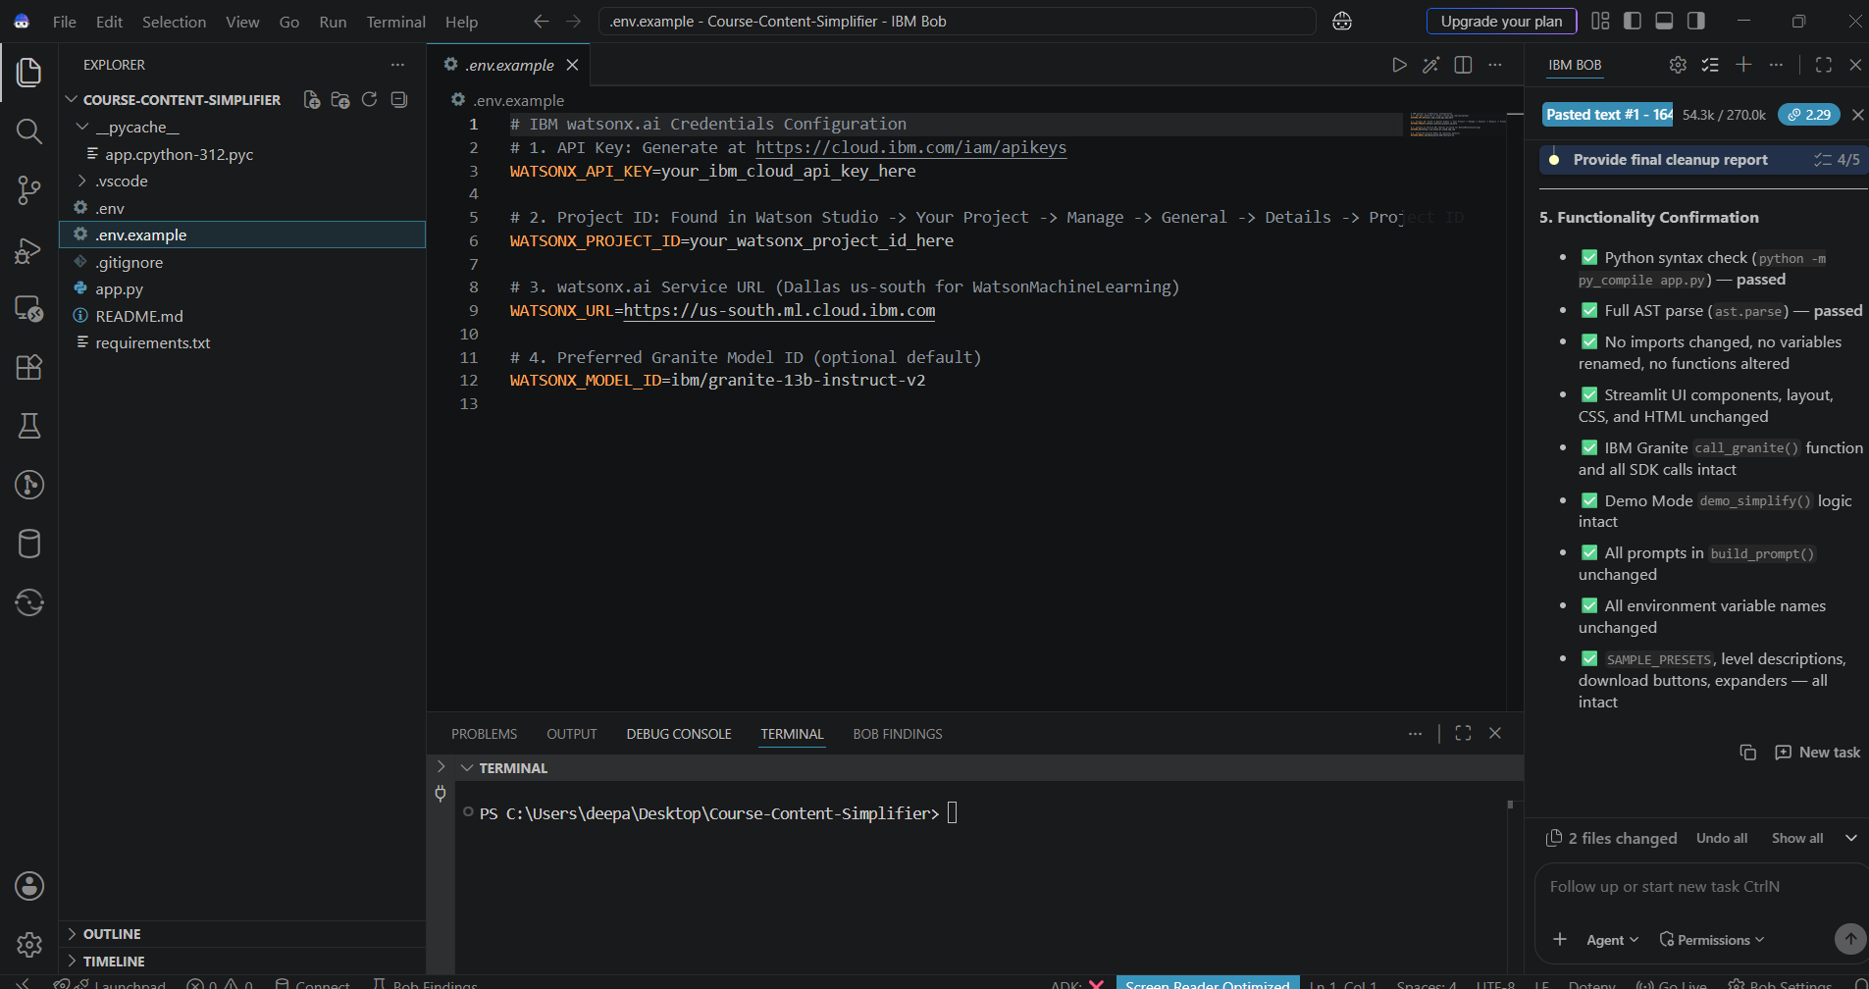
Required Files created using IBM bob -
App.py
Requirements.txt
Style.css
.env
Index.html

Slide 7
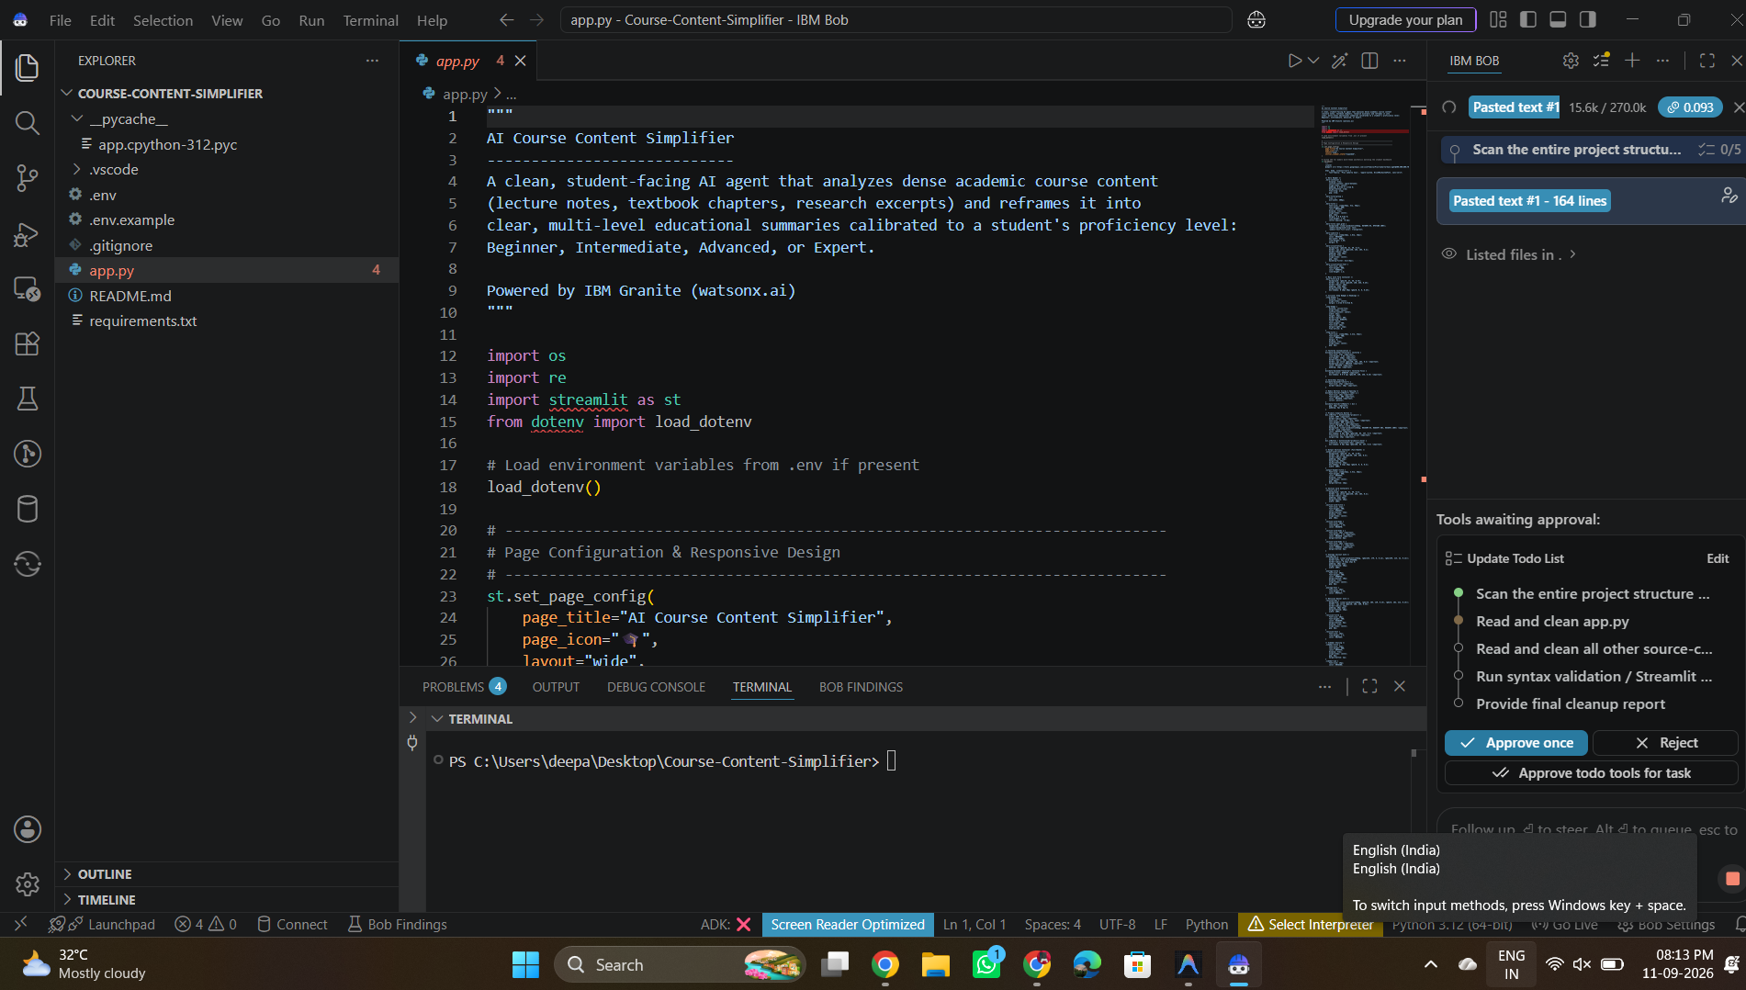
IBM Bob Screenshots:

Slide 8
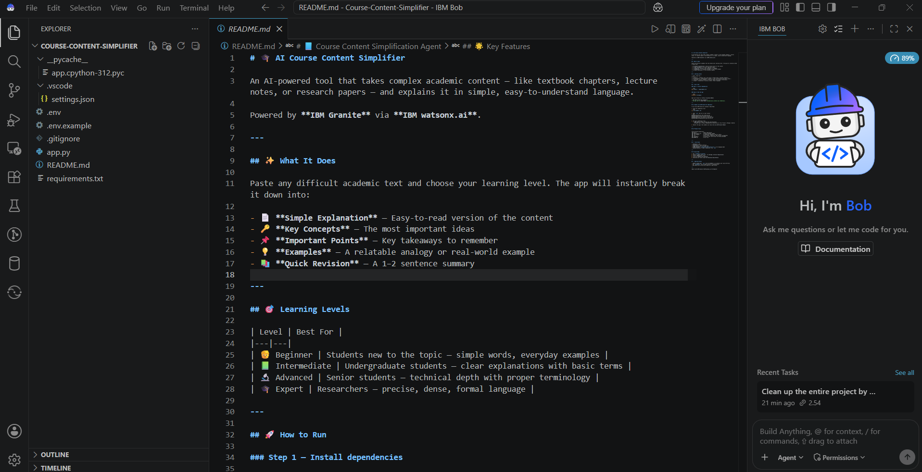

Slide 9

Role of Agentic AI in the solution
Analyzes complex academic content provided by students.
Adapts explanations based on the learner's selected proficiency level.
Breaks large content into simple, structured sections.
Generates key concepts, important points, examples, and revision notes.
Helps students understand and revise course material more efficiently.
Provides an interactive AI-based learning experience using IBM Granite.

Slide 10
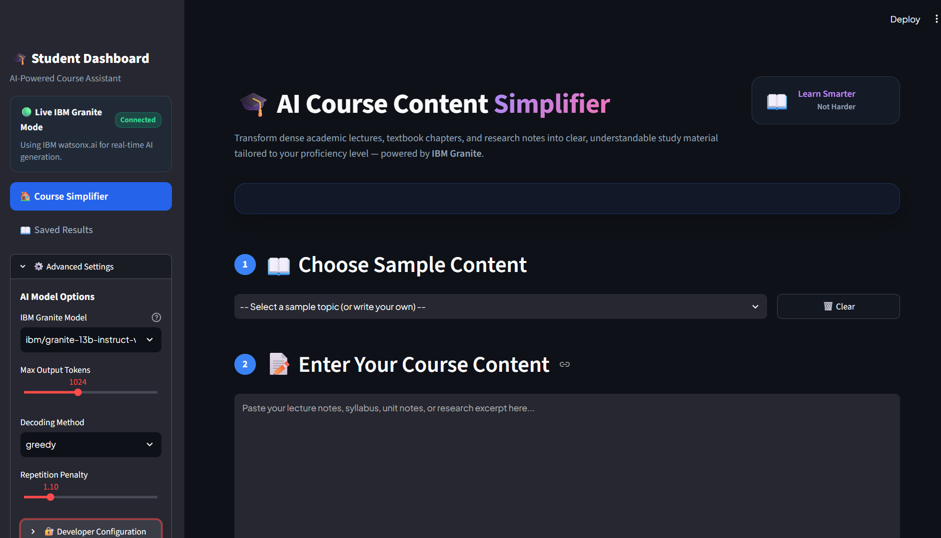
Project Output Screenshot
·
·
·

Slide 11
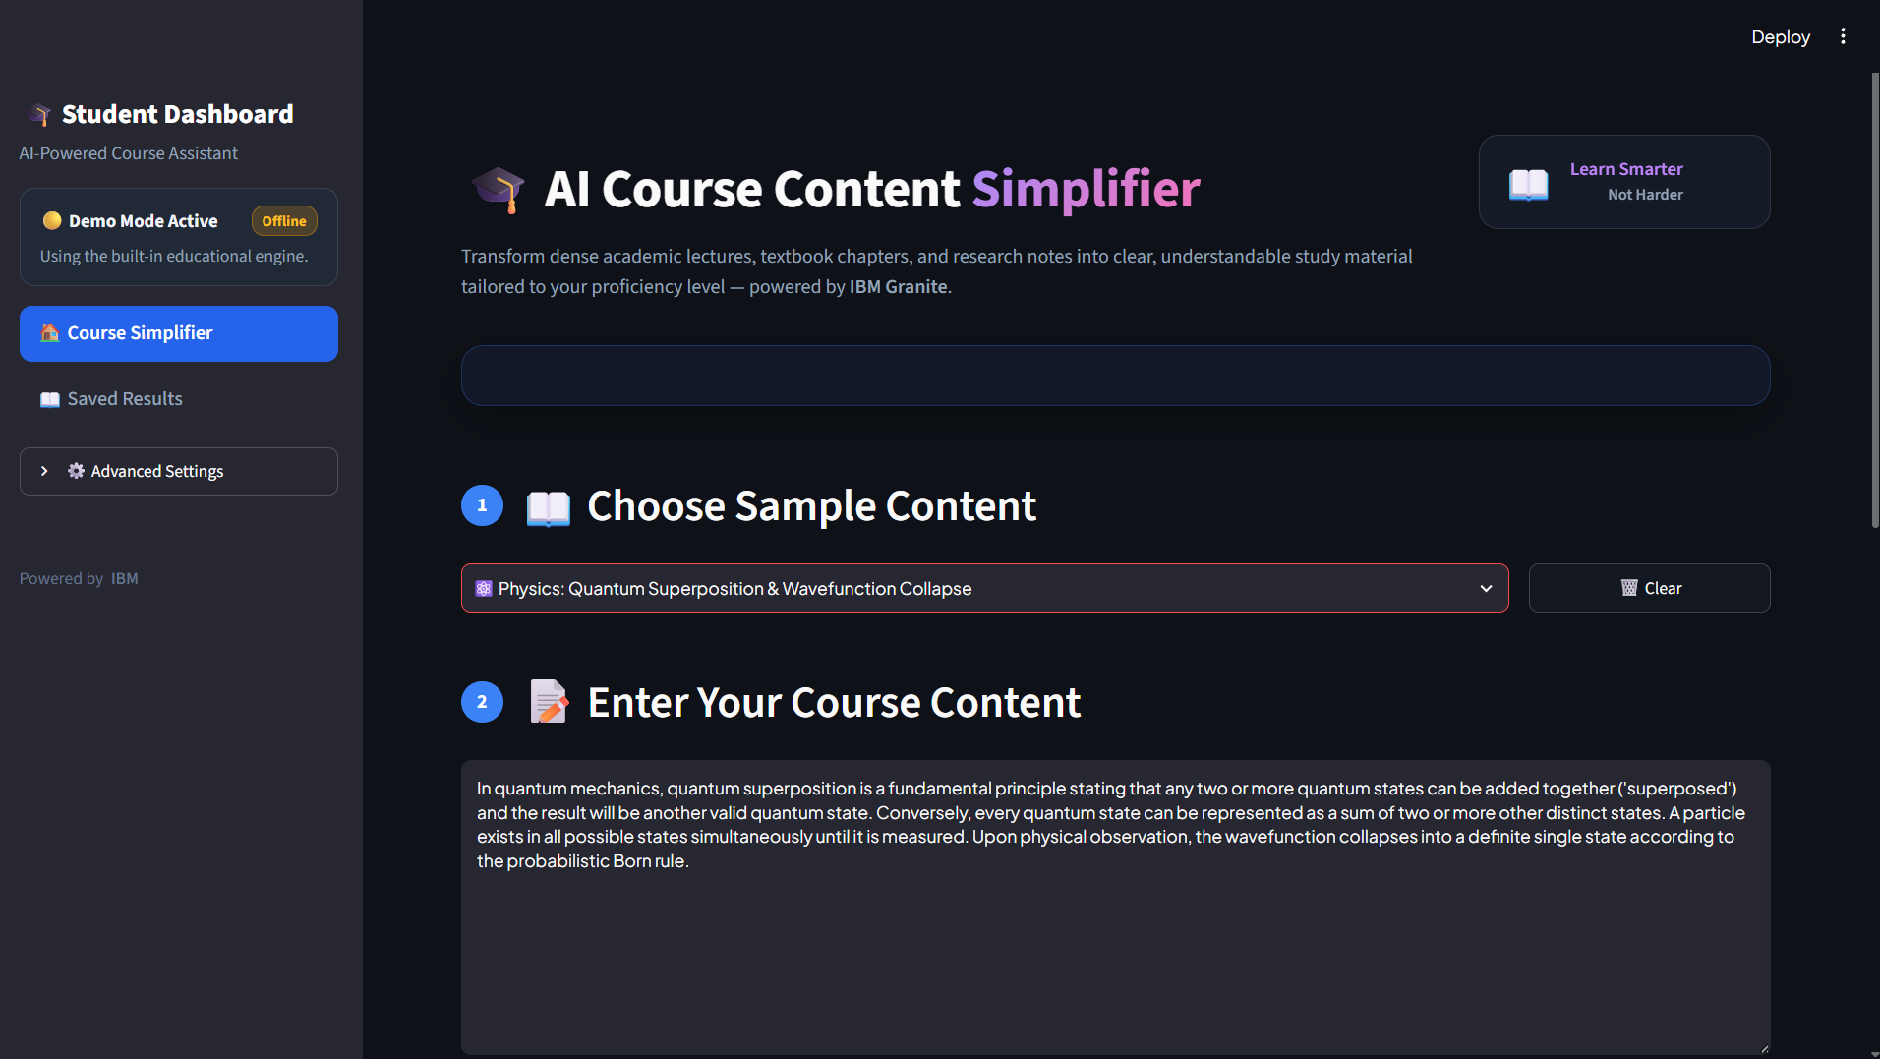
Project Output Screenshot
·
·
·

Slide 12
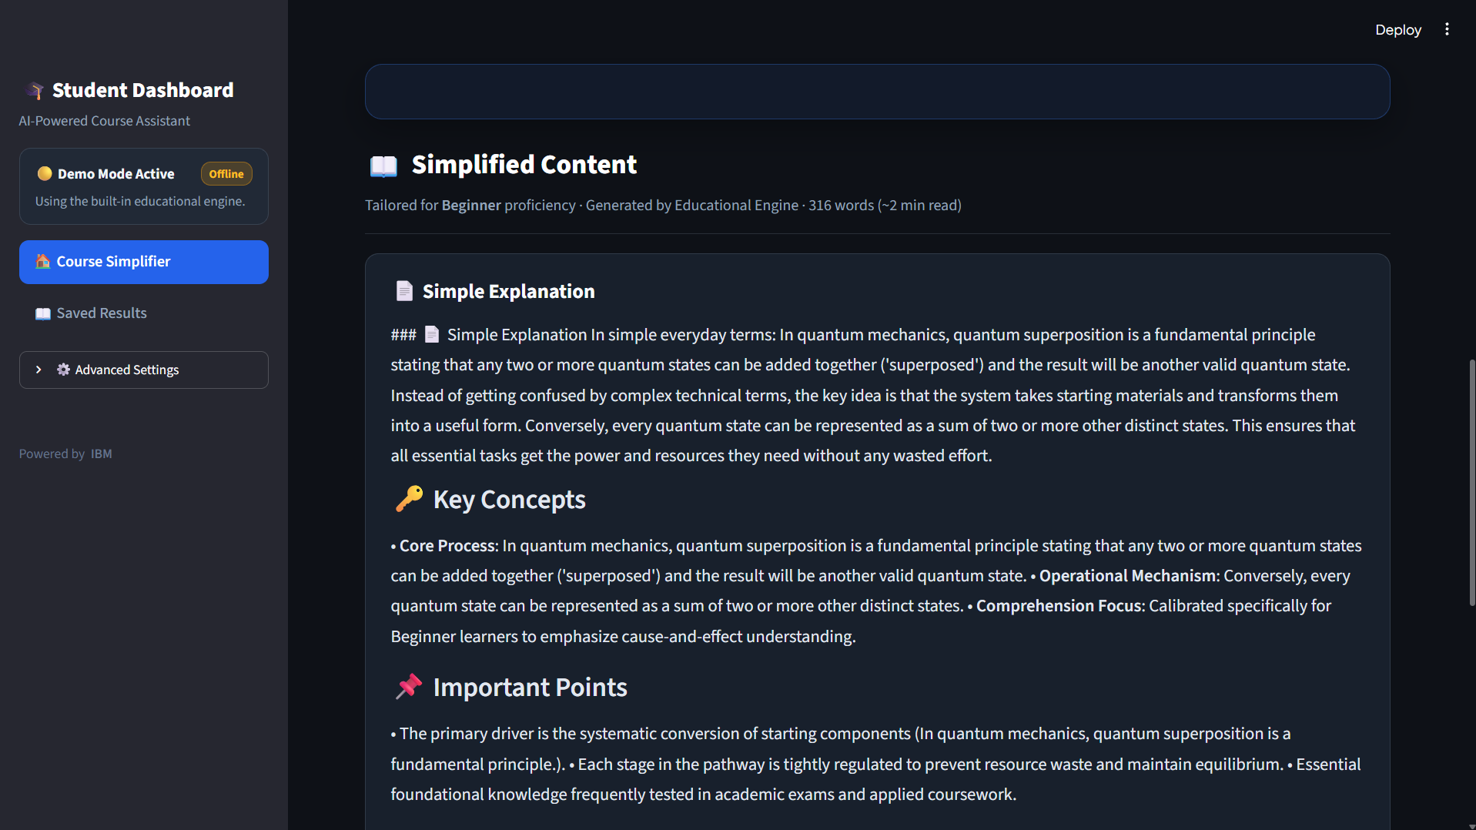
Project Output Screenshot
·
·
·

Slide 13
Novelty and Uniqueness
Learner-Level Adaptation: The system adjusts the complexity of explanations based on the student's selected learning level.
Structured Simplification: Instead of simply summarizing, it organizes content into Simple Explanation, Key Concepts, Important Points, Examples, and Quick Revision.
AI-Based Academic Assistance: IBM Granite is used to transform technical and lengthy study material into student-friendly content.
Single-Input to Multiple Learning Outputs: One piece of course content is converted into different study formats from the same input.
Student-Centered Design: The interface is designed specifically around common student needs such as understanding difficult topics and quick revision.
Demo + Live AI Support: The system can work in Demo Mode while also supporting live IBM Granite integration when configured.

Slide 14
Git Hub Link
https://github.com/deepakcodes-2028/Course-Content-Simplification-Agent.git
·
·
·

Slide 15
Future Scope
Personalized Learning: Adapt explanations automatically based on each student's learning progress and performance.
Multilingual Support: Provide simplified course content in multiple regional and international languages.
Document Upload: Allow students to upload PDFs, PPTs, notes, and textbooks for automatic simplification.
AI-Powered Question Generation: Generate quizzes, MCQs, short-answer questions, and practice tests from the provided content.
Voice-Based Learning: Add speech-to-text and text-to-speech features for hands-free learning.
Learning Progress Tracking: Track topics studied, quiz scores, and improvement over time.
Advanced AI Agent: Develop a more autonomous learning agent that can recommend what a student should study next based on their needs.
Mobile Application: Extend the system into a mobile app for learning anytime and anywhere
·
·
·

Slide 16
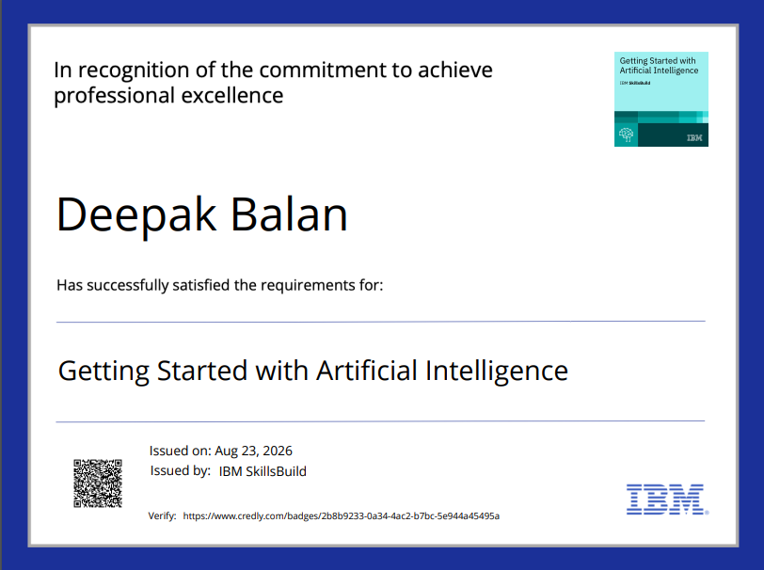
Certificates Earned:
  Credly Certificate(Getting Started with Artificial Intelligence)

Slide 17
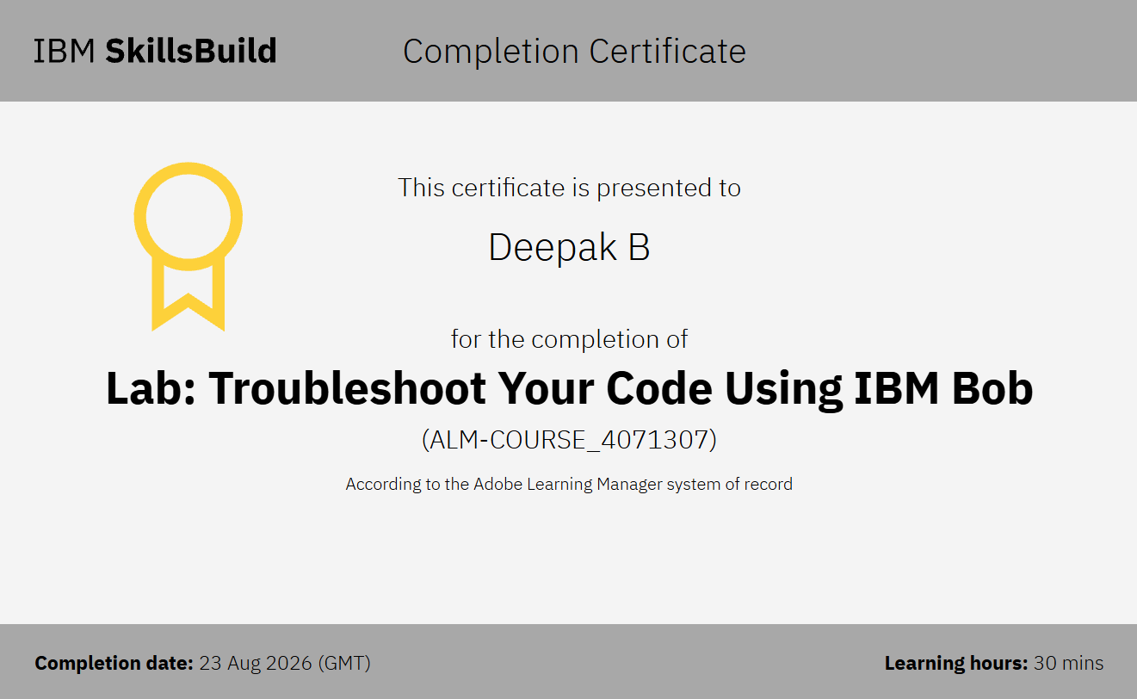
Certificates Earned:​
    IBM BOB Certificate

Slide 18


