Slide 1
Retail Sales Analytics
Capstone final presentation: Excel, SQL, Python and Power BI
PRESENTED BY
Deepak .N
Notes:
Good morning everyone. My name is Deepak, and I'm a data analyst with Vinsup Skill. Today I'll present my capstone project: a complete sales analytics solution for a three-store bicycle retailer. I worked through it in four phases: Excel, SQL, Python, and finally a Power BI dashboard. Over the next five minutes I'll walk you through each phase, show what I built, and finish with the insights and recommendations that the business can act on straight away.

Slide 2
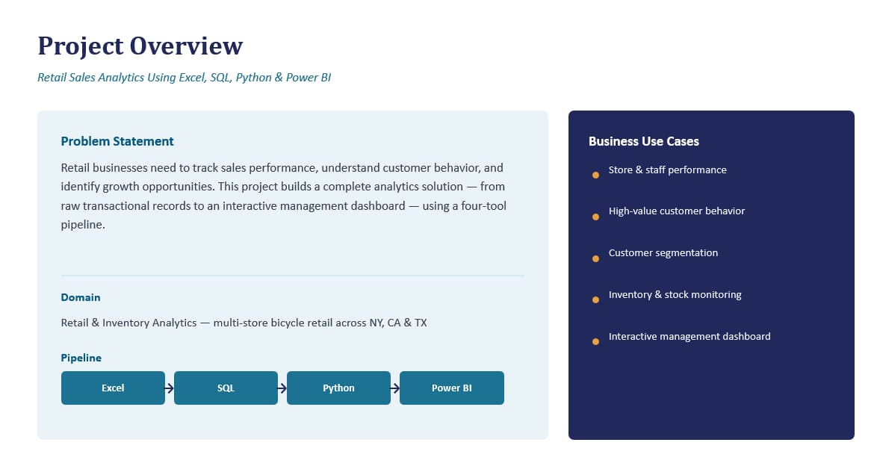

Slide 3
Phase 1: Excel
Data preparation and first analysis
Combined 10 tables: brands, categories, products, customers, orders, order items, staffs, stores, stocks
Cleaned data and calculated Total price after discount for each order line
Built pivot tables of sales by category
Prepared the clean tables for the SQL database
3
Notes:
Phase one was Excel. I brought together ten tables: brands, categories, products, customers, orders, order items, staff, stores and stocks. I cleaned them, calculated the total price for every order line after discount, and built pivot tables. This already showed that Mountain Bikes lead all categories with about 3 million dollars. Excel gave me a quick way to understand the data before moving to code. It also proved that the numbers were reliable, so every later phase could build on a clean and trusted foundation.

Slide 4
Phase 2: SQL
MySQL database "capstone" with keys and joined tables
Imported the cleaned CSV data into the database.
Created relationship between tables using primary and foreign keys
Used joins to combined the orders, order items and products completing information.
I analyzed staff performance ,customer spending and stock levels.
4
Notes:
Phase two was SQL. I built a MySQL database called capstone with proper keys and joined orders, items and products. I wrote queries for sales by store, the top five products, revenue per customer and per staff member, spending segments of low, medium and high, and a low stock alert for items under 10 units. SQL is where the analysis became repeatable. Instead of manual filtering, each business question is now a query that can be re-run whenever new orders arrive, and the results feed directly into the next phase.

Slide 5
Phase 3: Python
RFM customer segmentation
pandas and SQLAlchemy read the data from MySQL
Fixed date formats and merged orders with items
Scored customer RFM features: Recency, Frequency and Monetary value of customers
Used customer RFM features for customer segmentation
5
Notes:
Phase three was Python. Using pandas and SQLAlchemy, I pulled data from MySQL, fixed the dates, and built an RFM model: Recency, Frequency and Monetary value, each scored one to four. That gave five segments. 278 Champions, 405 Loyal, 472 Potential Loyalists, 262 At Risk and 28 Lost customers. I saved the result back to SQL. This step matters because not all customers are equal. Champions buy recently, often and with high value, while At Risk customers have gone quiet. Knowing who is who tells the business exactly where to focus its marketing effort.

Slide 6
Phase 4: Power BI Dashboard
Everything in one interactive report
$8.58M
1,615
7,078
1,445
Revenue
Orders
Units sold
Customers
Finally, I created an interactive dashboard using POWER BI.
I Used some like KPIs Revenue, Total Orders, Unit sold, and Total customers.
Added slicers and buttons for interactive exploration .
This helps users easily filter and understand the data .
6
Notes:
Phase four is the Power BI dashboard, which brings everything together. It has six pages with KPI cards, revenue by store and state, category and product performance, staff results and customer segments. Slicers let a manager filter by store, year or category and get answers in seconds. I connected the SQL tables and the segment results so the dashboard always uses the same trusted numbers. A store manager does not need to write code; they just click and explore, which is the real purpose of a dashboard.

Slide 7
Key Insights
68% from one store
Baldwin Bikes (NY) drives most revenue.
Mountain Bikes lead
About 35% of revenue ($3.03M).
2017 was the peak year
$3.85M, versus $2.71M in 2016.
7
Notes:
Now the key insights. Baldwin Bikes in New York generates about 5.8 million dollars, nearly 68 percent of all revenue, while Santa Cruz and Rowlett trail far behind. Mountain Bikes are the top category at 35 percent. Revenue peaked in 2017 at 3.8 million dollars. Together these findings show where the money comes from and where the opportunity lies. The smaller stores are not failing so much as under-used, and that is a growth opportunity rather than a problem.

Slide 8
Conclusion
Excel was used for cleaning.
SQL was used for database analysis.
Python was used for EDA and customer segmentation.
Power bi was used to create the interactive dashboard.
Thank you!
Notes:
To conclude: first, learn from Baldwin's success and lift Rowlett and Santa Cruz. Second, run a win-back campaign for the 262 At Risk customers. Third, restock products under 10 units. Thank you for listening. I'm Deepak from Vinsup Skill, and I'm happy to take your questions. Every phase of this project connects: Excel prepared the data, SQL organised it, Python found patterns, and Power BI made them visible. That is the workflow I want to bring to my work as a data analyst.

