Slide 1

ASSIST
Remind you of everything

Slide 2
Contents
Introduction to application
Common features
Objectives
Scope for Future
References

Slide 3
Introduction
Better option where dependency on cellular data is not needed.
Can be used in any office, colleges, schools and limited areas
Locate all the toilet facilities around you in a quick glance
The missing link between the Reminders on your phone and Beacons in the real world

Slide 4
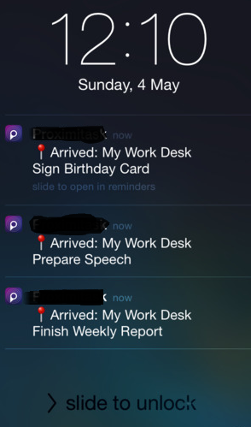
Your phone can now know where your desk is - something GPS can't really do. Similar to how the Reminders app allows you to trigger reminders based on locations, Assist allows you to trigger them based on Beacons. Contextualize your reminders.
1. Makes up for your forgetting behaviour

Slide 5
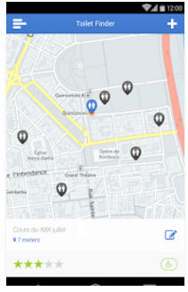
2.Swachh bharat
Tells you whenever u get near to a washroom or dustbin

Slide 6
Example uses
EXAMPLE USES:
• Attach a beacon to your desk in the office and get a reminder to finish a report when you arrive at work • Attach a beacon to your kitchen door and get a reminder to switch off appliances as you leave your kitchen • Leave a beacon in the glove compartment and get a reminder of all your daily errands when you step into your car • Put a beacon in your kid's bag and get an alert when they wander out of range • The possibilities are endless!

Slide 7
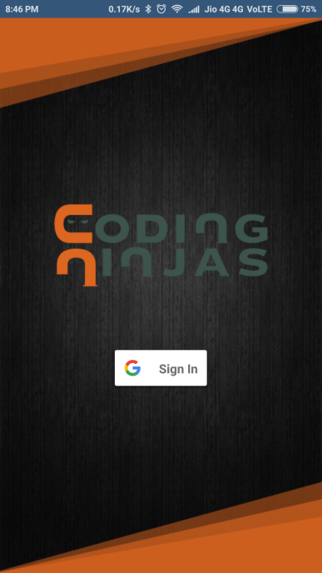
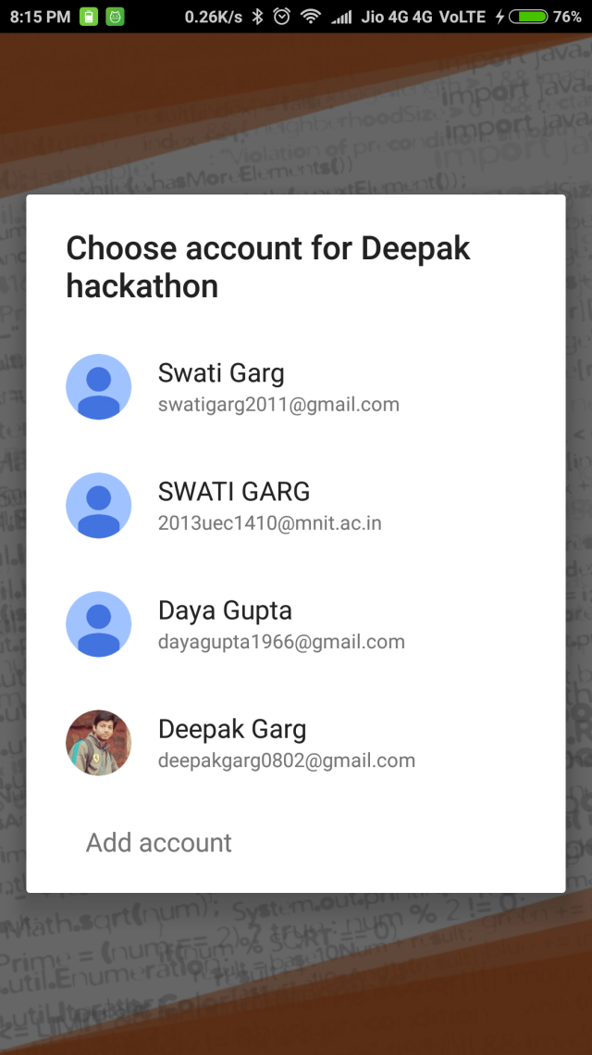
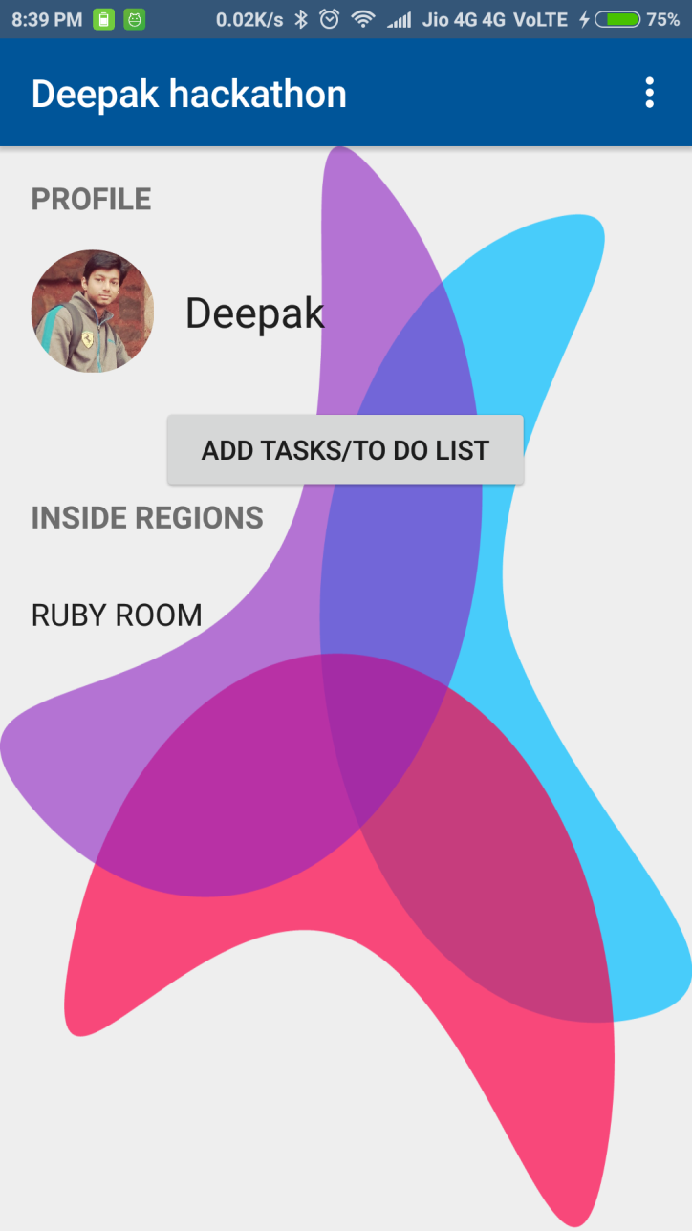

Slide 8
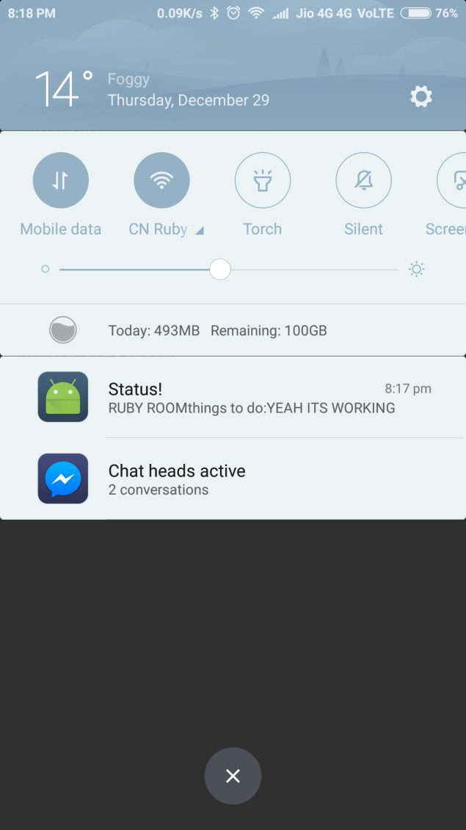
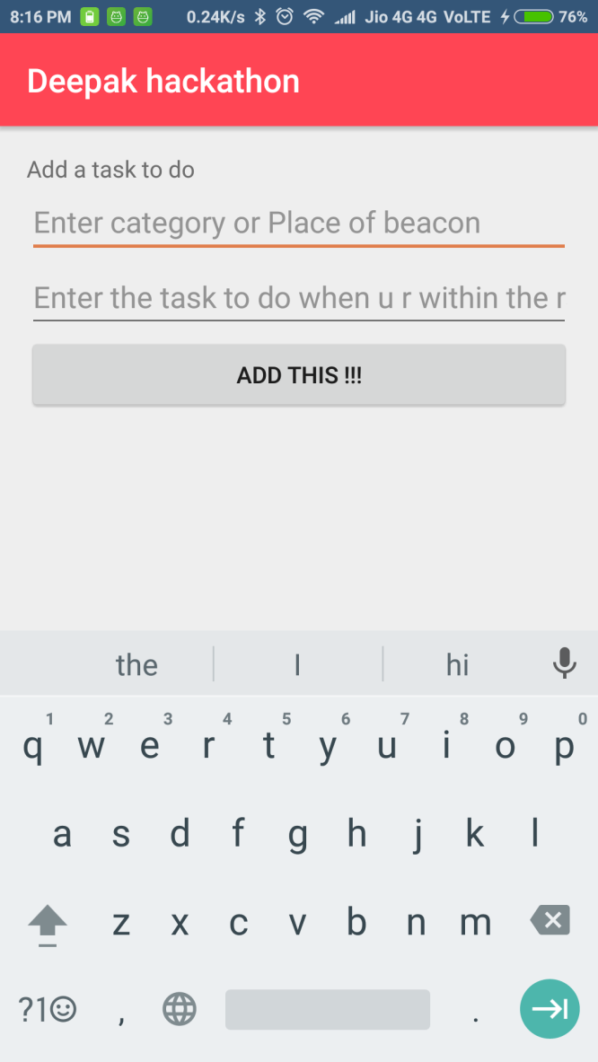

Slide 9
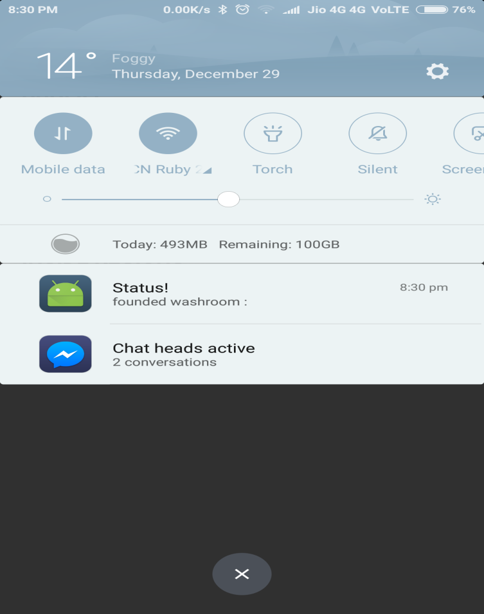


Slide 10
References
www.developer.android.com
www.stackoverflow.com (Discussions and doubts)
www.youtube.com (Online Tutorials)
www.androidhive.info

Slide 11
Thank You

