Slide 1
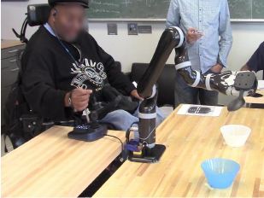
Human-in-the-Loop Optimization of
Shared Autonomy in Assistive Robotics
Deepak Gopinath, Siddarth Jain, Brenna Argall
Northwestern University, USA
Rehabilitation Institute of Chicago, USA
Interactive optimization procedure for
customizing control sharing
Pilot study with end-users (4 SCI, 13 Control)
Experiments: Assistive manipulation with
robotic arm
Within and across subject groups large
variability is observed in the customization
of assistance

